Slide 2
Problem Statement
31,677 cases of molestation 56,519 cases of kidnapping and many more such cases against women were registered in India in 2021.

Slide 3
Solution
We are building a solution named “Shadow”. Shadow will work as a companion to a women that would be recognised by its features – 1. Notification Alert 2. Current, Abandoned and Safe Locations with Safest Route. 3. Capture Vehicle Number 4. Fake Call 5. GPS Location along with Emergency Call and SMS 6. Police Siren 7.Track Police

Slide 4
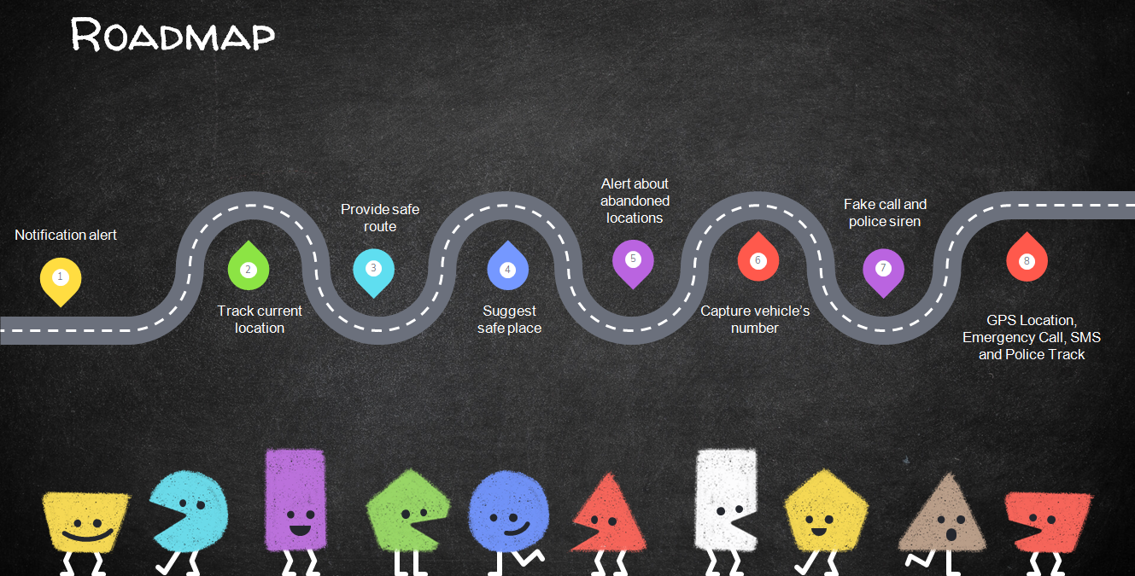
Uniqueness

Slide 5
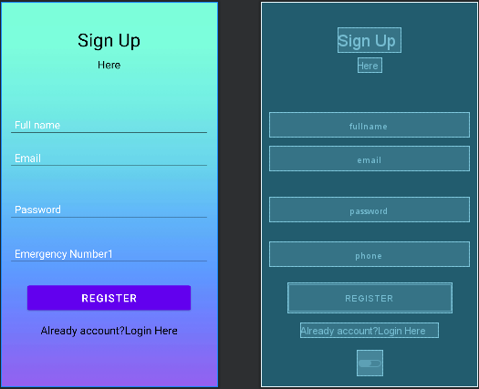
Solution Screenshot

Slide 6

Solution Screenshot

Slide 7
Solution Screenshot

