Slide 1
OBJECTIVE
Exploratory Data Analysis on the customer loan application which might help the bank w.r.t risk associated with the customer default behaviour.
To provide inferences and decisions based on the data analysis will further allows the company to channelize the business towards scaling out profits.
APPROACH
Importing and cleaning of the data.
Performing univariate and Bivariate analysis on categorical and numerical columns.
Draw useful insights.

Slide 2
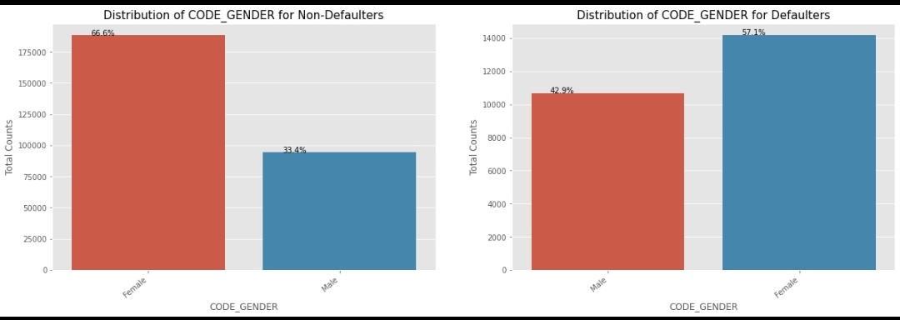
1.UNIVARIATE CATEGORICAL ORDERED ANALYSIS BASED ON GENDER
The above graph shows that the percentage of default and non default customers is higher for female i.e 66.6% and 57.1%.
Therefore we may conclude that females apply for loan more often than the males .

Slide 3
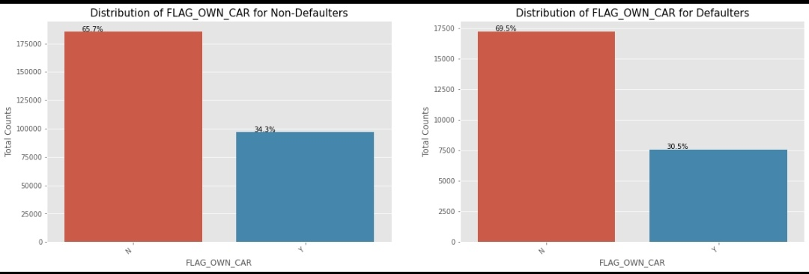
1.2.UNIVARIATE ANALYSIS ON THE BASIS OF CAR OWNER
We can observe people who have car default more often.
Also, people with cars contribute 65.7% to non-defaulters while 69.5% to defaulters.
Therefore we conclude that the rate of default of people having car is low .

Slide 4
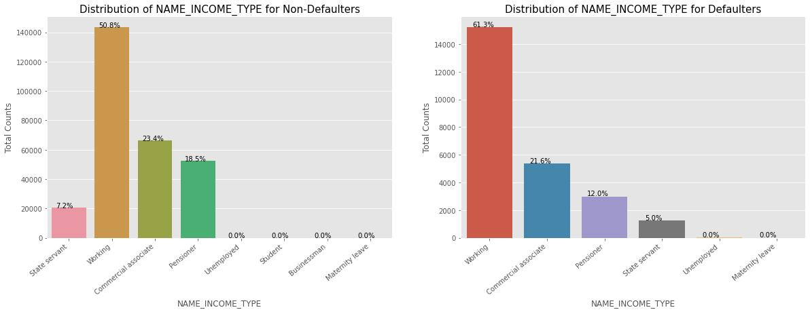
1.3. UNIVARIATE ANALYSIS BASED ON INCOME TYPE
We can see most of the loans are distributed to working class and they are the ones whose default percentage is the highest among all
People who are unemployed and the ones on maternity leave have 0% of loan default. The reason could be their no source of income or there could be possibility that these category are not aware about loan policies.

Slide 5
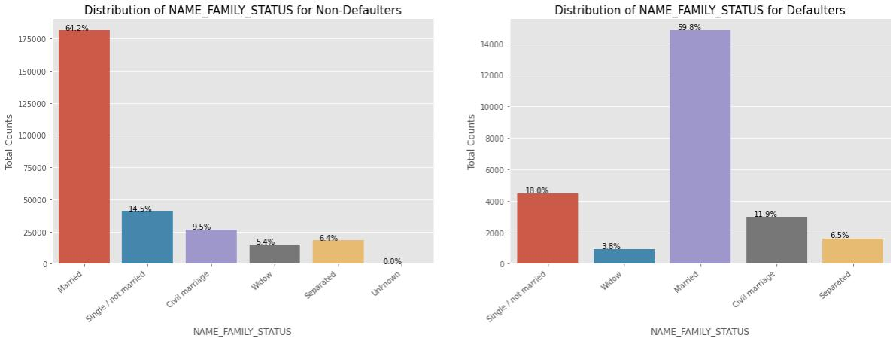
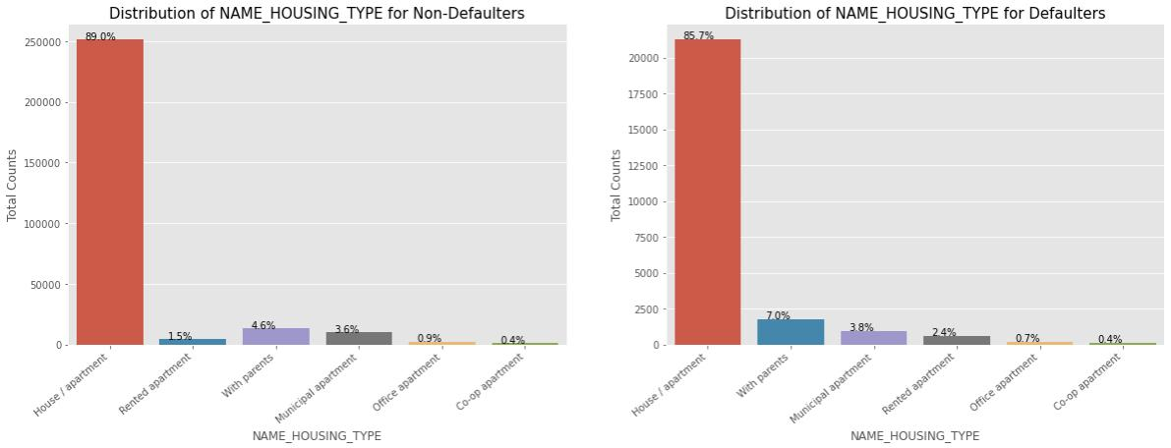
1.4. UNIVARIATE ANALYSIS BASED ON FAMILY STATUS AND HOUSE TYPE

Slide 6
From the above graphs we conclude the following observations:
People who are married and the ones who have house/appartment tend to apply for the loans more often. After marriage most of the couples prefer to live separately, so this coulf be one reason for the huge spike in percentage.
People living with parents tend to default more often, reason could be their living expenses are more when compared with others.
The single/non married people contribute 14.5% to non- defaulters and 18% to the defaulters. So the risk associated with them is more.

Slide 7
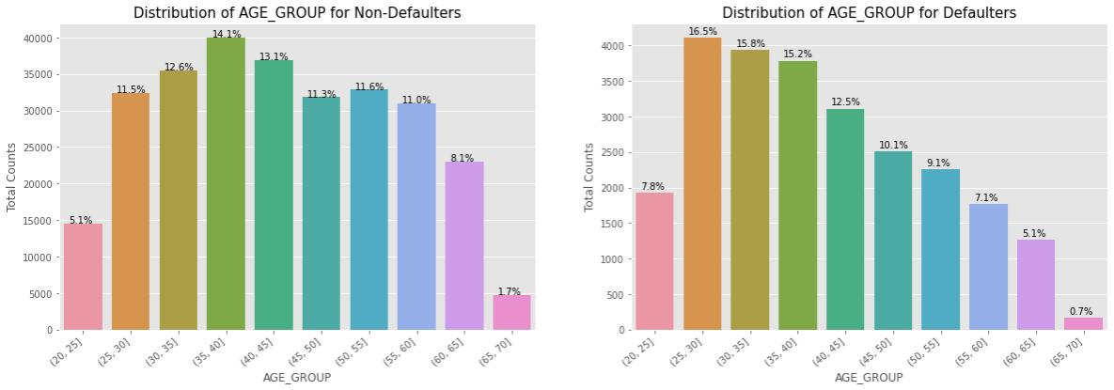
1.5. UNIVARIATE ANALYSIS BASED ON AGE GROUP
We see that people of age group 25-30 tend to default more often. So they are the riskiest people to loan.
With increase in age , people tend to default less. One of the reasons could be they get employed around that age and with increasing age, their salary also increasea.

