Slide 1
Trees

Slide 2
Tree in Data Structure
The tree is a nonlinear hierarchical data structure and comprises a collection of entities known as nodes.
It connects each node in the tree data structure using "edges”, both directed and undirected.
Root Node
Node
Edges

Slide 3
Why Tree Data Structure?
Trees find applications in various fields, including file systems, databases, network routing, artificial intelligence, syntax parsing, and more.
Other data structures such as arrays, linked list, stack, and queue are linear data structures that store data sequentially.
In order to perform any operation in a linear data structure, the time complexity increases with the increase in the data size.
But, it is not acceptable in today's computational world.
Different tree data structures allow quicker and easier access to the data as it is a non-linear data structure.
.

Slide 4
Tree Terminologies
Node :
A node is an entity that contains a key or value and pointers to its child nodes.The last nodes of each path are called leaf nodes or external nodes that do not contain a link/pointer to child nodes.The node having at least a child node is called an internal node.
Edge : It is the link between any two nodes.
Root: It is the topmost node of a tree.

Slide 5
Tree Terminologies
Height of a Node:It is the number of edges from the node to the deepest leaf (ie. the longest path from the node to a leaf node).
Depth of a Node: It is the number of edges from the root to the node.
Height of a Tree: It is the height of the root node or the depth of the deepest node.
Degree of a Node: The degree of a node is the total number of branches of that
node.

Slide 6
Example of Tree
h=2d=0
h=1d=1
h=0d=1
h=0d=2
h=0d=2

Slide 7
Binary Tree
A Binary Tree Data Structure is a hierarchical data structure in which each node has at most two children, referred to as the left child and the right child.
It is commonly used in computer science for efficient storage and retrieval of data, with various operations such as insertion, deletion, and traversal.

Slide 8
Types of binary tree
Binary Search Tree :
1. It is a node-based binary tree data structure that has the following properties:
2. The left subtree of a node contains only nodes with keys lesser than the node’s key.
3. The right subtree of a node contains only nodes with keys greater than the node’s key.
4. The left and right subtree each must also be a binary search tree.

Slide 9
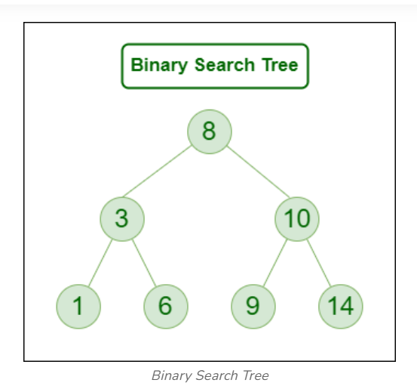
Binary Search Tree :

Slide 10
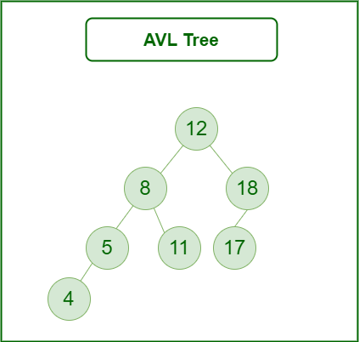
Types of binary tree
AVL Tree :
An AVL tree, also known as Adelson-Velsky and Landis tree is a self-balancing Binary Search Tree (BST) where the difference between heights of left and right subtrees cannot be more than one for all nodes.
1.

Slide 11
AVL Tree :
The previous tree is AVL because the differences between the heights of left and right subtrees for every node are less than or equal to 1.
Operations on an AVL Tree:
Insertion
Deletion
Searching

Slide 12
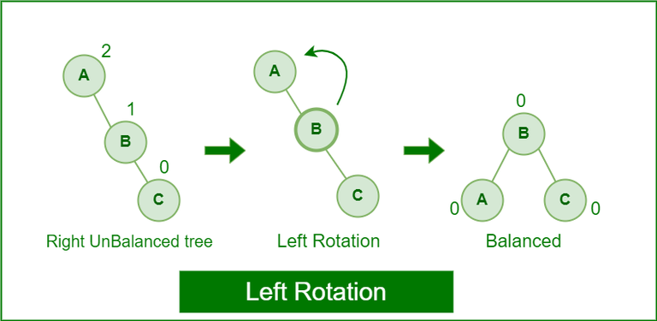
Rotating the subtrees in an AVL Tree:
Left Rotation:
When a node is added into the right subtree of the right subtree, if the tree gets out of balance, we do a single left rotation.

Slide 13
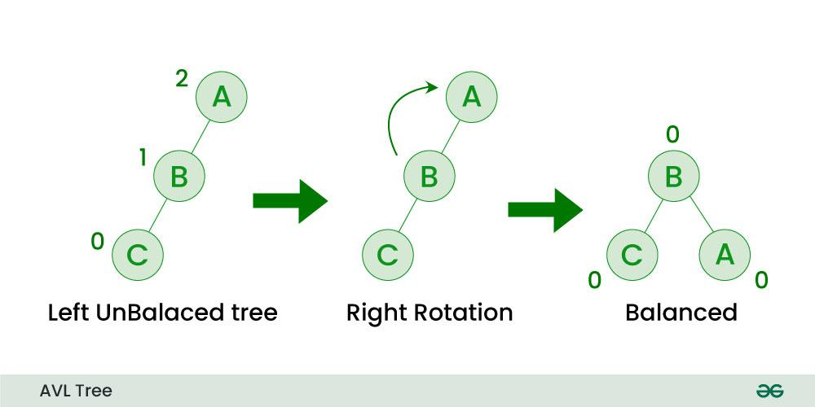
Rotating the subtrees in an AVL Tree:
Right Rotation:
When a node is added into the left subtree of the left subtree, if the tree gets out of balance, we do a single right rotation.

Slide 14
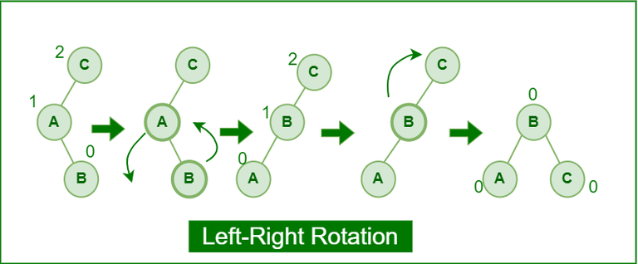
Rotating the subtrees in an AVL Tree:
Left-Right Rotation:
A left-right rotation is a combination in which first left rotation takes place after that right rotation executes.

Slide 15
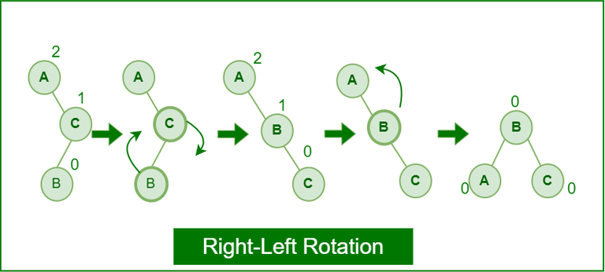
Rotating the subtrees in an AVL Tree:
Right-Left Rotation:
A right-left rotation is a combination in which first right rotation takes place after that left rotation executes.

