Slide 1
ANOVA
(ANALYSIS OF VARIANCE)

Slide 2
Hyperparameter Testing
Hypothesis testing is a statistical method that is used in making statistical decisions using experimental data. Hypothesis Testing is basically an assumption that we make about the population parameter.
Ex : you say avg student in class is 40 or a boy is taller than girls.
A hypothesis test evaluates two mutually exclusive statements about a population to determine which statement is best supported by the sample data. When we say that a finding is statistically significant, it’s thanks to a hypothesis test.

Slide 3
Basic of hypothesis
The basic of hypothesis is normalization and standard normalization.
Normalization:
A variable is said to be normally distributed or have a normal distribution if its distribution has the shape of a normal curve — a special bell-shaped curve.
The graph of a normal distribution is called the normal curve, which has all of the following properties: 1. The mean, median, and mode are equal.

Slide 4
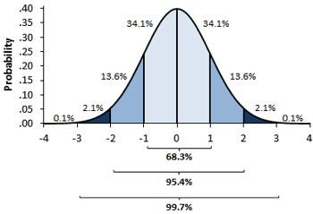
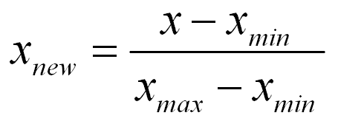
Basic of hypothesis:Normalisation

Slide 5

Basic of hypothesis
The basic of hypothesis is normalization and standard normalization.
Standard Normalization:
A standard normal distribution is a normal distribution with mean 0 and standard deviation 1.

Slide 6
Important Parameter of hypothesis testing
Null hypothesis :- In inferential statistics, the null hypothesis is a general statement or default position that there is no relationship between two measured phenomena, or no association among groups
In other words it is a basic assumption or made based on domain or problem knowledge.
Example : a company production is = 50 unit/per day etc.

Slide 7
Important Parameter of hypothesis testing
The alternative hypothesis is the hypothesis used in hypothesis testing that is contrary to the null hypothesis. It is usually taken to be that the observations are the result of a real effect (with some amount of chance variation superposed)
Example : a company production is !=50 unit/per day etc.

Slide 8
Level of significance
Refers to the degree of significance in which we accept or reject the null-hypothesis. 100% accuracy is not possible for accepting or rejecting a hypothesis, so we therefore select a level of significance that is usually 5%.
This is normally denoted with alpha(maths symbol ) and generally it is 0.05 or 5% , which means your output should be 95% confident to give similar kind of result in each sample.

Slide 9
Error types :Type1 error and Type 2 error
Type I error: When we reject the null hypothesis, although that hypothesis was true. Type I error is denoted by alpha. In hypothesis testing, the normal curve that shows the critical region is called the alpha region
Type II errors: When we accept the null hypothesis but it is false. Type II errors are denoted by beta. In Hypothesis testing, the normal curve that shows the acceptance region is called the beta region.

Slide 10
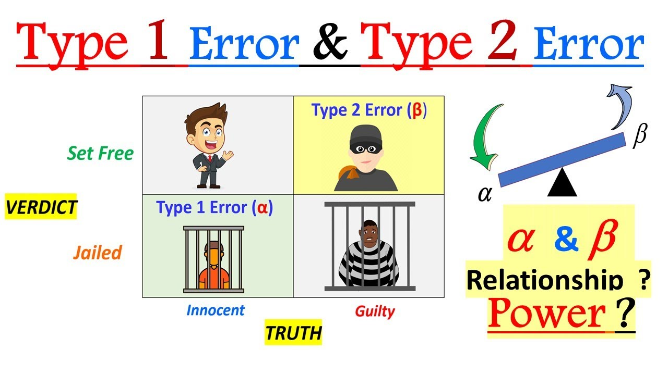

Slide 11
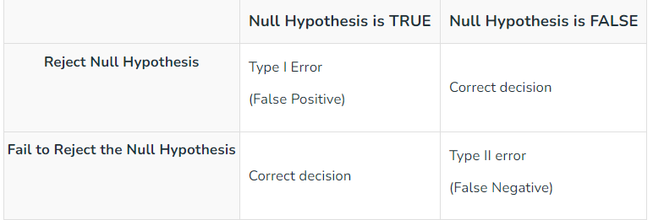

Slide 12
Tailed Test
One tailed test :- A test of a statistical hypothesis , where the region of rejection is on only one side of the sampling distribution , is called a one-tailed test.
Example :- a college has ≥ 4000 student or data science ≤ 80% org adopted.
Two-tailed test :- A two-tailed test is a statistical test in which the critical area of a distribution is two-sided and tests whether a sample is greater than or less than a certain range of values. If the sample being tested falls into either of the critical areas, the alternative hypothesis is accepted instead of the null hypothesis.
Example : a college != 4000 student or data science != 80% org adopted

Slide 13
P-value
The P value, or calculated probability, is the probability of finding the observed, or more extreme, results when the null hypothesis (H 0) of a study question is true — the definition of ‘extreme’ depends on how the hypothesis is being tested.

Slide 14
P-value
Example : you have a coin and you don’t know whether that is fair or tricky so let’s decide null and alternate hypothesis
H0 : a coin is a fair coin.
H1 : a coin is a tricky coin. and alpha = 5% or 0.05
Now let’s toss the coin and calculate p- value ( probability value).
Toss a coin 1st time and result is tail- P-value = 50% (as head and tail have equal probability)
Toss a coin 2nd time and result is tail, now p-value = 50/2 = 25%
and similarly we Toss 6 consecutive time and got result as P-value = 1.5% but we set our significance level as 95% means 5% error rate we allow and here we see we are beyond that level i.e. our null- hypothesis does not hold good so we need to reject and propose that this coin is a tricky coin which is actually.

Slide 15
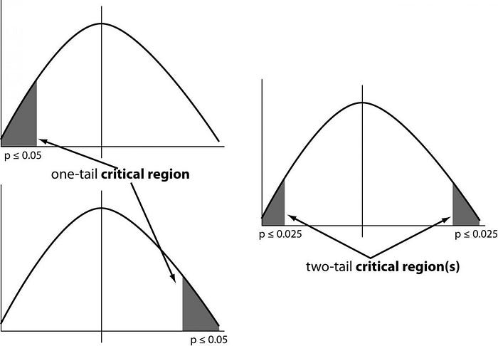

Slide 16
Types of Hypothesis Testing
T Test ( Student T test)
Z Test
ANOVA Test
Chi-Square Test

Slide 17
T-test
A t-test is a type of inferential statistic which is used to determine if there is a significant difference between the means of two groups which may be related in certain features.
T test is used as a hypothesis testing tool, which allows testing of an assumption applicable to a population.
T-test has 2 types : 1. one sampled t-test 2. two-sampled t-test.
One sample t-test : The One Sample t Test determines whether the sample mean is statistically different from a known or hypothesised population mean. The One Sample t Test is a parametric test.
Example :- you have 10 ages and you are checking whether avg age is 30 or not.

Slide 18
T-test
Two sampled T-test :-The Independent Samples t Test or 2-sample t-test compares the means of two independent groups in order to determine whether there is statistical evidence that the associated population means are significantly different.
The Independent Samples t Test is a parametric test. This test is also known as: Independent t Test.
Paired sampled t-test :- The paired sample t-test is also called dependent sample t-test. It’s an uni variate test that tests for a significant difference between 2 related variables. An example of this is if you where to collect the blood pressure for an individual before and after some treatment, condition, or time point.
H0 :- means difference between two sample is 0
H1:- mean difference between two sample is not 0

Slide 19
Z-test
You would use a Z test if:
Your sample size is greater than 30. Otherwise, use a t test.
Data points should be independent from each other. In other words, one data point isn’t related or doesn’t affect another data point.
Your data should be normally distributed. However, for large sample sizes (over 30) this doesn’t always matter.
Your data should be randomly selected from a population, where each item has an equal chance of being selected.
Sample sizes should be equal if at all possible.

Slide 20
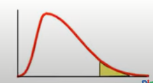
ANOVA
ANOVA stands for Analysis of Variance.
ANOVA enables us to test for significance of difference among more than two sample means.
It is extension of t-Test.
Two types of ANOVA :
1. One way ANOVA
One factor or independent variable
Compares three or more levels of one factor.
2.Two way ANOVA
Extension of one way Anova
More than one factor or independent variable
Compares the effect of multiple levels of two factors.
Test Statistics for ANOVA is F-test.

Slide 21
Assumption for ANOVA
Samples follow normal distribution
Samples have been selected randomly and independently.
Each group should have common variance.
Data are independent.

Slide 22


Basics of ANOVA
Null hypothesis-The means for all groups are the same(equal).
Alternate Hypothesis-The means are different for at least one pair of groups.
ANOVA=variance between/variance within

Slide 23
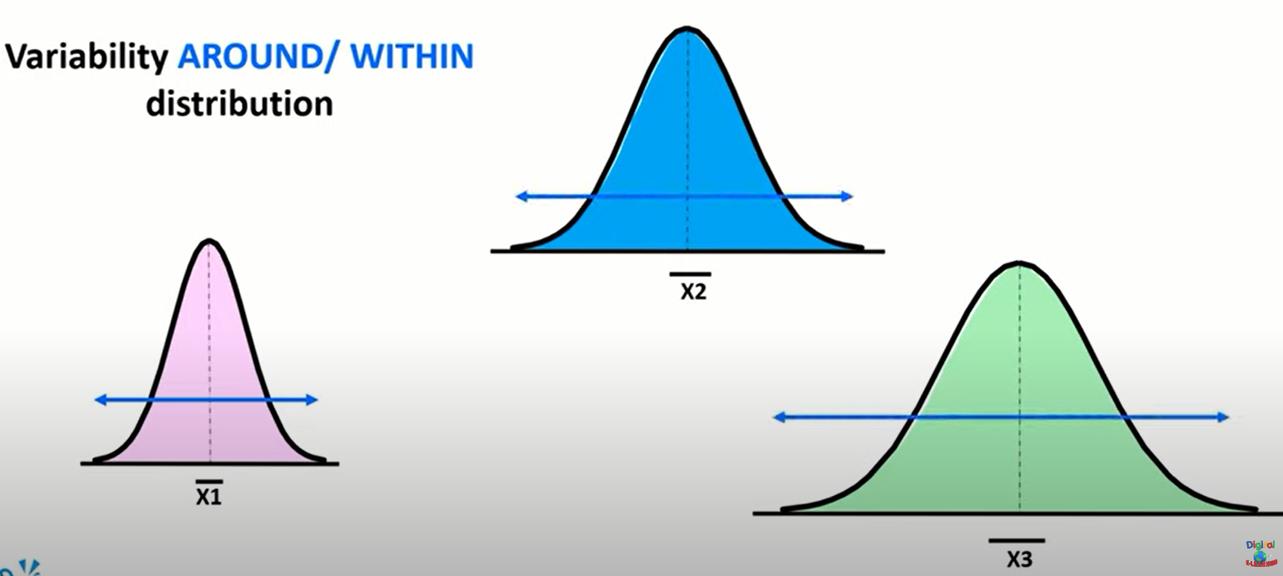

Slide 24
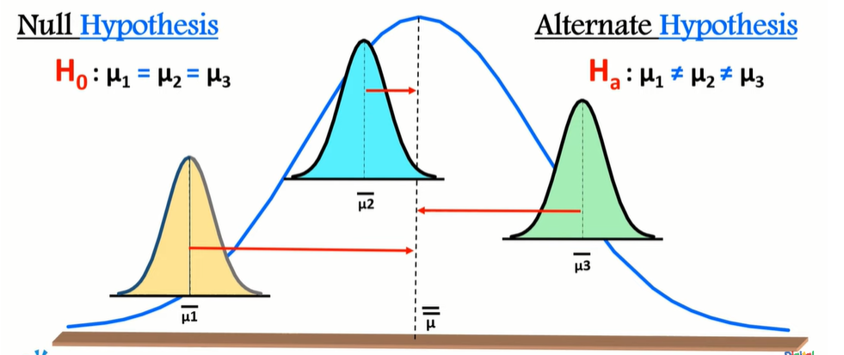

Slide 25
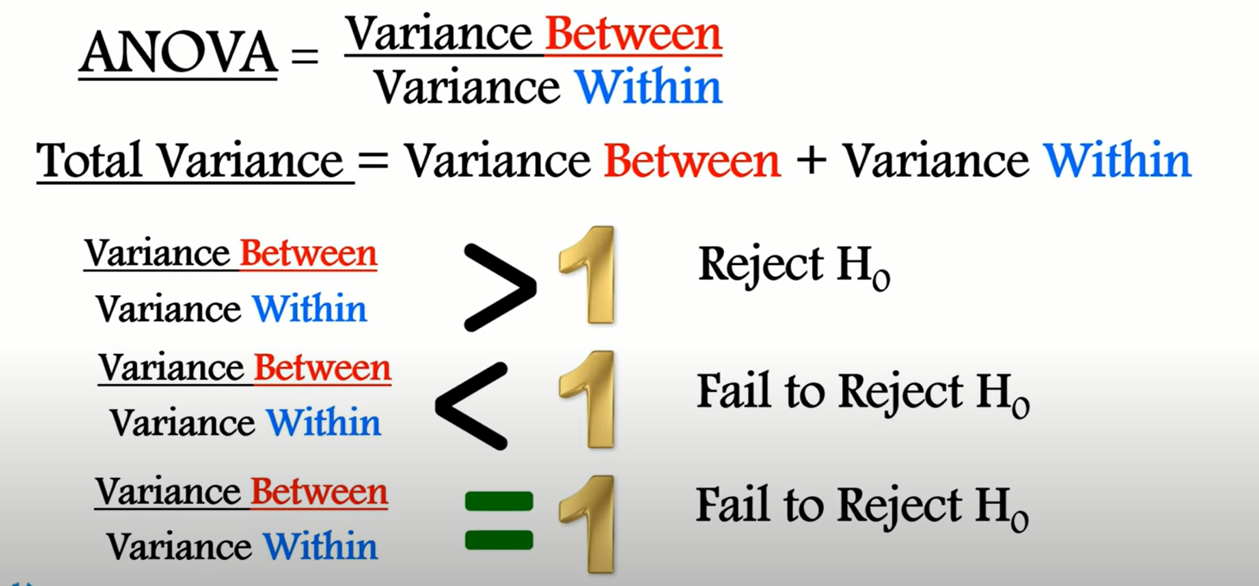

Slide 26
Example
We want to see if three different studying methods can lead to different mean exam scores or not.To test this,we select 30 students and randomly assign 10 each to use a different studying method.

Slide 27
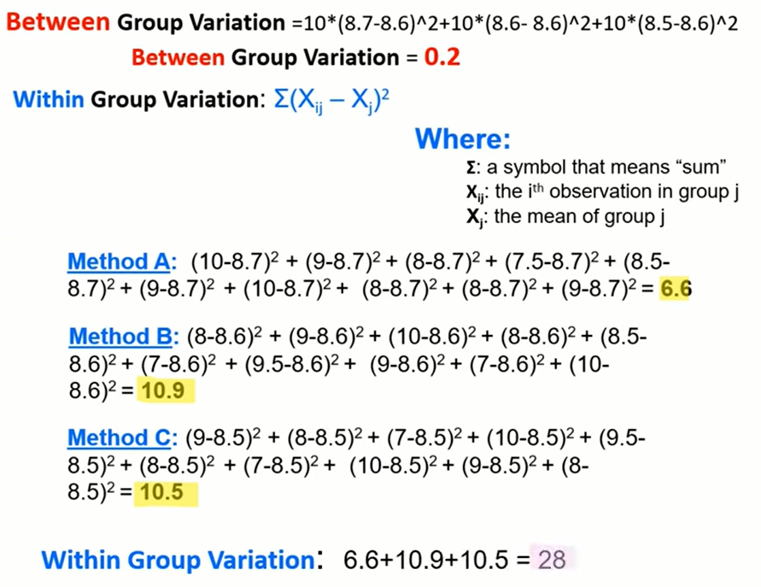
Sno. | Method A | Method B | Method C
1 | 10 | 8 | 9
2 | 9 | 9 | 8
3 | 8 | 10 | 7
4 | 7.5 | 8 | 10
5 | 8.5 | 8.5 | 9
6 | 9 | 7 | 8
7 | 10 | 9.5 | 7
8 | 8 | 9 | 10
9 | 8 | 7 | 9
10 | 9 | 10 | 8
Group mean | 8.7 | 8.6 | 8.5
Over all mean is 8.6

Slide 28
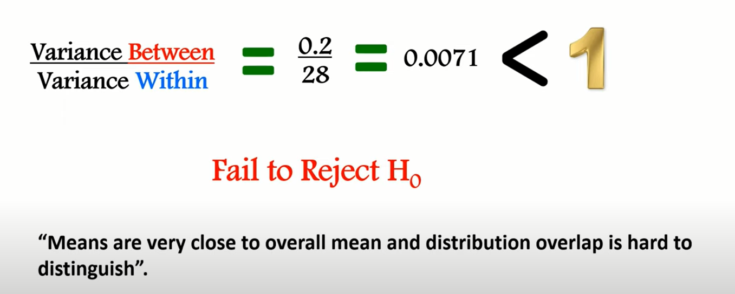

Slide 29
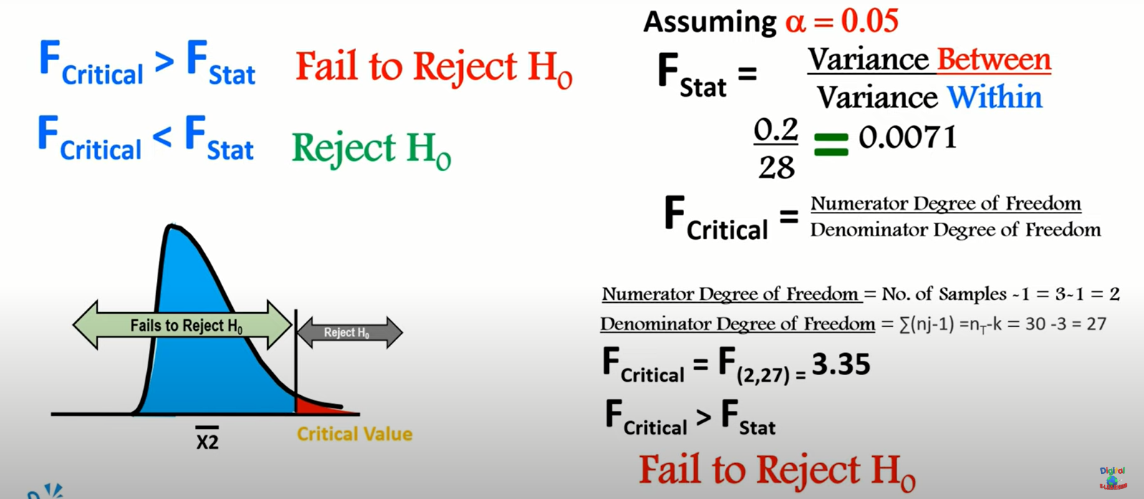

Slide 30
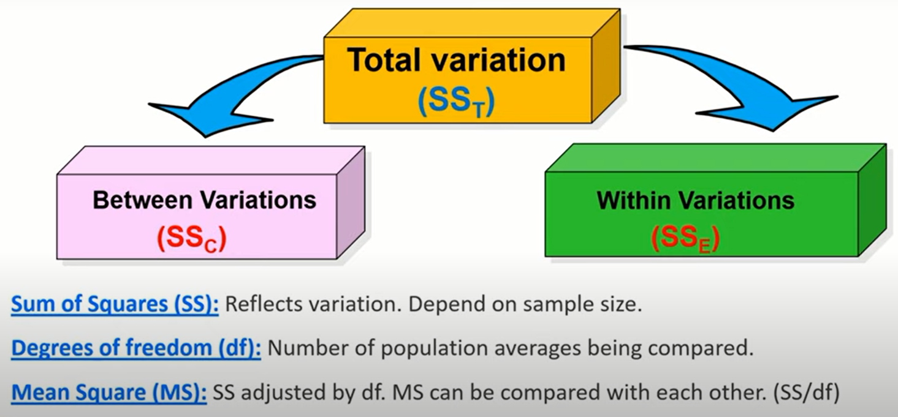

Slide 31
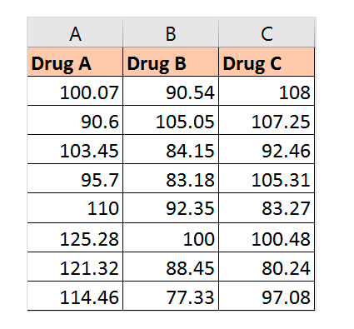
Example
The data below represents the time taken to cure the disease for different patients when they consume either Drug A, B, or C. The time is represented in terms of total hours and minutes. At the 0.05 level of significance (alpha value), we need to test whether the mean time for the three drugs to cure the disease are equal (H0).
The average time taken to cure the disease after consumption of the three drugs are approximately 107, 90 and 97 hours.
The difference between the largest and smallest mean is 17.47.
We can see that the F value > F-critical value.
So, we can reject the null hypothesis. This means that the average time taken to cure the disease is not the same for all the three drugs.
Using paired comparisons, we can conclude the time taken by the three drugs as follows: Time(Drug A) > Time(Drug C) > Time(Drug B).
Create and Showcase Your Portfolio from Scratch!
Caltech PGP Full Stack

