Slide 1
Deviation

Slide 2
Deviation
In statistics and mathematics, the deviation is a measure that is used to find the difference between the observed value and the expected value of a variable.
In simple words, the deviation is the distance from the center point. Similarly, the mean deviation is used to calculate how far the values fall from the middle of the data set.

Slide 3
Variance
Variance is the measure of how notably a collection of data is spread out. If all the data values are identical, then it indicates the variance is zero.
All non-zero variances are considered to be positive. A little variance represents that the data points are close to the mean, and to each other, whereas if the data points are highly spread out from the mean and from one another indicates the high variance.

Slide 4


Variance
The term variance refers to a statistical measurement of the spread between numbers in a data set.
Variance is often depicted by this formula:

Slide 5
Standard Deviation
Standard Deviation is a measure which shows how much variation (such as spread, dispersion) from the mean exists. The standard deviation indicates a “typical” deviation from the mean.

Slide 6
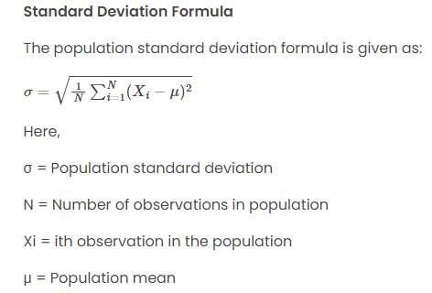
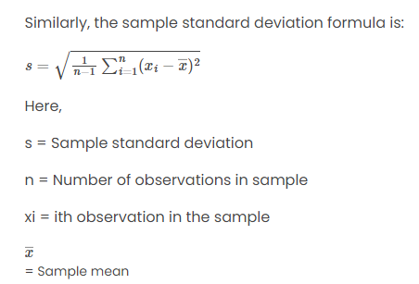
Standard Deviation

Slide 7
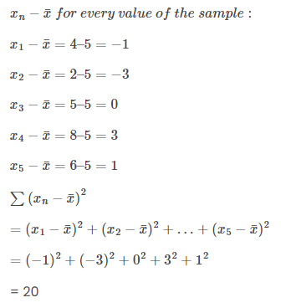
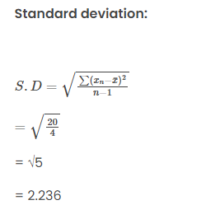
Example
Consider the number of gold coins 5 pirates have; 4, 2, 5, 8, 6.
Mean: (4 + 2 + 5 + 6 + 8) / 5= 5

Slide 8

Standard deviation for grouped data
Calculate the mean, variance and standard deviation for the following data:

Slide 9
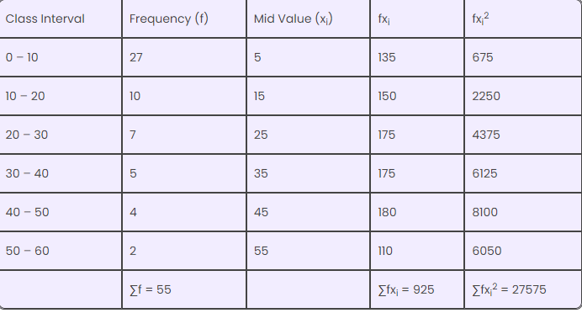
Solution

Slide 10
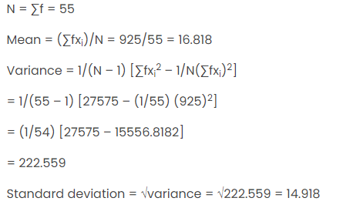
Solution

Slide 11
Co-variance
Covariance is a statistical tool used to determine the relationship between the movements of two random variables.
The covariance equation is used to determine the direction of the relationship between two variables—in other words, whether they tend to move in the same or opposite directions. A positive or negative covariance value determines this relationship.

Slide 12
Positive Covariance
A positive covariance between two variables indicates that these variables tend to be higher or lower at the same time.
In other words, a positive covariance between stock one and two is where stock one is higher than average at the same points that stock two is higher than average, and vice versa.
When charted on a two-dimensional graph, the data points will tend to slope upwards.

Slide 13
Negative Covariance
When the calculated covariance is less than negative, this indicates that the two variables have an inverse relationship.
In other words, a stock one value lower than average tends to be paired with a stock two value greater than average, and vice versa.

Slide 14
Example
To calculate the covariance between two stocks, assume you have the stock prices for a period of four days.
Day | ABC | XYZ
1 | 1.2% | 3.1%
2 | 1.8% | 4.2%
3 | 2.2% | 5.0%
4 | 1.5% | 4.2%
Average return for ABC (1.675%) and XYZ (4.125%),
Day 1=(1.2%−1.675%)×(3.1%−4.125%)=0.487​
Day 2=(1.8%−1.675%)∗(4.2%−4.125%)=0.009​
Day 3=(2.2%−1.675%)∗(5.0%−4.125%)=0.459​
Day 4=(1.5%−1.675%)∗(4.2%−4.125%)=−0.013​
Add each day's result to the previous result:
0.487+0.009+0.459−0.013=0.943​
Your sample size is four, so subtract one from four and divide the previous result by it:
0.943/3=.314​
This sample has a covariance of .314, a positive number, suggesting that the two stocks are similar in returns.

Slide 15
Correlation
Correlation measures the relationship between two variables.
The correlation coefficient measures the relationship between two variables.
The correlation coefficient can never be less than -1 or higher than 1.
1 = there is a perfect positive linear relationship between the variables
0 = there is no linear relationship between the variables
-1 = there is a perfect negative linear relationship between the variables .

Slide 16
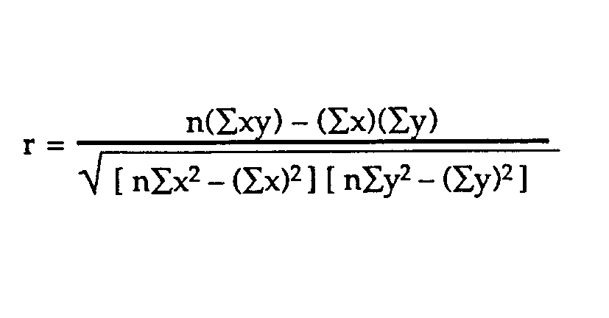
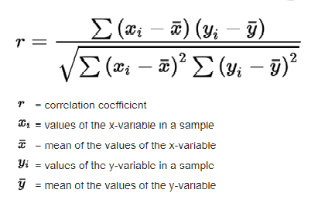
Types of correlation coefficient formulas.
Formula : Pearson’s correlation coefficient
.

Slide 17

Types of correlation coefficient formulas.
Formula : Sample correlation.
Formula : Population correlation.
S_{x} and s_{y} are the sample standard deviations, and s_{xy} is the sample covariance.
The population correlation coefficient uses σ_{x} and σ_{y} as the population standard deviations, and σ_{xy} as the population covariance.

Slide 18
Example: Find the value of the correlation coefficient from the following table:
Subject | Age x | Glucose Level y
1 | 43 | 99
2 | 21 | 65
3 | 25 | 79
4 | 42 | 75
5 | 57 | 87
6 | 59 | 81

Slide 19
Solution
Subject | Age x | Glucose Level y | xy | x² | y²
1 | 43 | 99 | 4257 | 1849 | 9801
2 | 21 | 65 | 1365 | 441 | 4225
3 | 25 | 79 | 1975 | 625 | 6241
4 | 42 | 75 | 3150 | 1764 | 5625
5 | 57 | 87 | 4959 | 3249 | 7569
6 | 59 | 81 | 4779 | 3481 | 6561
Σ | 247 | 486 | 20485 | 11409 | 40022

Slide 20
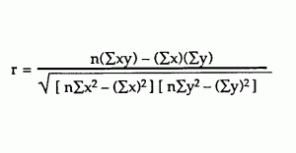
Solution
From our table:
Σx = 247
Σy = 486
Σxy = 20,485
Σx² = 11,409
Σy² = 40,022
n is 6
The correlation coefficient =
6(20,485) – (247 × 486) / [√[[6(11,409) – (247²)] × [6(40,022) – 486²]]]= 0.5298

Slide 21
Correlation Matrix
A matrix is an array of numbers arranged in rows and columns.
A correlation matrix is simply a table showing the correlation coefficients between variables.

Slide 22
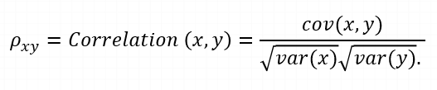
Relationship between covariance and correlation
where,
var(X) = standard deviation of X
var(Y) = standard deviation of Y

Slide 23
Linear regression
A simple example of a regression equation to predict the glucose level given the age.
Subject | Age x | Glucose Level y
1 | 43 | 99
2 | 21 | 65
3 | 25 | 79
4 | 42 | 75
5 | 57 | 87
6 | 59 | 81
7 | 55 | ?

Slide 24
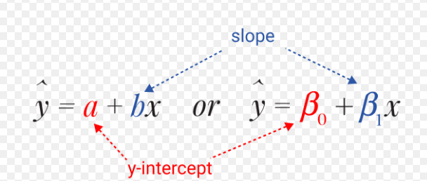
Simple linear regression
The simple linear regression equation provides an estimate of the population regression line

Slide 25
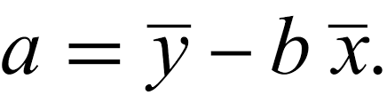
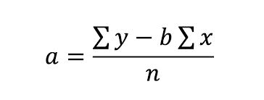
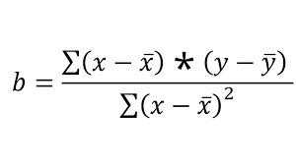
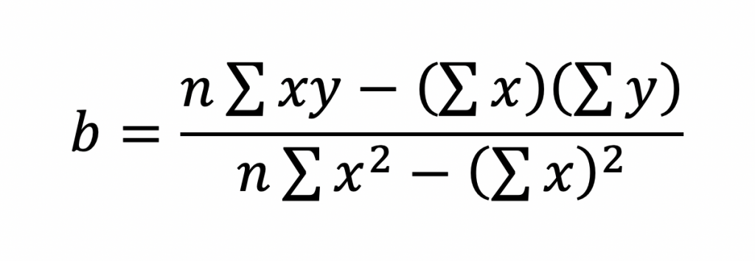
Formula for slope and intercept

Slide 26
Summary
However, variance measures the spread of data along a single axis, while covariance examines the directional relationship between two variables.
Covariance reveals how two variables change together while correlation determines how closely two variables are related to each other.
Both covariance and correlation measure the relationship and the dependency between two variables.
Covariance indicates the direction of the linear relationship between variables.
Correlation measures both the strength and direction of the linear relationship between two variables.
Correlation values are standardized,Covariance values are not standardized.
While correlation coefficients lie between -1 and +1, covariance can take any value between -∞ and +∞.

