Slide 1
Telecommunication User Analytics for Strategic Business Acquisition
PROJECT NO 5
- DEEPALI DAULAT CHAUGULE

Slide 2
Introduction
Purpose:
- Identify popular handset brands and models
- Analyze user behavior
- Apply clustering techniques for segmentation.

Slide 3
Dataset Overview
Source:
Telecom company dataset
Features:
Handset types, app usage, call duration, network activity.
Target:
Telecom marketing and strategy teams.

Slide 4
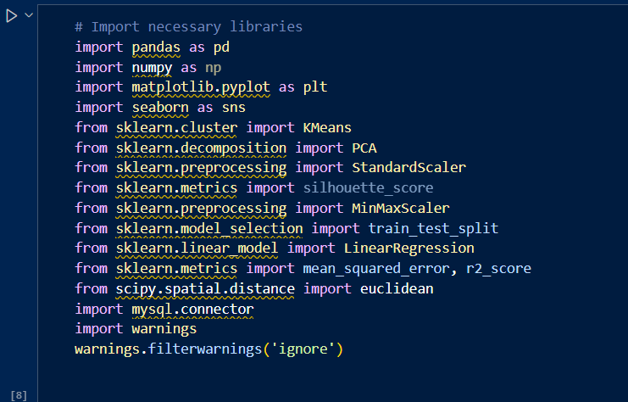
Import all necessary libraries

Slide 5
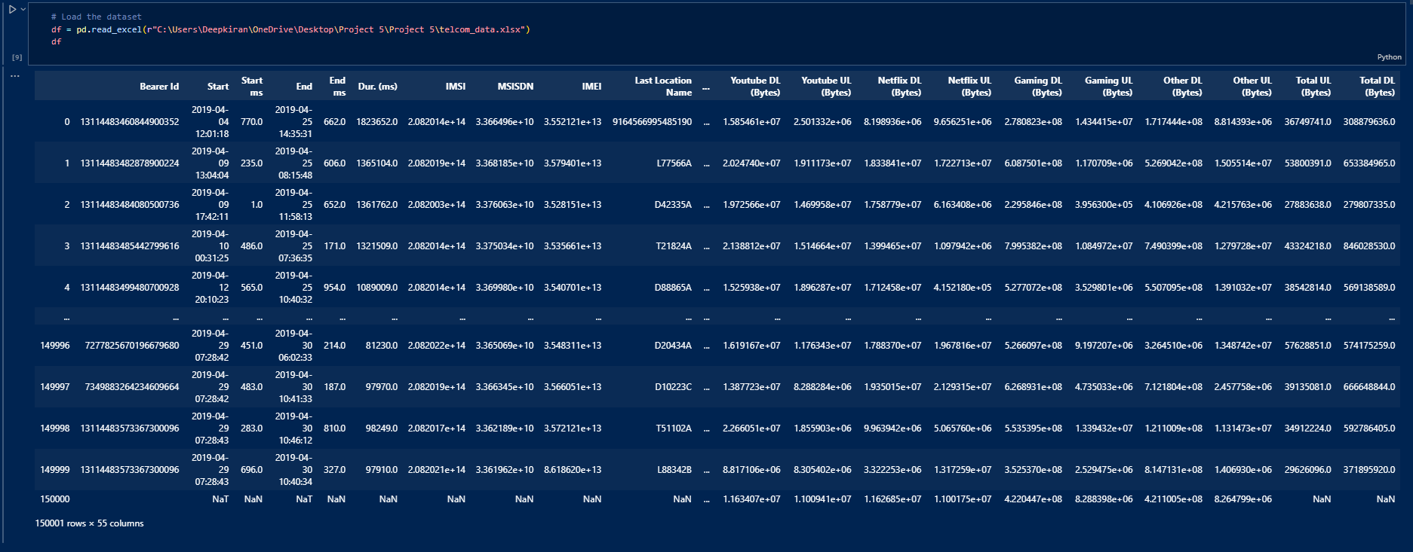
Load Dataset

Slide 6
Data Preprocessing
Steps taken:
- Handling missing values
- Encoding categorical variables
- Feature scaling using MinMaxScaler.

Slide 7
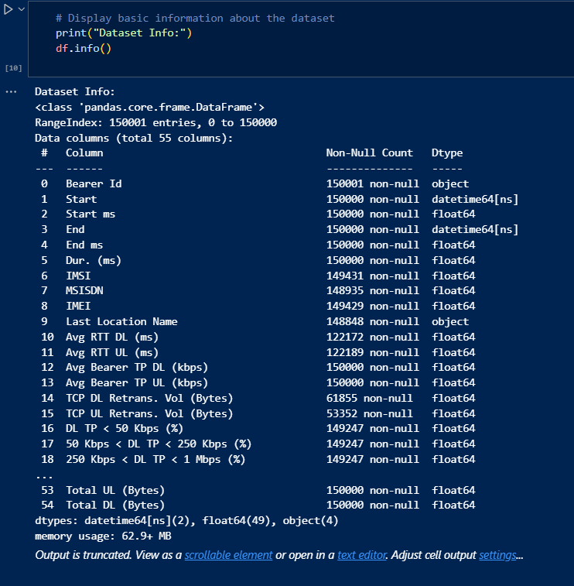
Basic information of loaded dataset

Slide 8
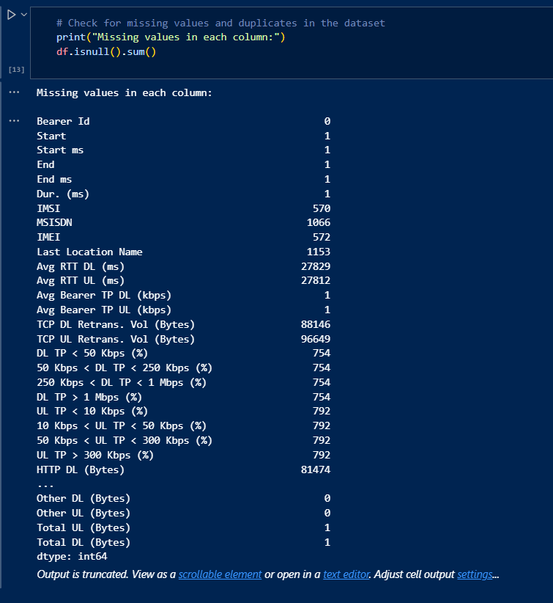
Find Missing Values of the dataset

Slide 9
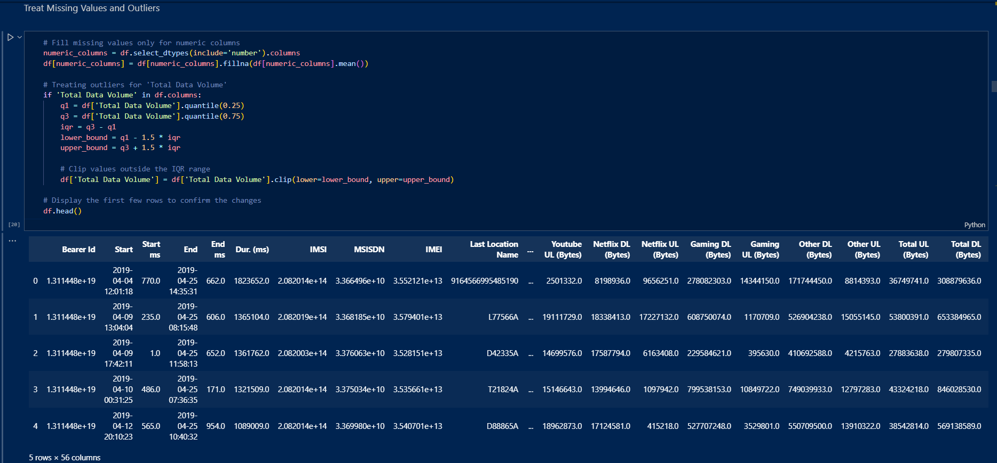
Exploratory Data Analysis (EDA)
Visualizing handset usage distribution, trends, and outlier removal.

Slide 10
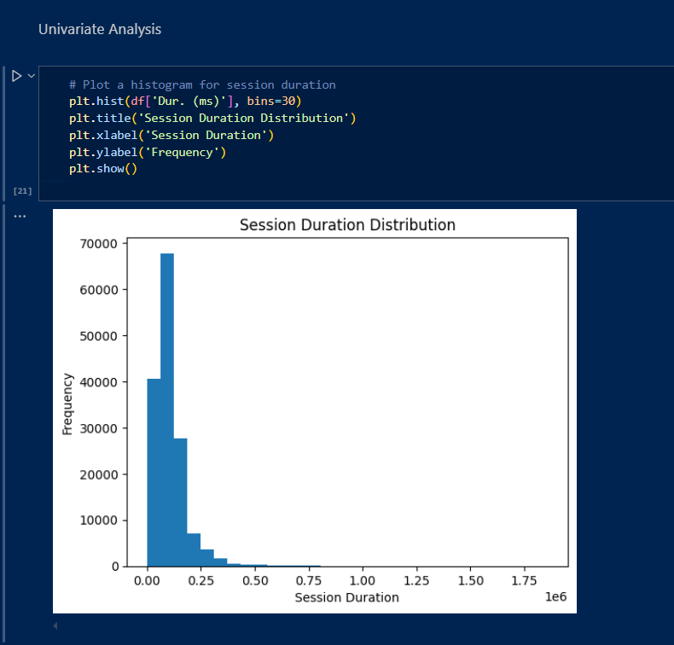
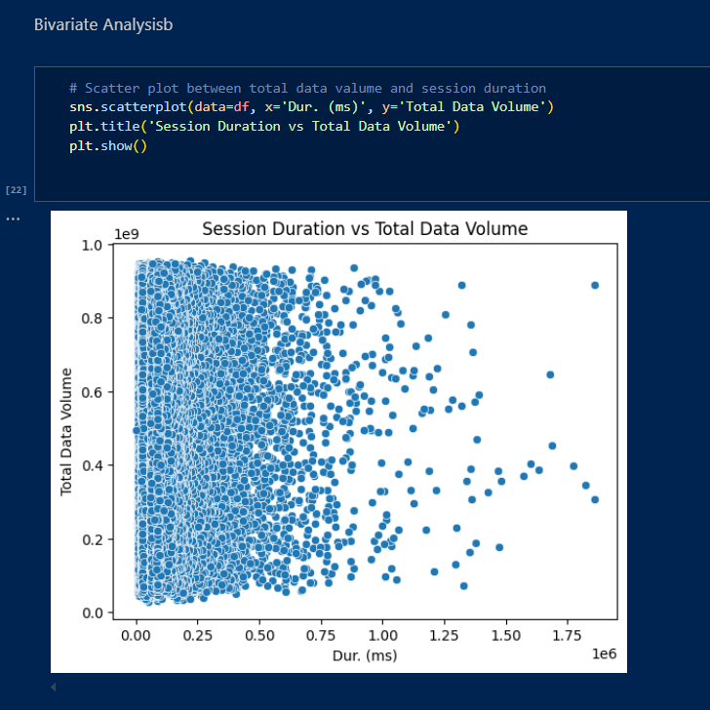
Univariate Analysis and Bivariate Analysis

Slide 11
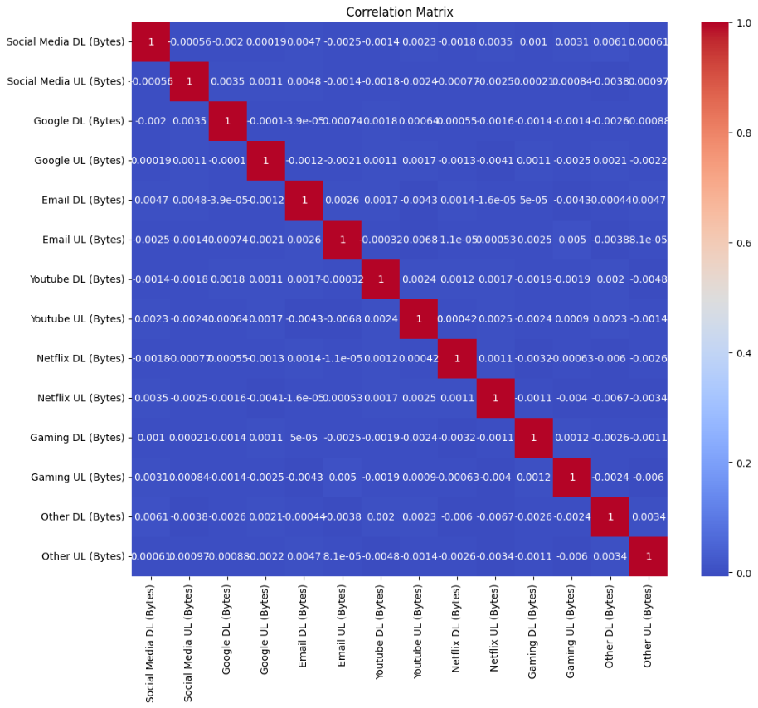
Heat Map

Slide 12
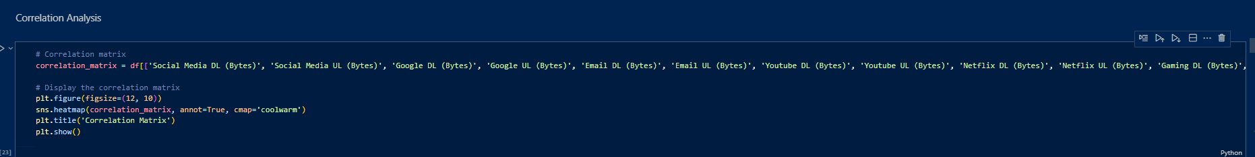
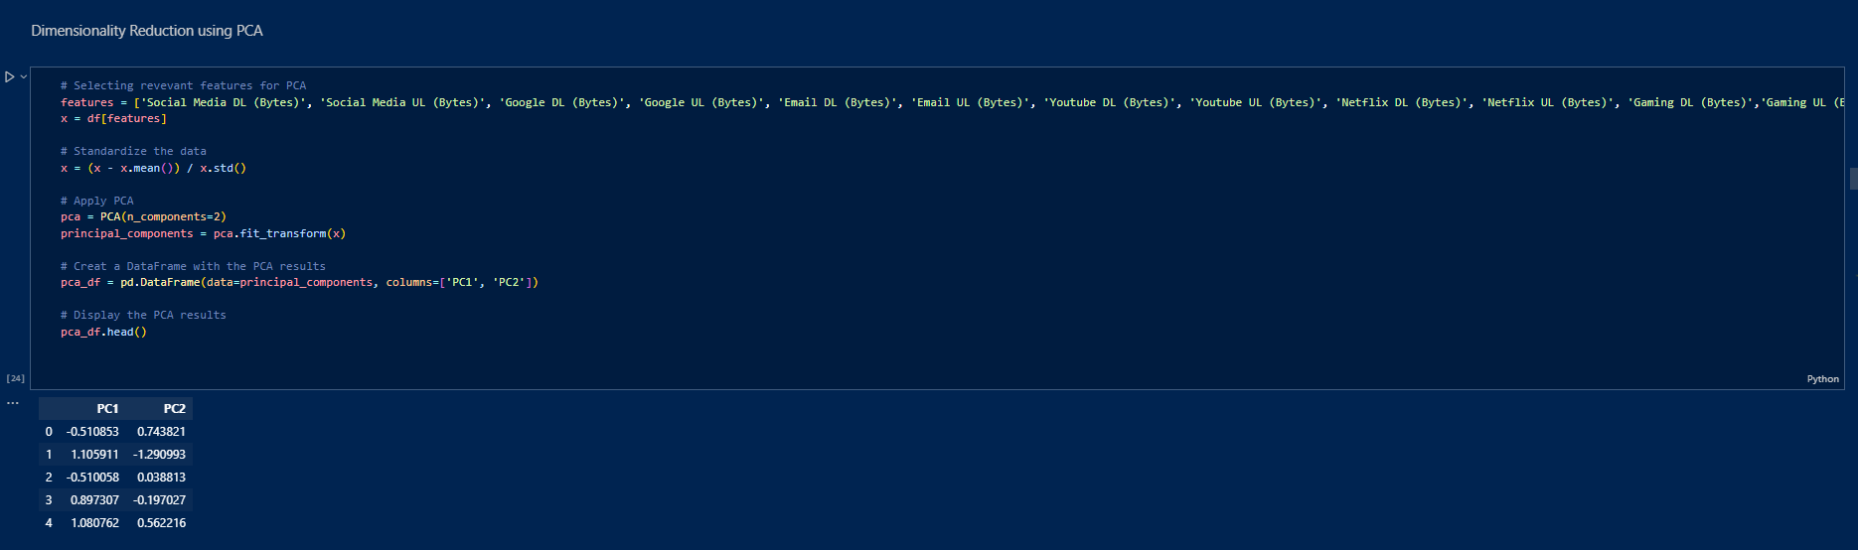
Correlation Analysis and Dimensionality Reducing using PCA

Slide 13
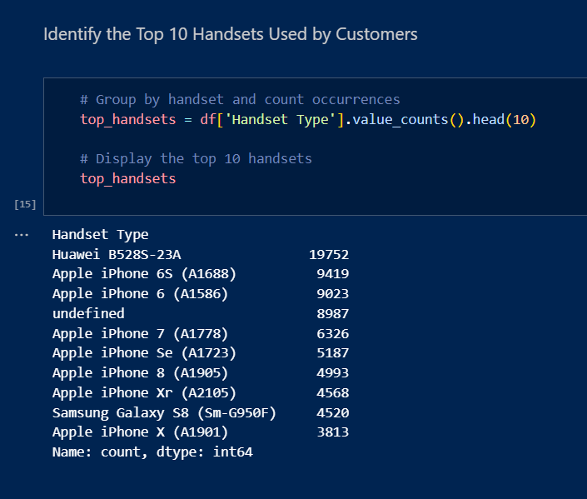
Top 10 Handsets Used
Most popular handsets based on customer data, visualized using bar charts.

Slide 14
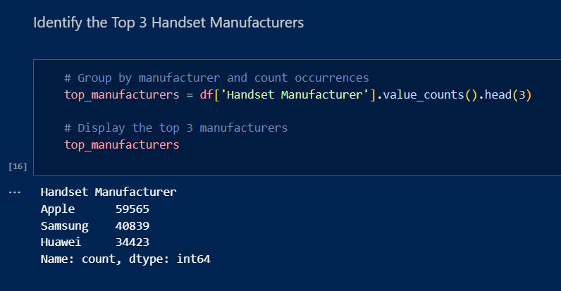
Top 3 Handset Manufacturers
Leading brands preferred by users and their market share.

Slide 15
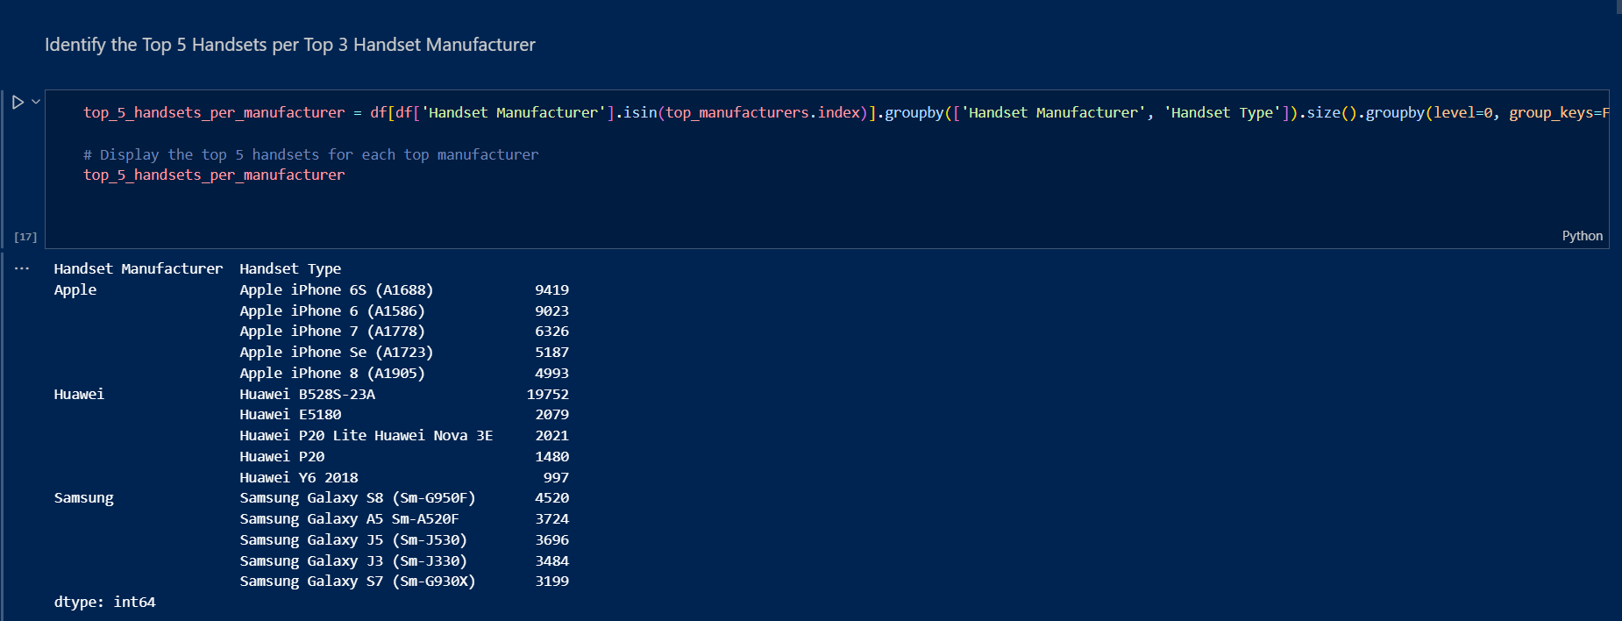
Top 5 Handsets per Manufacturer
Detailed brand-wise handset usage analysis.

Slide 16
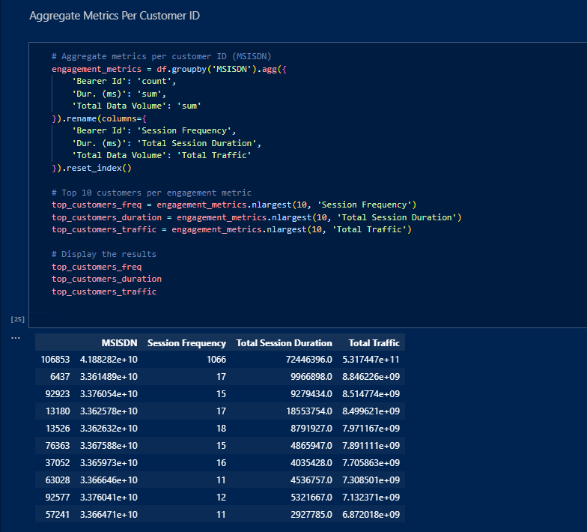
User Behavior Overview
Analyzing app usage, data consumption, and call patterns to identify user habits.

Slide 17
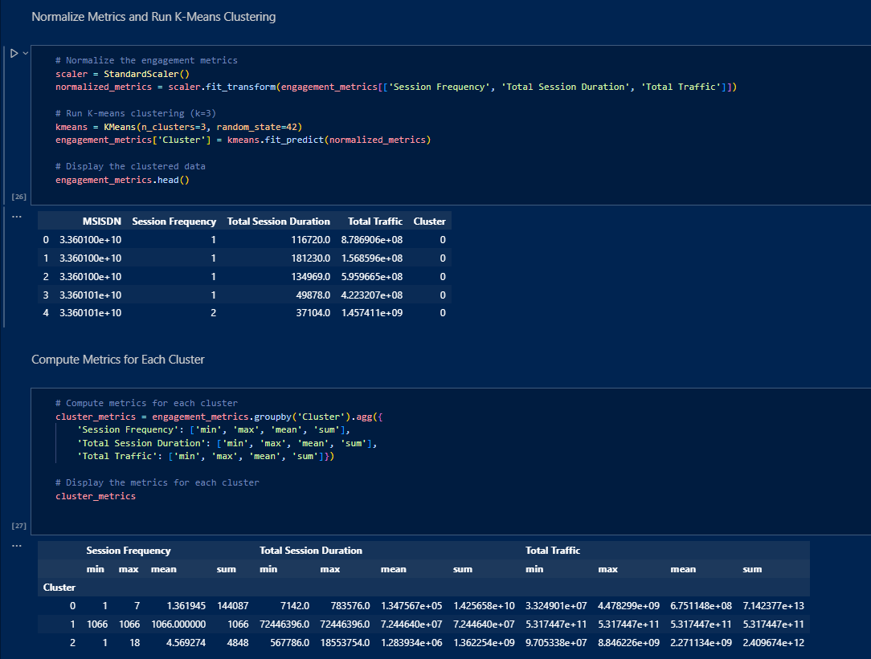

Slide 18
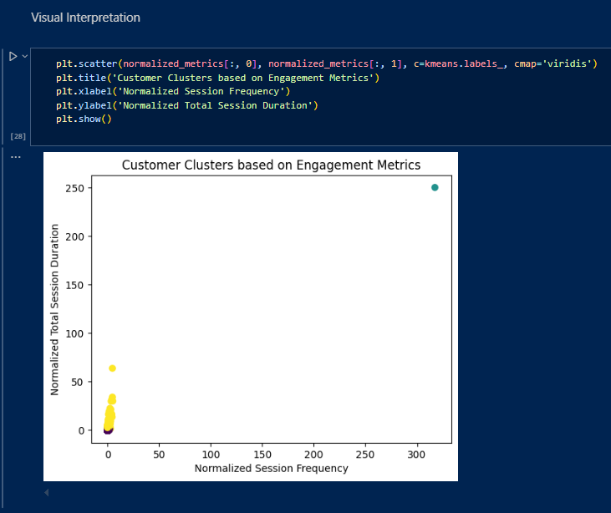
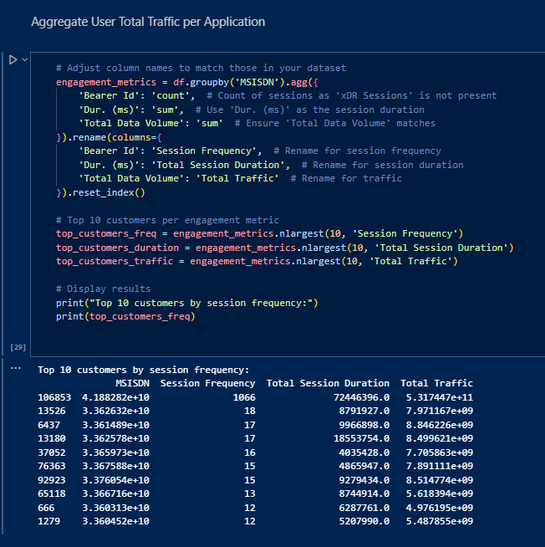

Slide 19
Interpretation:
Top Customers:
The top 10 customers based on each engagement metric highlight who the most engaged users are, allowing targeted strategies for retention or upselling.
Clusters:
Clustering users into three groups helps identify distinct engagement levels, informing personalized marketing efforts.
Top Applications:
Understanding which applications drive the most engagement enables better resource allocation and promotional activities.

Slide 20
Clustering Approach
Applying K-Means Clustering and PCA for user segmentation.
Evaluating cluster quality using Silhouette Score.

Slide 21
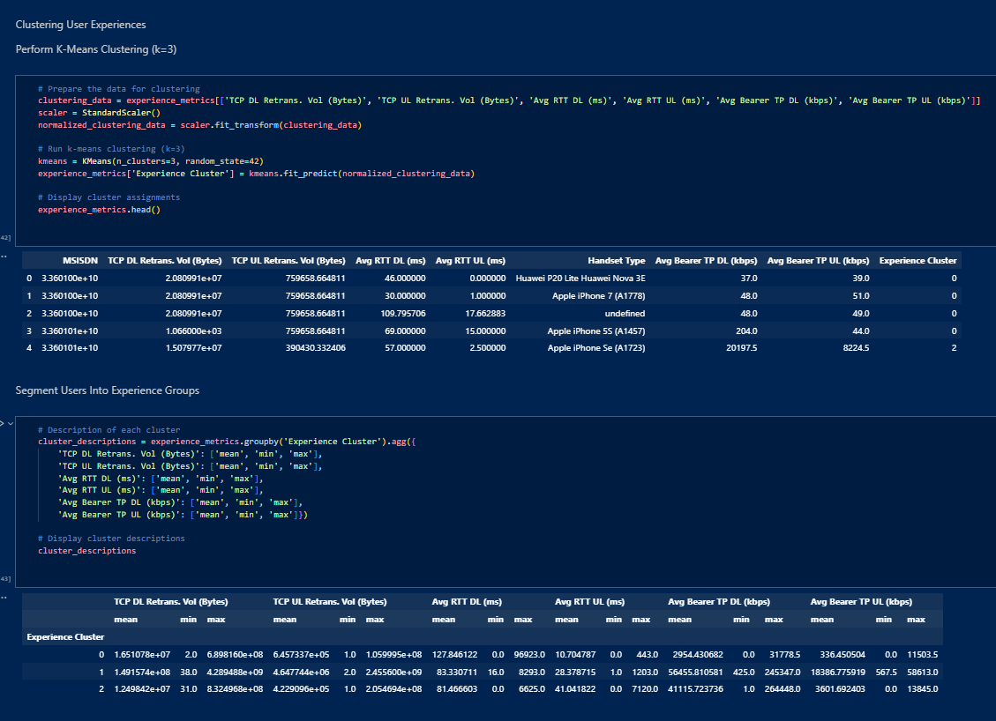

Slide 22
Interpretation:
Aggregated Metrics:
The aggregated data shows customer-level insights into TCP retransmission, RTT, throughput, and handset type.
Top and Bottom Values:
Identifying top and bottom performers for each metric highlights variability in user experiences.
Distribution Analysis:
Visual distributions of throughput and TCP retransmission per handset type reveal performance trends across devices.
Clustering:
Clustering helps segment users into experience groups, offering a pathway to tailor services for different user needs.

Slide 23
Model Implementation
Regression model for price prediction and clustering for segmentation.

Slide 24
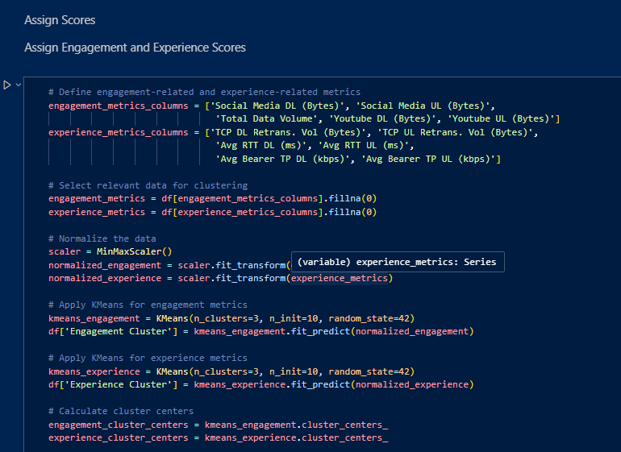

Slide 25
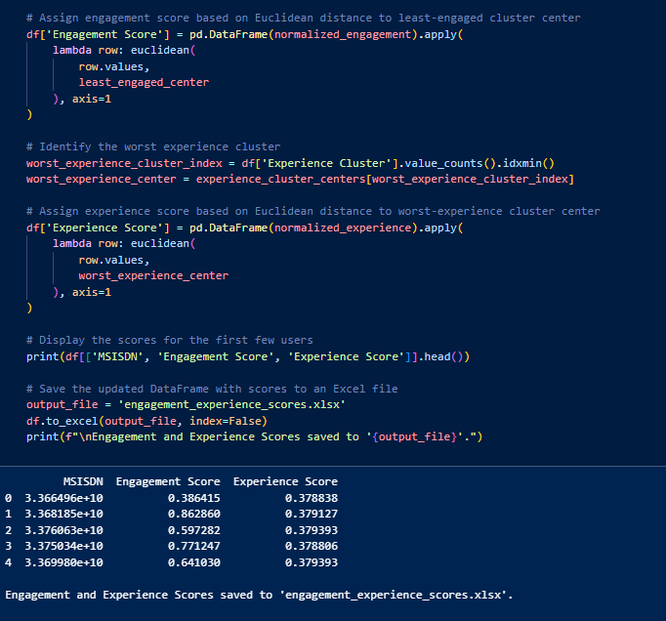

Slide 26
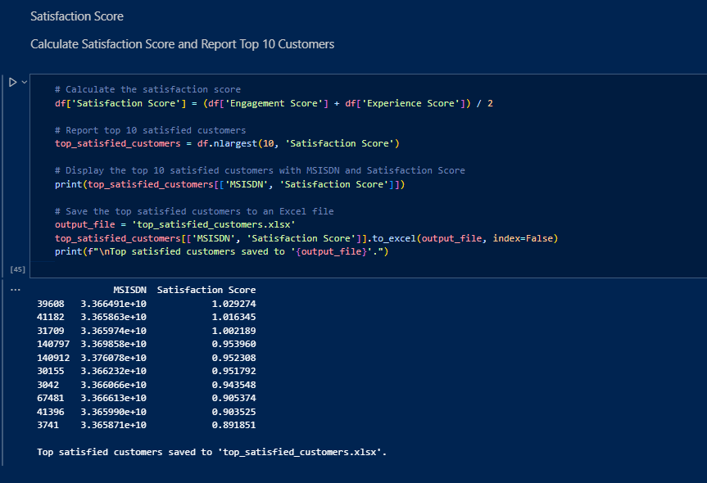

Slide 27
Performance Metrics
Regression:
- RMSE (Root Mean Squared Error)
- R² Score
Clustering:
- Silhouette Score for cluster validation.

Slide 28
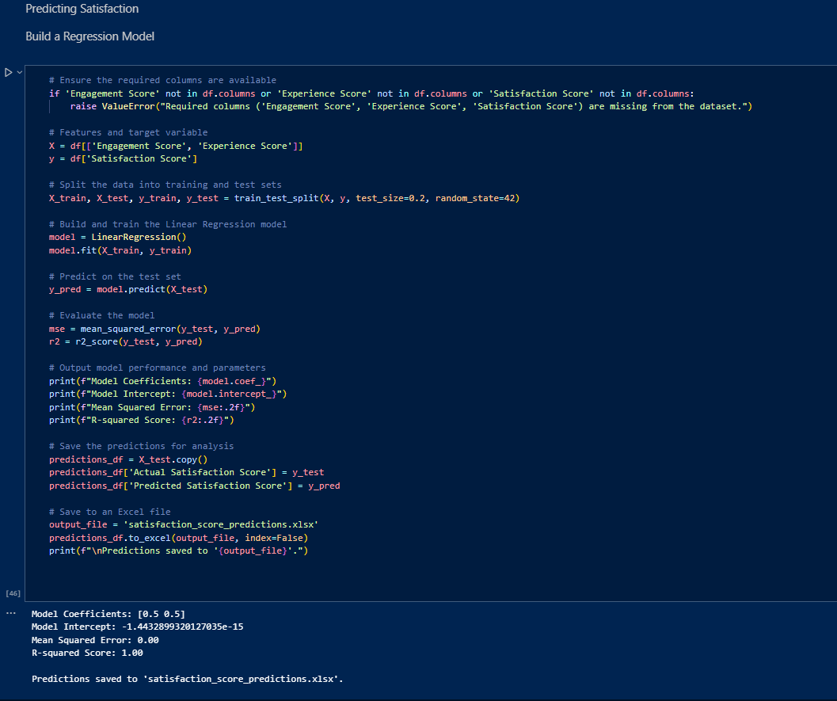

Slide 29
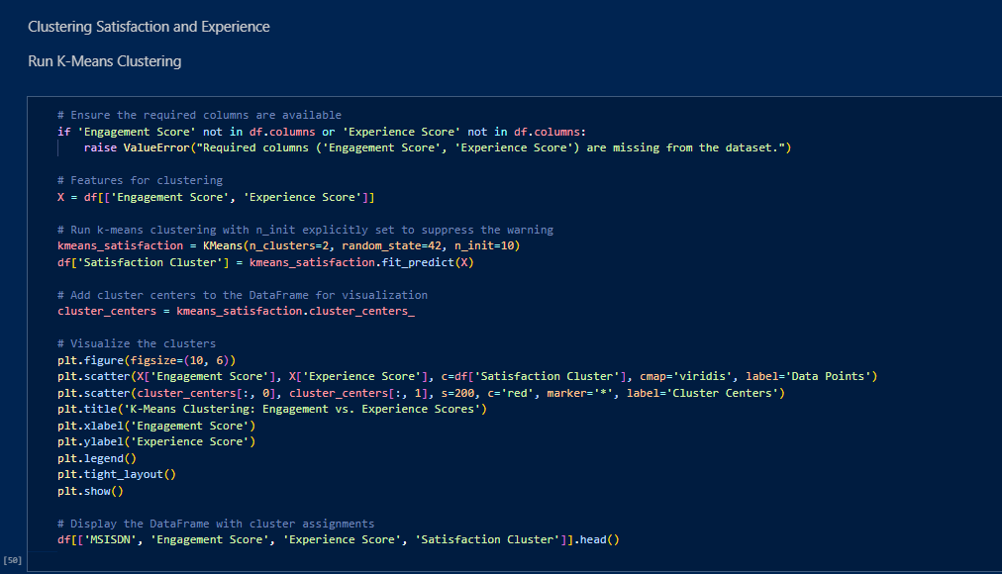

Slide 30
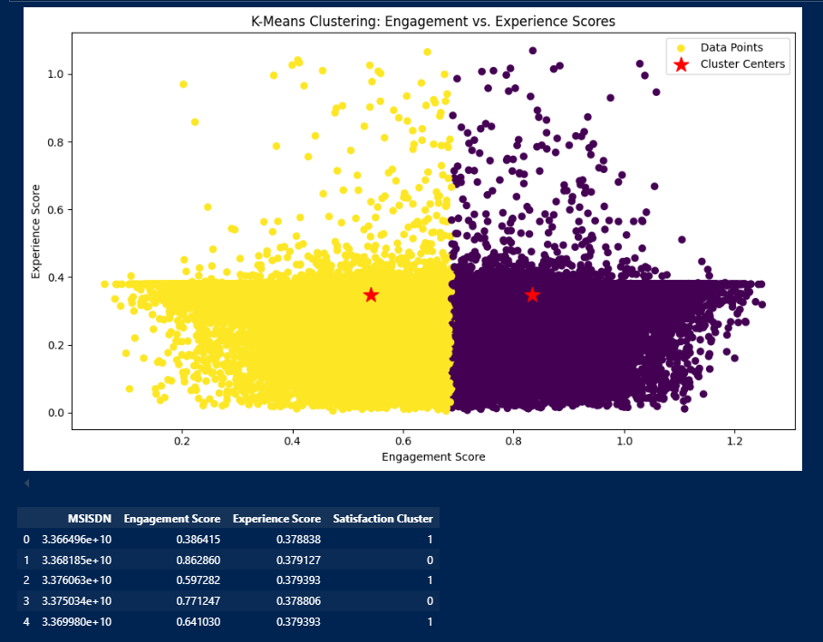

Slide 31
Export to mysql
Export the final table containing all user IDs, engagement scores, experience scores, and satisfaction scores to a local MySQL database.

Slide 32
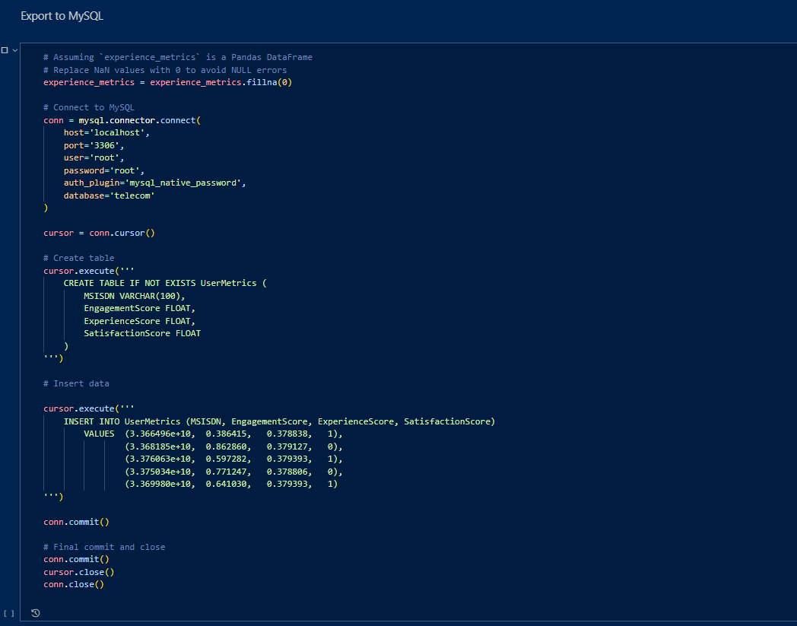

Slide 33
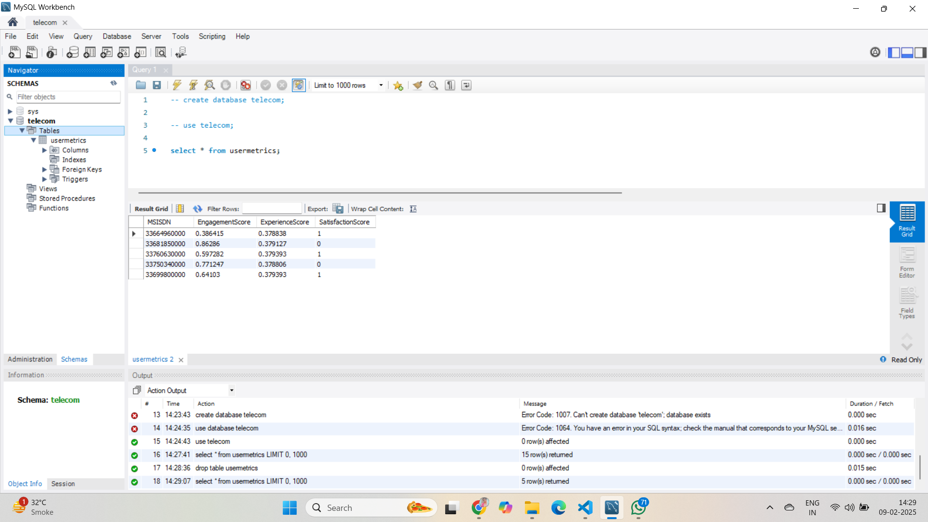
A screenshot of a select query output from the exported table

Slide 34
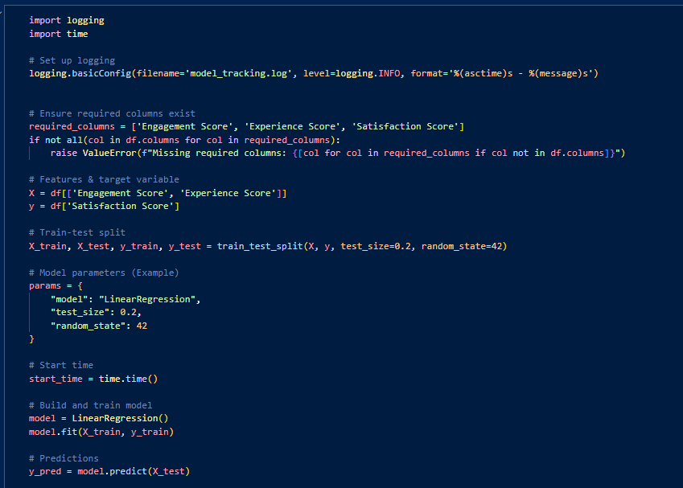
-Model Deployment Tracking

Slide 35
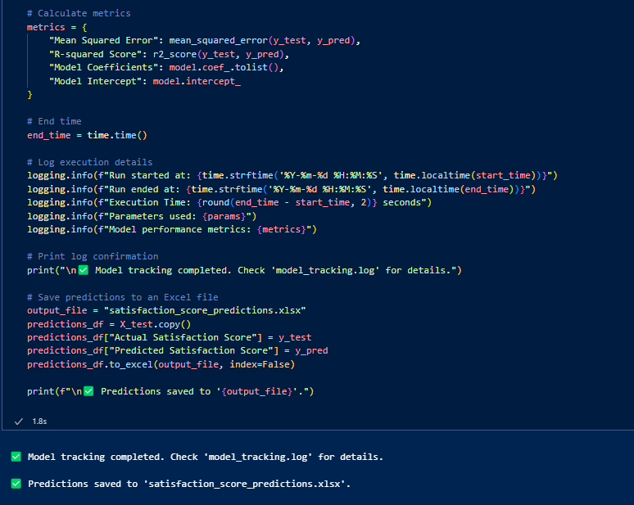

Slide 36
Insights & Findings
High-end smartphones are dominant among premium users, while mid-range devices are the most common overall.
Top handset patterns in data usage, app preferences, and call durations. manufacturers have strong brand loyalty among users.
User behavior analysis shows distinct

Slide 37
Business Recommendations
Insights from this study can help telecom companies optimize their marketing strategies, tailor promotions, and improve customer satisfaction.
Recommending targeted data plans and offers based on user clusters.

Slide 38
Conclusion
Expand the analysis to incorporate 5G adoption trends.
Enhance clustering accuracy by integrating additional behavioral features.
Implement predictive models for customer churn analysis.

Slide 39
References
Libraries:
Pandas, Scikit-Learn, Matplotlib, Seaborn
Dataset Source

Slide 40
Thank you.

