Slide 1
Rossmann Sales Forecasting
Project 6
Sales Prediction Across Multiple Retail Stores
-Deepali Daulat Chaugule

Slide 2
Project Overview
Predict daily sales for Rossmann drug stores across various stores and dates.

Slide 3
Problem Statement
Rossmann needs a reliable system to forecast sales based on historical data to optimize operations.

Slide 4
Business Objective
Deliver accurate sales predictions to assist in staffing, inventory, and marketing planning.

Slide 5
Dataset Overview
- Historical sales data
- Store information
- Promotions, holidays, and seasonal effects

Slide 6
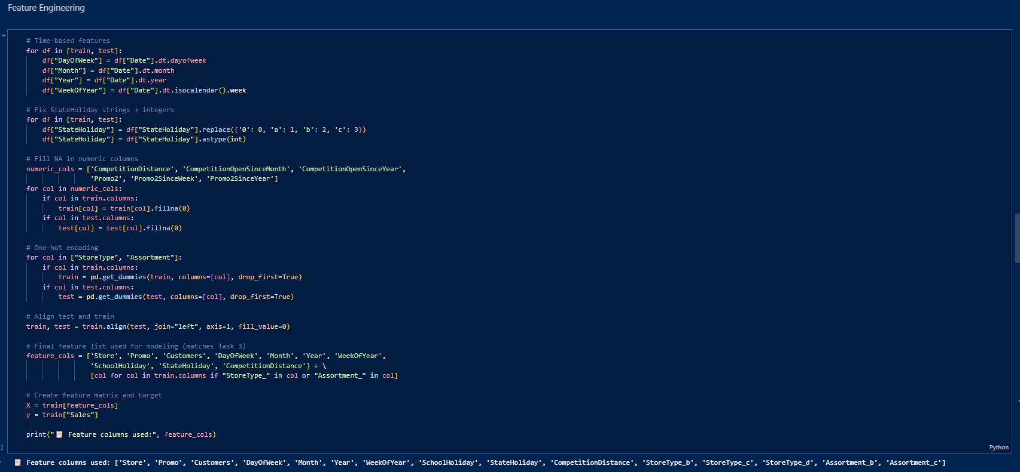
Feature Engineering
- Extracted features: DayOfWeek, Promo, Month, Year, WeekOfYear
- Holiday features

Slide 7
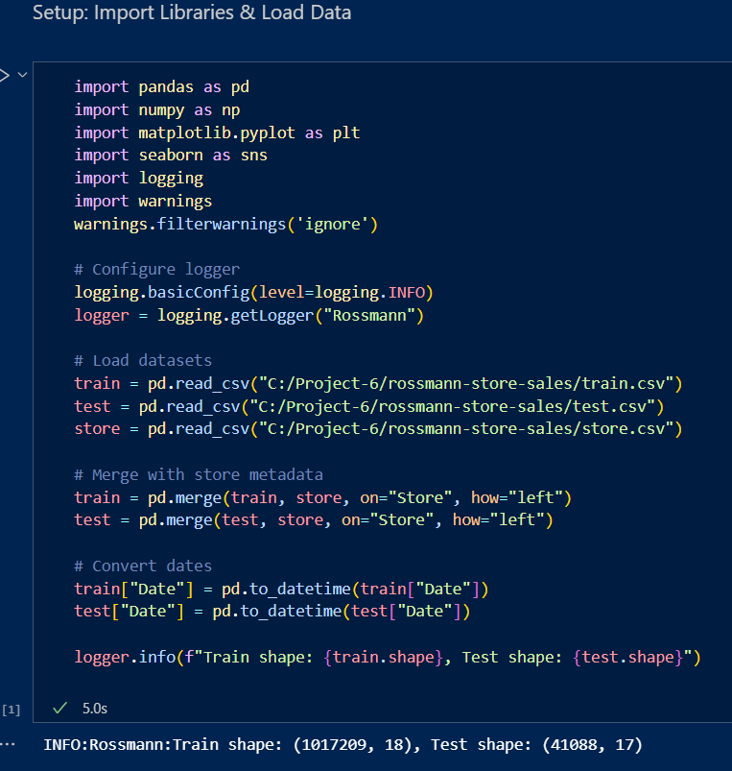
Data Preprocessing
- Missing value handling
- Date feature extraction
- Categorical encoding

Slide 8
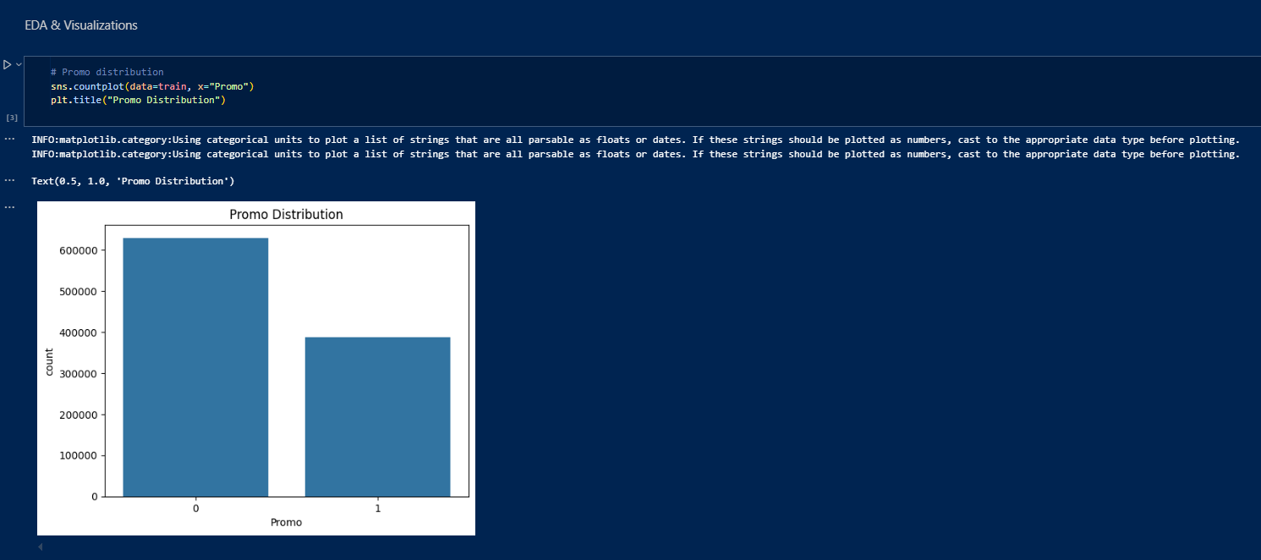
Exploratory Data Analysis (EDA)
- Sales trends by store and time
- Promo impact on sales
- Holiday effects on customer flow

Slide 9
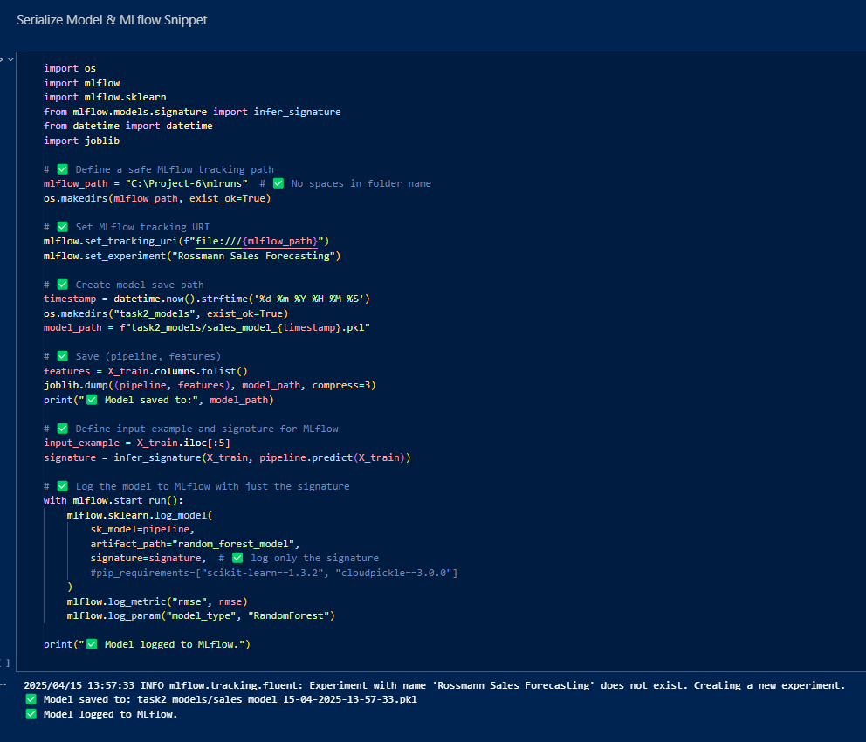
Modeling Approach
- Trained multiple models
- Selected the best based on RMSE
- Models saved with joblib

Slide 10
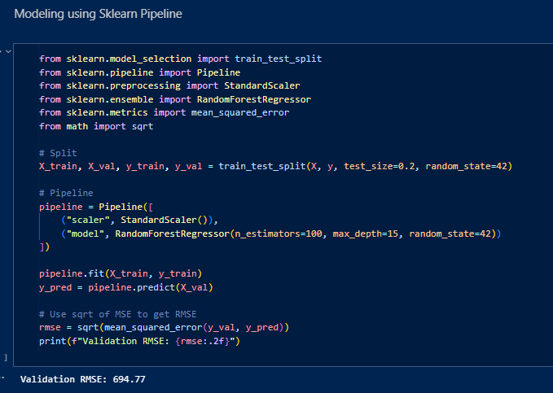
Model Evaluation Metrics
- RMSE as primary evaluation metric
- Comparison across different models

Slide 11
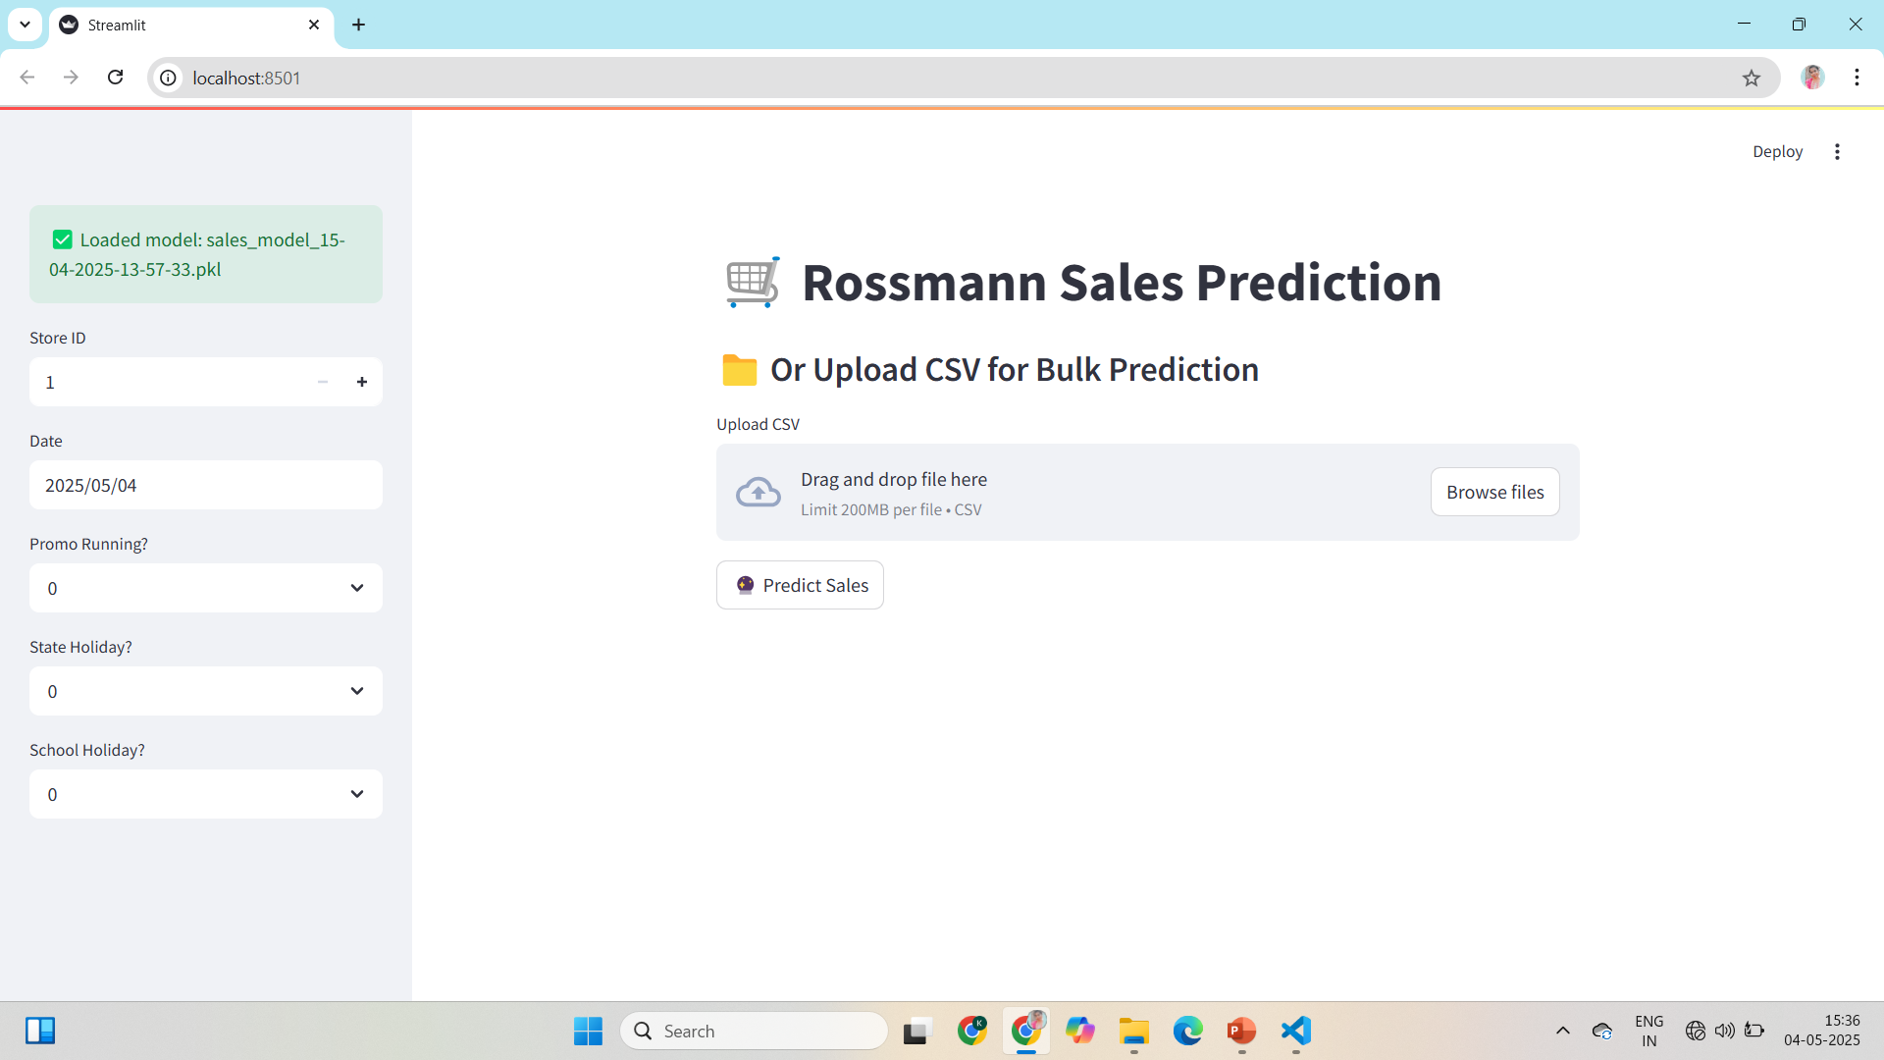
Streamlit App Overview
Interactive web app for single/bulk sales prediction.
Built using Streamlit and joblib models.

Slide 12
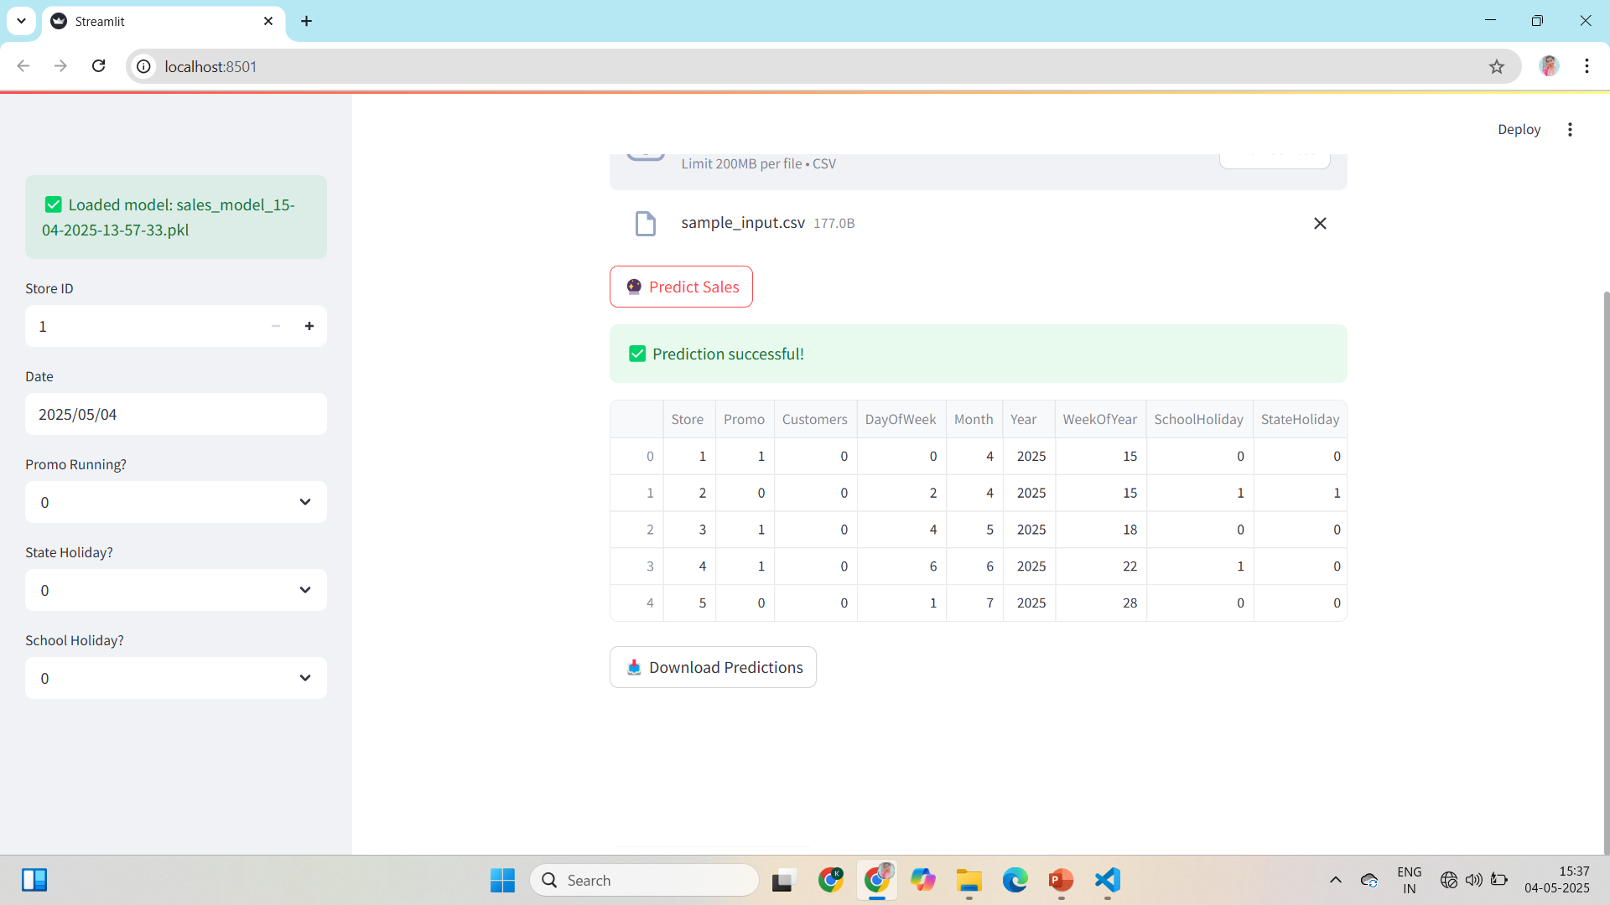
Streamlit App: Key Features
- Input Store ID, Date, Promotions, Holidays
- Upload CSV for bulk predictions

Slide 13
Conclusion & Next Steps
- Deploy app for business users
- Continuously retrain with latest sales data

