Slide 1
MA-697
Knn Algorithm in machine learning
BY-DEEPALI DAGAR
Roll No. 212123020

Slide 2
K- Nearest Neighbors
It is a supervised machine learning algorithm.
i.e. It contains a model that is able to predict with the help of a labelled dataset.
A labelled dataset is one where you already know the target answer.
K-Nearest Neighbors is one of the simplest supervised machine learning algorithms
used for classification. It classifies a data point based on its neighbors classifications.
It stores all available cases and classifies new cases based on similar features.
The algorithm can be used to solve both classification and regression problem statements.

Slide 3
In most of the cases, our datapoint is more likely to behave like the other data points with similar features, so KNN finds out the nearest such datapoint and gives output accordingly. The idea is to find such k, which is enough to depict the behaviour of our new datapoint
IDEA BEHIND THE ALGORITHM:

Slide 4
Suppose we have a new point- X, Now you want to classify it:
K-nearest neighbors of a record x are data points that have the k smallest distance to x
So, this diagram shows that change in value of K can surely affect our result

Slide 5
Can we choose any value of K? If k is too small, sensitive to noise points. If k is too large, neighborhood may include points from other classes. It basically works more on trial and error Rule of thumb: K = sqrt(N) N: number of training points
Value Of ‘K’

Slide 6
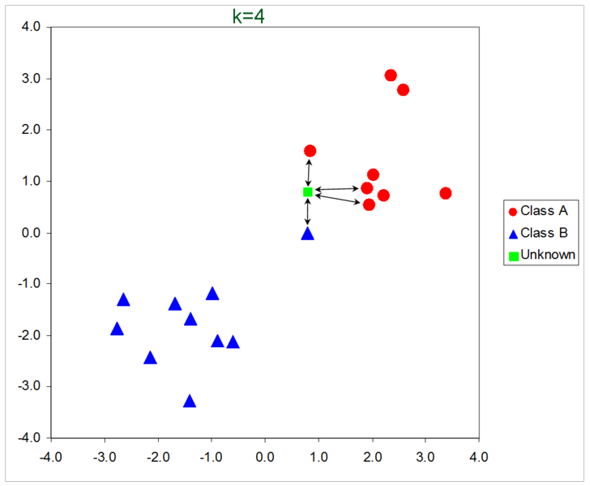

Slide 7
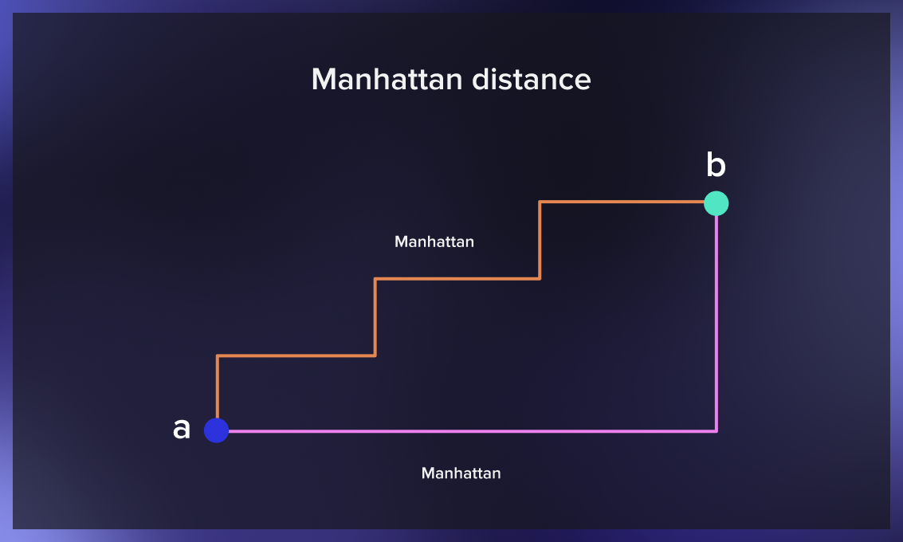
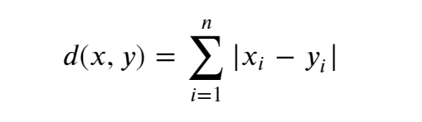
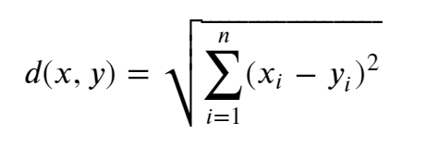
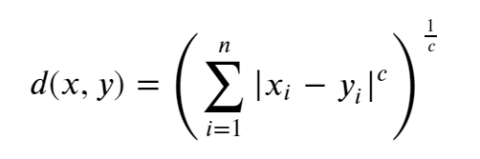
How do we know which point is closer? The "nearest neighbors" are defined in terms of the following distances. The choice of distance matters a lot and can change the prediction. There are major 3 ways to calculate distance: 1.Manhattan distance 2.Euclidean distance 3.Minkowski distance
Choice of Distance Metric to compute distance between records

Slide 8
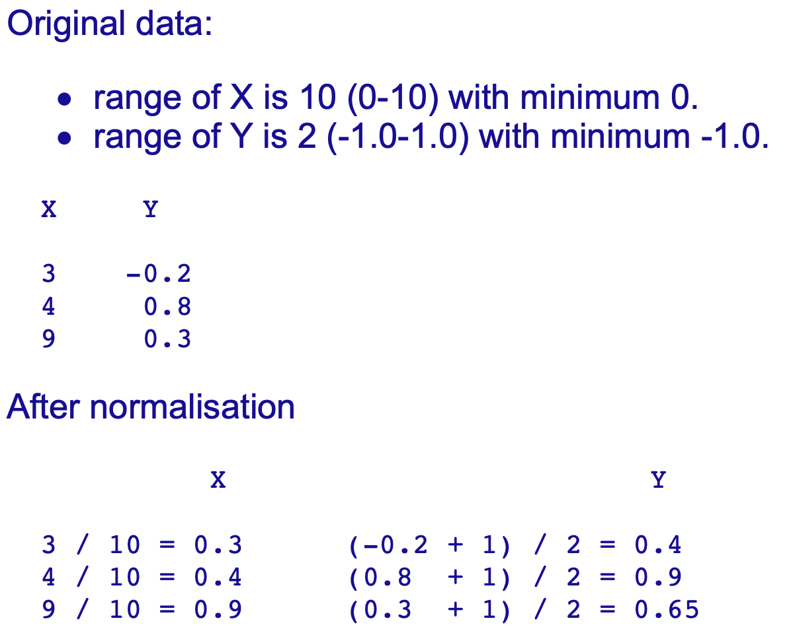
Normalization is a way of standardizing a set of numbers so each one is somewhere between 0.0 and 1.0. We take each number in turn and subtract from it the minimum observed value. We then divide by the observed range of values. The result is a number between 0.0 and 1.0.
NORMALIzation

Slide 9
For classification algorithms like KNN, we measure the distances between pairs of samples and these distances are influenced by the measurement units also. For example: Let’s say, we are applying KNN on a data set having 3 features.First feature ranging from 1-10, second from 1-20 and the last one ranging from 1-1000. In this case, most of the clusters will be generated based on the last feature as the difference between 1 to 10 and 1-20 are smaller as compared to 1-1000. To avoid this miss classification, we should normalize the feature variables.
IMPORTANCE OF normalIZATION

Slide 10
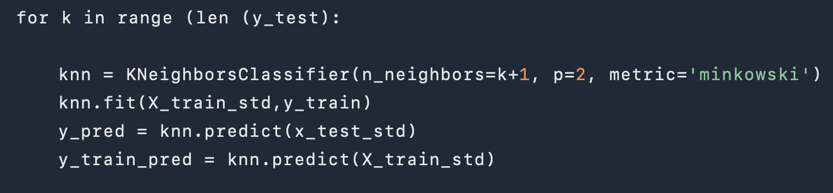
1. Load the data 2. Initialize K to your chosen number of neighbors 3. Calculate the distance between the query example and the current example from the data. Add the distance and the index of the example to an ordered collection 4. Sort the ordered collection of distances and indices from smallest to largest (in ascending order) by the distances 5. Pick the first K entries from the sorted collection 6. Get the labels of the selected K entries 7. If regression, return the mean of the K labels 8. If classification, return the mode of the K labels
Steps to follow:

Slide 11
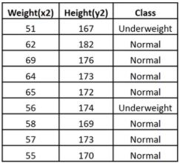

Consider an example
Now, we have a new data point (x1, y1), and we need to determine its class.

Slide 12

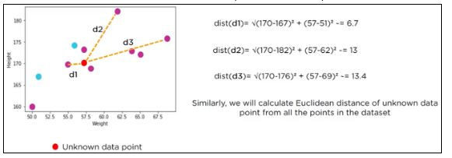
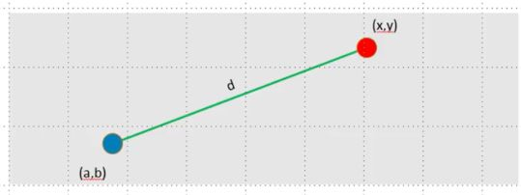
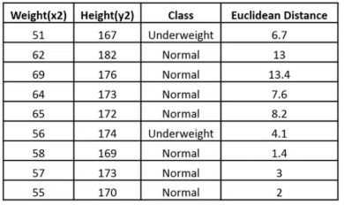
s.
The following table shows the calculated Euclidean distance of unknown data points from all point:

Slide 13
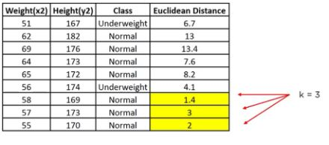
Since the majority of neighbors are classified as normal as per the KNN algorithm, the data point (57, 170) should be normal.

Slide 14
1. No Training Period: KNN is called Lazy Learner (Instance based learning). It does not learn anything in the training period. It does not derive any discriminative function from the training data. In other words, there is no training period for it. It stores the training dataset and learns from it only at the time of making real time predictions. This makes the KNN algorithm much faster than other algorithms that require training e.g. SVM, Linear Regression etc. 2. Since the KNN algorithm requires no training before making predictions, new data can be added seamlessly which will not impact the accuracy of the algorithm. 3. KNN is very easy to implement. There are only two parameters required to implement KNN i.e. the value of K and the distance function (e.g. Euclidean or Manhattan etc.)
Advantages of knn

Slide 15
1. Does not work well with large dataset: In large datasets, the cost of calculating the distance between the new point and each existing points is huge which degrades the performance of the algorithm. 2. Does not work well with high dimensions: The KNN algorithm doesn't work well with high dimensional data because with large number of dimensions, it becomes difficult for the algorithm to calculate the distance in each dimension. 3. Need feature scaling: We need to do feature scaling (standardization and normalization) before applying KNN algorithm to any dataset. If we don't do so, KNN may generate wrong predictions. 4. Sensitive to noisy data, missing values and outliers: KNN is sensitive to noise in the dataset. We need to manually impute missing values and remove outliers.
Disadvantages of knn

Slide 16
Although there are certain limitations, this algorithm is widely used in industries because of its simplicity. Some of these applications are: Email spam filtering: For detecting the trivial and fixed types of spam emails, KNN can perform well. Credit rating: The KNN algorithm helps determine an individual's credit rating by comparing them with the ones with similar characteristics. Loan approval: Similar to credit rating, the k-nearest neighbor algorithm is beneficial in identifying individuals who are more likely to default on loans by comparing their traits with similar individuals. Recommendation system: KNN is used to build recommendation engines that recommend some products/movies/songs to the users based on their likings or disliking.
USES OF KNN IN REAL WORLD

Slide 17
The kNN algorithm is popular, effective, and relatively easy to implement and interpret. It can efficiently solve classification and regression tasks for complicated multivariate cases. Despite the emergence of many advanced alternatives, it maintains its position among the best ML classifiers.
Takeaway

