Slide 1
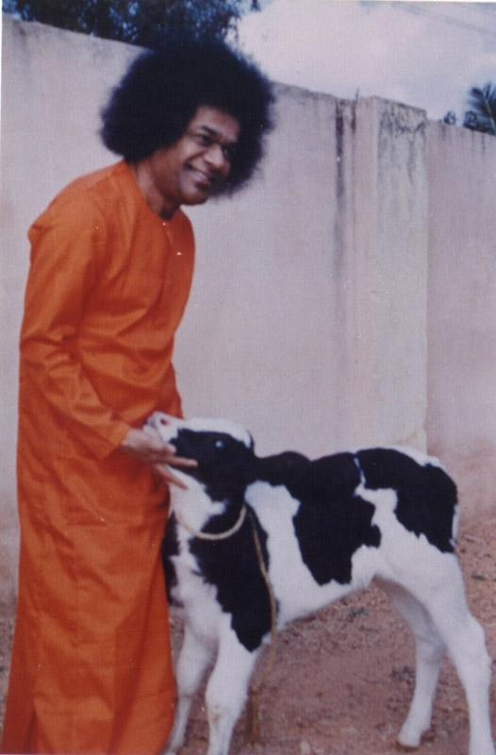

Deepest Salutations at His Divine Lotus Feet…

Slide 2
Agenda
Problem Statement
Methodology
Data Generation
Fraud Detection
PyNeFrauds
Conclusion

Slide 3
Problem Statement:
Detecting possible frauds in relevant domains using GANs and KG.

Slide 4









PM-JAY Domain Knowledge
Anti-Fraud Guidelines
Data
Domain Knowledge,
Fraud Detection Logic
Methods, Techniques & Tools
Rule Based & Model Based Fraud Detection
On PM-JAY data

Slide 5
Datasets
Sri Sathya Sai District Data
23312 rows.
30 features: Claim No, Card No, Patient No, Category, Diagnosis, Surgery/Therapy, Status, Procedure, Estimated Amount, Pre Authorization Estimated Amount, Date of Admit, etc.
Maharashtra Data
1539 rows.
13 features: Id, Status, Procedure, Estimated Amount, Pre Authorization Estimated Amount, Date of Admit, etc.

Slide 6


Methodology
Domain Knowledge Helps Detect Fraud
PM-JAY
Docs
CYPHER
Ontology
Previous Phase
KG
Helps to
Build
Helps Detect Fraud
Detect Fraud
Schema
Neo4j
Knowledge
Graph
Fraud
GNN Models
Detect Fraud
PM-JAY
Data
Processed Data
GAN generated Data
Process
GAN
Label Fraud Data

Slide 7
Data Generation

Slide 8
Why Data Generation?
Why GANs?
Data Augmentation: Less than 3% fraud data.
Data Privacy.
DL Models, Reduce Bias,etc.
High fidelity synthetic data.
Maintain statistical properties.
Learns complex, high dimensional data distribution.
They need not see the real data.

Slide 9
CTGANs
Why CTGANs?
Handles continuous and discrete columns.
Handles multimodal distributions.
Handles imbalanced categorical columns.

Slide 10
Generator
Generator Input
Synthetic Representative
Output
Linear 256
Batch Norm 256
ReLU
Linear 256
Batch Norm 256
ReLU
Linear 128
Batch Norm 128
ReLU
Linear 64
Batch Norm 64
ReLU
Residual
Residual
Residual
Residual
Hyperparameters
Batch Size: 516
Epochs: 5000
Discriminator Steps: 1
Loss: WGAN Loss
Adam Optimizer
Learning Rate: 0.002
Decay Rate: 1e-06

Slide 11
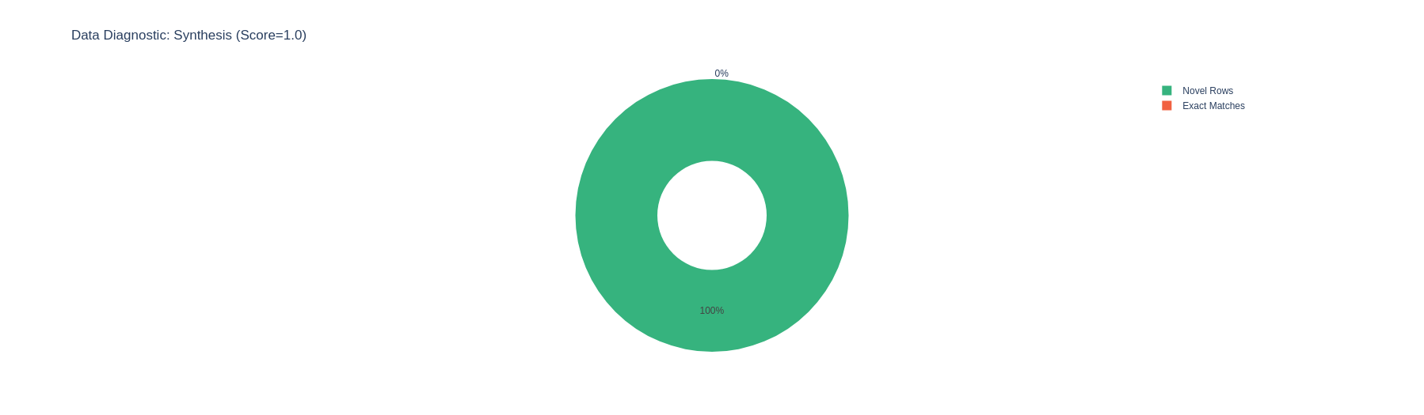
Synthetic Data Evaluation
100% Authentic Data.
Coverage Score: 91%
Column Shapes: 79.2%
[KSComplement & TVComplement]
Column Pair Trends: 67.49%
[Correlation Similarity & Contingency Similarity]
Notes:
KSComplement(Kolmogrov Smirnov Statistic)
TVComplement(Total Variation Distance).

Slide 12
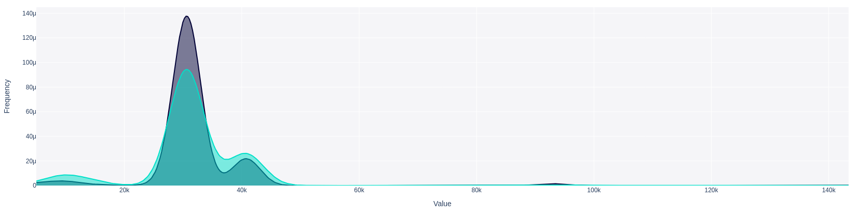
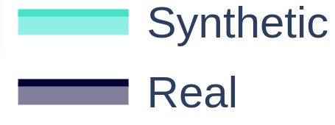
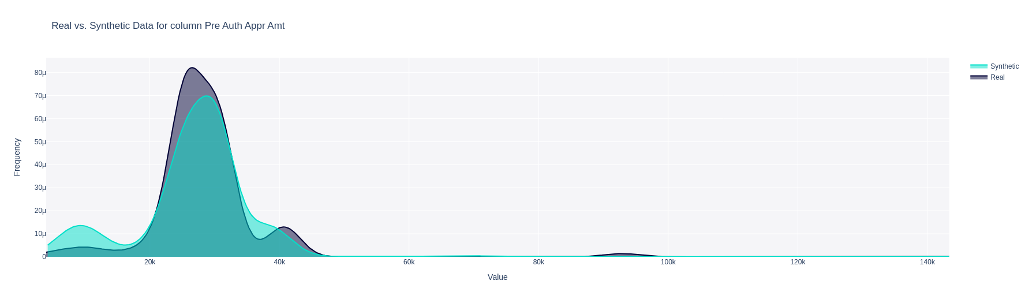
Continuous Features
Est Amt
Pre Auth Appr Amt
Notes:
KSComplement(Kolmogrov Smirnov Statistic)
TVComplement(Total Variation Distance).

Slide 13
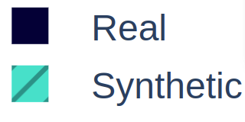
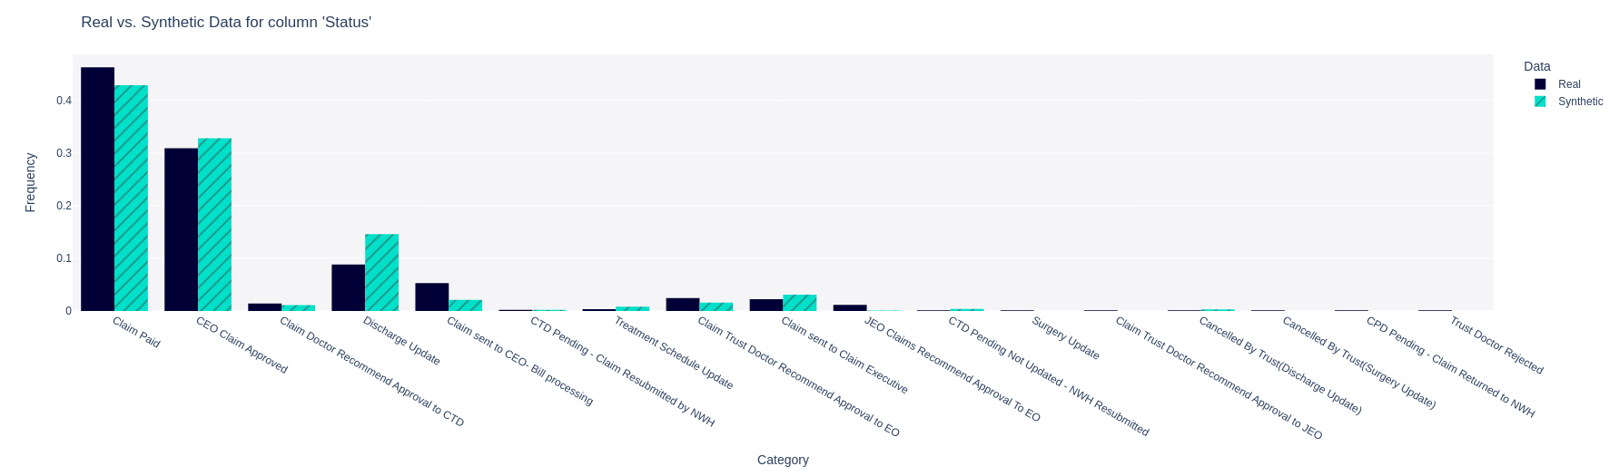
Discrete Features
Status
Notes:
KSComplement(Kolmogrov Smirnov Statistic)
TVComplement(Total Variation Distance).

Slide 14
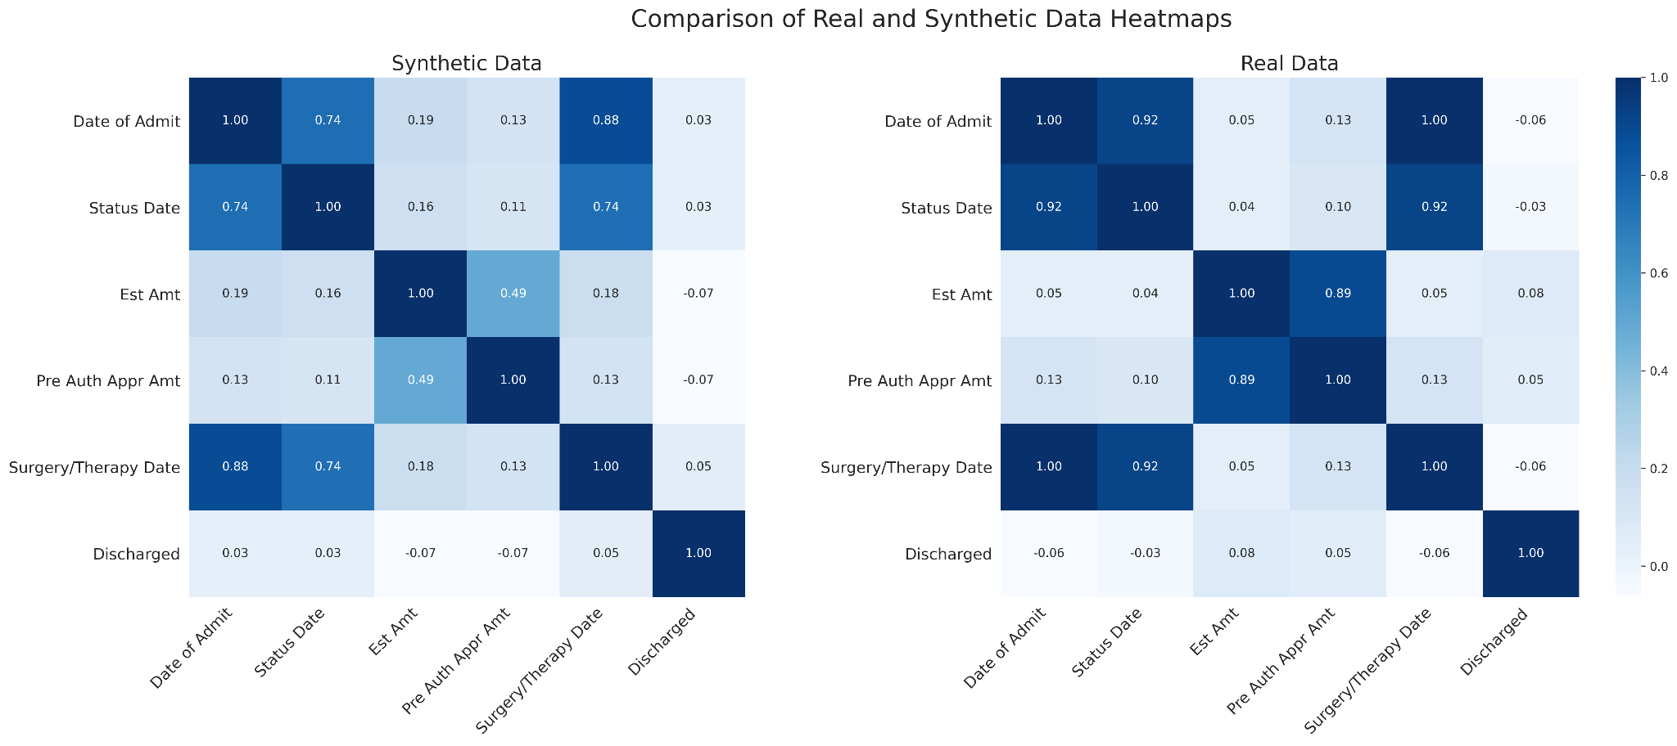
Column Pair Trend Comparison
Notes:
KSComplement(Kolmogrov Smirnov Statistic)
TVComplement(Total Variation Distance).

Slide 15
Fraud Detection

Slide 16











Preparing Data
Preprocessing
[Tabular Data]
CYPHER
Raw-Data
Guidelines
Preprocessing
[Graph Data]

Slide 17
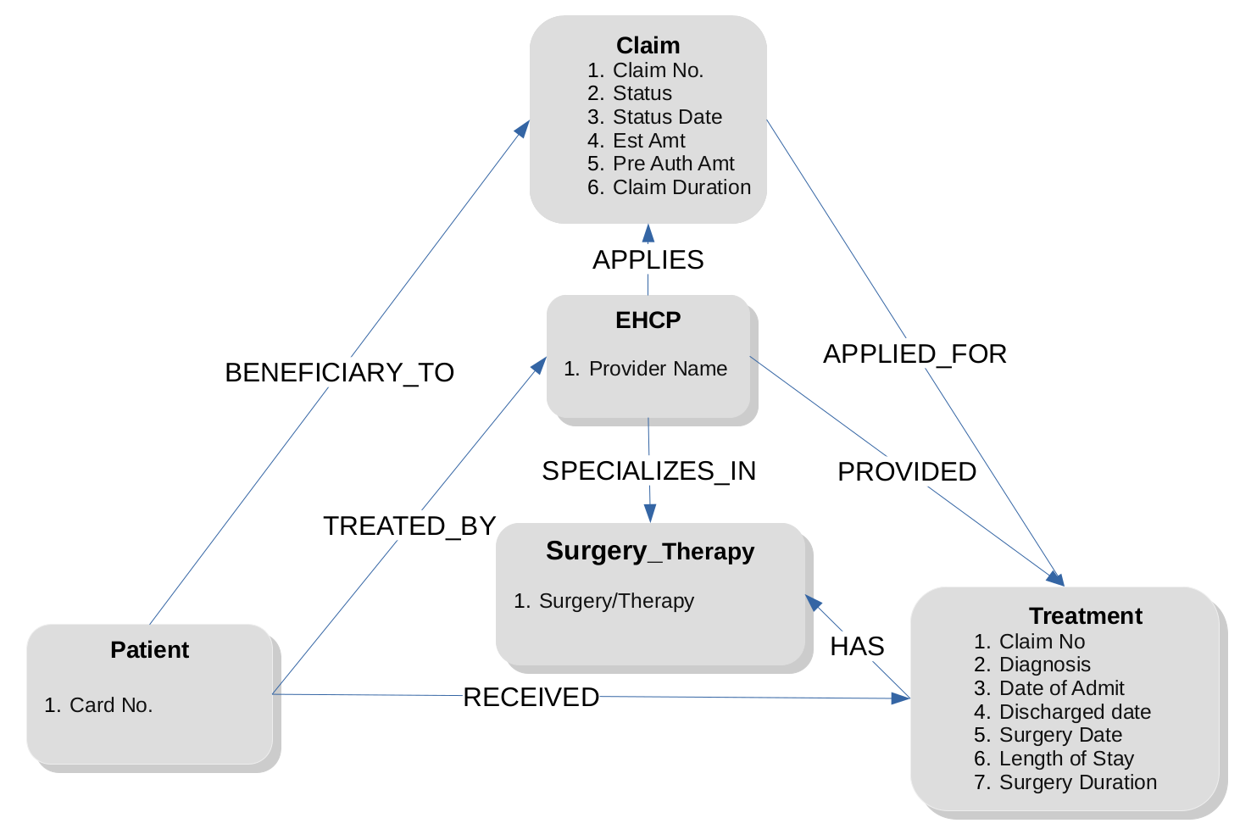
Graph Schema

Slide 18
Expert-System Framework
Rule-Based System
Model-Based System
Convert Data
Build Model
Domain Knowledge
CYPHER
Train
Evaluate
Graph Algorithms

Slide 19
Rule Based - CYPHER Queries
Anti-Fraud Guidelines
Anomaly Detection
Embeddings
Centrality
Community Detection
Clustering Algorithms
Estimated Amount for Packages
Procedures Time Limit
Dates Chronology
…
CYPHER

Slide 20
Model Based - GNN
Why GNN(Graph Neural Network?
Non-euclidean graph data
Captures network structure
Relationships are retained

Slide 21
GNN Classifier Architecture
Embedding
GCNConv(7,30)
Prediction
DropOut(0.5)
ReLU
GCNConv(30,40)
ReLU
Linear(40,512)
ReLU
DropOut(0.5)
Linear(512,2)
Softmax
Hyperparameters
Epochs: 601
Loss: Cross-Entropy loss
Optimizer: Adam(lr=0.001)

Slide 22
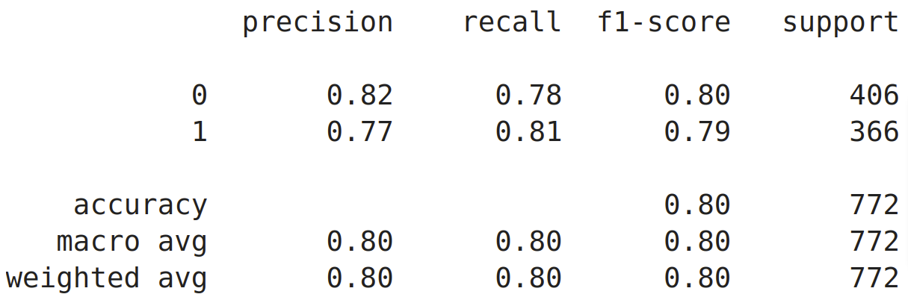
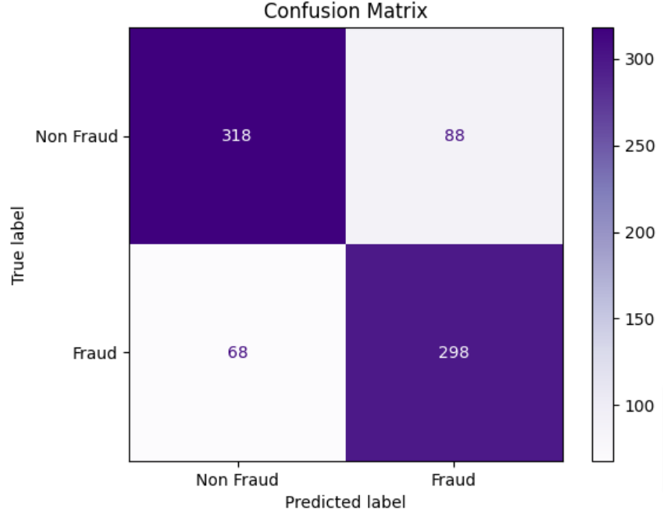
GNN Classifier Performance

Slide 23
Automation - PyNeFrauds

Slide 24
PyNeFrauds
Open source, functional python library
Fraud detection
Integrates neo4j and pytorch
Automates many parts of process
Github: https://github.com/Deepam-Rai/PyNeFrauds
Available in PyPI

Slide 25
Library Modules
User
nn
EmbedFetcher
QueryConstructor
PyGDataWrapper
Neo4jHandler
NNModel
train
Globals
ConfusionMatrix

Slide 26
Conclusion

Slide 27
Conclusion
Value of synthetic data generation.
CTGAN is capable of high fidelity synthetic data generation for PM-JAY.
Though unscalable rule-based fraud detection methods are indispensable.
Necessity of manual intervention.
GNNs are very much usable for PM-JAY.
Many parts of fraud detection can be automated.
Attempt to fill gap in tools specializing in fraud detection using neo4j and torch.

Slide 28
Future Scope
Increase the data(guideline docs and tabular data) and cover more scenarios.
Consequently, build better deep learning models.
Leveraging the potential of graph algorithms.
Addition of modules in PyNeFrauds.
Confirming PyNeFrauds to PEP convention.
Holy Grail: Totally Automated Fraud Detection.

Slide 29
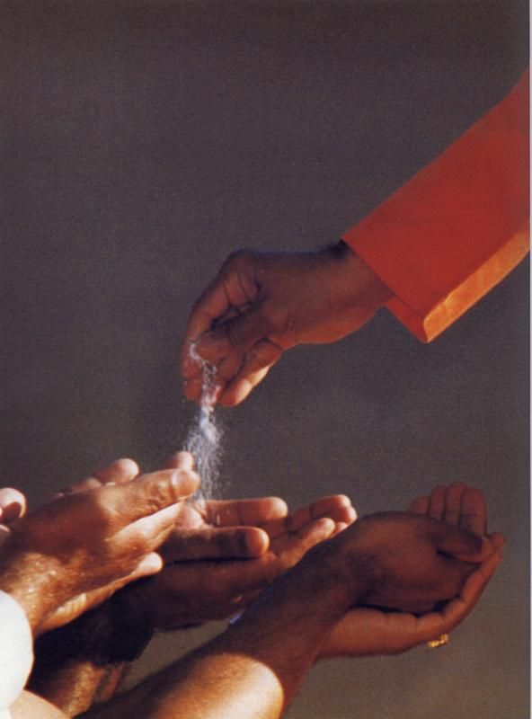
We are very much thankful to
To Swami we are ever grateful..
Our Mentor Sir P. Sunil Kumar
for guiding us and providing us with the required resources.
Brother Anil Kumar Reddy
for guiding us through the landscape of tools and techniques and helping us in every step.
Sri Sathya Sai Mudigonda
for providing us with the indispensable dataset.
Sri P. V. S.S. Prakash
providing us with extensive workshop on Deep Learning.

Slide 30
Thank You
Sairam

