Slide 1

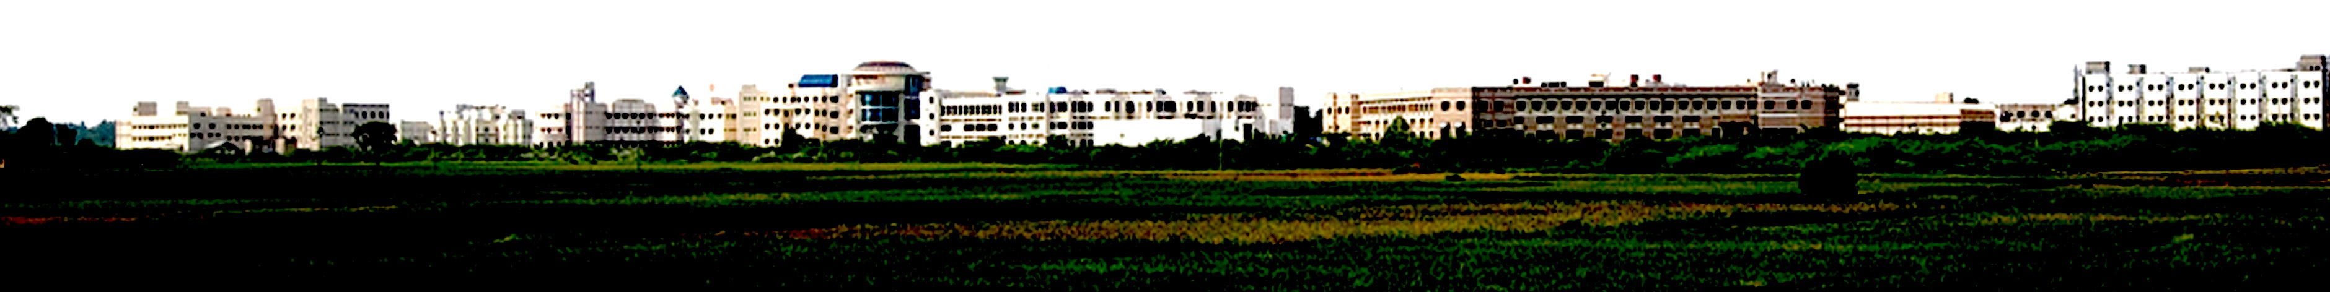
Hardware Implementation of Lossless Image Compression
Presented by
Abhishek S R
Deepan Raj K
Vidhya Vinayaga K G
Department of ECE
School of EEE
Supervised by
Dr.J Siva
School of EEE
SASTRA
Final Review

Slide 2
Abstract
Lossless image compression is essential in embedded imaging systems where exact pixel reconstruction and efficient storage are required. This work presents a hardware implementation of a low-complexity compression algorithm on the Xilinx Zynq-7000 SoC (PYNQ-Z1). The design uses a MED predictor for spatial prediction and an adaptive Golomb-Rice encoder with escape coding for efficient compression. Key components such as a BRAM-based line buffer, bit-packer, and AXI interface are integrated into a streaming architecture. The system is tested on 12 grayscale images and achieves compression ratios from 1.14 to 3.99 with bits-per-pixel between 2.001 and 6.998. Results show efficient resource utilization and linear processing time, making the design suitable for real-time embedded imaging applications.

Slide 3

Objective
To design and implement the lossless image compression algorithm as a synthesizable Verilog RTL architecture.
To reduce computational complexity through the MED predictor and adaptive Rice Golomb entropy coder.
To integrate the design as an AXI4 and package it using Xilinx Vivado IP Packager.
To validate functional correctness using simulation and hardware verification on the PYNQ-Z1 platform.
To evaluate compression performance (BPP, CR) on a standard benchmark dataset and compare with the software LOCO-I baseline.
To analyze FPGA resource utilization and power consumption post-implementation.

Slide 4
Time Line
Weeks 1–2: Foundation & Modeling
Finalize algorithm details and precisely define the predictor and residual models.
Weeks 3–4: Encoder RTL Design
Develop Register-Transfer Level (RTL) architecture for the Line Buffer, Predictor, and Entropy Encoder.
Weeks 5–6: Decoder RTL & Integration
Design the decoder RTL and integrate it with the encoder module.
Weeks 7–8: Simulation & Verification
Simulation of Encoder is verified Successfully
Weeks 9–10: FPGA Implementation & Optimization
Perform FPGA synthesis, detailed timing analysis, and implement critical optimizations with GUI.
Week 11: Evaluation & Documentation
Final performance evaluation, comprehensive testing, and completion of all project documentation.

Slide 5
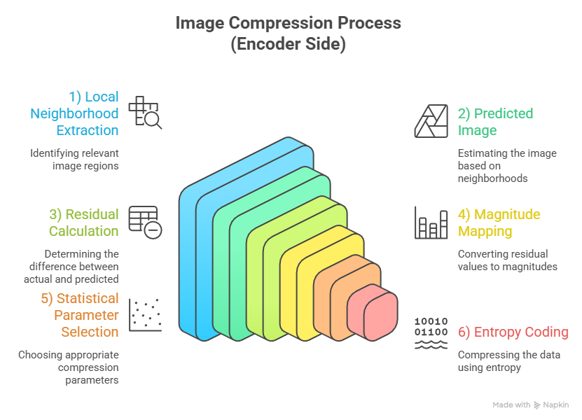
Working Process

Slide 6
Escape coding
Escape coding is used to handle residual values that cannot be efficiently represented using standard Golomb–Rice encoding. In predictive compression, most residual values are small, but occasionally large errors can occur due to sharp edges or sudden changes in intensity in the image.
When such large residual values appear, encoding them with Golomb–Rice coding can produce very long unary codes. This increases the bitstream size and reduces compression efficiency.
To solve this problem, an escape unit detects these large residual values and activates escape mode. Instead of Golomb Rice coding, the residual value is transmitted using a fixed length representation.
This mechanism prevents inefficient encoding and ensures that all residual values can be encoded reliably while maintaining stable compression performance and simple decoding.

Slide 7
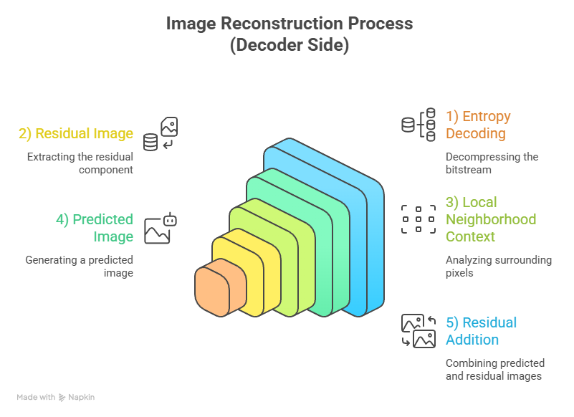

Slide 8
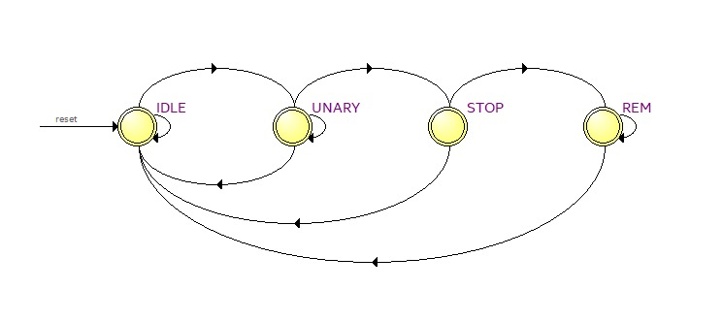
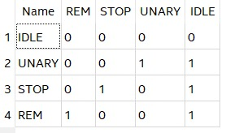
Rice Encoder FSM

Slide 9
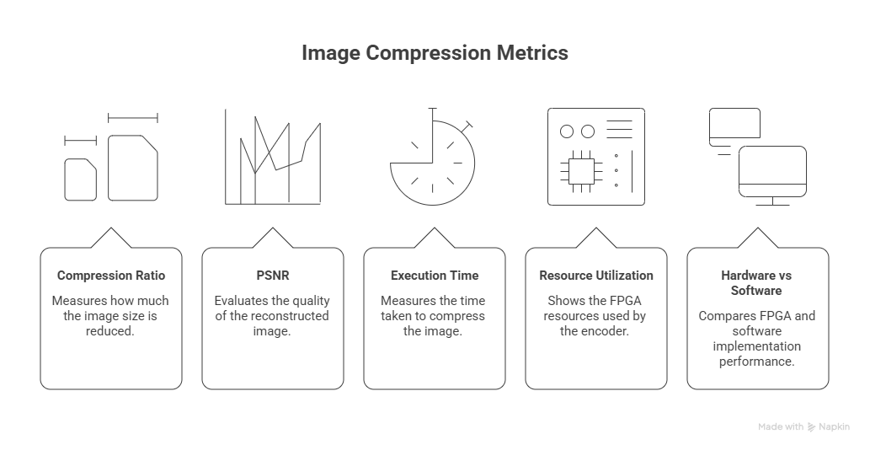
Performance Metrics

Slide 10
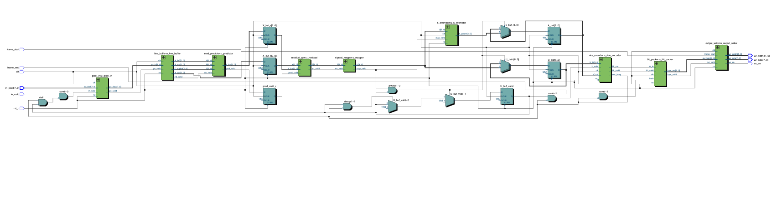
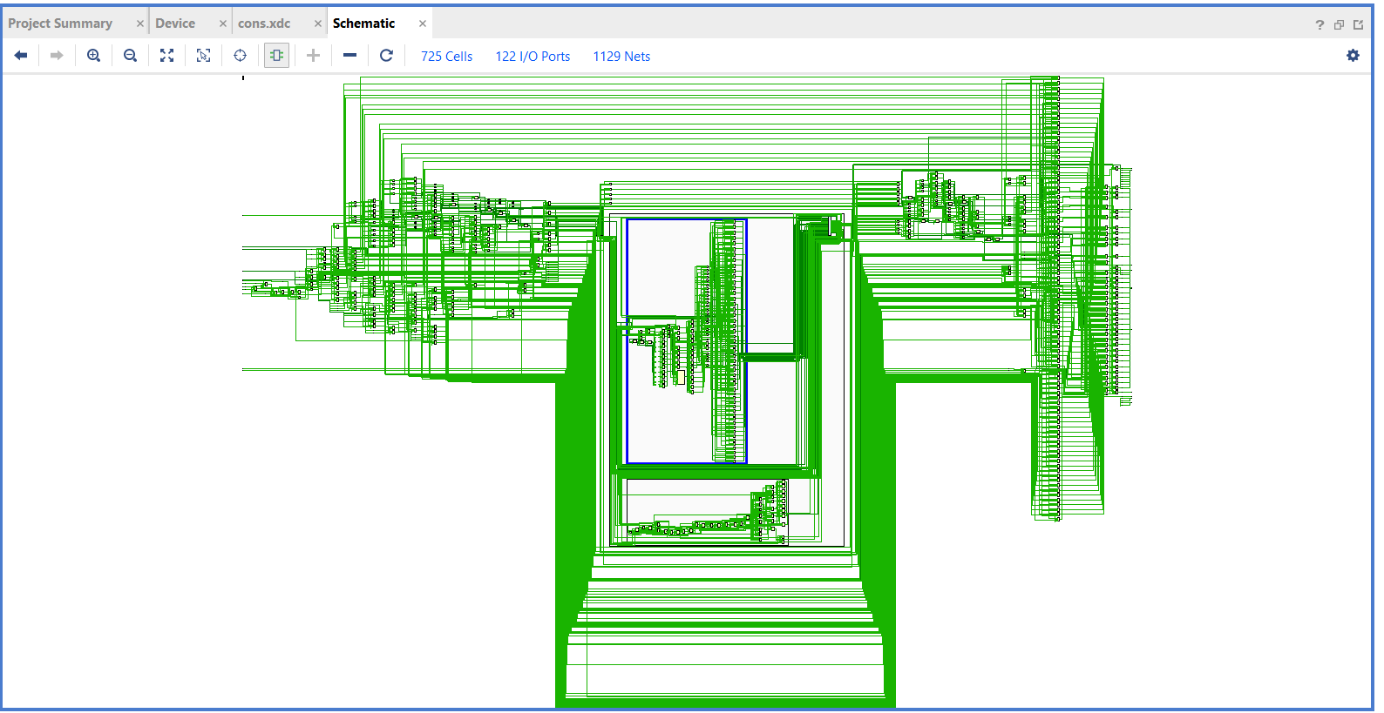
RTL Netlist Synthesis
In Quartus Prime:
In Vivado:

Slide 11
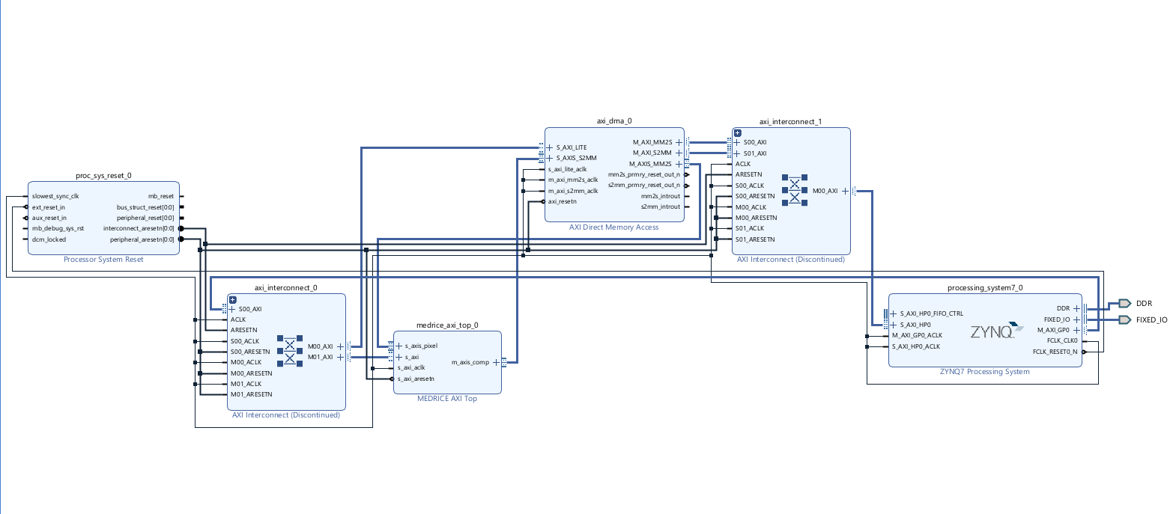
Hardware – Software Codesign Diagram

Slide 12
Obtained parameters
For 12 test images:
Rank | Image | Resolution | Pixels | Original Bits | Compressed Bits | Compressed Bytes | CR | BPP | Time (ns)
1 | img25 | 512×512 | 2,62,144 | 20,97,152 | 5,24,596 | 65,575 | 3.9977 | 2.001 | 18,353,815
2 | img2 | 3072×4080 | 1,25,33,760 | 10,02,70,080 | 3,15,36,838 | 39,42,105 | 3.1795 | 2.516 | 9,42,056,545
3 | img20 | 512×512 | 2,62,144 | 20,97,152 | 7,56,664 | 94,583 | 2.7716 | 2.886 | 2,06,74,435
4 | img5 | 256×256 | 65,536 | 5,24,288 | 2,20,531 | 27,567 | 2.3774 | 3.365 | 54,82,775
5 | img1 | 3072×4080 | 1,25,33,760 | 10,02,70,080 | 4,79,42,123 | 59,92,765 | 2.0915 | 3.825 | 1,10,61,09,355
6 | img3 | 256×256 | 65,536 | 5,24,288 | 3,40,209 | 42,526 | 1.5411 | 5.191 | 66,79,475
7 | img4 | 256×256 | 65,536 | 5,24,288 | 3,51,984 | 43,998 | 1.4895 | 5.371 | 67,97,215
8 | img13 | 512×512 | 2,62,144 | 20,97,152 | 14,78,912 | 1,84,864 | 1.418 | 5.642 | 2,78,96,925
9 | img8 | 512×512 | 2,62,144 | 20,97,152 | 17,61,688 | 2,20,211 | 1.1904 | 6.72 | 3,07,24,705
10 | img7 | 512×512 | 2,62,144 | 20,97,152 | 17,83,024 | 2,22,878 | 1.1762 | 6.802 | 3,09,38,015
11 | img16 | 512×512 | 2,62,144 | 20,97,152 | 18,31,744 | 2,28,968 | 1.1449 | 6.988 | 3,14,25,245
12 | img12 | 512×512 | 2,62,144 | 20,97,152 | 18,34,344 | 2,29,293 | 1.1433 | 6.998 | 3,14,51,245

Slide 13
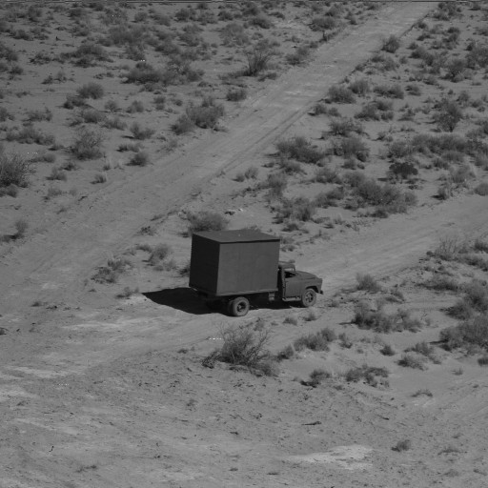
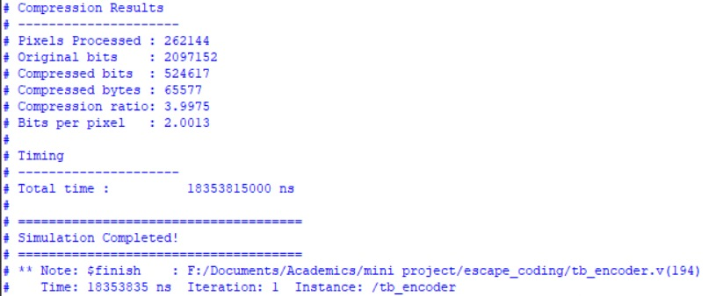
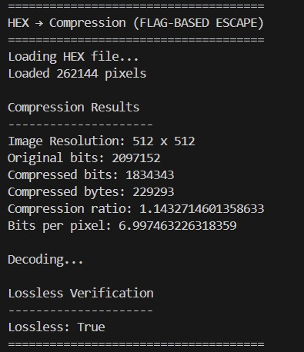
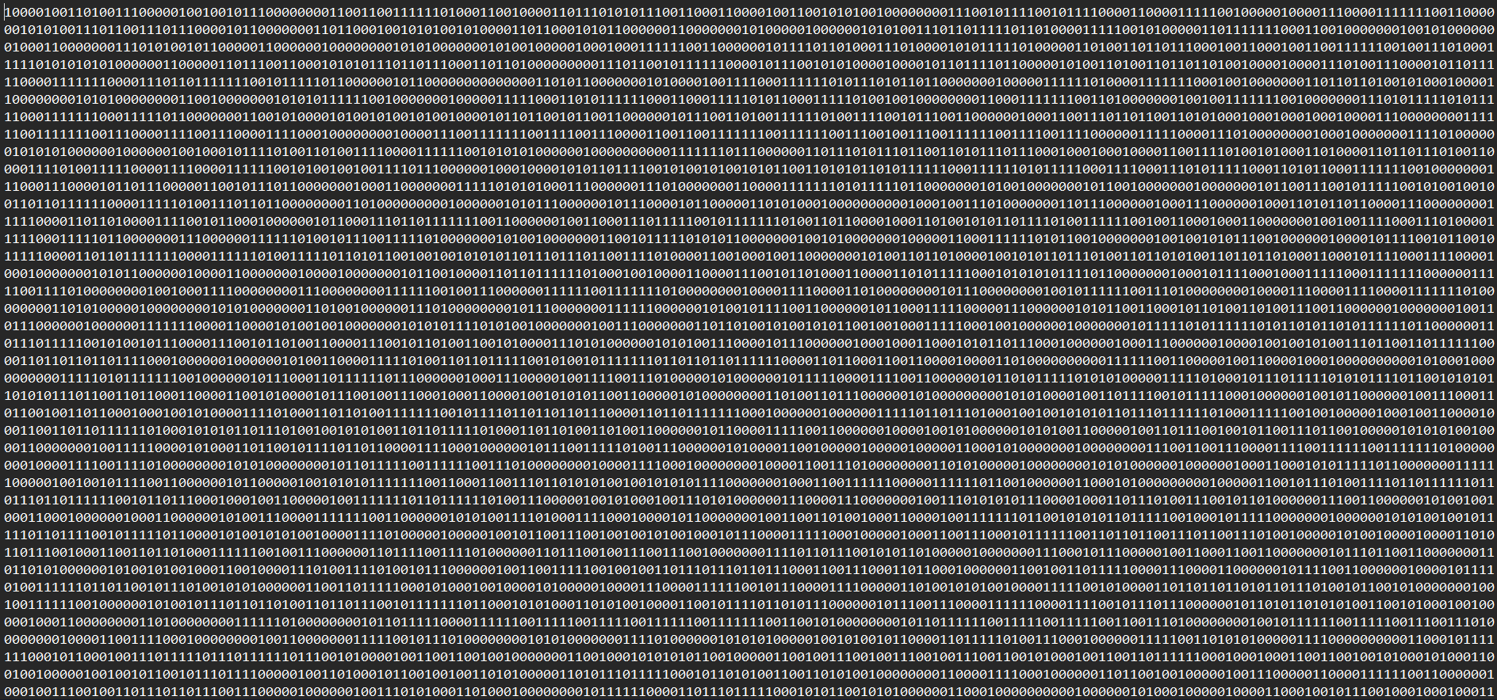
Testbench Results
Img12 (Worst case)
RTL Testbench (Modelsim)
Compressed binary file (.bin)
Software Testbench (Python)

Slide 14

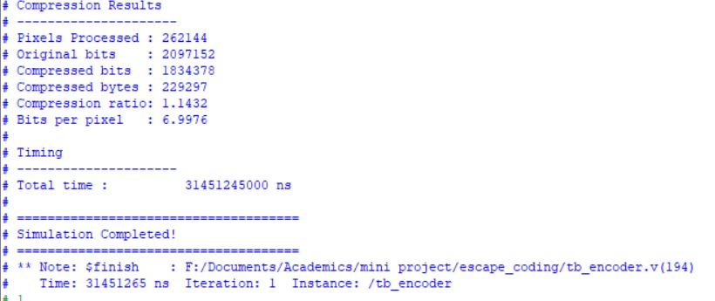
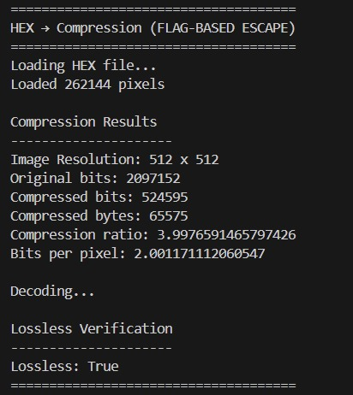

Testbench Results
Img25 (Best case)
RTL Testbench (Modelsim)
Compressed binary file (.bin)
Software Testbench (Python)

Slide 15
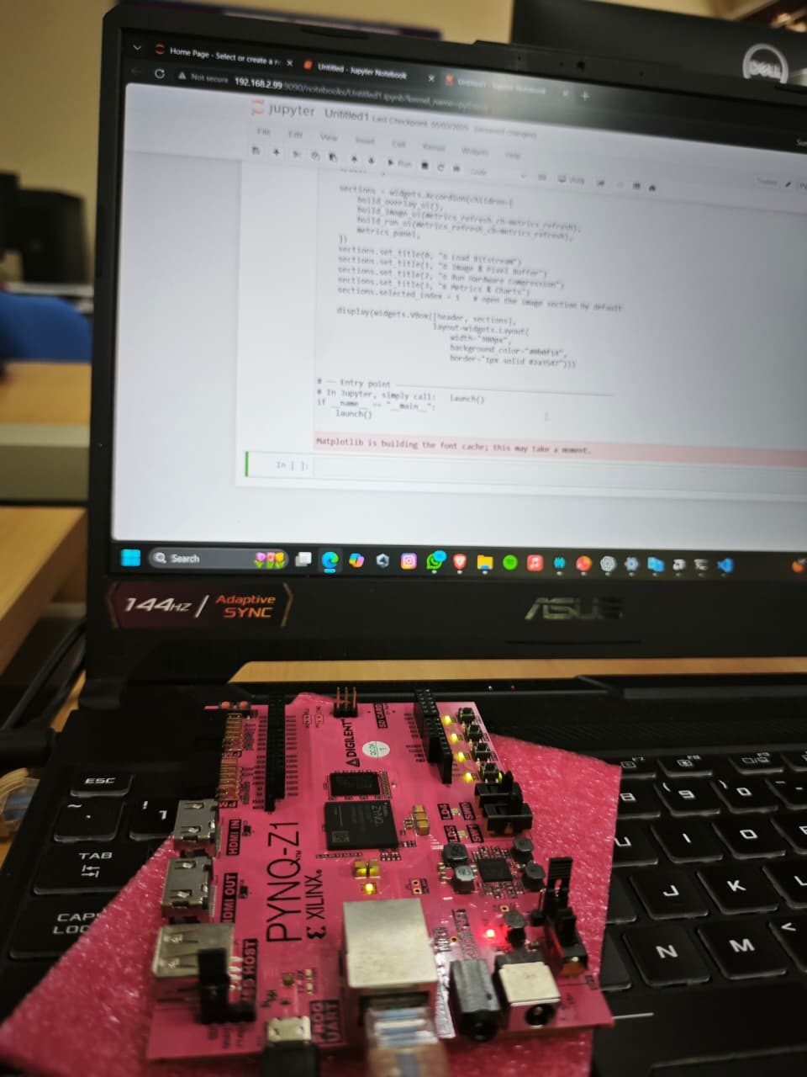

PYNQ Setup and GUI

Slide 16
FPGA implementation
Resource Utilization:
Resource | Used | Available | Utilization (%)
LUT | 374 | 53,200 | 0.70
FF | 353 | 1,06,400 | 0.33
BRAM (36K) | 1 | 140 | 0.71
DSP48 | 0 | 220 | 0
IO | 106 | 125 | 84.80
Power Consumption:
Parameter | Value
Total On-Chip Power | 0.0118 W
Power Supplied to off -chip devices | 0 W
Junction Temperature | 25.0 ℃
Thermal Margin | 58.6℃

Slide 17
Comparison with other works
Work | Algorithm | Platform | Avg. BPP | Year
[1] | JPEG-LS | ASIC.18 µm | 6.7 | 2001
[2] | Context-based | Virtex-4 FPGA | 5.2 | 2007
[3] | LOCO-I | Zynq-7000 | 6.4 | 2019
This work | MEDRICE | Zynq-7000 (PYNQ-Z1) | 4.74 (avg) | 2025

Slide 18
References
[1] M. Abramowitz and C. Morimoto, "An ASIC implementation of the JPEG-LS lossless image compression standard," in Proc. IEEE International Symposium on Circuits and Systems (ISCAS), 2001.
[2] X. Wu and N. Memon, "Context-based, adaptive, lossless image coding," IEEE Transactions on Communications, vol. 45, no. 4, pp. 437–444, Apr. 1997.
[3] A. Kumar and R. Sharma, "FPGA implementation of LOCO-I lossless image compression on Xilinx Zynq-7000," in Proc. International Conference on Signal Processing and Communication (ICSC), 2019.

Slide 19
THANK YOU !

