Slide 1



Assignment_2
View in Power BI
Last data refresh:
6/20/2022 6:08:06 PM UTC
Downloaded at:
6/20/2022 6:08:59 PM UTC

Slide 2
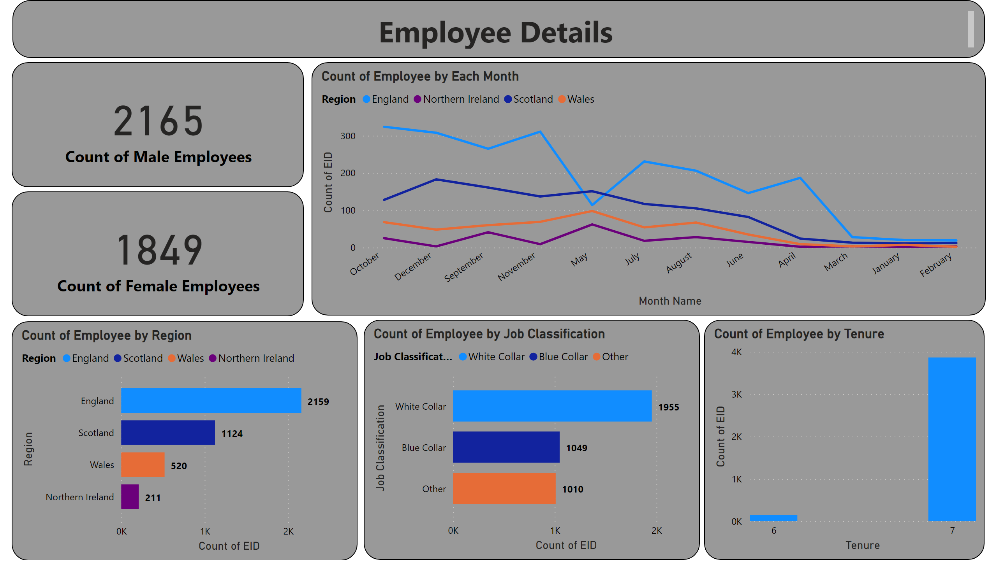
Page 1
Notes:
card
No alt text provided
textbox
No alt text provided
card
No alt text provided
Count of Employee by Region
No alt text provided
Count of Employee by Job Classification
No alt text provided
Count of Employee by Tenure
No alt text provided
Count of Employee by Each Month
No alt text provided

