Slide 1



Assignment_1
View in Power BI
Last data refresh:
6/19/2022 10:49:56 AM UTC
Downloaded at:
6/19/2022 10:51:38 AM UTC

Slide 2
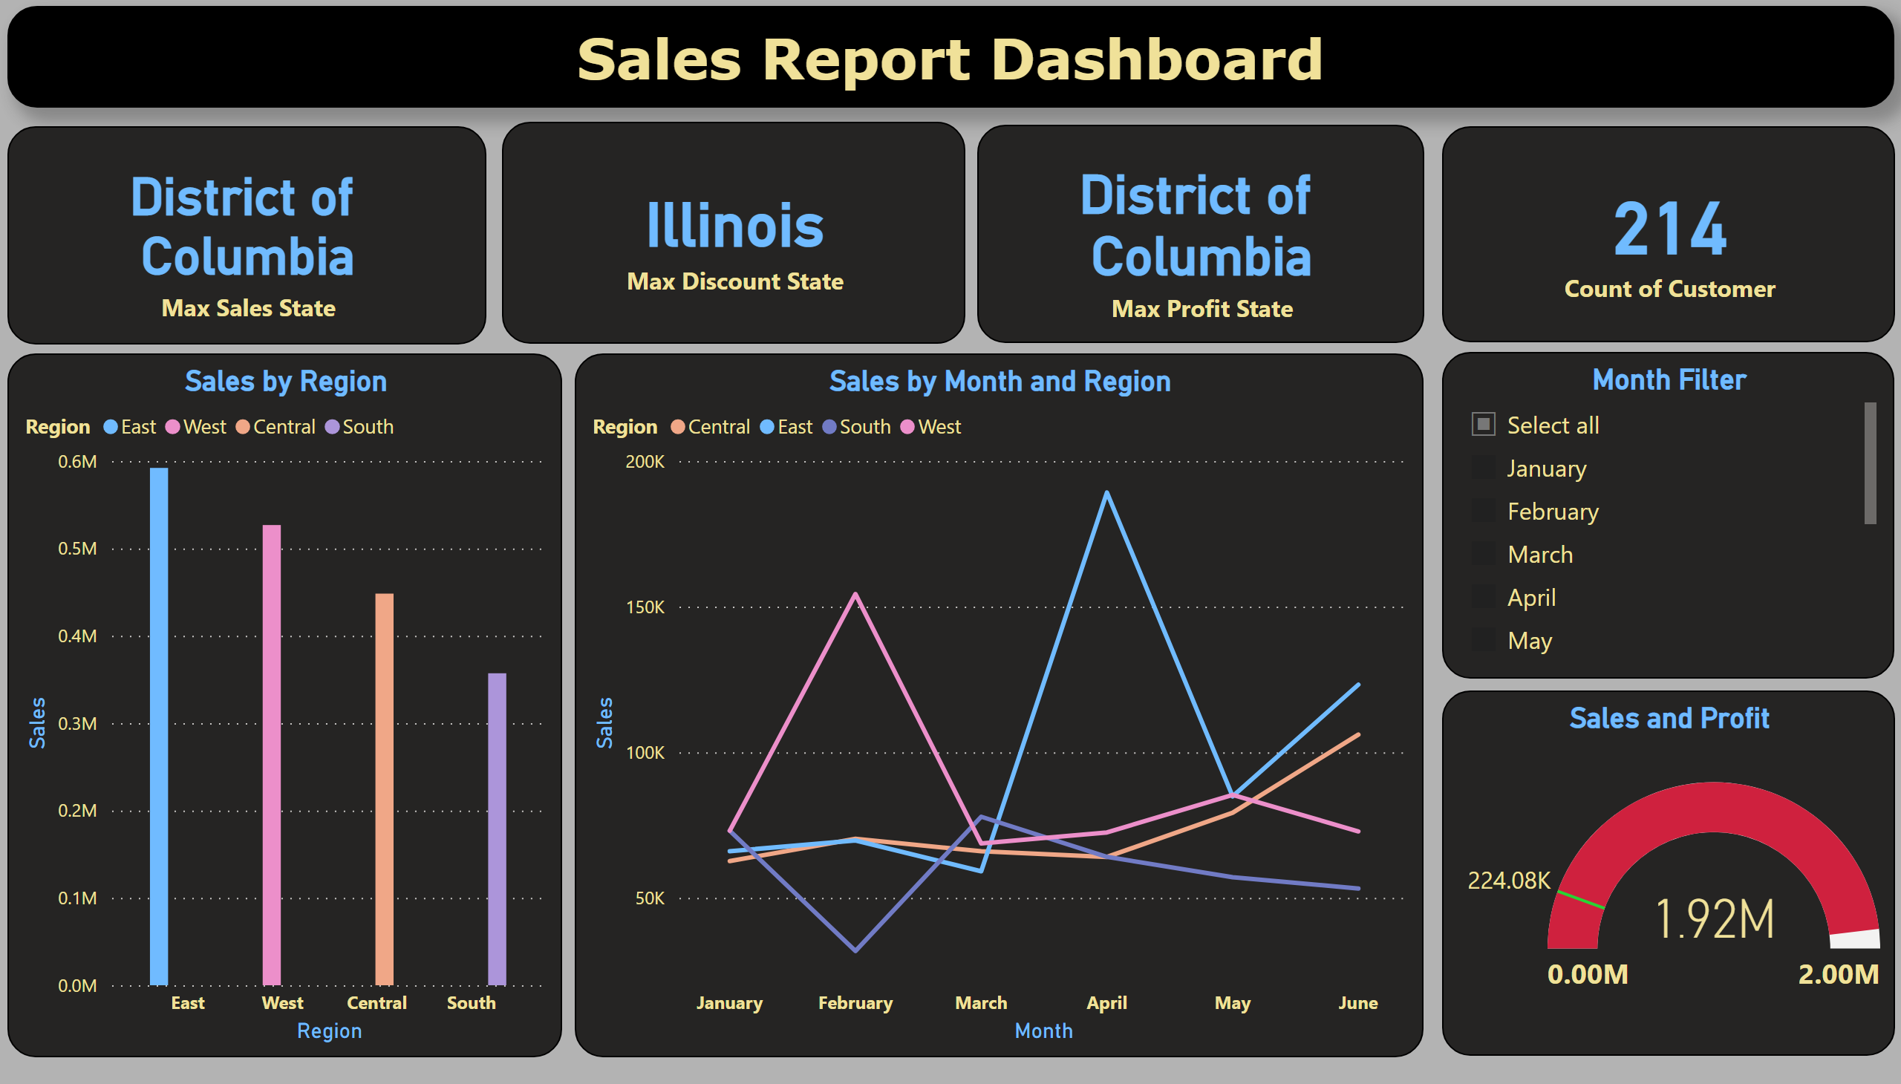
Page 1
Notes:
textbox
No alt text provided
card
No alt text provided
card
No alt text provided
card
No alt text provided
card
No alt text provided
Sales by Region
No alt text provided
Sales by Month and Region
No alt text provided
Month Filter
No alt text provided
gauge
No alt text provided

