Slide 1



Assignment_4
View in Power BI
Last data refresh:
6/22/2022 6:23:02 PM UTC
Downloaded at:
6/22/2022 6:25:00 PM UTC

Slide 2
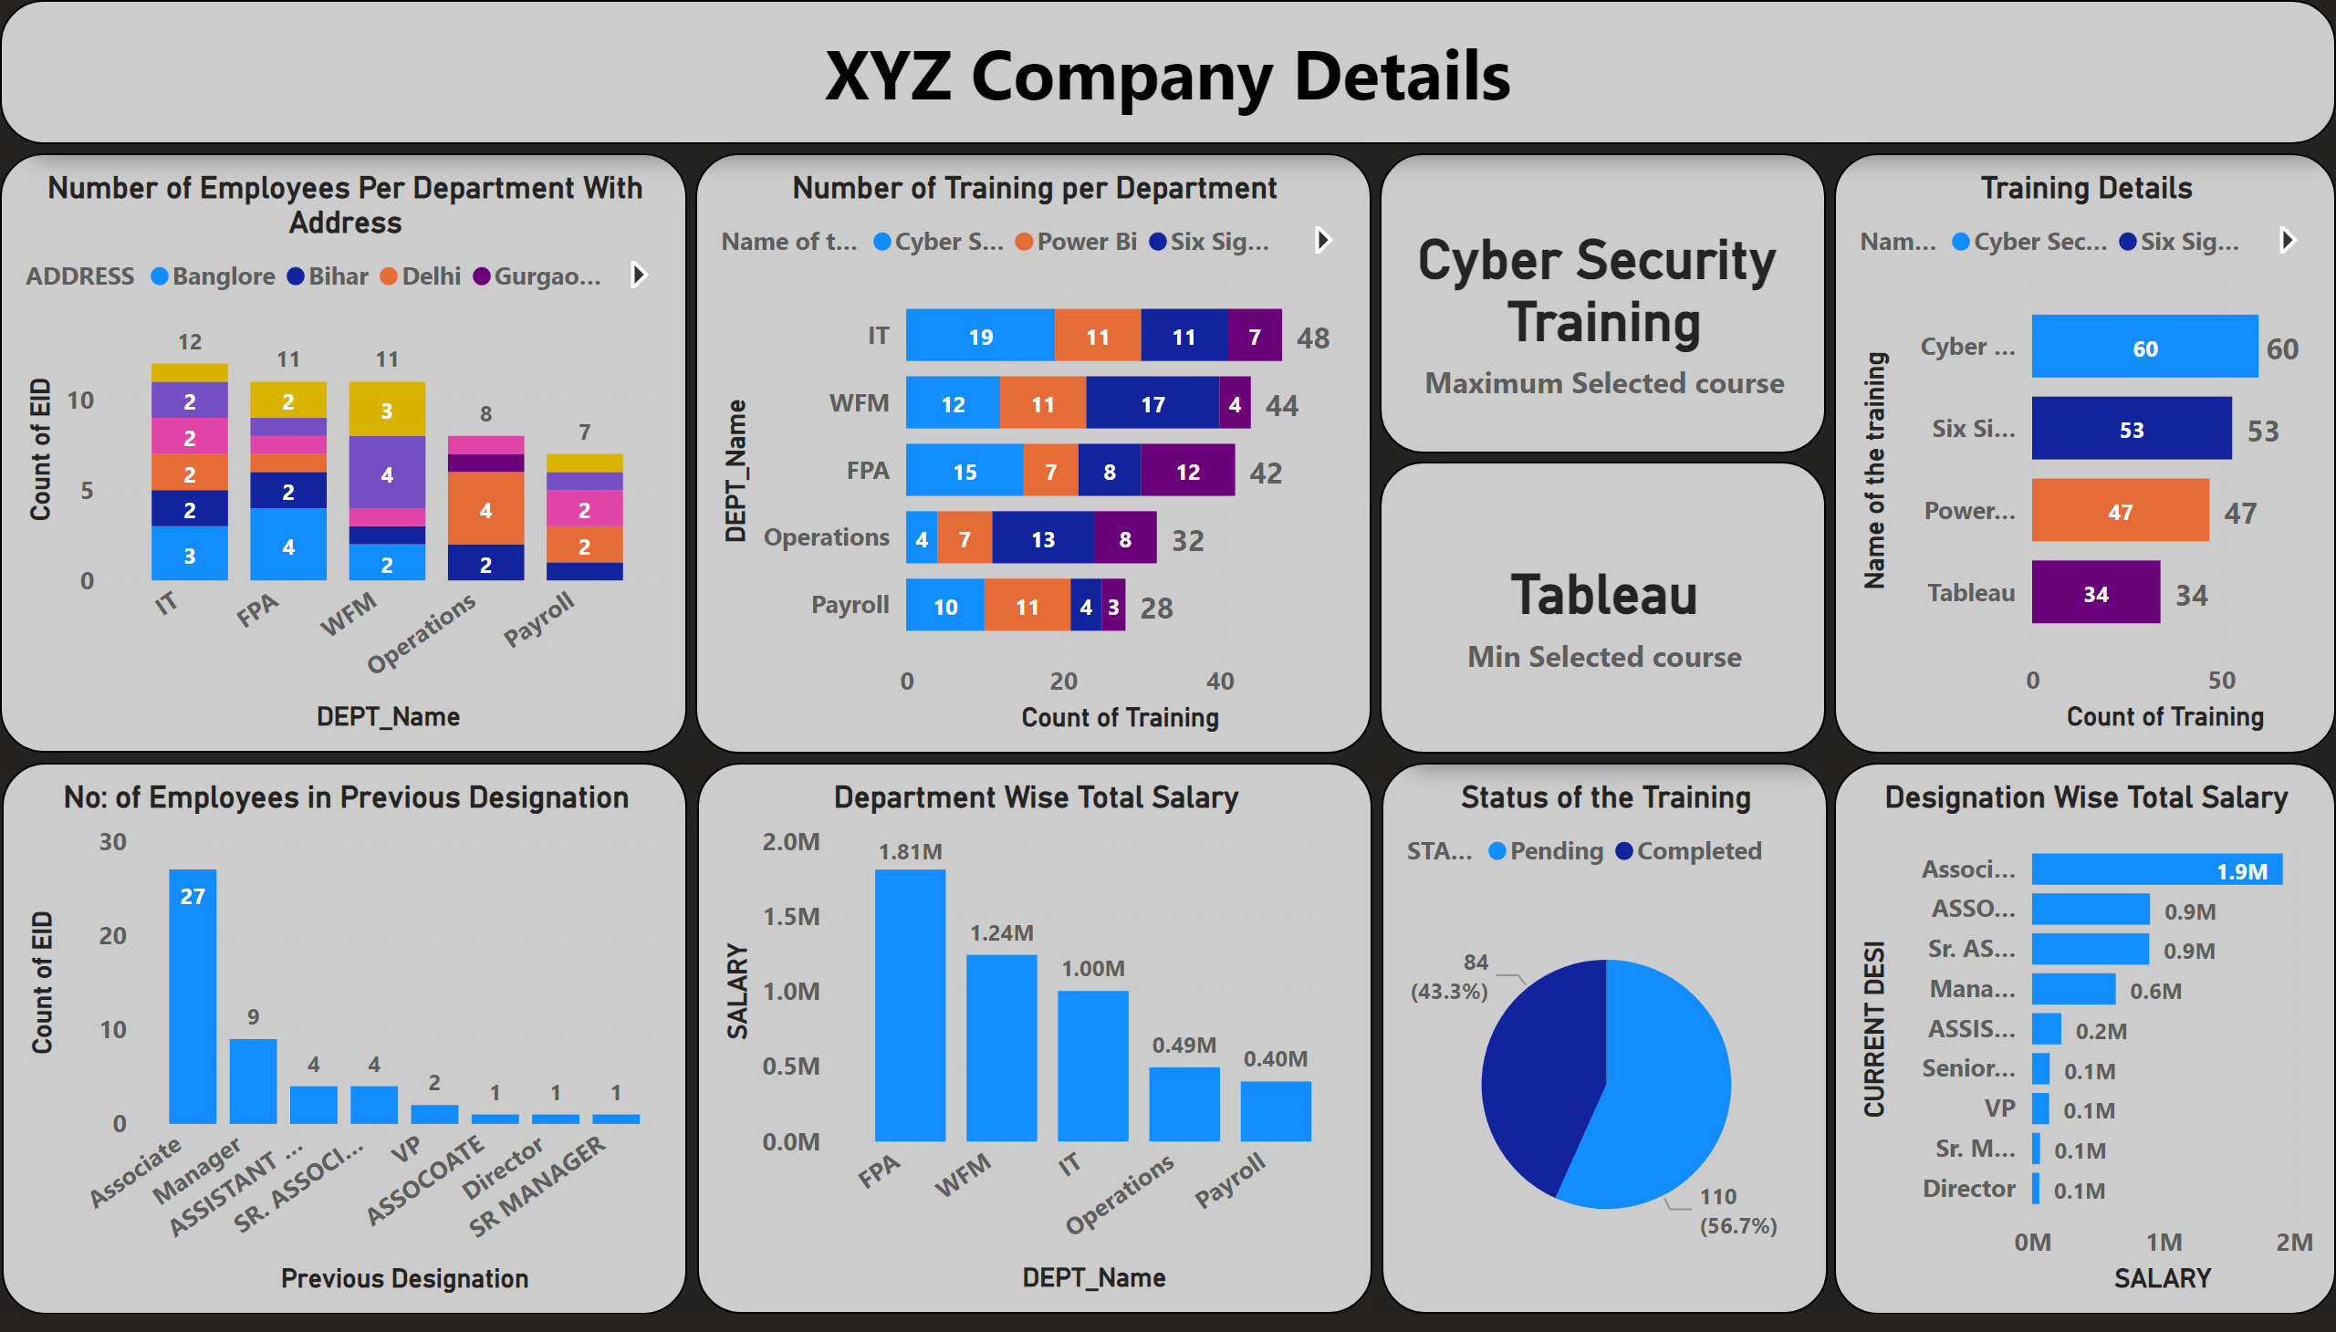
Page 1
Notes:
Number of Employees Per Department With Address
No alt text provided
Number of Training per Department
No alt text provided
Status of the Training
No alt text provided
card
No alt text provided
card
No alt text provided
Training Details
No alt text provided
No: of Employees in Previous Designation
No alt text provided
Department Wise Total Salary
No alt text provided
Designation Wise Total Salary
No alt text provided
textbox
No alt text provided

