Slide 1
Prisoner’s Dilemma in Sodtware Testing
1

Slide 2
Introduction :
Software Testing is used to find errors so that they can be repaired and hopefully, the software quality improved.
Here we will be considering software quality as an economic issue and will be applying rational methods
The problem of Software testing is modeled as a formal strategic game.

Slide 3
Software Testing
Software Testing is used in serious attempts to improve the situation by detecting errors as soon as possible.
There is an opposition of interests between the tester and the implementor.
The goal of the tester is to find errors, whereas an implementor likes his program to be shown correct (as he often believes it is)

Slide 4
Prisoner’s Dilemma
Types of Games
Zero Sum Games
Non-zero Sum Games
Sum of payoffs to all players equals zero.
Players have a conflict of interests such that their interests are completely opposite.
eg. Game of chess
There is a conflict of interest, but the opposition is not complete.
To a certain extent, the players can have shared interests, but their interests are not completely.
eg. Software Testing

Slide 5
An idealised Testing Game
The motivation for this game is as follows
The implementor is rewarded if he delivers an error-free software.
The tester is rewarded if he performs a thorough testing job
p means ‘poor’(bad) and q means ‘quality’ (good)

Slide 6
An idealised Testing Game
So
The implementor chooses between doing a poor job and doing a high quality job, delivering error-free software.
The tester chooses between doing a poor job, performing a test with low error detection capability and performing a quality test, which takes more effort.

Slide 7
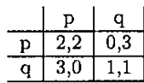
An idealised Testing Game
The payoffs for the action profile (p,p) are 2 for the implementer and 2 for the tester
If both do a poor job, the software contains errors, but at the same time there is a low error
detection capability by the tester's choice.
Both the implementer and the tester are equally well rewarded

Slide 8
An idealised Testing Game
Next consider the action profile (q,p), that is, an almost perfect piece of software investigated by a poor test.
Clearly this gives a PASS.
The implementer's effort is higher, so the implementer gets 3.
The tester has no costs for the effort, so no rewards either.

Slide 9
An idealised Testing Game
Conversely, (p, q) gives a FAIL with payoffs 0 and 3.
The tester has no costs for the effort, so no rewards either.
The payoff matrix of ITG is the payoff matrix of a Prisoner's Dilemma. There is one N.E., the action profile (q,q). In the N.E. both players choose to do a quality job.

Slide 10
What happens if implementer moves first :-
.
This is motivated by the way many software engineering projects are organised.
As soon as the requirements analysis phase has been completed and the software specification is available, not only the implementer starts working, but also the tester.
For, the main development of the present paper we adopt the viewpoint that testing is a strategic game which means that both players move simultaneously, as motivated by the parallelism in the development project.
It is also motivated by the fact that even after the implementer has delivered his implementation, the tester does not know the implementer's performance level (usually, testing is needed for that).

Slide 11
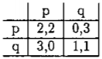


But, as a short side-line we shall briefly analyse a sequential version of lTG, wich we call ITGseq . In ITGseq the payoff matrix is:
If the implementer chooses p then the tester is left with the upper sub-matrix:
In this case the implementer receives payoff O. Alternatively, if the implementer chooses q then the tester is left with the lower sub-matrix:

Slide 12
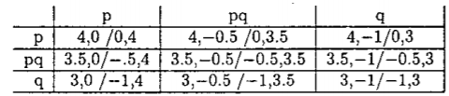
Adding an extra performance level :-
A as a model of an implementer's behavior and a tester's behavior is the binary choice with respect to the performance level. Perhaps a real implementer does not want to choose between two extreme values of 'poor' and 'quality' levels, or between Q = 20% and Q = 50%.
But will the dilemma disappear if there is a third, intermediate level? In order to investigate this, we construct another game called ITG3 which is a 3 x 3 strategic two-player game.
Therefore the refined payoff matrix is:

Slide 13
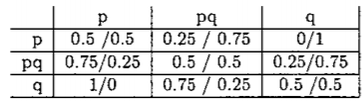
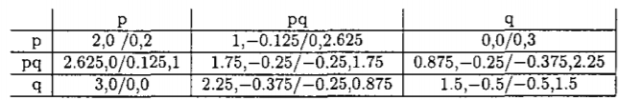
The weighting matrix is also taken to be the result of linear interpolation between the idealized values of P(FAIL) which are 0%, 50% and 100% in ITG.
Therefore the weighting matrix is:
The payoff matrix and the weighting matrix can be multiplied in an element-wise fashion to get:

Slide 14
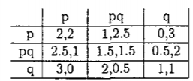
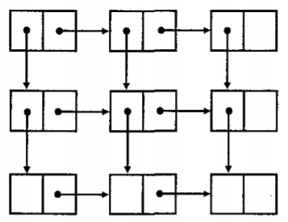
And by pair-wise adding the payoffs for PASS and FAIL the following payoff matrix is obtained (call this abstract 3 x 3 game ):
From this analysis we see that introducing an intermediate performance level does not change the essential nature of the game.

Slide 15
Testing is a Prisoners Dilemma; so what ?
.
Four different types of theoretical results are discussed:
If both the programmer and the tester are rational, then they must choose the 'quality' performance levels; for the lab manager this means that they do their best to deliver quality software, which is the manager's (and the customer's) best outcome.
The Prisoner's Dilemma was conceived precisely as a tool for investigating this. In the Flood-Dresher experiment done in 1950 a sequence of Prisoner's Dilemma games was conducted by the same pair of players; mutual cooperation was the most common outcome: 60 of the 100 games. Mutual defection, the N .E., occurred only 14 times.

Slide 16
Testing is a Prisoners Dilemma; so what ?
.
In game theory this is known as an 'extensive game with perfect information and simultaneous moves. Now each player has to decide upon a strategy which contains his initial move and also all the answers to all sequences of moves of the other player. Special examples of such strategies are finite state machines.
If the programmer and the tester have to play ITG in a finite repetition and if they behave rational then this result means that they choose (q, q), which is good from the lab manager's viewpoint.
From this article the problem of software testing is modeled as a formal strategic game. It is found that for certain values of the productivity and reward parameters the game is essentially equivalent to the Prisoner's Dilemma.

Slide 17
Concluding remarks :-
.
The results of our investigations show that if the reward for passing tests for the programmer is high enough and the reward for finding an error for the tester is high enough, there is essentially a Prisoner's Dilemma game hidden in the interaction of a programmer and a tester.
The main cause of this seems to be in the assumption that the development laboratory manager cannot measure the quality of the software directly; he only sees PASS or FAIL
In view of our findings it seems wise for a software development lab manager to make sure that he separates the roles of programmers and testers and that he makes sure there is enough reward for a programmer to achieve PASSes and for a tester to achieve FAILs.

Slide 18
Analyzing Software Development as a Noncooperative Game
2

Slide 19
Abstract :-
A significant number of failures of software projects are widely attributed to poor requirements gathering and making various errors in specifications, choosing an incorrect architecture, following a wrong design and development model, and incurring significant cost in the maintenance stage.
While these and other reasons are correct, they are based on an assumption that everyone involved in a software project is driven to make it successful and agrees on the goals and the methods of how to achieve that success.
In this paper we analyze software projects as noncooperative games and showhow to use the tools and techniques of game theory to uncover some hidden causes of failures.

Slide 20
Issue Statement :-
A significant number of failures of software projects are widely attributed to poor requirements gathering and making various errors in specifications, choosing an incorrect architecture, following a wrong design and development model, and incurring significant cost in the maintenance stage.
Type of issue :-
We consider the long-term strategic issues of making individual decisions by each participant of a software project team with respect of the common goals of the project.

Slide 21
Goals of Software Engineering :-
Every software engineering project pursues two major goals.
The first goal is to achieve a successful software product.
In the second is to conduct a successful software development and maintenance process.
In software engineering economics it is assumed that every participant of a software project strives toward achieving these goals.
While it is understood that goal conflicts are possible, the space of generally considered goal conflicts includes situations where conflicts arise due to external circumstances, for example, unknown requirements, poorly organized software process, or selecting a wrong tool.

Slide 22
Proposed Approach :-
We consider software development activities as strategic interactions that include the constraints on the actions that the project participants can take with respect to their interests, but do not specify the actions that the participants do take.
As such, a software development project is a software development game (SD game). A participant of an SD game is a player and is the basic entity in all game theoretic models. We offer the following caveat: we define the general characteristics of the players and ignore all the possible exceptions.

Slide 23
Rationality :-
Each player of an SD game is a rational decision maker.
This statement may be read with certain degree of disbelief since it is a known fact that various failures of software projects have been linked to irrational technical and managerial choices.
What we mean by players of SD games being rational is that they make choices in the best of their own self-interests.
There is a set of actions A from which a player makes a choice, a set C of possible consequences of these actions, and a consequence function gA C : → that associates a consequence with each action.

Slide 24
Players :-
We divide all SD game players into three categories: management, customers, and developers.
We designate them with uppercase letters M, C, and D respectively.
Finally, software engineers or developers include project participants who gather requirements, write specifications, architect and design, code, test, and deploy the system. In short, D stands for every player of an SD game who is directly involved in creating and evolving a software product.

Slide 25
Strategies :-
M’s strategy comprises three goals: decrease cost of the software product, increase its price, and ship the product faster.
C’s strategy revolves around three goals: decrease the price of the product, increase a number of features that it offers, and purchase a higher quality product for a smaller price.
D’s strategy is less than clear. While M and C have well-defined financial goals based on the successful outcome of the SD game, D’s goals are to satisfy job requirements, increase personal marketability, and increase M and C’s dependence on D.

Slide 26
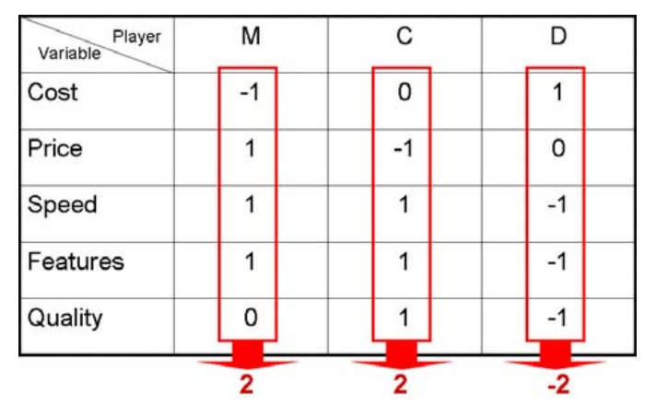
Payoff
Three columns specify SD game players, i.e. M, C, and D.

Slide 27
Payoff
Value -1 means that a player is not interested in increasing the value of that variable.
Value 0 means that a player is neutral on that variable
Value 1 mean that a player is interested in
increasing the value of that variable.

Slide 28
Analysis of Payoffs
M :
M’s strategy is to minimize the cost.
M wants to increase the price, speed, and the number of features of a software product as it gives him a positive payoff.
The effect of quality on M is neutral

Slide 29
Analysis of Payoffs
C:
C is not concerned with the cost of manufacturing of a software product.
C wants to pay less while getting a software product
faster, with more features, and of the highest quality.
These objectives are reflected by assigning negative
value -1 to price variable and
Positive values (1) to speed, features, and quality variables.

Slide 30
Analysis of Payoffs
D :
Since salary increases drive up the cost of the project, D is interested in the increase of the cost of a project.
The price of a product has no effect on D since it is not D who pays this price.
The speed, features, and quality variables have negative impact on D since improving these variables requires more work from D.

Slide 31
Analysis of Payoffs
Summary :
Summing up the values of M,C & D,
M and C gets 2 while D gets -2.
This indicates that while M and D end up with positive payoffs, the payoff for D in the same game is negative.

Slide 32
Nash equilibrium for SD Games
Each player knows the unspoken rules for maximizing payoff for M and C
M knows that D cannot be relied upon especially if D knows how M maximizes its payoff.
Managers try to hire mostly fresh college graduates for large-scale projects. As irrational as it seems this action is perfectly rational

Slide 33
Reaching winning equilibrium
Consider forming coalitions between M and D, where D and M receive shares of a company.
Payoff, for this coalition should be Pareto optimal -- that is, all players should simultaneously do better.
If M and D get equal number of company’s shares, then the payoff may be optimal.
But as a general rule M receives more shares than D.
In order to reach a winning equilibrium in SD games a payoff should be structured in a way that all players win when a project’s outcome is a successful product.

Slide 34
Software Complexity and SD Games
Management was trying to maximize its payoff and wanted to reduce the cost of the project by laying off a number of developers.
Managers first let go employees whose systems were less buggy and required less maintenance.
A natural strategy for D is to maximize the dependence of M on D.
D realizes that it is in his/her interest to write complicated software that would require M to incur a high switching cost when trying to replace D.

Slide 35
THANK YOU

