Slide 1
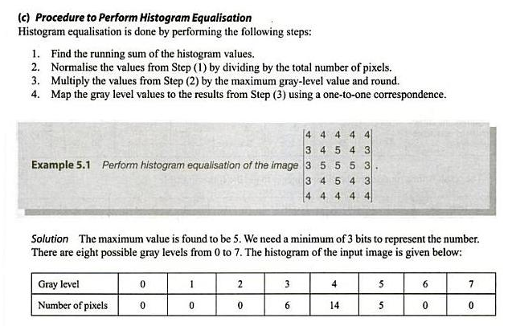
Histogram matching (specification)

Slide 2
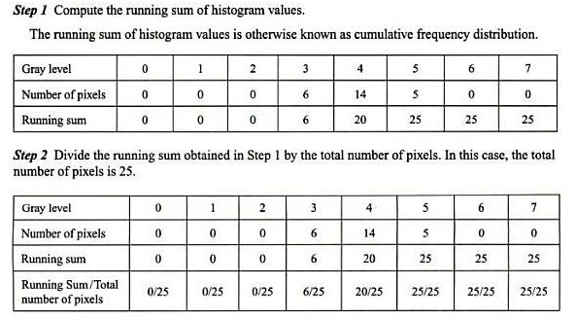
Histogram matching (specification)

Slide 3
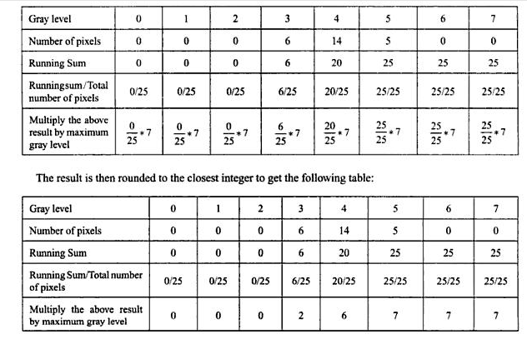
Histogram matching (specification)

Slide 4
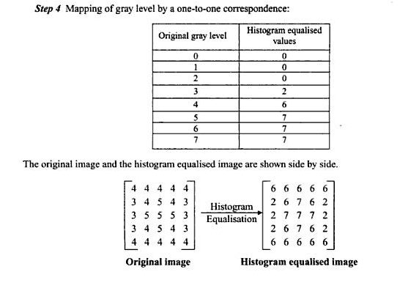
Histogram matching (specification)

