Slide 1
Module 2
Fingerprint Matching Techniques

Slide 2
Fingerprint Processing
Human fingerprints are unique to each person and can be regarded as some sort of signature, certifying the person's identity.
Because straightforward matching between the fingerprint pattern to be identified and many already known patterns has problems due to its high sensitivity to errors (e.g. various noises, damaged fingerprint areas, or the finger being placed in different areas of fingerprint scanner window and with different orientation angles, finger deformation during the scanning procedure etc.).
Modern techniques focus on extracting minutiae points (points where capillary lines have branches or ends) from the fingerprint image, and check matching between the sets of fingerprint features.

Slide 3
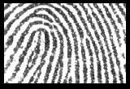
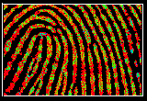
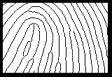
Progressive Fingerprint Matching
Image Processing
Capture the fingerprint images and process them through a series of image processing algorithms to obtain a clear unambiguous skeletal image of the original gray tone impression, clarifying smudged areas, removing extraneous artifacts and healing most scars, cuts and breaks.
Original image
Undesirable features marked
Final image

Slide 4
General Model for Fingerprint Authentication

Slide 5
Fingerprint matching techniques
There are two categories of fingerprint matching techniques: minutiae-based , correlation based and Ridge based.
Minutiae-based techniques first find minutiae points and then map their relative placement on the finger.
The correlation-based method is able to overcome some of the difficulties of the minutiae-based approach.
Ridge based techniques used even if features are damaged or shortage of features.

Slide 6
Minutiae based Processing
The following steps are followed in a minutiae based system:
directional field estimation
adaptive filtering for noise reduction
thresholding to obtain a binary fingerprint image
morphological operations like thinning to obtain ridges that are only one pixel wide
minutiae extraction from the thinned image
application of heuristics to reduce the number of false minutiae
registration of minutiae templates by Hough transform
matching score computation.

Slide 7
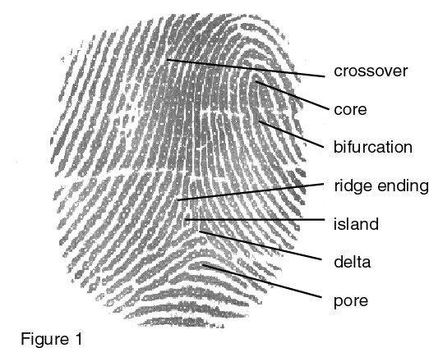

Slide 8
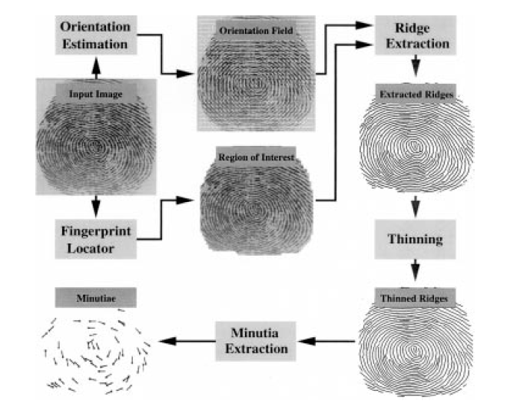
Minutiae Extraction

Slide 9
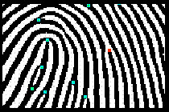
Feature Detection for Matching Ridge ends and bifurcations (minutiae) within the skeletal image are identified and encoded, providing critical placement, orientation and linkage information for the fingerprint matching process.

Slide 10
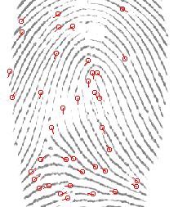
A selected fingerprint is mapped into a digital frame by a function f (minutiea type t, site l, neighborhood theta) =
f( t, l, theta).
Map the selected minutiae

Slide 11
Disadvantages
In real life you would have impressions made at separate times and subject to different pressure distortions.
On the average, many of these images are relatively clean and clear, however, in many of the actually crime scenes, prints are anything but clear.
There are cases where it is not easy to have a core pattern and a delta but only a latent that could be a fingertip, palm or even foot impression
The method does not take into account the global pattern of ridges and furrows.
Fingerprint matching based on minutiae has problems in matching different sized (unregistered) minutiae patterns.
Local ridge structures can not be completely characterized by minutiae.
The solution is to find an alternate representation of fingerprints which captures more local information and yields a fixed length code for the fingerprint.

Slide 12
Correlation based Processing
Instead of only using the minutiae locations, it directly uses the gray-level information.
Because a gray-level fingerprint image contains much richer, more discriminatory, information than only the minutiae locations
The following steps involved
selects characteristic templates in the primary fingerprint.
Template matching is used to find the positions in the secondary fingerprint at which the templates match best.
Template positions in both fingerprints are compared in order to make the decision whether the prints match.

Slide 13
Advantages
The method uses the much richer gray-level information of the fingerprint image instead of only positions of minutiae.
The method is also capable of dealing with fingerprints of bad image quality from which no minutiae can be extracted reliably.
False and missed minutiae do not decrease the matching performance.
Unlike the minutiae templates, the template locations are already paired, which results in much simpler matching methods. When registering minutiae sets, it is not known in advance which minutiae from both sets should correspond.
The first decision stage only classifies relative template positions. This method tolerates non-uniform local shape distortions in the fingerprint, unlike the minutiae templates for which the optimal global transform is searched.

Slide 14
Disadvantages
Correlation-based techniques require the precise location of a registration point
It is also affected by image translation and rotation.
The method is at the moment not capable of dealing with rotations of more than about 10 degrees.

Slide 15
Ridge Based Processing
extracting ridge information of an inputted fingerprint.
determining an identity between the inputted fingerprint and a reference fingerprint by comparing the ridge information
Steps involved
Calculate Regions of inputted fingerprint and reference fingerprint
Calculate Overlapped region of the reference fingerprint and inputted fingerprint.
Calculate distance from inputted fingerprint and reference fingerprint
Determine identity between inputted fingerprint and reference fingerprint.

Slide 16
Pros of Fingerprint Recognition
Finger tip most mature measure
Accepted reliability
High quality images
Small physical size
Low cost
Low False Acceptance Rate (FAR)
Small template (less than 500 bytes)

Slide 17
Cons of Fingerprint Recognition
Requires careful enrollment
Potential high False Reject Rate (FRR) due to:
Pressing too hard, scarring, misalignment, dirt
Vendor incompatibility
Cultural issues
Physical contact requirement a negative in Japan
Perceived privacy issues with North America

