Slide 1

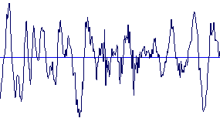
Biometrics: Voice Recognition

Slide 2

Outline of Presentation
Introduction to voice biometrics
The history of voice recognition and its milestones
How voice biometric works
Benefits and problems that voice recognition encounters
Current applications and the future of this technology

Slide 3
Introduction to Voice Biometrics
-Voice biometrics is a growing technology in
computer security
-It uses a measurable, physical characteristic, or
personal behavioral trait to verify and authenticate
an individual
-It uses what you are as a way to identify yourself
-Compares two (2) samples of data and verifies
if they match
Notes:
In this biometric system a device captures a sample from a user
and then compare it against the data contained in its database.
The system then decides how well the two match and indicates
whether or not an identification or verification has been achieved

Slide 4
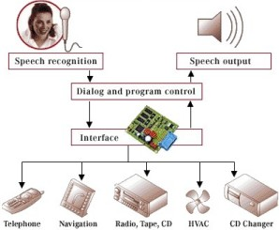
Speech Recognition vs
Speaker Verification
-The most important difference is that:
-Speech recognition identifies what you are saying
-Speaker verification verifies that you are who you say you are

Slide 5
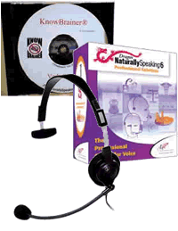
Speech Recognition
A speech recognition system is designed to assist the speaker in accomplishing what that person wants to do

Slide 6
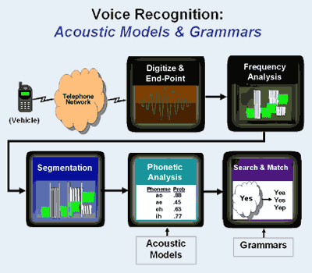
Speaker Verification
However, if an application needs to know who is speaking, then it must authenticate the person and verify that he or she is in fact that person

Slide 7
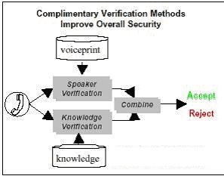
Combining Speech recognition and speaker verification
Speech recognition and speaker verification systems are combined to create voice biometric systems

Slide 8
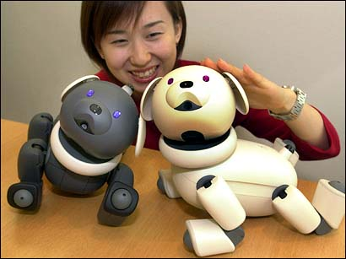
History of voice recognition
-Radio Rex who was created by the Elmwood Button Company in 1922
-During the 1940’s and 1950’s the United States Department of Defense and MIT became the largest contributors to the speech recognition field
-In the 1960’s and 1970’s, the technology can be attributed to the educational institutions
-Today, voice recognition systems are important

Slide 9
Voices are Unique
-Voice recognition systems must be able to distinguish between various people’s voices
-Frequency and Intensity
-Training our body’s nasal and oral passages, as well as our lips, teeth, tongue, and jaw muscles

Slide 10
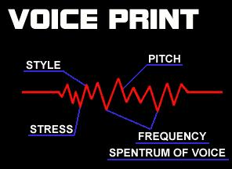
How Voice Biometrics Work
-Voices are nearly impossible to recreate
-Digitizing a person's speech to produce a “voice print”

Slide 11
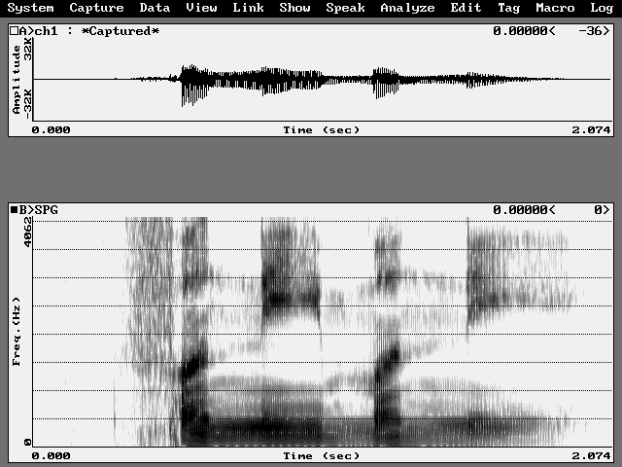
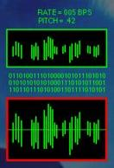
Capturing a Voice Sample
Within these smaller segments they are “captured” in a digital form and plotted on a spectrum.

Slide 12
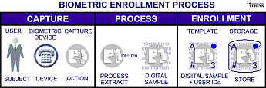
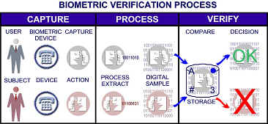
Verification Process
The voiceprint is then stored as a table of numbers, where the presence of each dominant frequency in each segment is expressed as a binary number. Since all table entries are either a 1 or 0, each column can be read bottom to top as a long binary code.

Slide 13
Trying to Fool Voice Recognition Systems
-Voice biometrics should be able to tell the differences between real and fake users
-One of the concerns about voice recognition systems is the threat of recording a person’s voice
-Anti-spoofing is the key!
-Challenge Response Mechanism

Slide 14
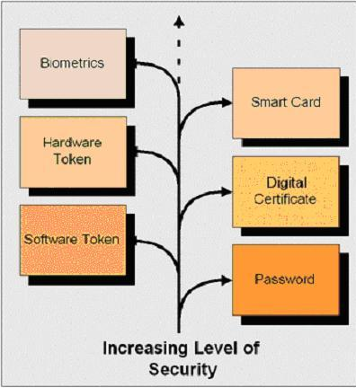
Benefits of Voice Recognition Systems
-Another layer of security for computer systems
-Produces a more efficient and cost effective environment
-Saves costs: Employee’s do not need ID access cards
-Saves time for companies

Slide 15
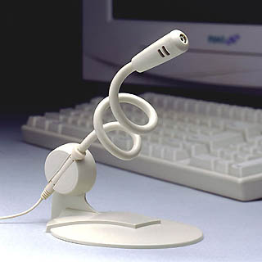
Problems with Voice Recognition Biometrics
-Human voices do not necessarily remain the same over one’s lifetime
-Uses of microphones
-Environmental noise
-Poor phone, or cellular connections
-Vocal variations: accents
-Telephone devices: voice samples are converted and transferred from an analog format to a digital format for processing

Slide 16
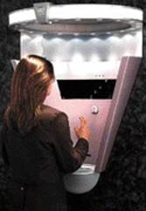
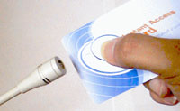
Current Applications of Voice Biometrics
-Security system for physical access entry into a building
-Corrections industries: inmates on parole
-Telephone companies use voice-enabling services
-Voice verification in telephone banking: ATM machines
-Voice verification in credit cards

Slide 17
Voice Recognition on the Rise
-Voice recognition applications are slowly growing
-Vocent Solutions, Inc. suggested that:
(1) Telephones are the primary means by which consumers will conduct financial transactions and access financial account information
(2) Consumers know about the problem of identity theft
(3) Consumers feel that PIN Numbers and passwords are not secure enough
(4) A strong amount of concern exists when communicating confidential information over the telephone
(5) As a result of these security concerns and fears, consumers would be willing to participate in a voice recognition system, and also feel that it could potentially reduce fraud as well as identity theft

