Slide 1
DESIGN PATTERNS Digital Assignment - I Title : Decorator Pattern Name : S.Deepan. Reg No : 19MIS0102 Slot : C1

Slide 2
CONTENTS
What is Decorator Pattern ?
Real World examples
Applicabitity
Implementation
Consequences

Slide 3
Decorator Pattern
The decorator design pattern is a structural design pattern in object-oriented programming.
It enables behaviour and functionality to be dynamically extended to an object while not impacting other objects in the same class.

Slide 4

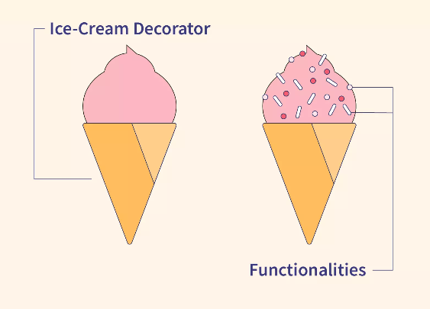
Real World Example
Customer
Worker

Slide 5
Applicability
Functionalities that are needed to add dynamically without affecting the other object in the class
We use inheritance or composition to extend the behaviour of an object but this is done at compile time and its applicable to all the instances of the class.
When :
The Decorator pattern is mostly used for implementing caching.

Slide 6
Implementation
User
Type
Veg
Non-Veg

Slide 7
Consequences
Decorators might result in a lot of small elements in our design, which can be difficult to manage.
This design pattern is not beginner-friendly.
A decorator and its component aren't identical.
It can lead to a system with “lots of little objects” that all look alike to the programmer trying to maintain the code.

Slide 8
Related Pattern
Adapter Pattern - A decorator is different from an adapter in that a decorator changes object's responsibilities, while an adapter changes an object interface.
Composite Pattern - A decorator can be viewed as a degenerate composite with only one component. However, a decorator adds additional responsibilities.

Slide 9
Thank You

