Slide 1



TEACHERS FEEDBACK FORM USING JAVA
Name : DEEPAN B
Roll No : 23ADL194
Date : 18/11/2024

Slide 2
Introduction
The Teacher Feedback Form Project is a Java-based application designed to collect structured feedback from students about teachers..
Technology Used :
Java programming language
JDBC (Java Database Connectivity) for interaction with the database
SQL for data storage and retrieval

Slide 3
System Design and Features
Features:
Add, remove, update, and search contacts
Store contact information such as Students and teachers name, ratings.
Uses a relational database for storage
Database:
MySQL (or any relational database)

Slide 4
Core Functionalities
Add a New Contact: Allows users to input contact details and store them in the database.
Remove a Contact: Allows users to remove a contact by name.
Update a Contact: Users can update any field of an existing contact (e.g., Name, ratings).
Search a Contact: Allows users to search for a contact by name.
Display All Contacts: Displays a list of all contacts stored in the database.

Slide 5
Key Components of the Code
Classes :
TeacherFeedbackForm: Manages the graphical user interface (GUI) to collect feedback from students.
Database Connection: Handles the connection between the Java application and the MySQL database.
Feedback: Represents a feedback entry with attributes like student name, teacher name, ratings, and comments.
Feedback Manager: Performs CRUD operations (Create, Read, Update, Delete) on the feedback data in the database.
Feedback: The main driver class that launches the application and provides options to submit or view feedback.

Slide 6
Database Design
Table content
id | INT | Auto-increment primary key for uniquely identifying feedback.
student name | VARCHAR(255) | Name of the student submitting the feedback.
teacher_name | VARCHAR(255) | Name of the teacher receiving the feedback.
interaction | INT | Rating for teacher's interaction skills (1 to 5).
teaching | INT | Rating for teacher's teaching effectiveness (1 to 5).
knowledge | INT | Rating for teacher's subject knowledge (1 to 5).
clarity | INT | Rating for teacher's clarity in explanation (1 to 5).
punctuality | INT | Rating for teacher's punctuality (1 to 5).
comments | TEXT | Additional feedback or comments from the student.

Slide 7
Flow Chart
START
Display Feedback Form (GUI)
Student Enters Feedback:
- Student Name
- Teacher Name
- Ratings (Interaction, Teaching, Knowledge, Clarity, Punctuality)
- Comments
[Validation]
Save Feedback to Database
Show Success Message
View All Feedback
(optional)

Slide 8
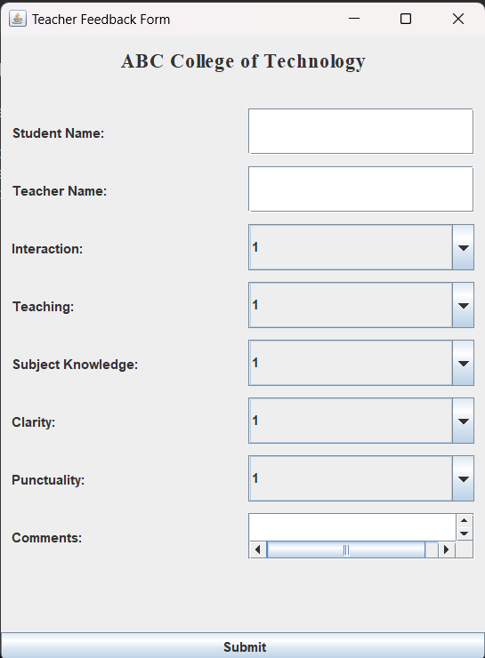
Code Output Feedback Form

Slide 9
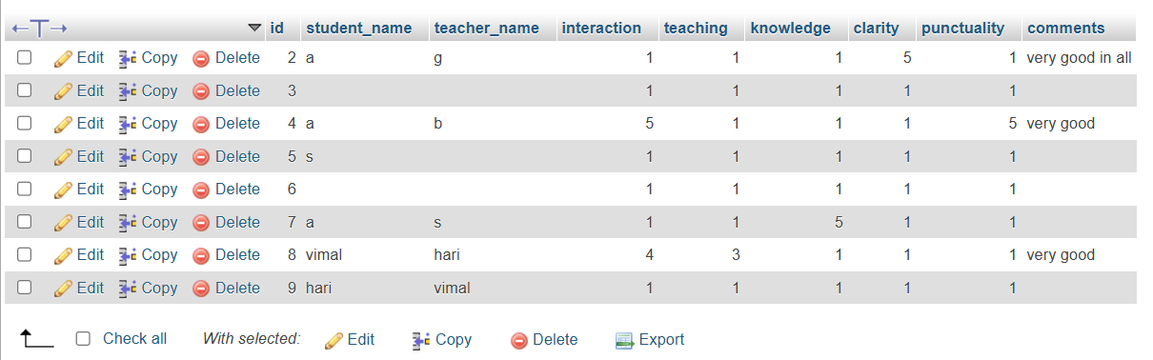
Database Format :

Slide 10
Conclusion
The Teacher Feedback Form project successfully addresses the need for a structured, user-friendly system to collect and store feedback about teachers. By leveraging technologies like Java, Swing for the GUI, and MySQL for database storage, the application ensures an efficient and reliable feedback process. It is a practical and impactful project that promotes a culture of constructive feedback and continuous improvement in education. It enhances communication between students and educators, fostering a better learning environment.

Slide 11
THANK YOU

