Slide 1
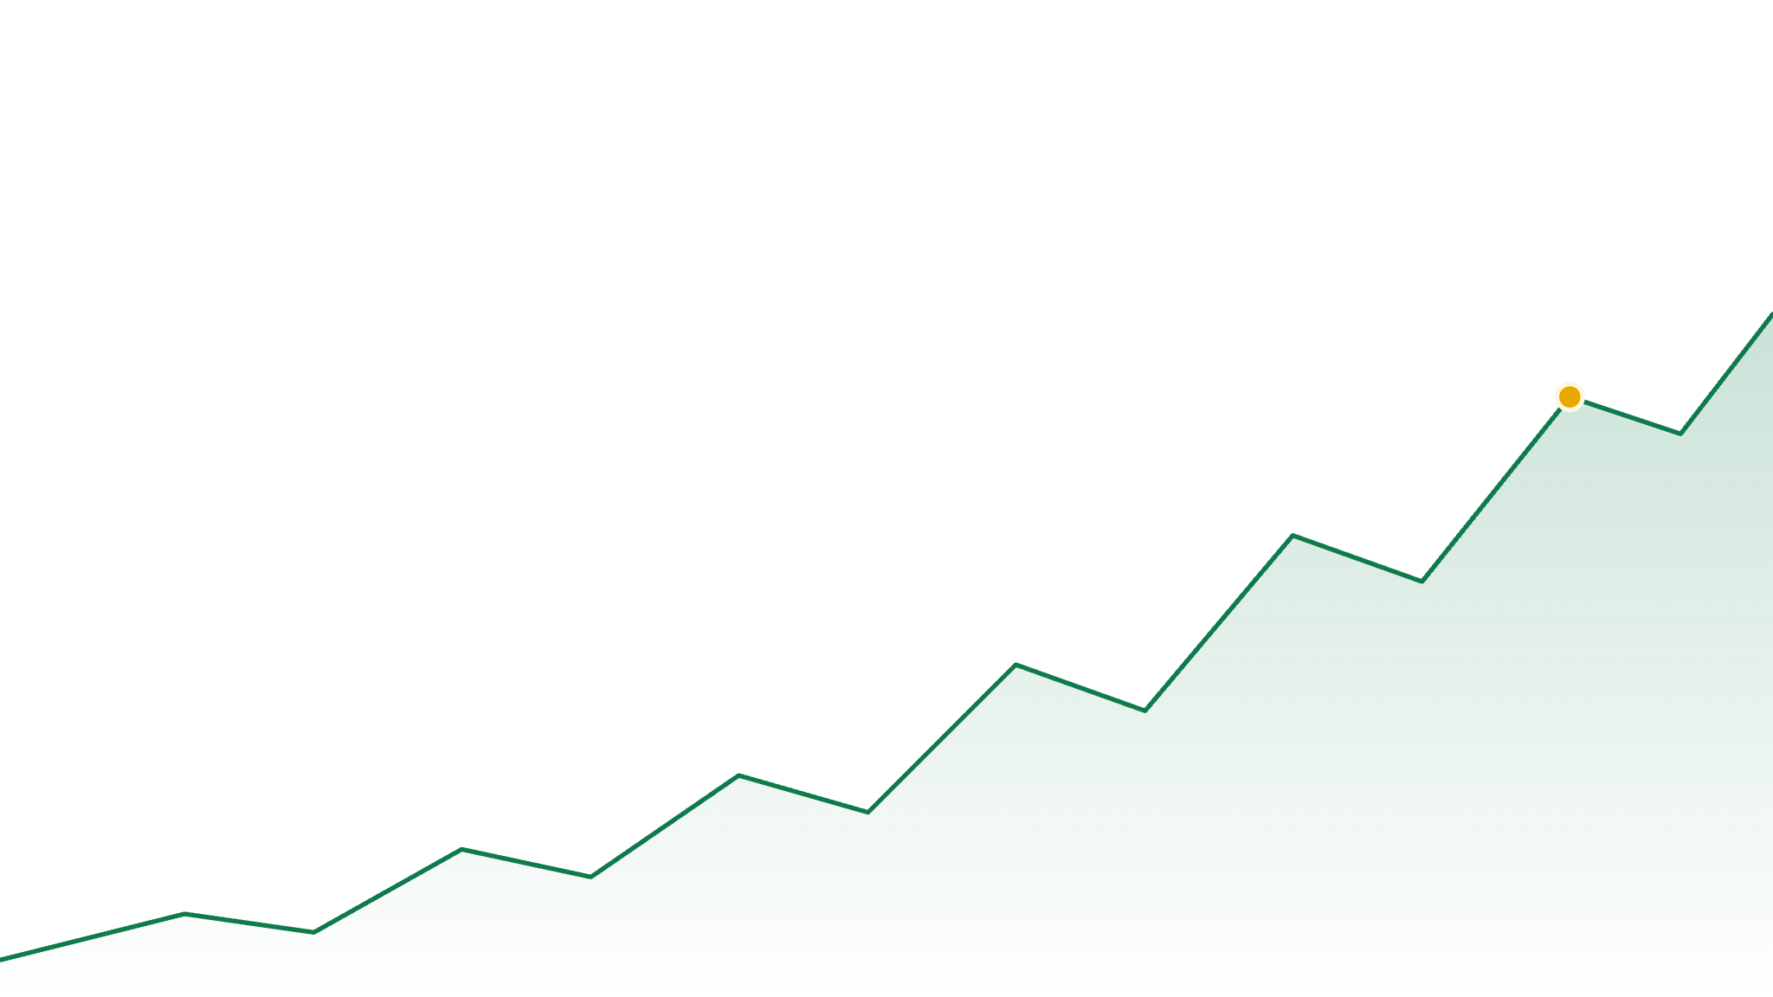


IIM CALCUTTA · STARTUP PITCH · 2026
TradeSim
Practice on the real market.
Lose nothing but the fear.
Piloted with 100 MBA students at IEM
FOUNDERS
FOUNDING TEAM
CONTACT
Prof. Saugata Ghosh · Prof. (Dr.) Subhadip Chandra
Ratul Mukherjee · Shinjini Chakraborty · Deepan Sadhukhan
80170 24589 · 93322 35642
Notes:
Area mapping: Financial Education. Tech mapping: FinTech. Hook comes on the next slide — do not introduce yourselves here; the slide does it.

Slide 2
FY26
SEBI · EQUITY DERIVATIVES · ONE FINANCIAL YEAR
₹91,685 crore
lost by individual traders in India last year — most of it by people learning to trade with real money.
87.7%
₹1.17 lakh
78.6 lakh
of them lost money
average loss per trader
people. In one year.
02
Notes:
Source: SEBI, "Profitability of individual traders in the equity derivatives segment, FY25–FY26", press release 50/2026, 20 Aug 2026. FY26: 87.7% of individual traders lost; net loss ₹91,685 crore; average loss ₹1.17 lakh; 78.6 lakh active traders. FY25 (restated): ~₹1.12 lakh crore, 91% lost. Backup: Sept 2024 study — 93% lost, ₹1.8 lakh crore over FY22–24. If a judge says losses fell in FY26: yes, by design — SEBI tightened F&O rules and 20% of traders left. The ones who stayed still lost 9 times in 10.

Slide 3
THE PROBLEM
The youngest traders lose the most.
100 TRADERS UNDER 30, ONE YEAR
43%
of India's F&O traders are now under 30 — up from 31% four years ago
89%
of those under-30s lost money — worse than any other age group
3 in 4
earn under ₹5 lakh a year. They are learning on money they cannot afford to lose.
74% of Indians who don't invest say the market is too complex. They don't need another video. They need a place to practise.
89 lost money
11 made money
03
Notes:
Sources: SEBI study on trading behaviour of individual traders in equity derivatives, FY25–FY26 (Aug 2026): under-30s are 43% of traders (31% four years earlier); 89% of them lost (vs 81% for 60+); ~three-quarters of traders earn under ₹5 lakh/yr. SEBI Investor Survey 2025 (Sept 2025, 90,000+ households): 74% of non-investors cite complexity / information gaps; only 9.5% of households invest. NCFE 2019: 27% of Indians financially literate. The waffle shows 89 of 100 — the under-30 loss rate.

Slide 4
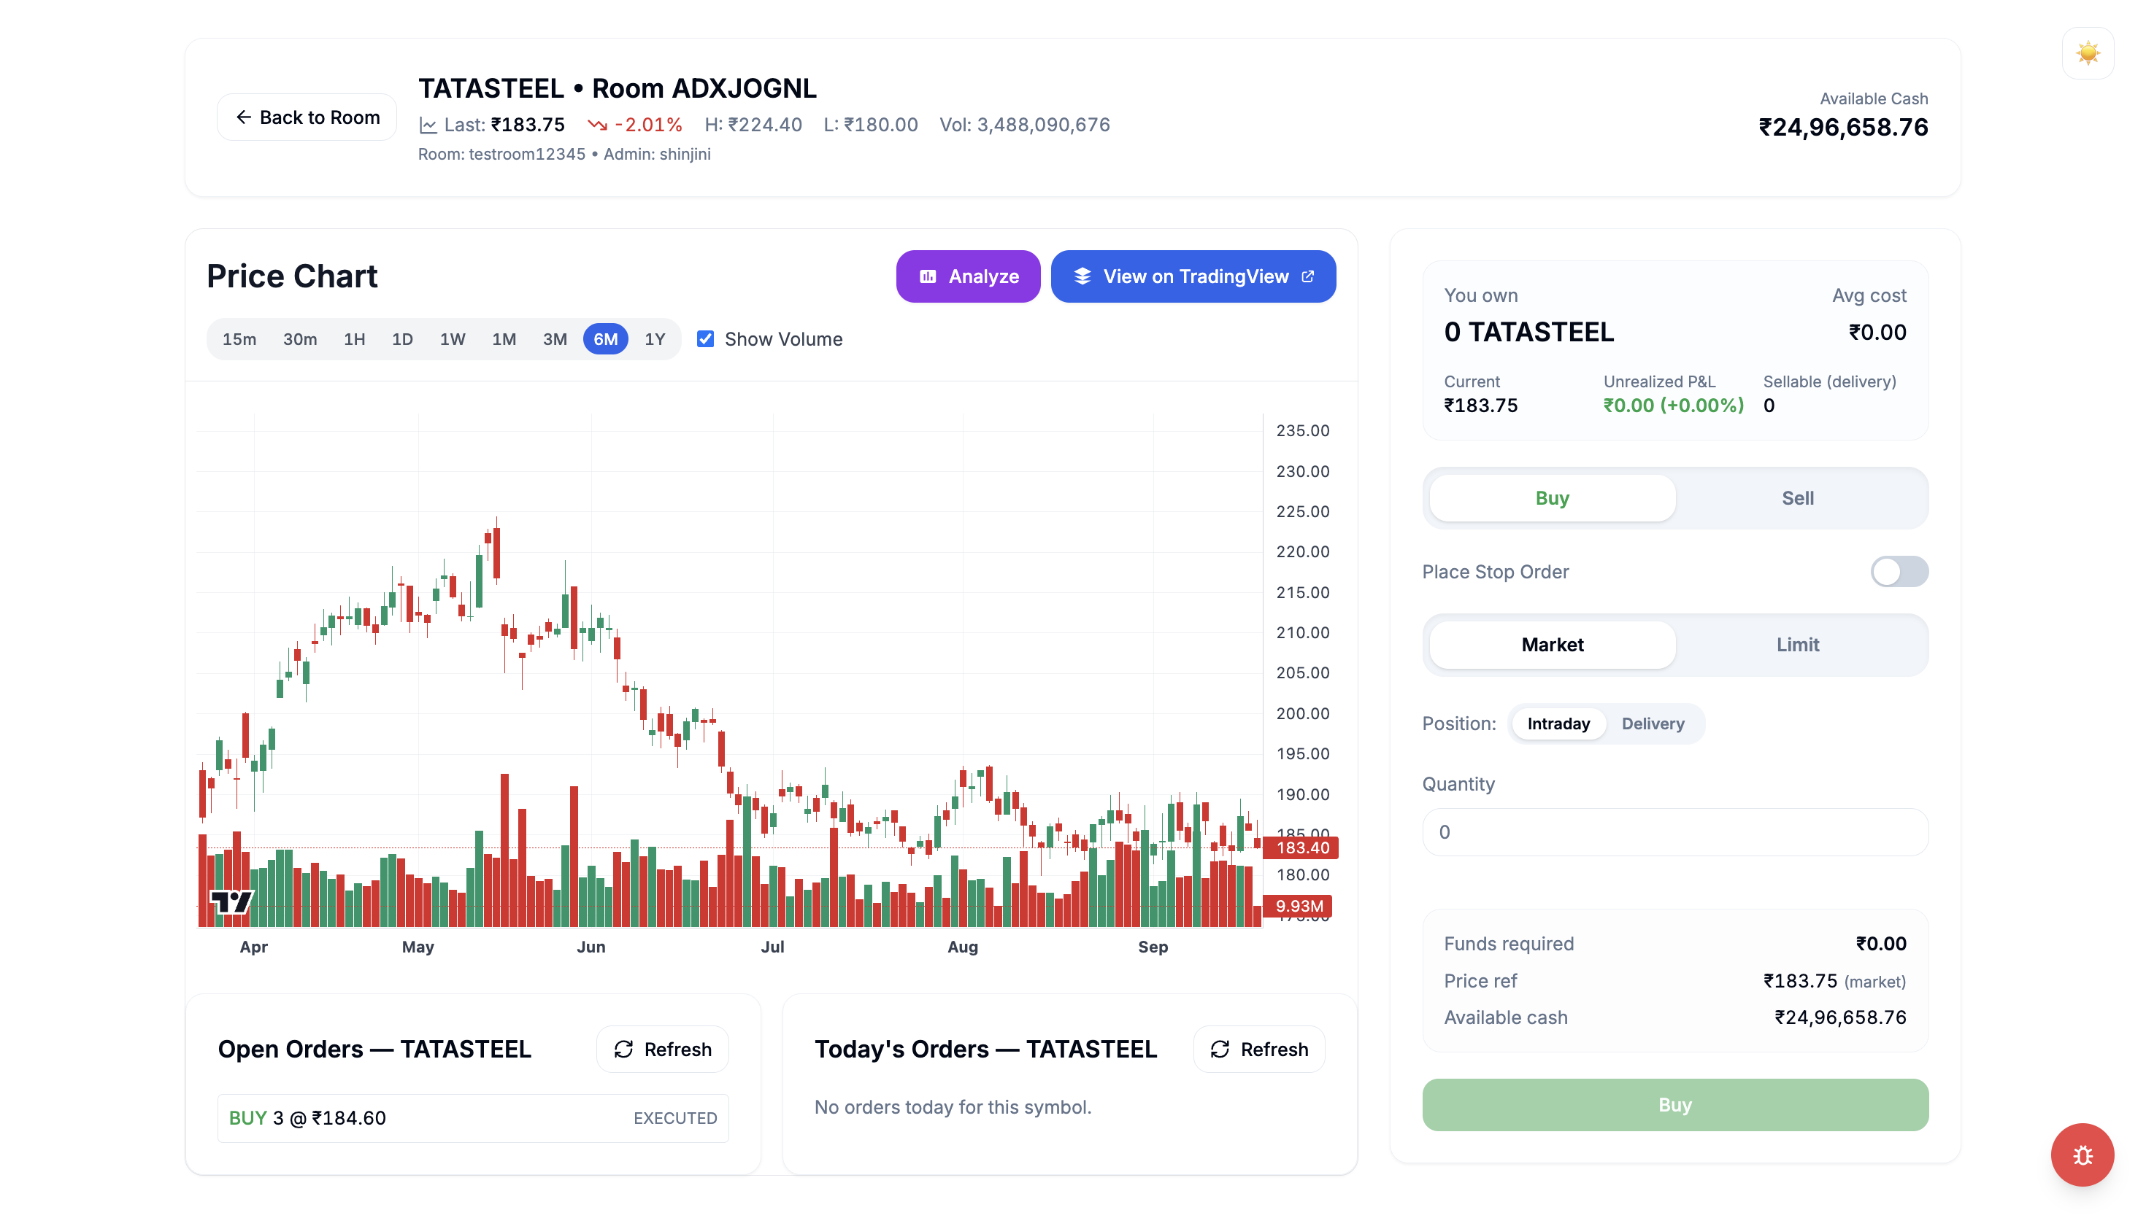
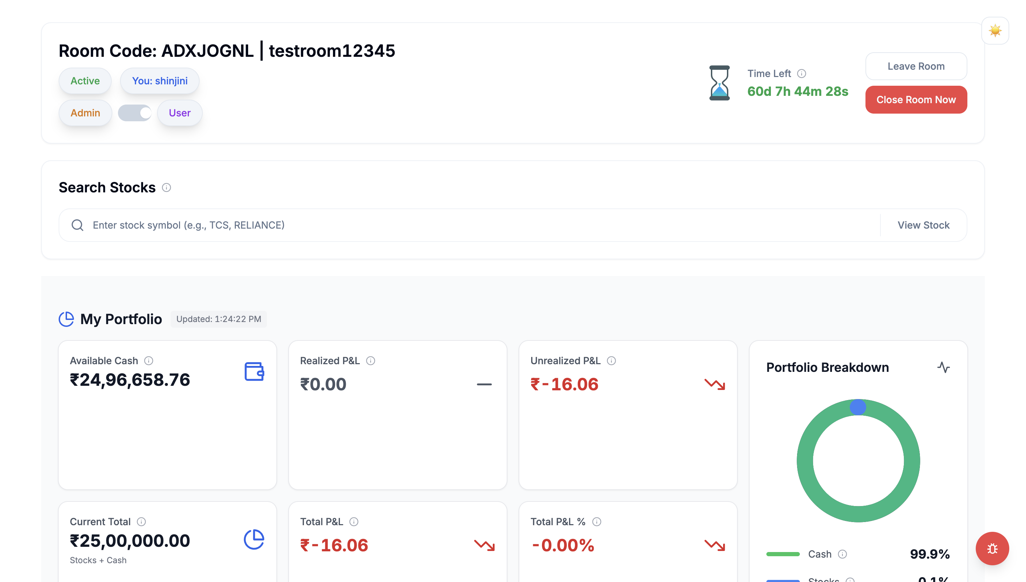
THE SOLUTION
Live NSE / BSE feed
Trade the real market. Lose nothing.
01
Live NSE & BSE prices — the same candles a broker terminal shows
02
Market, limit and stop orders; intraday and delivery; long and short
03
Faculty host a room; every student starts with the same virtual corpus
04
A live leaderboard ranks the room by P&L — zero real money at risk
Actual product screens, Sept 2026
04
Notes:
Both screenshots are from the live build: the stock page (TATASTEEL, TradingView chart, order panel) and the room dashboard (room code, admin/user toggle, P&L cards). If asked: order book, stop-loss, intraday vs delivery all exist today.

Slide 5




HOW IT WORKS
A full trading competition, hosted by a teacher, in under five minutes.
One room. One corpus. One leaderboard.
1
2
3
4
Faculty opens a room
Students join
They trade the live market
Leaderboard decides
Sets the duration, the virtual corpus and the rules. Shares a room code.
Everyone starts with the same virtual capital. No demat, no KYC, no money.
Real prices, real order types, real volatility. No real losses.
Ranked live on realised + unrealised P&L. Faculty sees every trade.
05
Notes:
Same experience as a brokerage terminal — minus the ability to lose a rupee. Test room shown in screenshots used a ₹25 lakh virtual corpus.

Slide 6
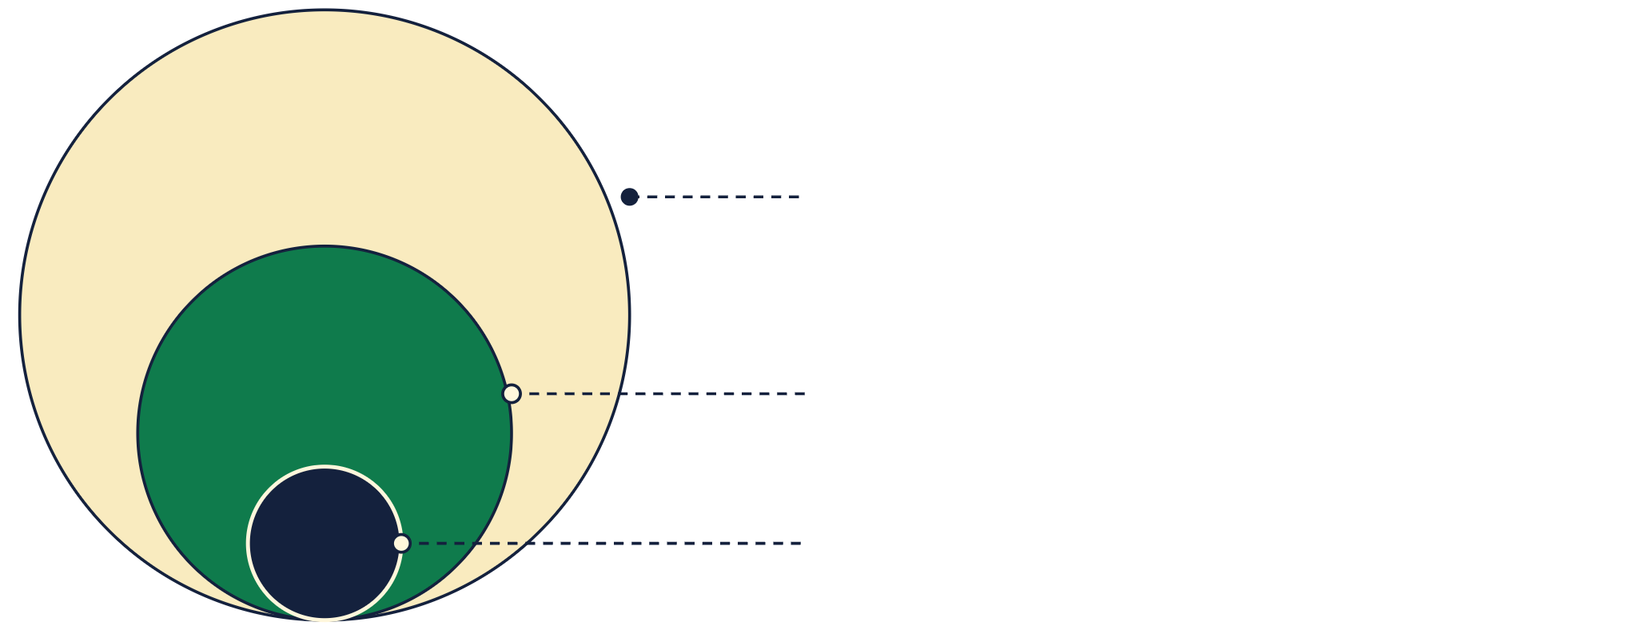
MARKET OPPORTUNITY
Students today. Investors next year.
59% of new NSE investors are under 30
TAM
4.5 crore
students in Indian higher education — tomorrow's first-time investors
SAM
1.1 crore
in commerce, management and engineering courses
1,00,000
SOM
Year-1 target: ~60 partner colleges, starting inside the IEM-UEM network
06
Notes:
TAM: AISHE 2023-24 (Ministry of Education, released July 2026) — total enrolment 4,50,01,123; 1,289 universities, 48,246 colleges. SAM: UG Commerce 40.8 lakh + UG Management 10.8 lakh + PG Management 10.4 lakh + PG Commerce 4.5 lakh + UG Engineering 43.9 lakh = 110.4 lakh ≈ 1.1 crore (same report). SOM: 1,00,000 = 60 colleges at ~1,000 relevant students plus organic B2C sign-ups; that is 0.12% of India's 48,246 colleges and under 1% of SAM. Youth stat: NSE Market Pulse July 2026 — 59% of new registrations Apr-Jun 2026 were under 30; median investor age 33; 13.2 crore unique investors. India edtech market USD 7.5 bn, projected USD 29 bn by 2030 (IAMAI / Grant Thornton Bharat, Jan 2025) if asked for the sector number.

Slide 7
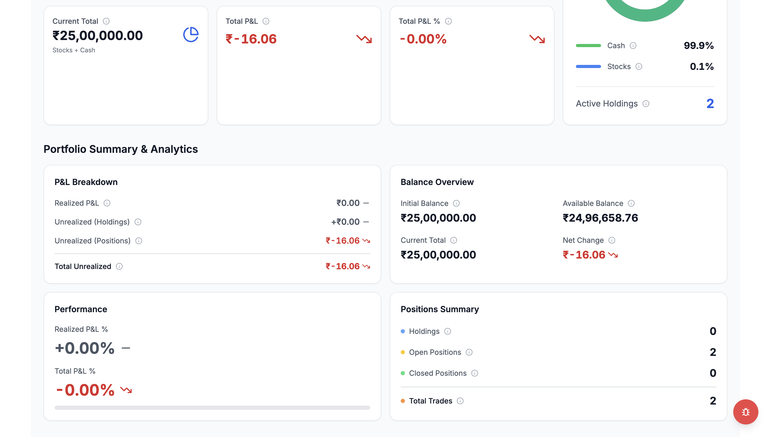
100
IEM MBA pilot · 2026
TRACTION — PROOF, NOT PROJECTION
100 MBA students.
One live room.
₹0 at risk.
Piloted with IEM's MBA batch on live NSE/BSE data. The product on this screen is the product students are already using.
Live P&L, positions and analytics — every trade auditable by faculty
07
Notes:
Say exactly what happened: 100 MBA students onboarded, one competition room hosted end-to-end, on real market data. Do not inflate. If asked for feedback scores, say they are being collected.

Slide 8
BUSINESS MODEL
Priced against Seekho (₹149/mo), Sensibull Lite (₹480/mo) and campus software at ₹99–279 per student per year.
Students never pay. Colleges do.
INSTITUTION · CORE REVENUE
₹199
per student, per year
₹50,000 minimum per college
INDIVIDUAL
₹149/mo
College licenses its student strength. Students get the full product free. Faculty get admin rooms, cohort reports and every trade on record.
FREE
or ₹999 a year. Ad-free. AI trade coach when it ships. Priced below one Sensibull month.
₹0
Full simulator, live data. Ads shown. No AI coach.
1,000 students = ₹1.99 lakh a year
08
Notes:
Pricing anchors (all fetched Sept 2026): Seekho ₹149/month, ₹599/year (App Store India). Sensibull Lite ₹480/month, Pro ₹800–1,300/month — the only Indian paid paper-trading product, and paper trading sits in its paid tier. TradingView Essential ₹995/month. StockSim Plus ₹1,199/month. Campus SaaS benchmark: Drishti EdOS publishes ₹99 / ₹179 / ₹279 per student per year with ₹35k–95k minimums; LMS guides quote ₹50–500 per user per month. Indian colleges' edtech budgets run ₹5–50 lakh a year (SalesUp, 2025). No major broker (Zerodha, Groww, Upstox, Angel One) sells paper trading — Zerodha bundles Sensibull free. So ₹199/student/yr sits inside the campus band and 2.4x below one month of Sensibull.

Slide 9
UNIT ECONOMICS · AT 1,00,000 USERS
Break-even in year one. Margin on every renewal.
Paid individuals · ₹10 L
Ops ₹10 L
80%
Ads · ₹15.6 L
Data ₹10 L
contribution per student: ₹199 price − ₹40 cloud & data = ₹159
Cloud ₹30 L
4 : 1
LTV to CAC per college: ₹3.2 L over a 2-year contract vs ₹0.8 L to sign
Sales ₹48 L
Institutions
₹1.19 Cr
35%
Team ₹42 L
margin in year 2: same colleges renew, ₹48 L of sales cost disappears
₹1.45 Cr
₹1.40 Cr
REVENUE
COST · YEAR 1
09
Notes:
User mix at 1,00,000: 60,000 institutional (60 colleges × ~1,000 students), 39,000 free, 1,000 paid individuals (2.5% of B2C users; RevenueCat 2026 median download-to-paid is 2.18%). Revenue: 60,000 × ₹199 = ₹1.19 Cr; 39,000 × ₹40 ad ARPU = ₹15.6 L (India AdMob eCPM ≈ $0.30, ~150 impressions per user per month; ShareChat earns ₹36/user/yr all-in); 1,000 × ₹999 = ₹10 L. Total ₹1.45 Cr. Cost: 3 engineers ₹3.5 L/month = ₹42 L (Instahyre 2026 salary bands); B2B sales 60 colleges × ₹80,000 CAC = ₹48 L (SalesUp benchmark, 60–120 day cycle); cloud ₹2.5 L/month = ₹30 L (100k-MAU backend estimates $3.5–4k/month); market-data licence ₹10 L — an assumption: NSE vendor licence plus per-end-user fees, price list not public; ops/support ₹10 L. Total ₹1.40 Cr. Founders' faculty time not costed. Judges will push on the data-licence line: say it is a budgeted assumption; every ₹5 L on that line moves year-1 result by ₹5 L, and year-2 margin absorbs it.

Slide 10
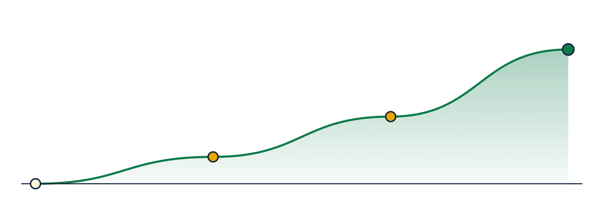
GROWTH PLAN
One campus at a time, a thousand students at a time.
Targets, not results. Revenue at today's prices and mix.
5,00,000
300 colleges · ₹7.3 Cr
2,50,000
150 colleges · ₹3.6 Cr
1,00,000
60 colleges · ₹1.45 Cr
100
Year 3 = 4.5% of SAM, 0.6% of colleges
students · IEM pilot
2026
YEAR 1
YEAR 2
YEAR 3
10
Notes:
Year 1: 60 colleges × ~1,000 relevant students plus organic sign-ups = 1,00,000; revenue ₹1.45 Cr at the slide-9 mix. Year 2: 150 colleges, 2,50,000 users, ₹3.6 Cr. Year 3: 300 colleges, 5,00,000 users, ₹7.3 Cr — 4.5% of the 1.1 crore SAM and 0.6% of India's 48,246 colleges. Curve is drawn to scale on users. Go-to-market: IEM-UEM group campuses first, then West Bengal, then AICTE-approved management institutions (~3,500 nationally, AICTE 2024-25 — count unverified against the AICTE primary, quote as approximate).

Slide 11

COMPETITIVE LANDSCAPE
Real market, or built for a class. Nobody does both.
No Indian broker sells paper trading. Zerodha bundles Sensibull; Groww and Angel One have none.
Faculty-hosted rooms
TradeSim
Investopedia Simulator
US stocks only
₹199 / student / yr
LIVE DATA + HOSTED ROOMS
Seekho · ₹149/mo
Sensibull · ₹480/mo
Zerodha Varsity · free
Moneybhai · free
Solo learner
TradingView · ₹995/mo
Content only
Live NSE / BSE trading
11
Notes:
Placement is qualitative. Prices fetched Sept 2026: Sensibull Lite ₹480/mo (paper trading is in the paid tier; free for Zerodha users), TradingView Essential ₹995/mo annual, Seekho ₹149/mo, Moneybhai free (₹1 crore virtual), Zerodha Varsity free (certification ₹250 + GST), Investopedia simulator free but US-listed stocks only. Brokers: Zerodha Kite no native paper trading, Upstox demo tour only, Groww none, Dhan via Sensibull, Angel One none found. If asked "why won't Zerodha just build this": brokers earn on real trades; a classroom simulator with a faculty admin view is not their business, and none of them sells to colleges.

Slide 12
WHAT'S NEXT
From a simulator to a coach.
NOW · SHIPPED
NEXT · 12 MONTHS
LATER · 24 MONTHS
Hosted competitions
AI trade coach
Campus analytics
Live NSE/BSE data, full order types, room leaderboard, faculty admin view. Running at IEM.
Reviews every trade, flags the mistake, explains why in plain language. Compares you to the room. Paid tier.
Cohort dashboards for faculty, inter-college leagues, placement-ready trading records.
12
Notes:
Only the first column exists today. Be explicit that AI coaching and analytics are roadmap, and that the AI tier is what justifies a higher price later.

Slide 13
THE CLOSE
India learns to trade at full price.
Our students learn on TradeSim first.
100 students at IEM already do. Bring the next room to your campus — we set it up, your faculty runs it.
80170 24589 · 93322 35642
Ratul Mukherjee · Shinjini Chakraborty · Deepan Sadhukhan
Notes:
No funding ask. The call to action is a campus partnership: a hosted competition room for their institution. End on the green line and stop talking.

