Slide 1

DETECTION OF SICKLE CELLS USING ML
Team Members:
Abi Shankar [19CS002]
Akilan R [19CS006]
Deepan Kumar S [19CS026]
Fayaz A [19CS028]
Guided By:
Ms.Gayathri M.E.,
Assistant Professor,CSE

Slide 2
Outline
DOMAIN
ABSTRACT
INTRODUCTION
OBJECTIVE OF THE SYSTEM

Slide 3
ABSTRACT
Sickle Cell Anemia (SCA) is a type of haemolytic anemia which is the most commonly inherited blood disorder.Detection of red blood cell and sickle cell from sickle cell anemic person is a very challenging task. Besides traditional visual inspection of microscopic images, various methods have been developed which are based on image processing technique for faster and more accurate diagnosis of SCA. In this paper normal and abnormal red blood cells have been detected using Niblack’s thresholding technique from microscopic blood images of sickle cell anemic patient. The process involves preprocessing of microscopic blood smear and segmenting the preprocessed image using Niblack’s thresholding algorithm. Then using geometrical features of blood cells a metric (form factor) is calculated to classify normal red blood cells and abnormal cells. Index Terms—Sickle cell anemia (SCA), red blood cell, Niblack’s thresholding, form factor.

Slide 4
INTRODUCTION
In human blood, red blood cells (RBCs) are the most copious cell type. The key function of RBC is distribution of oxygen to body tissues. They bring waste carbon dioxide back to the lungs. RBCs are biconcave so they have large surface area for gaseous exchange. They can easily pass through narrow capillary blood vessels because of their elasticity. RBCs contain enormous amounts of a protein called hemoglobin. The oxygen binds with this iron containing molecule and enter blood vessels in the lungs. The development of sickle shaped cell is result of the mutation in the hemoglobin gene which leads to sickle cell disorder. In this disorder, sickle shaped cells are rigid and get trapped in blood vessels. Therefore normal blood movement gets blocked in human body. That will affect our health tremendously causing pain and organ damage . Sickle cell disease (SCD) is a genetic blood disorder. Children with this disorder have two defective hemoglobin S genes (sickle cell gene), carrying one from each parent.

Slide 5
There are different forms of sickle cell disorder. A person is said to have sickle cell trait when he/she inherits an imperfect hemoglobin S gene and usual hemoglobin A gene. They do not show symptoms of sickle cell disease, and their bodies do not produce rigid sickle shaped blood cells. But these people can carry the imperfect hemoglobin S gene to their next generation. analysis of microscopic blood images is very important .These problems are solved by applying different quantitative digital image analysis on microscopic blood images for classifification of normal cell and abnormal cell.Various works have been reported for counting normal blood cells from abnormal cell using different image processing methodologies .

Slide 6
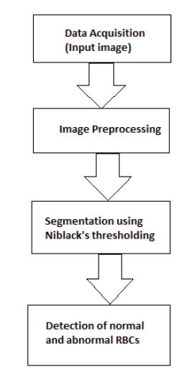
Flow chart for the detection of RBC

Slide 7
Objectives of the system
In this section we will discuss how the targeted method is being implemented for achieving signifificant results in terms of detection of normal RBC and sickle cell. Thresholding is applied to the image data set. Then normal and abnormal RBCs are classifified calculating geometrical parameter i.e. form factor of each cell in the blood images. shows the four microscopic blood images of sickle cell anemic person and their corresponding results after applying Niblack’s thresholding and calculation of form factor to classify normal and abnormal RBCs. In form factor determines the classifification of normal and abnormal RBCs. The RBCs where form factor is nearer to 1 are detected as normal RBCs. For sickle cells value of form factor is nearer to 0.5. Thus using form factor the normal RBCs and sickle cells have been differentiated from the microscopic images.

Slide 8
Thank You

