Slide 1
Online Payroll System
A project built on PHP by
Deepanjan Kowar
CSE 7th Sem
Roll No. 3012213024

Slide 2
Objective
The purpose of developing this software project is to fully automate salary system for the college. This software is capable of calculating monthly salaries and tax of employees of that organization. On the basis of certain formulas it will generate files as an output such as salary slips, Form 16, etc.
Payroll system is the heart of any Human Resource System of an organization. The solution has to take care of calculation of salary as per rules of the company and various deductions to be done from the salary. It has to generate a pay-slip.

Slide 3
Software Requirements
Operating System - Any
Browser - Any (Google Chrome Recommended)
Front End - PHP, HTML, CSS
Back End - MySQL

Slide 4
Hardware Requirements
Memory minimum of 512MB (1 GB Recommended)
Hard disk of 40 GB (Recommended)
Printer (Optional)

Slide 5
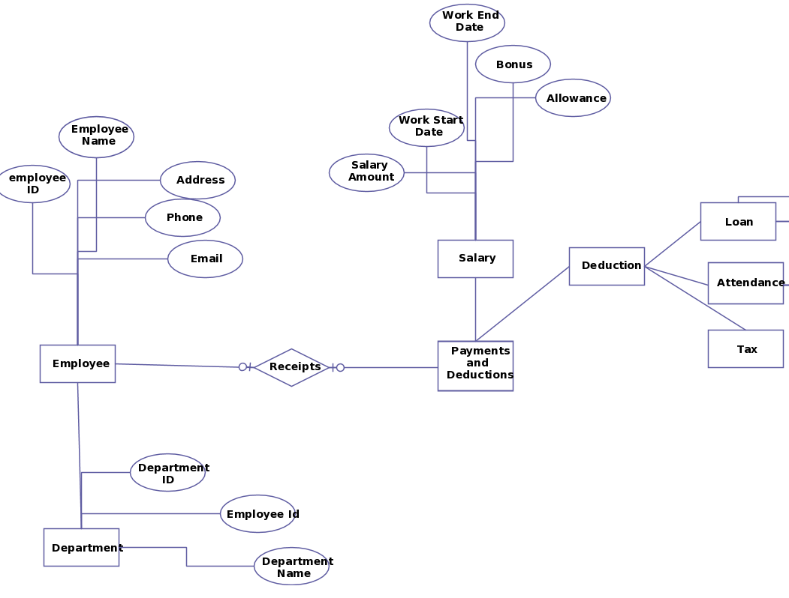
E R Diagram

Slide 6
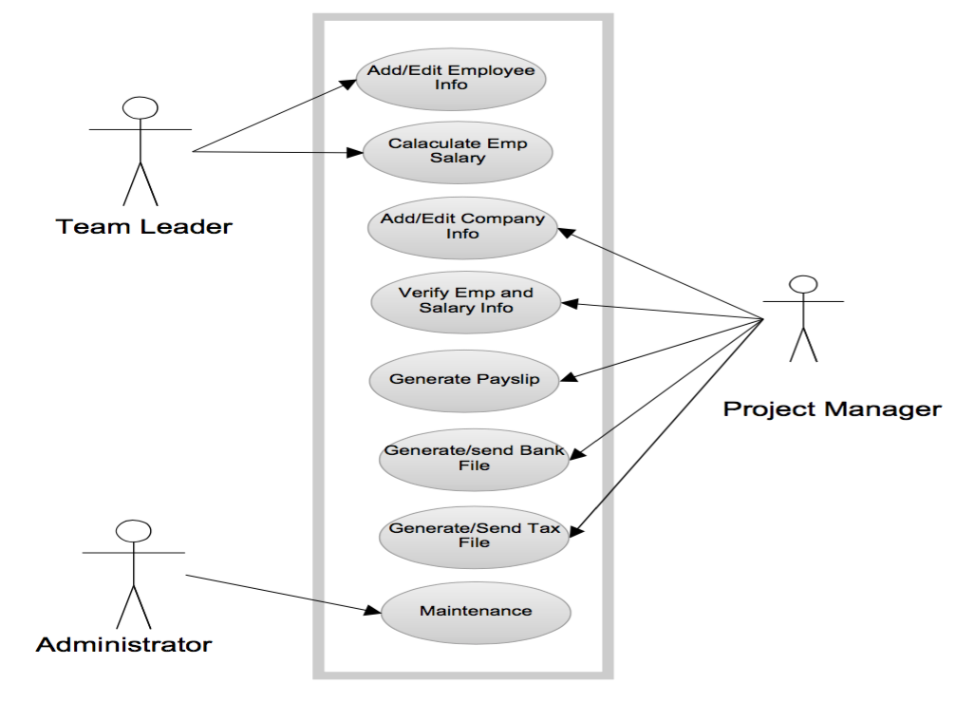
Use Case Diagram
Administrator
Employee
DBA

Slide 7
DFD
Employee
Admin
Online Payroll System
Leave
Reports
Management
Accounts

Slide 8
Tables and Fields
Admin
Username
Password
Employee
Id
Emp No.
Pay
Days Worked
OT Rate
OT Hours
Allowance
Advance
Insurance
Date

Slide 9
Tables and Fields
Employee Info
ID
Emp No.
Photo
Lname
Fname
Initials
Gender
Bdate
Dept
Position
Other Information
Emp No.
Address
Contact
Post
Gender

Slide 10
Architecture
A 3 Tier architecture comprises of following :
Presentation / Client Tier
Middle Tier
Data Tier

Slide 11
Advantages
Speed
Accuracy
Reduced Labor
Convenience
Keeping Up With Regulations

Slide 12
Thank You

