Slide 1
Online Payroll System
A project built on PHP by
Deepanjan Kowar
CSE 8th Sem
Roll No. 3012213024

Slide 2
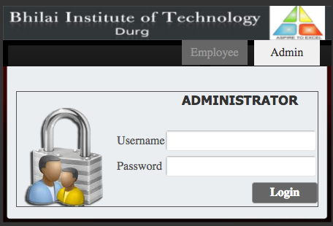
Login Page

Slide 3
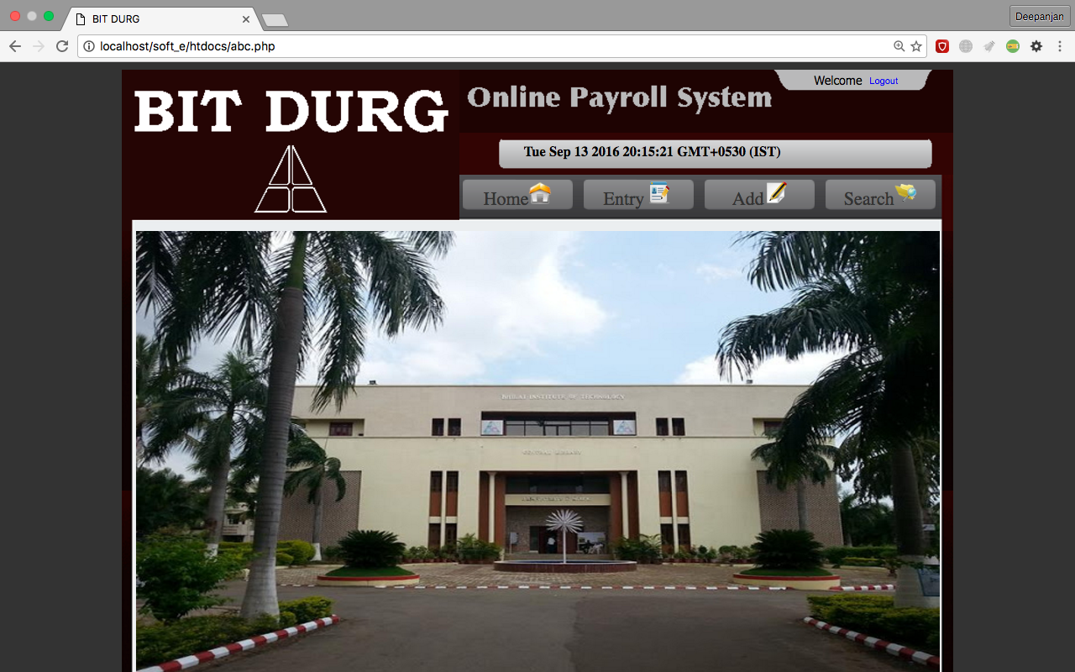
Homepage (For Admin)

Slide 4
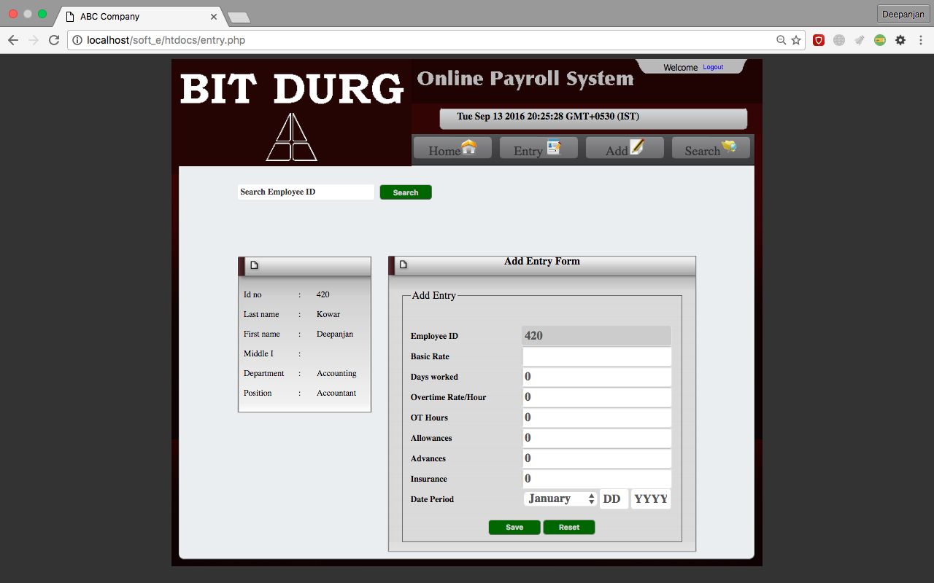
Entry Page

Slide 5
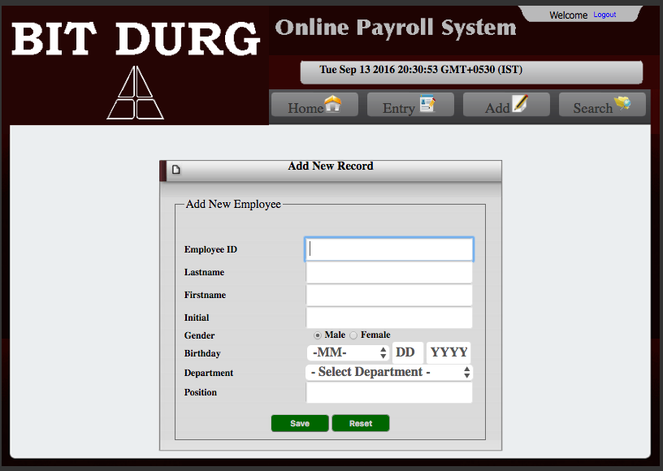
To Add an Employee

Slide 6
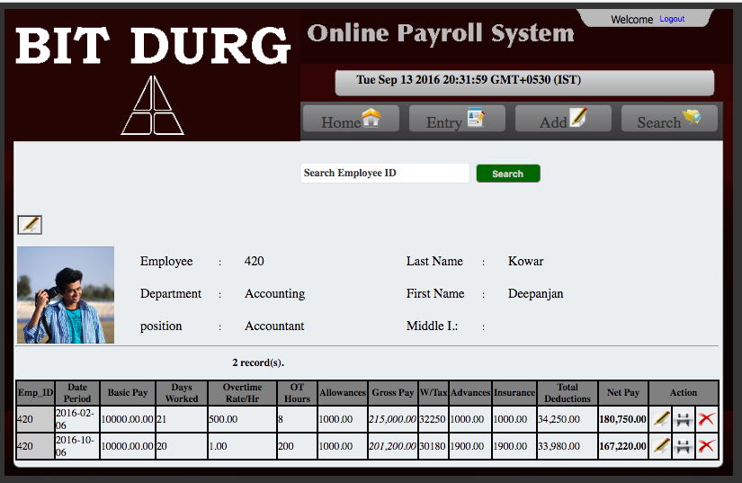
Searching an Employee

Slide 7
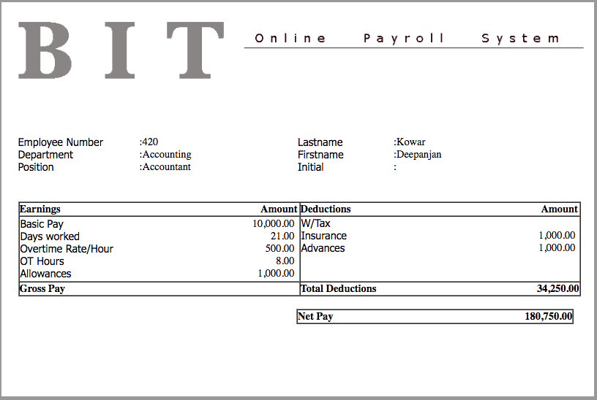
Pay Slip

Slide 8
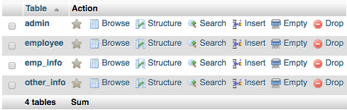
Database

Slide 9

Admin Table

Slide 10
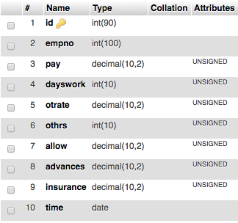
Employee Table

Slide 11
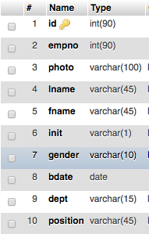
Emp_Info Table

Slide 12
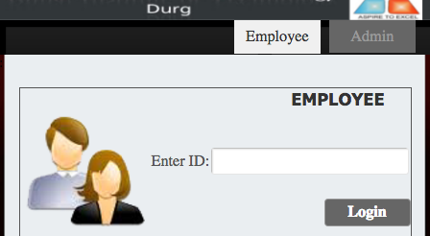
Employee Login

Slide 13
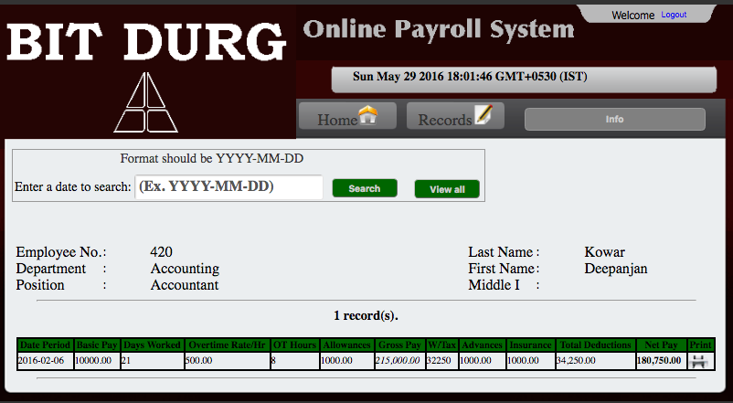
Employee Records

Slide 14
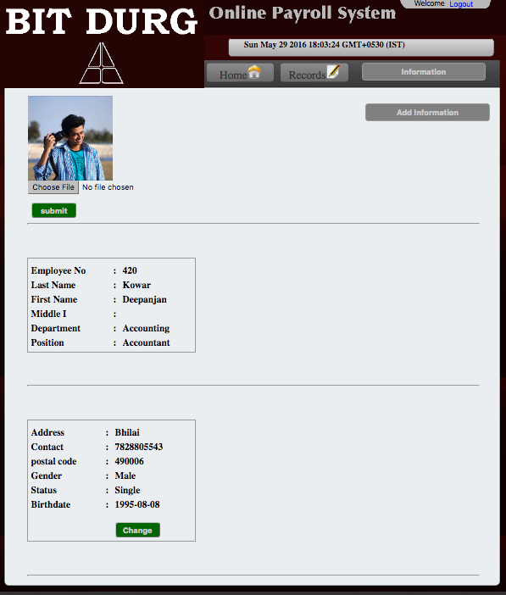
Employee Info Screen

Slide 15
Thank You

