Slide 1
ZENSATION STORE
Group 4 Final Presentation
By
Deepank Khurana(001352458)
Dimple Zatkia(001474071)
Sindhura Kolli(001387687)

Slide 2
EXISTING DESIGN
E-Commerce is a process of buying, selling, transferring or exchanging products, services, and information via electronic networks or computers
With the boom of E-Commerce, there are hundreds of websites on the web with each aimed at bringing something unique to the market
The existing Online E-Commerce stores brings different sellers to one platform
But there is hardly 2-3 ecommerce stores that has wider customer reach, lower cost of operations, global products and increasing internet penetration
Logistics and shipment services are one of the biggest challenges faced by E-Commerce industry

Slide 3
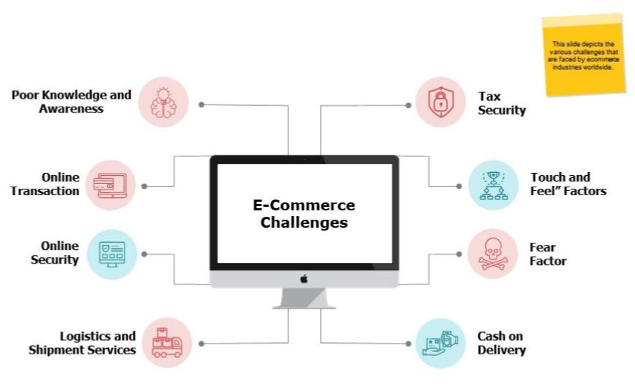
Ecommerce Challenges

Slide 4
Flaws
Most of the e-commerce platforms are focused on only one or two categories and doesn’t explore many verticals. So consumers have to use multiple platforms for different orders
Existing e-commerce platforms are unable to meet supply demand during pandemics
Quality checking is not done and many customers are left unsatisfied

Slide 5
Improvements
Rather than traditional systems which aim to bring different sellers to a single platform, we aim to bring complete stores to our website. Each store will provide whole range of products and both regular customers and business individuals can buy using Zensation
We have tied up with stores all across the world and to maintain the quality, there will be a regular quality inspection at each store
We have a policy of fixed 2 days delivery with no exceptions. If the delivery is delayed customers gets to keep the product and have their money refunded
We have whole range of payment option such as Credit card, Debit card etc.
The range of options Zensation provides is next to none

Slide 6
UX PRINCIPLES
Meet the users’ needs :
The main aim is to meet users needs while using ecommerce website.
Know where you are in the design process:
Knowing the design phase like Sketch, Wireframe, Prototype, Design.
Have a clear hierarchy:
This site have primary and secondary menus.
Keep it consistent:
Consistency is maintained throughout the site.

Slide 7
UX PRINCIPLES Contd.
Understand accessibility:
Design is accessible for all age groups.
Use simple language:
Simple language is used, which enhances it to be user-friendliness.
Narrative design:
User experience design principles is narrative design, or telling a story with your design.

Slide 8
UX RESEARCH METHODS
Ethnographic Field Studies: This method allowed to gather detailed and in-depth information on a society’s customary ideas, values, and practices through participation in its collective social life. To understand the pain points of the users life – what frustrates them, what holds them up.
A/B Testing: Tested different designs on a site by randomly assigning groups of users to interact with each of the different designs and measuring the effect of these assignments on user behavior. For eg: Changing the label of the main call-to-action button from Buy Now to Add to Cart

Slide 9
UX RESEARCH METHODS
Card Sorting: This site has organized items into groups and assign categories to each group. The primary goal of navigation is to help users find information and functionality, and encourage them to take desirable actions. Navigation components include global navigation, local navigation, utility navigation, breadcrumbs, facets, related links, footers, fat footers, and so on.
Participatory Design: participants are given design elements or creative materials in order to construct their ideal experience in a concrete way that expresses what matters to them most and why.

Slide 10
Strategy Plane
Easy and Flexible Onboarding
Easy to Navigate User Panel
Optimal Search Strategy
Content Marketing
Faster One Click Checkout
Review on Product Pages

Slide 11
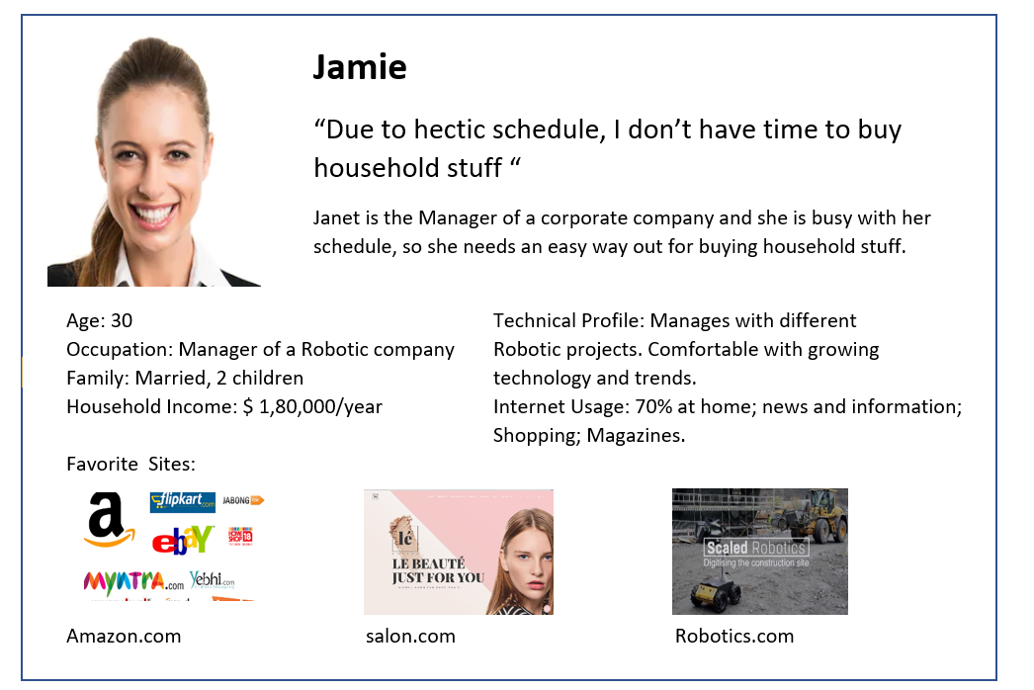
Personas

Slide 12
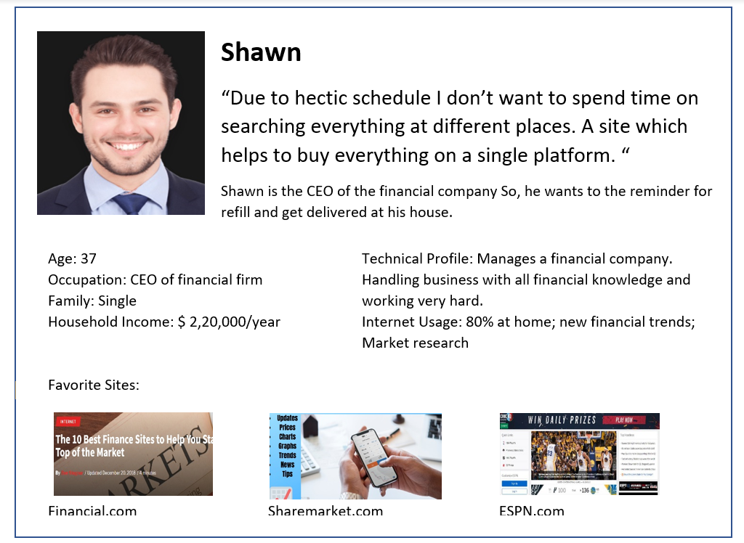
Personas

Slide 13
IBM DESIGN THINKING

Slide 14
THE PRINCIPLES
Our Main goal for the website is to make it Accessible to all kind of users and solve the problems that are there with the existing ecommerce websites and mobile applications. To make this happen:
With user outcome being as the end goal, all user needs are met and continuous modifications were done to make sure final prototype is best in business
Multiples teams are hired with each team has specific role and responsibilities. Technical and Business experts worked alongside developers and researchers to make sure all requirements are met
Multiple team brought many innovative and challenging ideas and after careful discussions, the ideas were incorporated in the prototypes

Slide 15
THE LOOP
We OBSERVED! We REFLECTED!! We DELIVERED
UI/UX research team worked directly with the user. They observed user habits, patterns, gathered information and conducted surveys
Based on User feedback , we reflected that on our design and made changes and then additional users were again interviewed for additional feedback
With this continuous process we were able to generated the most optimal Design that meets business and user requirements

Slide 16
THE KEYS
We understand that Individuals have limited capabilities and the project in hand a much bigger scope. So, for critical decisions, experts were hired and their opinion were sorted.
In addition to having expert members, the stakeholders were also involved in all critical decision making
We continuously worked with real time users to get their inputs and make sure that realistic user expectations are met and we make the user interface as simple as possible.
Regular sprint were held where each teams performance was monitored, feedback was give and issues were resolved

Slide 17
Scope Plane
Functional Requirements
The user should easily navigate the website
The user should be able to make a account on the website
The user should be able to search for products based on his/her requirements
Selling store should be able to list their product without any hassle
User should be able to add or remove products from the cart
Payment should always go through. User shouldn’t face any issue during checkout
Seller should be able to accept or decline orders without any hassle
User should be able to cancel or return the order in a certain time frame

Slide 18
Scope Plane
Content Requirements
Elaborated Images and visual clips should be provided for the user.
There should be shortcut menus provided to the user for easy navigation.
Homepage should be attractive and pretty easy to use.
The product displays the updated details of costs, ratings, delivery of the product.
The site should provide information about various brand
Gifts cards and membership plan should be available in the application

Slide 19
Structural Plane Conceptual Model
The homepage should include the features of application in brief.
The site should be tested correctly with three layers of error handling that is prevention, correction, recovery.
The homepage should consists of interactive menus that lands to jewelry, Clothing, Accessories, Home & living, Music, Movies etc.
The site should define patterns and sequences in which options will be presented to users.

Slide 20
Structural Plane
Error Handling
The application provides smooth onboarding process which reduces user error.
Simple user interaction by provision of checkboxes, radio buttons, date picker help in prevention of errors.
While entering the data, it provides appropriate information as to how data needs to be filled.
User should have an option to edit the data entered. If it is incorrect then user can go back to the previous activity to edit.

Slide 21
GOOGLE MATERIAL DESIGN
Google Material Design was incorporated in our website to provide continuity throughout the application
The Images used for products has plain background in order to highlight the product and avoid distraction
The color used across the website is pleasant and constant. Application’s primary and secondary colors ensure that there is pretty good contrast between the elements so all user can see and use application
All the text is in black font and it was made sure that readability of the website remains good
Writing style is also consistent throughout the whole website

Slide 22
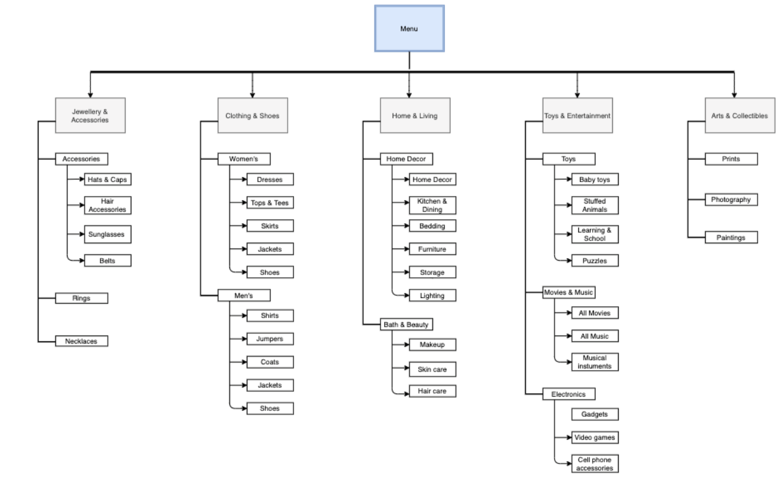
Information Architecture

Slide 23
On Boarding
The onboarding process is pretty smooth and simple
There is a step by step instructions about how to create an account, how to search items, how to place order etc. on the homepage
Sign Up and Sign In process is simple and user can use range of options to sign up/sign in such as Facebook account, Google account etc.
The website has reviews and star-based rating system for user reference. User can read the reviews and see overall rating for the product they are interested in
We also provide information regarding trending products and stores and which item is best selling so user can make informative decisions

Slide 24
User Requirements Considered
The user prefers a single application to buy different products.
The website should provide some graphical data to show user’s progress.
Users requires special gifts and membership plans
The website should give variety of different brand products.
The content of the website should be text based along with video/images for better understanding.
The website’s homepage should give overall idea of the contents included in the website.

Slide 25
QA TESTING
Test Case ID | Test Scenario | Test Steps | Test Data | Expected Results | Actual Results | Pass/Fail
TC01 | Check User Signup with valid Data | Go to site ZensationSignUp Page and Preview Enter Full Name Enter Email Address Enter Password Click Submit | Full Name = John Email Address = john@gmail.com Password = John@123 | User should Sign up into application | As Expected | Pass
TC02 | Check User Signup with invalid Data | Go to site ZensationSignUp Page and Preview Enter Full Name Enter Email Address Enter Password Click Submit | Full Name = John Email Address = john Password = Joh123 | User should not Sign up into application | As Expected | Pass

Slide 26
QA TESTING
Test Case ID | Test Scenario | Test Steps | Test Data | Expected Results | Actual Results | Pass/Fail
TC03 | Check User Login with valid Data | Go to site ZensationSignIn Page and Preview Enter UserId Enter Password Click Submit | Userid = john@gmail.com Password = John@123 | User should Login into application | As Expected | Pass
TC04 | Check User Login with invalid Data | Go to site ZensationSignIn Page and Preview Enter UserId Enter Password Click Submit | Userid = john@gmail.com Password = john123 | User should not Login into application | As Expected | Pass

Slide 27
QA TESTING
Test Case ID | Test Scenario | Test Steps | Test Data | Expected Results | Actual Results | Pass/Fail
TC05 | Check cart with valid Data | Go to BeddingCart Page and Preview Select Quantity(Single Unit Price = $49.72) | Qty = 4 | User should see Estimated total as $309.96 | As Expected | Pass
TC06 | Check Guest Checkout with invalid Data | Go to site ContinueAsGuest Page and Preview Enter Full Name, Email Address, Country, Street address, zip code, city, state Click Continue to Payment | Full Name =Guest Email = abc Country =United States Street = 1 A street Zip code= 123456 City = Boston State = Massachussets | Guest should not be able to continue payment with incorrect email format | As Expected | Pass

Slide 28
WIREFRAME
https://app.moqups.com/vUAjRgxwbR/edit
https://app.axure.cloud/app/project/ikbpet/overview

Slide 29
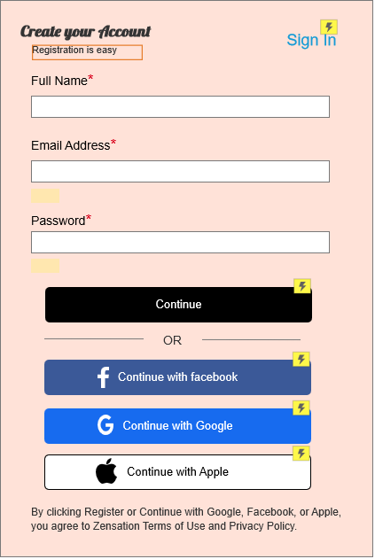
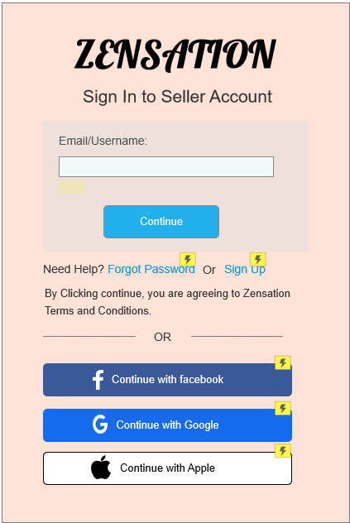
SIGN-IN AND SIGN-UP PAGE

Slide 30
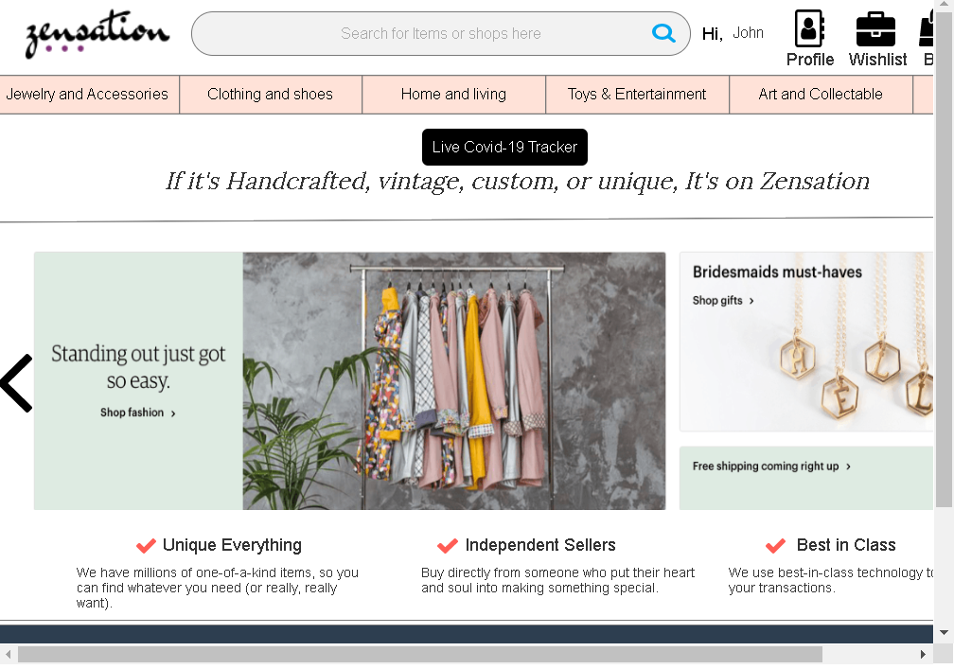
HOMEPAGE

Slide 31
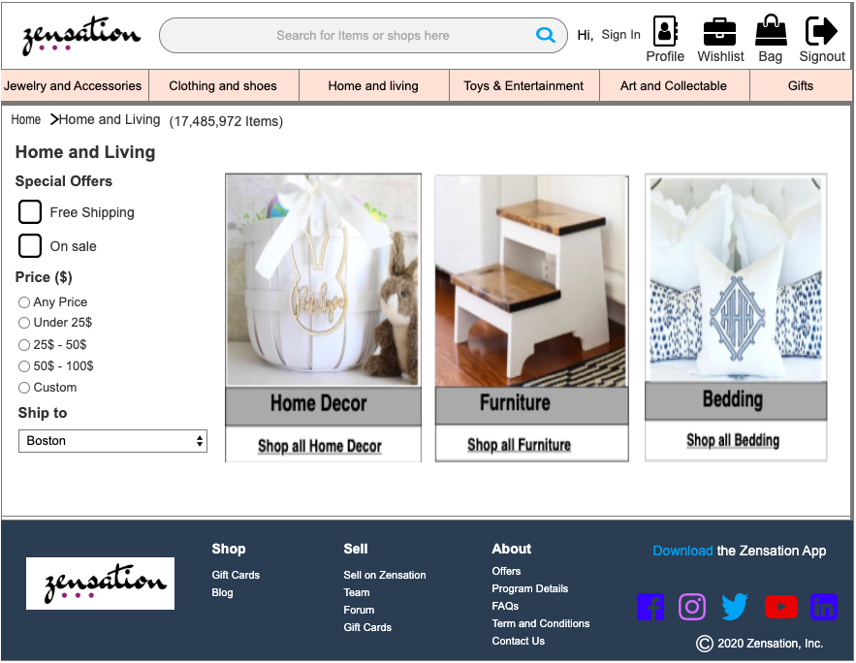
PRODUCT CATEGORIES

Slide 32
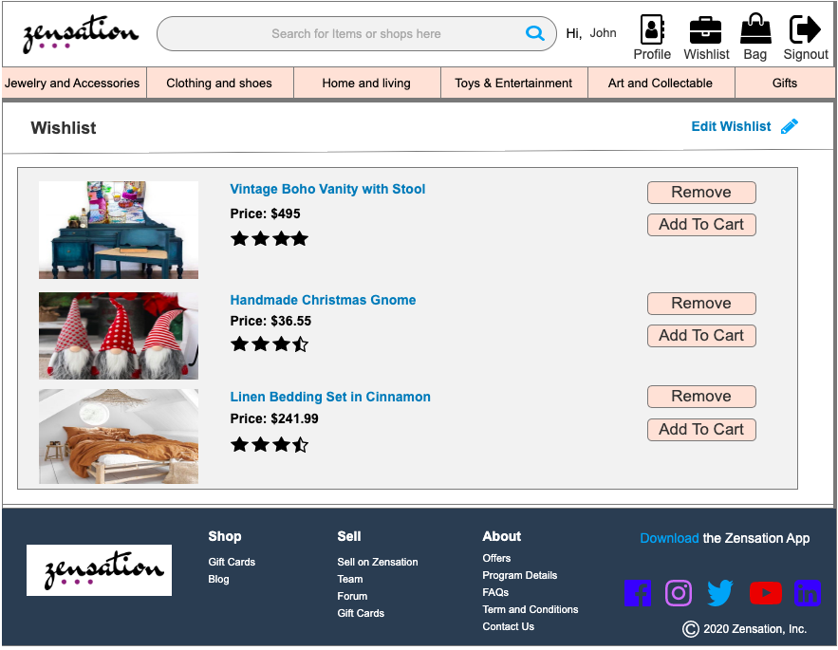
WISH LIST PAGE

Slide 33
Thank You!!

