Slide 1

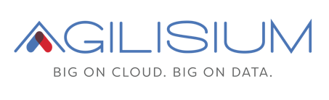
Data Assurance Framework

Slide 2
Highlights :
7 common scenarios are automated across all ETL based projects.
Improved Test coverage – Test coverage will be improved by effective planning of automation scripts.
Scenarios to be covered as part of this Framework :
Data Extraction: Handling data from various formats (CSV, Parquet, text, etc.) and databases (SQL-based or cloud databases).
Schema validation - Comparing schema definitions between the source and target datasets.
Row-by-Row Comparison: Checking the consistency of the data row by row.
Column-by-Column Comparison: Checking individual column values for equality.
Primary Key Duplicate validation
Not null values specified for Business key columns
Source Minus Target validation
Report Generation - The framework should output detailed reports (CSV) to summarize validation results, mismatches, and any discrepancies found during the comparisons.
Aggregation Validation: Comparing the results of aggregation functions (sum, count, avg, etc.) between the source and target.

Slide 3
Framework Benefits :
Common set of quality test cases for different scenario’s across all the projects.
Standard test queries to validate across testing platform.
Complete data set can be tested with 100% accuracy between source and target table data comparison.
No time consuming for regression.
Technologies & Services Used:
AWS Glue – ETL processing
Amazon RDS – Relational database storage
PostgreSQL – Database engine
Amazon S3 – Data storage and retrieval
IAM Roles – Access and permissions management
AWS Secrets Manager – Secure credential management
Amazon CloudWatch – Monitoring and logging
PySpark – Distributed data processing
Python – Scripting and automation

Slide 4
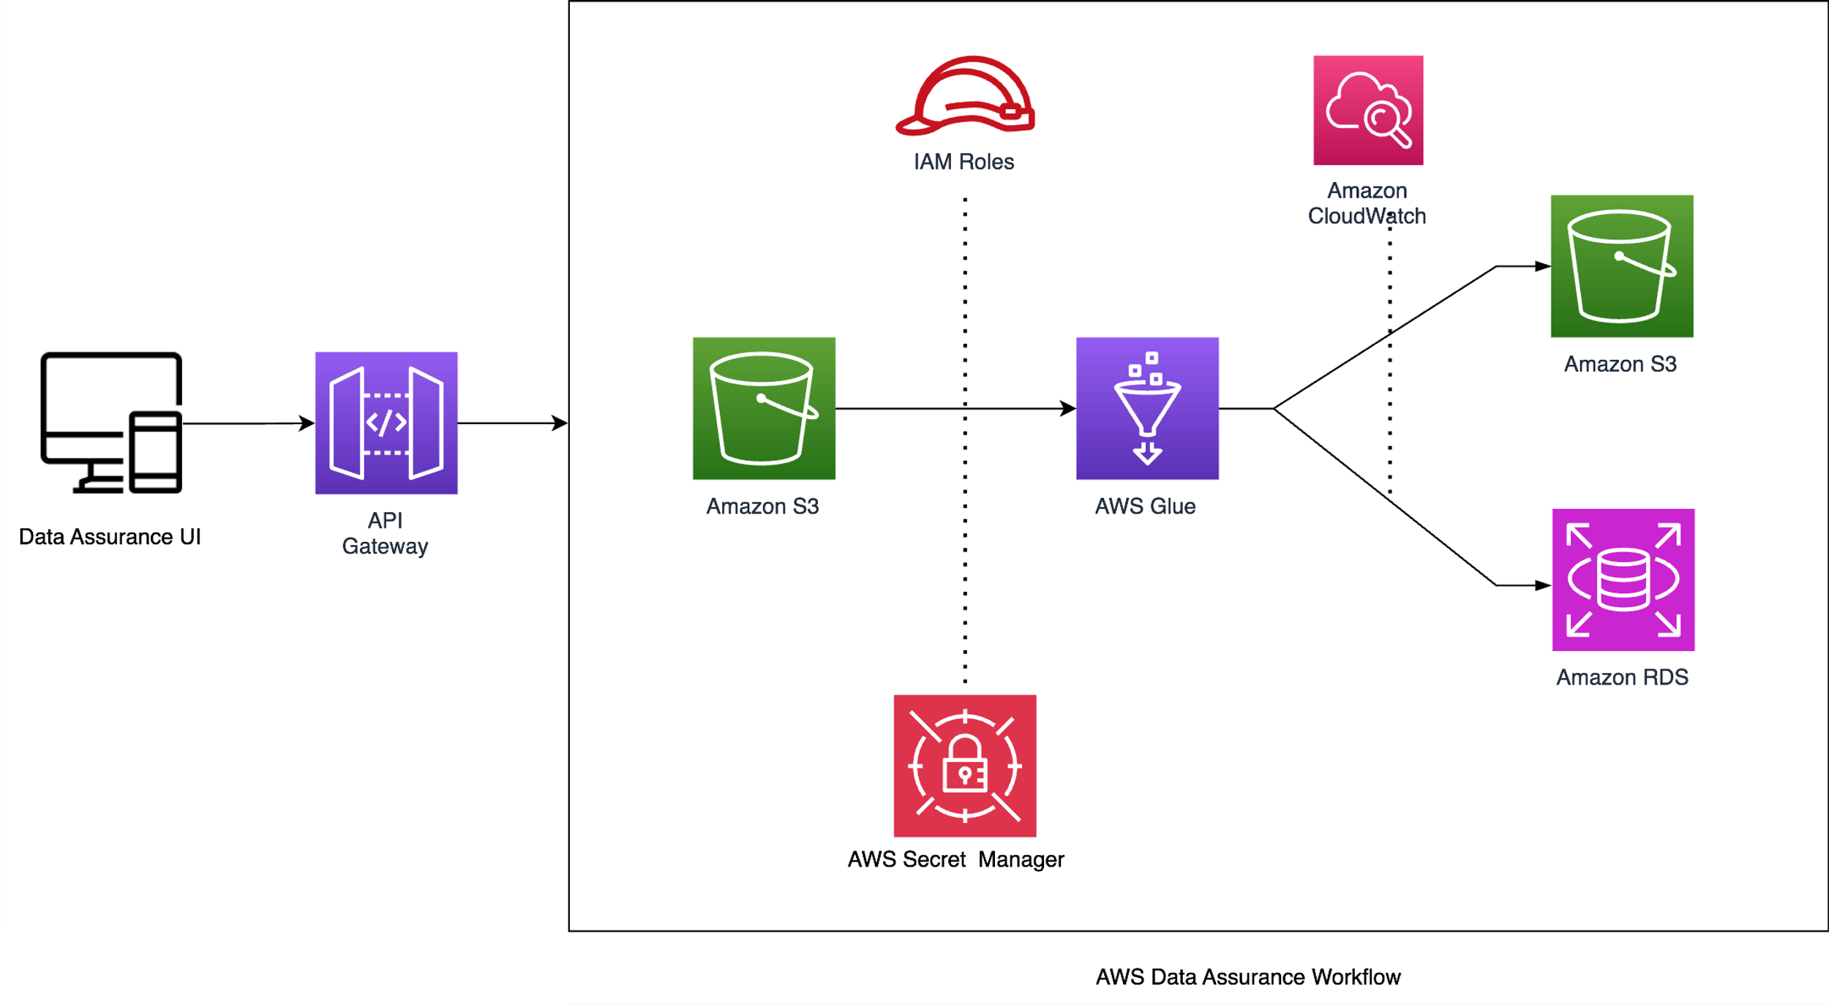
Data Assurance Architecture

Slide 5
Thank You

