Slide 1
DATA VISUALIZATION & ANALYTICS | DVA CAPSTONE 2 | NEWTON SCHOOL OF TECHNOLOGY
UK Road Safety Analysis
Accident Trends, Risk Factors & Safety Insights
KEY NUMBERS
927K
SECTOR
TEAM ID
MENTOR
DATE
Section E
G-4
Archit Raj
April 29, 2026
Total Accidents
1.2%
TEAM MEMBERS
Ved Pawar
Aaryan Krishna
Dev Kothari
Fatal Rate
Yash Agrawal
Adityaraj Pal
Deepanshu Choudhary
13.2%
🔗 GitHub:
github.com/Deepanshu-Nst/SectionE_G-4_UK-Road-Safety
Serious Rate
📊 Tableau:
public.tableau.com/app/profile/dev.kothari/viz/UKAccidentAnalysis2...
1.34
Avg Casualties

Slide 2
CONTEXT & PROBLEM STATEMENT
Why UK Road Safety Needs Data-Driven Action
🌍 SECTOR CONTEXT
🎯 PROBLEM STATEMENT
✅ OBJECTIVE
Transportation & Public Safety sector
Large accident datasets exist but remain underutilized
Analyze 1.8M+ UK accident records
UK roads: ~1,700+ fatalities annually
Safety measures are broad & generalized
Identify key severity drivers (weather, light, location)
Billions in economic loss each year
No targeted visibility into WHERE & WHY severe accidents occur
Detect high-risk hotspots & time patterns
Strong regulations exist — yet accidents persist
High-risk zones go unidentified and unaddressed
Deliver interactive dashboards for decision-makers
KEY DECISION-MAKERS: Transport Authorities · Urban Planners · Road Safety Regulators · Policy Makers

Slide 3
DATA ENGINEERING
DATASET
From Raw Data to Analytical Pipeline
Kaggle UK Road Safety
~1.8M records
30+ columns | Multi-year (2005–2014)
Python: pandas · numpy · Jupyter
DATA DICTIONARY
01
02
03
04
05
Accident Severity
Raw Data
Cleaning
Feature Eng.
Analysis
Slight / Serious / Fatal
Tableau
No. of Vehicles
CSV Import
Schema Validation
Null Handling
Duplicate Removal
Hour / Month
Time Buckets
EDA & Stats
KPI Computation
Interactive
Dashboards
Count involved
No. of Casualties
Injured + fatal victims
ETL STEPS EXECUTED
Date / Time
Parsed to hour, month, weekday
Missing Values
Filled with 'Unknown' or mode — weather, road surface, light conditions
Weather Condition
Rain, fog, snow, fine...
Duplicate Removal
Accident Index + row-level check → exact duplicates removed
Light Conditions
Datetime Parsing
Date/Time → hour, weekday, month for temporal analysis
Daylight / Darkness type
Road Type
Feature Engineering
Time buckets: AM Rush / PM Rush / Night / Late Night created
Single / dual carriageway
Urban or Rural
Standardization
Snake_case columns, consistent category labels for Tableau filters
Area classification

Slide 4
KPI & METRICS FRAMEWORK
Executive Dashboard Cards — What We Measure & Why
Total Accidents
Fatal Accident Count
Severe Accident Rate
Casualties per Accident
927,320
10,977
14.4%
1.34
Formula: Count of all records
Formula: Severity = Fatal
Formula: (Serious+Fatal) / Total × 100
Formula: Total Casualties / Total Accidents
Overall road safety burden
Loss-of-life indicator
High-risk incident proportion
Avg. human impact per event
Night Accident Share
Weather Risk Rate
Peak Hour Accident Rate
Urban Accident Share
~18%
~22%
~28%
~63%
Formula: Night Accidents / Total × 100
Formula: Adverse Weather Accidents / Total × 100
Formula: Rush Hour Accidents / Total × 100
Formula: Urban Accidents / Total × 100
Low-visibility risk period
Environmental impact measure
Congestion-driven risk
Dense traffic zone risk

Slide 5
KEY INSIGHTS FROM EDA
What the Data Tells Us
INSIGHT SUMMARY
📌 794K Slight accidents dominate volume — but Serious & Fatal drive REAL impact
📉 Year-on-year decline confirms policy progress — but risk remains persistent
🌧️ Rain, fog, snow → higher severity despite fewer total accidents
🌙 Darkness (no street light): 4× higher fatal rate than daylight
🏙️ Urban = more accidents; Rural = higher fatality rate (speed + delayed EMS)
🚗 Multi-vehicle crashes raise casualty counts — chain-collision risk (r = 0.62)

Slide 6
ADVANCED ANALYSIS
Statistical Testing & Root Cause Findings
ANOVA
ANOVA
Chi-Square
Spearman
Severity vs Weather
Severity vs Light
Severity vs Urban/Rural
Vehicles vs Casualties
F = 58.21
F = 74.35
χ² = 112.4
r = 0.62
p < 0.0001 | ✓ Significant
p < 0.0001 | ✓ Significant
p < 0.0001 | ✓ Significant
p < 0.0001 | ✓ Moderate +ve
Accident severity varies significantly across weather conditions
Lighting conditions strongly influence accident severity
Area type classification significantly linked to severity
More vehicles involved → higher casualties (chain collision)
ROOT CAUSE DRIVERS
🌑 Poor Visibility
🚗 High-Speed Rural Roads
🌧️ Adverse Weather
💥 Multi-Vehicle Collisions
Darkness (no lights): 4.03% fatal rate — highest risk condition
Rural fatal rate 2× urban due to speed & delayed EMS
Fog, rain, snow statistically confirmed to raise severity (ANOVA)
Spearman r=0.62: more vehicles = more casualties
HIGHEST RISK SCENARIOS: Night + Rain → peak severity · Rural + High Speed → fatal outcomes · Multi-Vehicle → casualty spikes

Slide 7
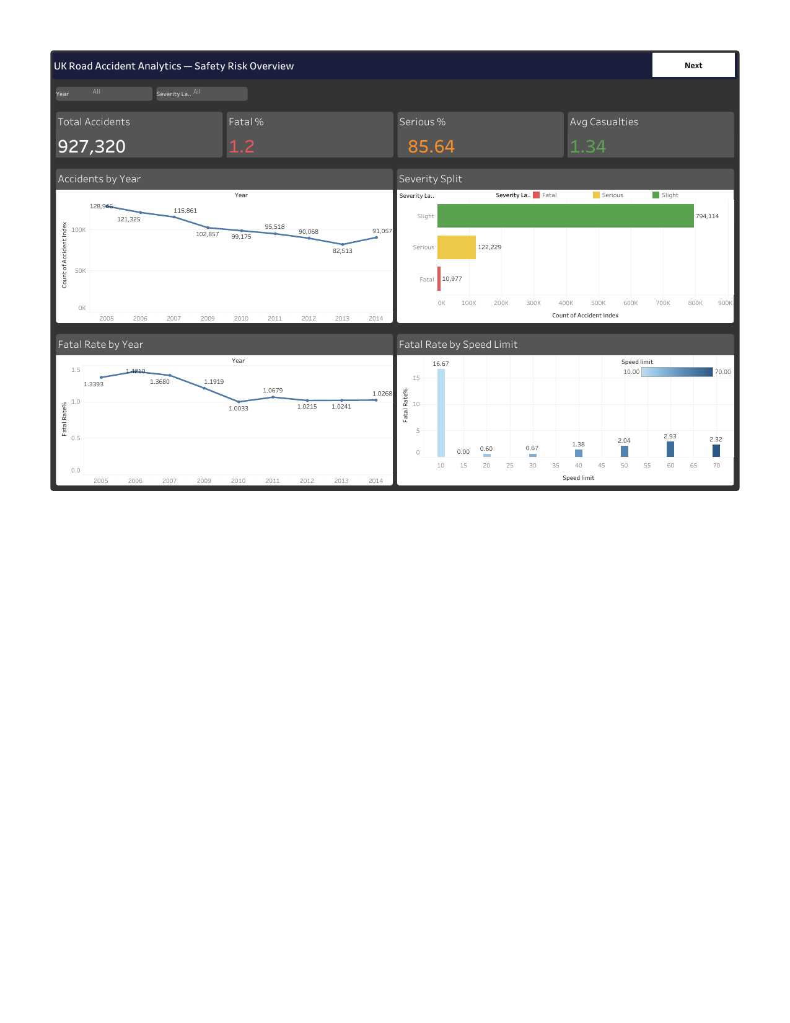
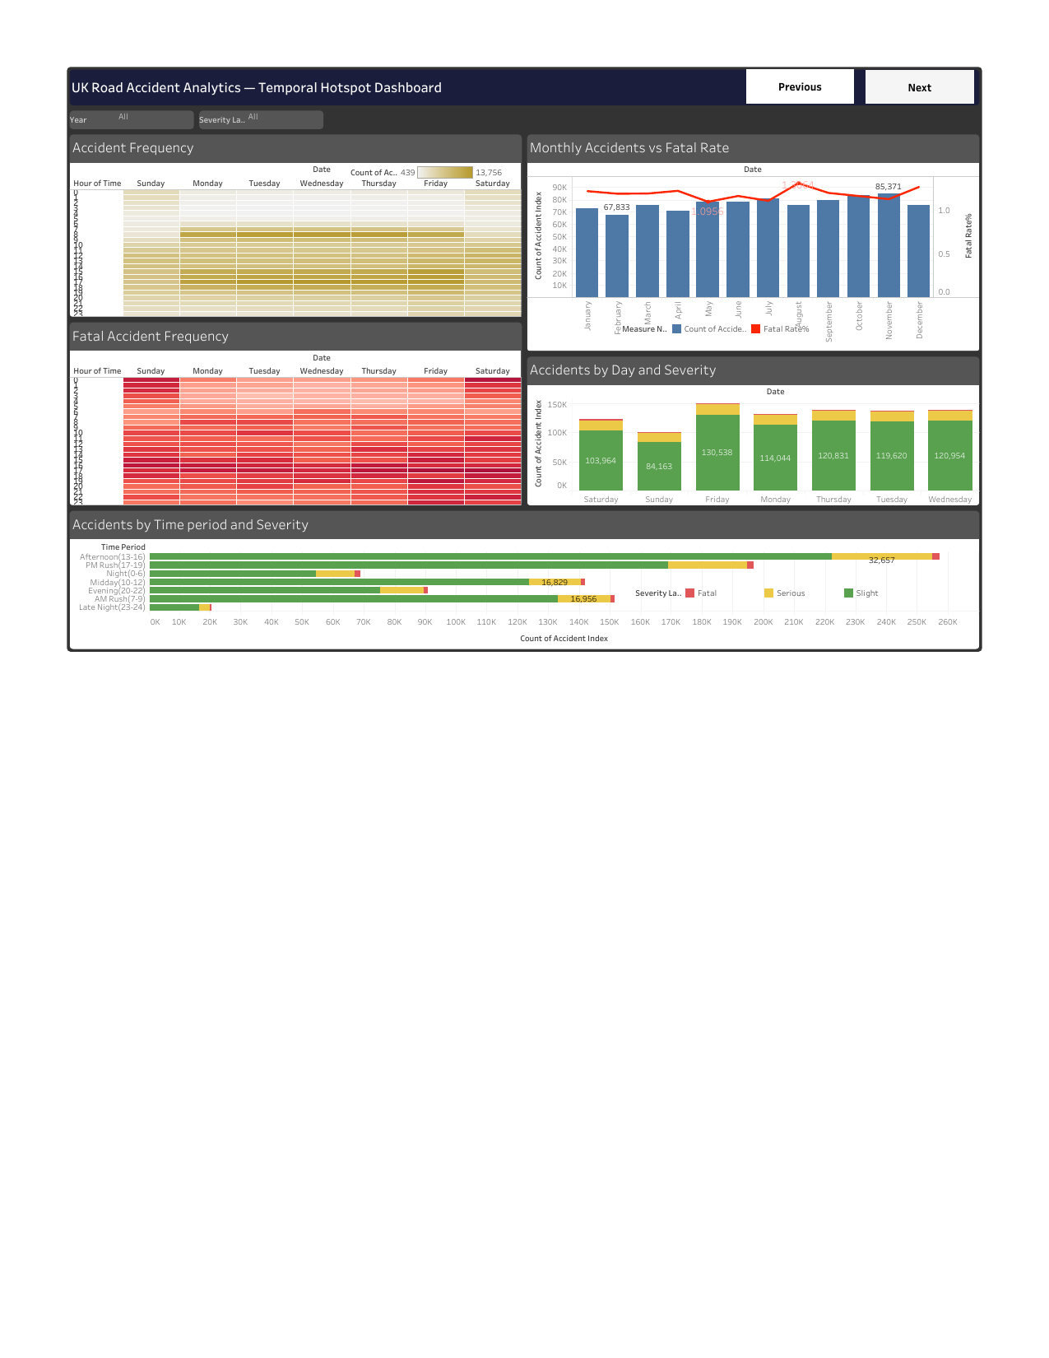
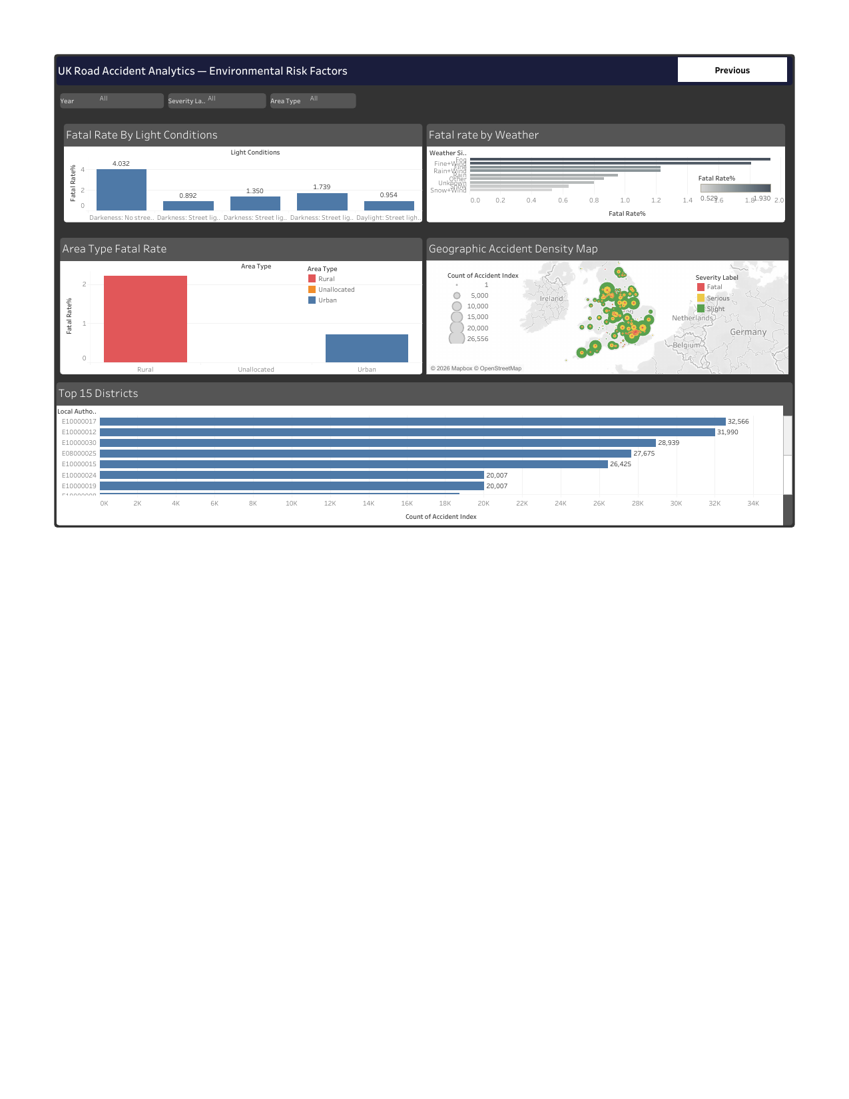
TABLEAU DASHBOARD WALKTHROUGH
Three Interactive Views for Decision-Makers
1. Safety Risk Overview
2. Temporal Hotspot
3. Environmental Risk
Executive KPI Summary
Time & Day Analysis
Weather, Light & Geography
Total Accidents · Fatal % · Severity Split · Fatal Rate by Speed
Hour/Day heatmaps · Monthly trends · Rush hour patterns
Light conditions · Weather fatality · Geographic density map
INTERACTIVE FILTERS: 📅 Year · ⚠️ Severity Level · 🏙️ Area Type (Urban / Rural)
🔗 Tableau Public Dashboard

Slide 8
RECOMMENDATIONS
Insight → Recommendation → Expected Impact
#
INSIGHT
RECOMMENDATION
EXPECTED IMPACT
Severity rises sharply in fog, rain & snow (ANOVA F=58.21)
Deploy weather-responsive adaptive speed limits, real-time alerts & dynamic signage in high-risk corridors
10–15% reduction in severe accidents during adverse weather
R1
Darkness (no street light) has 4× higher fatal rate vs daylight
Expand street lighting coverage, install reflective road signs & enforce stricter night-time speed limits
8–12% reduction in fatal accidents; improved visibility response
R2
Rural areas show 2× higher fatality rate due to speed & delayed EMS
Deploy speed cameras in rural zones, improve emergency response infrastructure & run awareness campaigns
12–18% reduction in rural fatalities
R3
Multi-vehicle crashes increase casualties significantly (r=0.62)
Implement signal optimization, lane discipline enforcement & real-time traffic monitoring at congestion hotspots
10–20% fewer chain-collision incidents
R4
Accident risk varies by location — uniform policy is ineffective
Build centralized hotspot dashboard (Python + Tableau) to direct enforcement & infrastructure spend
8–10% accident reduction in high-risk zones via targeted action
R5

Slide 9
IMPACT & VALUE
The Business Case for Action
10–15%
8–12%
12–18%
10–20%
8–10%
Severe Accident Reduction
Fatal Accident Reduction
Rural Fatality Reduction
Chain Collision Reduction
Hotspot Zone Reduction
R1 — Weather Systems
R2 — Night Safety
R3 — Rural Zones
R4 — Congestion Ctrl
R5 — Targeted Intv.
BROADER VALUE DELIVERED
⚠️ COST OF INACTION
✅ Data-driven safety resource allocation vs. uniform spending
· Preventable fatalities continue each year
✅ Early hotspot identification → proactive not reactive policy
· Safety budget spent on low-impact zones
✅ Reusable Python + Tableau pipeline for continuous monitoring
· High-risk hours & locations remain unmonitored
✅ Scalable to real-time with live data API integration
· Rural communities bear disproportionate risk
· Opportunity to save lives with data already available — wasted

Slide 10
LIMITATIONS & NEXT STEPS
What We Know, What We Don't, and Where We Go Next
⚠️ LIMITATIONS
🚀 NEXT STEPS & FUTURE SCOPE
No Driver Behavior Data
01
ML Prediction Model
Fatigue, distraction, alcohol influence — not captured in dataset
Classification & time-series forecasting to predict severity & identify high-risk windows in advance
Missing Real-Time Context
Real-Time Dashboard
Static historical data; no live traffic density or road conditions
02
Integrate live traffic, weather & IoT sensor feeds for dynamic risk monitoring
Correlation ≠ Causation
Patterns identified but causal mechanisms need further validation
03
GIS Hotspot Mapping
Advanced geospatial analysis for precise accident hotspot maps enabling location-specific interventions
Reporting Bias Possible
Only police-reported accidents; minor incidents may be excluded
04
Smart City Integration
Inconsistent Categories
Connect to adaptive traffic signals, automated alerts & coordinated emergency response systems
Some records contain missing or inconsistent categorical values across years
Scope Constraint
05
Policy Simulation
Predictive modelling and real-time traffic analysis out of scope
Scenario modelling to evaluate intervention impact BEFORE implementation, improving decision efficiency

Slide 11
CONCLUSION
Data-Driven Safety Can Save Lives
This analysis of 927,320 UK road accident records reveals clear, actionable patterns. Environmental factors — weather, light conditions, and road type — are statistically proven severity drivers. With targeted interventions guided by this data pipeline, authorities can prevent thousands of casualties annually.
PROJECT SUMMARY
Dataset:
1.8M accident records
Period:
2005 – 2014
🎯 Severity-focused policy outperforms volume-focused approaches
Tools:
Python · Tableau
🔬 Statistical testing confirms environmental factors are root causes
Tests Run:
ANOVA · Chi-Sq · Spearman
📊 Interactive Tableau dashboards make insights accessible to decision-makers
Dashboards:
3 Interactive Views
🚀 Scalable to real-time ML & smart city integration
Recommendations:
5 Actionable Insights
Thank You
Section E · Team G-4 · Newton School of Technology · DVA Capstone 2 · April 2026

