Slide 1
CSES003
PROJECT
Title :- Visualizing the N-Queen Problem Solution
Name :- Deepanshu Singh
Reg No. :- 12212527
Section :- PK01
GitHub link:- https://github.com/Deepanshu-three/NQUEENS
Submitted by :-
Deepanshu Singh
Submitted to:-
Mr. Rahul Singh

Slide 2

Visualizing the N-Queen Problem Solution

Slide 3



Visualizing the N-Queen Problem
The N-Queen problem is a classic algorithmic challenge that involves placing N queens on an N x N chessboard such that no two queens attack each other. This slide introduces the problem and its signiﬁcance in computer science.

Slide 4


Understanding the
Problem
The goal of the N-Queen problem is to ﬁnd all possible solutions where N queens can be placed on an N x N chessboard without any two queens attacking each other. This involves ensuring that no two queens share the same row, column, or diagonal.

Slide 5


Implementing a Java Swing Solution
This slide explores a Java Swing-based approach to visualizing the solutions to the N-Queen problem. Java Swing is a powerful GUI toolkit that allows for the creation of interactive and visually appealing applications.

Slide 6

Backtracking Algorithm
The solution to the N-Queen problem often relies on a backtracking algorithm, which recursively attempts to place queens on the chessboard, backtracking when a solution is not found. This slide discusses the implementation of the backtracking algorithm in the Java Swing solution.

Slide 7
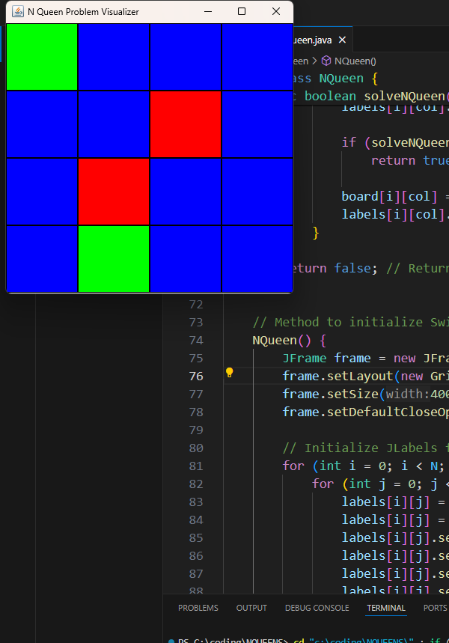
Visualizing the Solutions
The Java Swing-based solution allows users to visualize the solutions to the N-Queen problem. This slide showcases the interactive features of the application, such as the ability to step through the solution or display all possible solutions.

Slide 8





Optimizing the Solution
The slide discusses various optimization techniques that can be applied to the Java Swing-based solution to improve its performance and efﬁciency, such as using bitwise operations or pruning techniques.

Slide 9
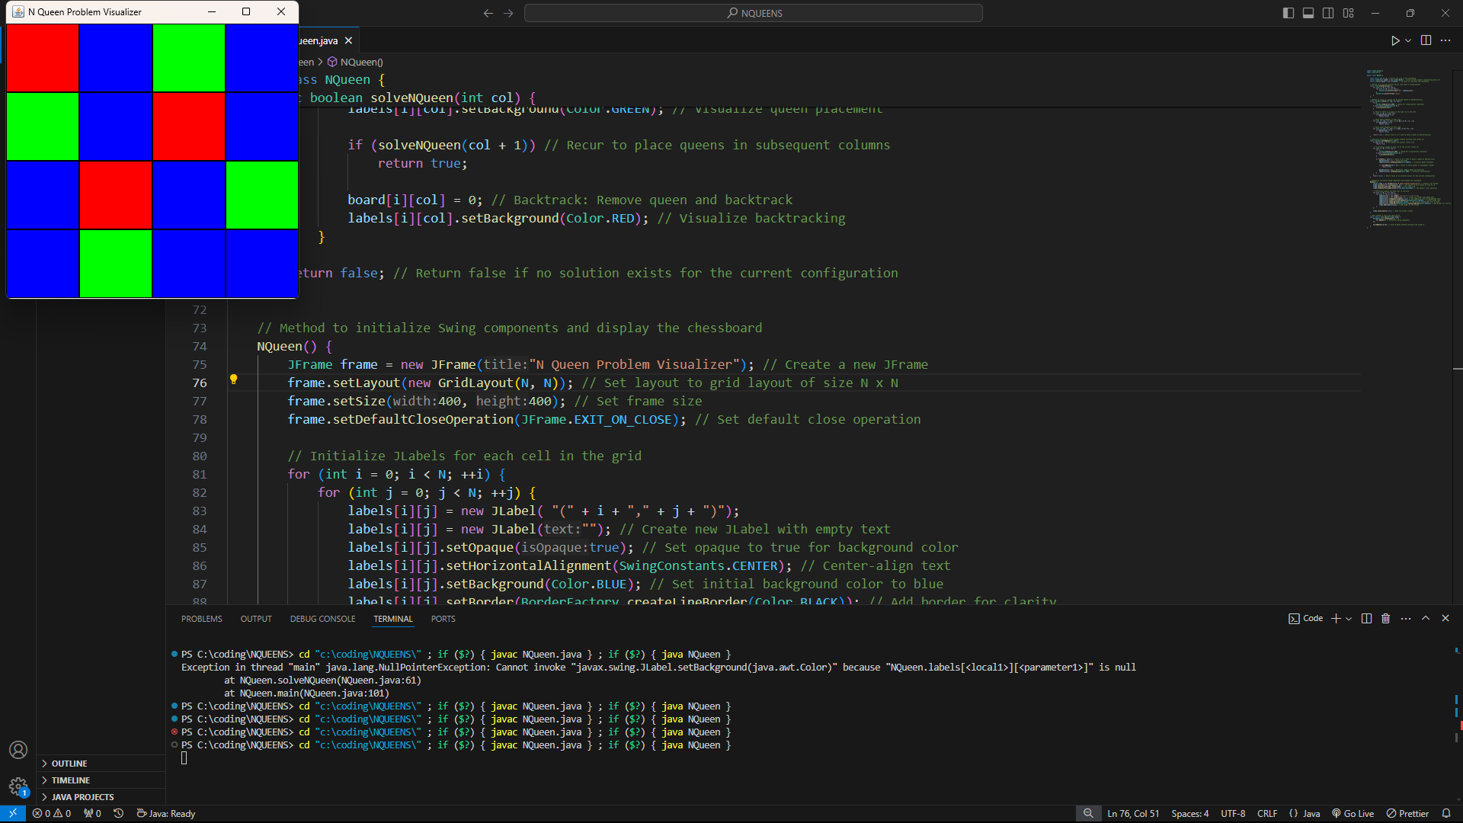





Applications and E tensions
The N-Queen problem has numerous applications in computer science, such as in constraint programming, scheduling, and cryptography. This slide explores some of these applications and discusses potential extensions of the Java Swing-based solution.

Slide 10



Conclusion
In conclusion, the Java Swing-based solution presented in this presentation provides a visual and interactive approach to solving the N-Queen problem. The combination of backtracking algorithms, optimization techniques, and Java Swing makes this solution a valuable tool for understanding and exploring the N-Queen problem.

Slide 11
Thanks!
12212527
Deepanshu Singh

