Slide 1
Project Presentation of Co-Op Project at Industry (Module-1)
On
Threshold-Tuned Gradient Boosting for Fetal Health Classification
Deepanshu | Harshit Kukreja | Arsh Sudan | Inder Goswami
2210990253 | 2210990387 | 2210990167 | 2210991677
Team-17
Supervised By
Rajat Takkar, Chitkara University
Department of Computer Science and Engineexsring,
Chitkara University, Punjab

Slide 2


Introduction & Objective
report_problem
Problem Statement
Fetal health monitoring via Cardiotocography (CTG) is critical for early detection of fetal distress
Manual CTG interpretation varies widely between clinicians — delays can prove fatal
lightbulb
Key Insights
Recall > Precision > Accuracy
Missing Pathological case → baby could die (Worst Outcome)
False alarm → extra tests, but baby is safe (Acceptable Cost)
flag
Primary Objectives
Classify 2,113 CTG records into Normal, Suspect, or Pathological
Achieve 100% Pathological Recall while maintaining accuracy
Utilize Gradient Boosting with two-stage optimization
2

Slide 3
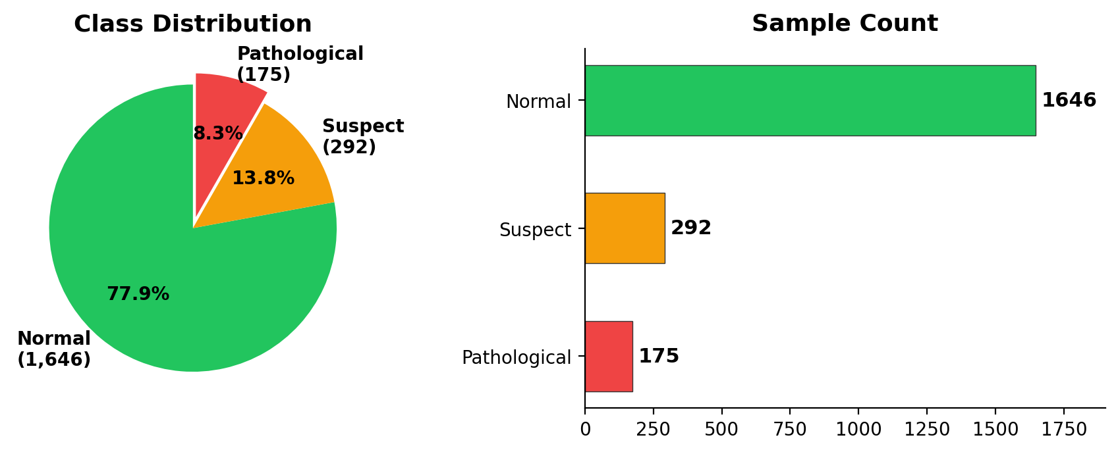
Dataset & EDA
UCI Fetal Health CTG
2,113 records (after deduplication)
21 features, 0 null values
Heavy class imbalance: Pathological is only 8.3%
Class Distribution
Key EDA Findings
Top Predictors: Prolonged decelerations, abnormal short-term variability
Heavy right skew in deceleration variables
Features kept untransformed; tree models handle skew via rank-order splits
3

Slide 4
Preprocessing Experiments
Rather than applying preprocessing as a default pipeline step, each technique was tested in isolation against a no-preprocessing baseline:
IQR-based Outlier Capping: Values beyond 1.5×IQR were clipped to the fence values.
Log Transformation: Applied to positively skewed features to reduce distributional asymmetry.
Feature Engineering: Nine derived features were created (ratios, products, interaction terms).
SMOTE and Variants: Synthetic Minority Over-sampling Technique, Borderline-SMOTE, and ADASYN.
Feature Scaling: StandardScaler (zero mean, unit variance).
Preprocessing Ablation Results None of the tested preprocessing steps improved the top tree-based models:
Outlier Capping: RF accuracy 95.04% → 94.33%. Trees handle extremes naturally; clipping removes clinical signal.
Log Transform: Degraded performance. Monotonic remapping doesn't affect split order.
Feature Engineering (+9): RF accuracy → 94.33%. Importance dilution across correlated columns.
SMOTE + GB: Patho recall 100% but Suspect recall dropped 79.31% → 70.69%.
Feature Scaling: GBDT accuracy 95.98% → 95.04%. Tree splits depend only on ordering

Slide 5
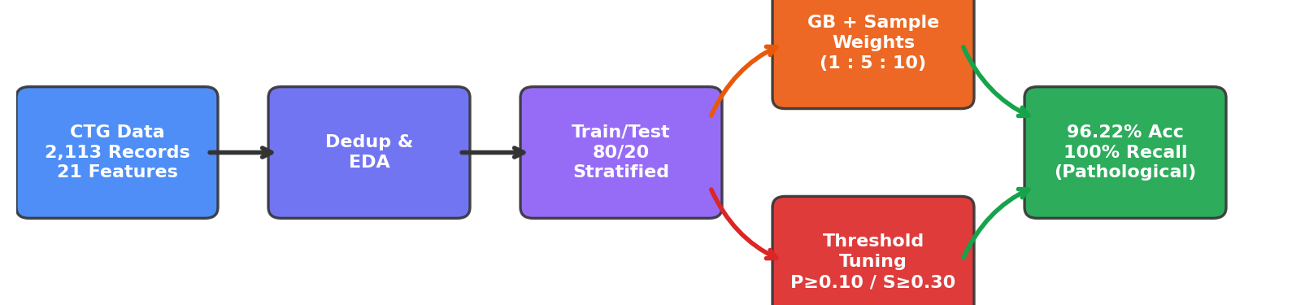
Methodology: Key Takeaways
Stage 1: Sample Weighting
Cost-Aware weight distribution to handle class imbalance:
Normal : Suspect : Pathological 1 : 5 : 10
Stage 2: Threshold Tuning
Post-Hoc probability adjustments for conservative classification:
P(Pathological) ≥ 0.10
P(Suspect) ≥ 0.30
Preprocessing Ablation: Outlier capping, log transforms, SMOTE, and feature engineering were tested but degraded top tree-based models.
Result: Original features kept untransformed for optimal performance.
4

Slide 6
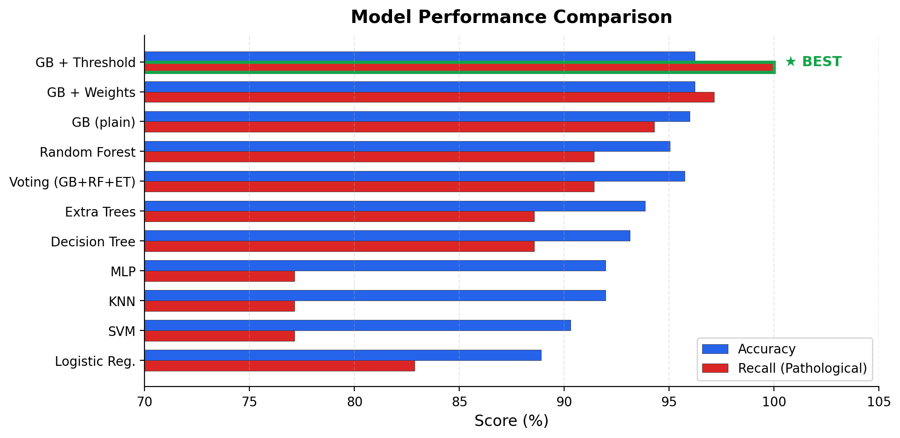
Results — Model Comparison
11 configurations benchmarked: GB (3 variants), RF, Extra Trees, Decision Tree,
SVM, KNN, Logistic Regression, MLP, Voting Ensemble | Train/Test: 80/20 stratified
5

Slide 7
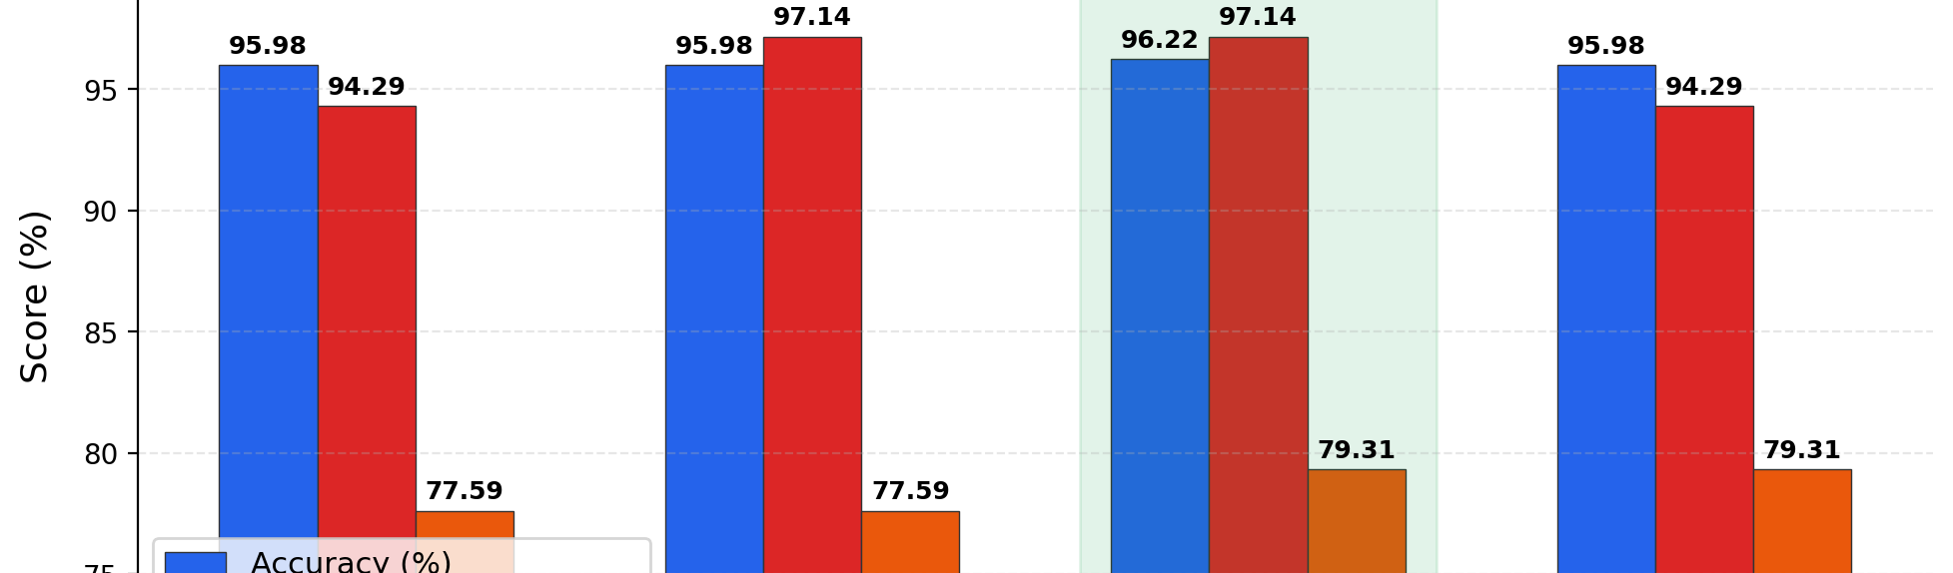
Sample Weighting
Why Sample Weighting?
Class Imbalance: Pathological class is only 8.3% (175 / 2,113)
Bias Correction: Standard training treats samples equally, biasing toward "Normal"
Cost Penalty: Assigns higher cost to misclassifying minority classes
How It Works
Assigned Weights: Normal = 1x, Suspect = 5x, Pathological = 10x
Loss Penalization: Errors on Pathological cases penalized 10x more
Gradient Shift: Adjusts signal without altering data distribution
Sample Weight Configuration Comparison — Gradient Boosting
5

Slide 8
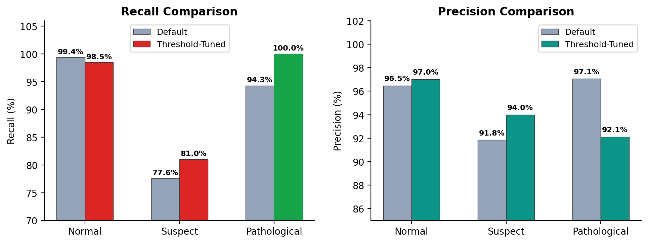
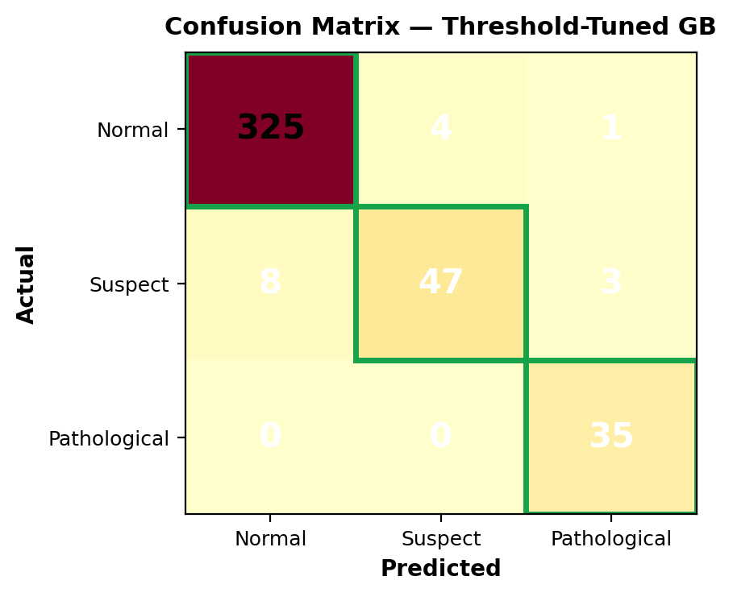
Threshold Tuning and Confusion Matrix
Key Takeaways:
100% Pathological Recall — Zero missed sick cases achieved via threshold tuning.
High Precision: Only 3 false alarms out of 38 Pathological predictions (92.11%).
Suspect recall improved from 77.59% → 81.03%.
Robustness: 94.08% ± 1.17% Accuracy (5-Fold CV).
Model Performance: Recall Comparison
Confusion Matrix (Threshold-Tuned GB)
Page 6

Slide 9
Conclusion & Future Scope
Conclusion
96.22% Accuracy & 100% Recall: Achieved with Pathological class.
Optimized Strategy: Two-stage weighting + threshold tuning outperforms all configurations.
Preprocessing Risks: Outlier capping and SMOTE can degrade tree-based model performance.
Gradient Boosting: Superior at correcting errors on hard minority samples.
Future Scope
Validation: External testing on diverse hospital CTG data and populations.
Clinical Impact: Prospective trials to measure real patient outcomes.
Advanced Architectures: Deep learning (LSTMs/Transformers) on raw FHR/UC waveforms.
Real-time Support: Bedside decision tools with clinician feedback loops.
Slide 7

Slide 10
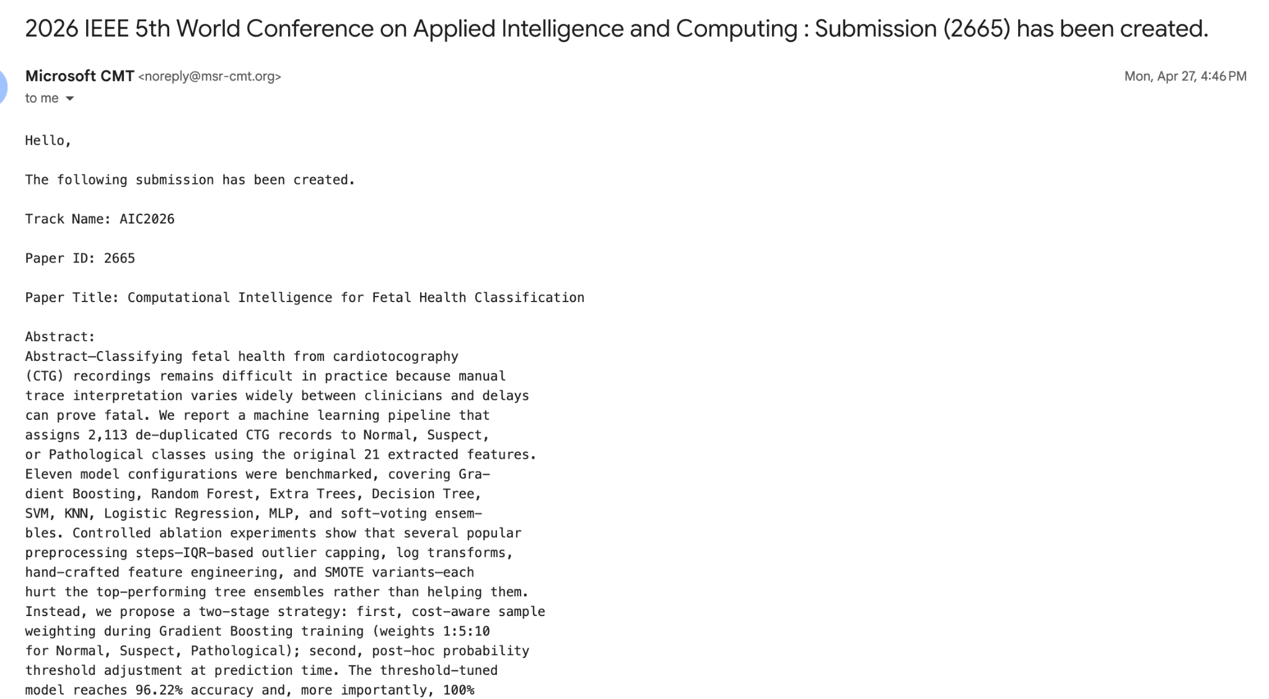
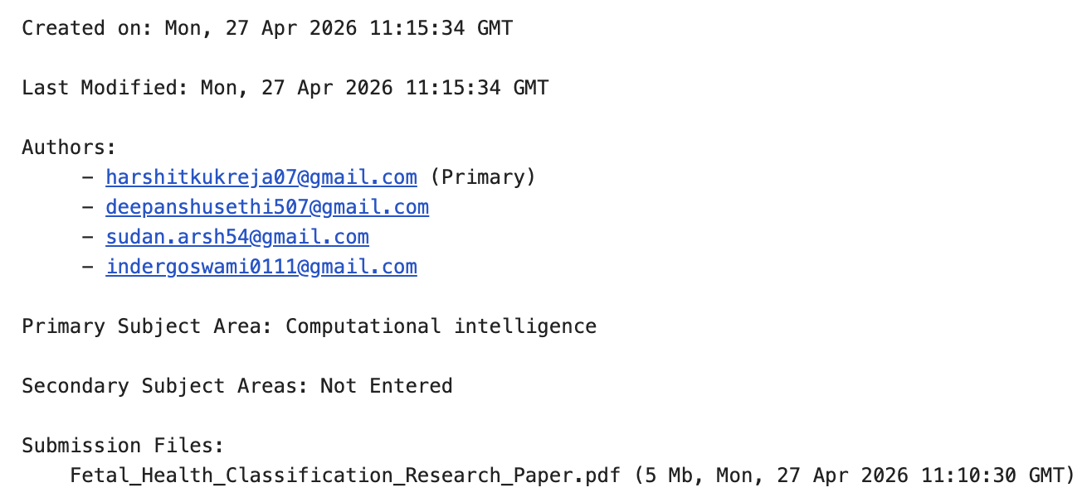
Conference Submission Details
This research was submitted to the 2026 IEEE 5th World Conference on Applied Intelligence and Computing (AIC 2026).
Paper ID: 2665
Title: Computational Intelligence for Fetal Health Classification
Authors: Harshit Kukreja, Deepanshu Sethi, Arsh Sudan, Inder Goswami (Chitkara University)
Primary Subject Area: Computational Intelligence
Submission Date: April 27, 2026

Slide 11
References
[1] Şahin & Subasi (2015). Classification of cardiotocogram data. Applied Soft Computing, 33.
[2] Rahmayanti et al. (2022). Comparison of ML algorithms for fetal health. Procedia CS, 197.
[3] Subasi et al. (2020). Cardiotocogram classification using bagging. Procedia CS, 168.
[4] Bache & Lichman (2013). UCI Machine Learning Repository.
[5] Cömert & Kocamaz (2017). ML techniques for fetal heart rate. Acta Physica Polonica A, 132.
[6] Cömert et al. (2019). Prediction of intrapartum fetal hypoxia. Health Info. Sci. & Systems, 7.
[7] Sundar et al. (2012). Cardiotocogram classification using neural networks. IJCA, 47.
[8] Batra et al. (2017). Cardiotocography analysis using conjunction of ML algorithms.
8

Slide 12
Thank You

