Slide 1
ARTISIAN WORLD
GROUP NO:-38
KIRTI PATIL(1142)
DEEPANSHU CHAUDHARY(1045)

Slide 2
ACTORS IN PROJECT:-
1.ARTIST
2.CUSTOMER
3.ADMIN

Slide 3
FUNCTIONALITIES OF ARTIST:-
Artist can add/delete painting.
Artist can see the customer list.
Artist can see list of orders.

Slide 4
FUNCTIONALITIES OF CUSTOMER:-
Customer can see the list of products.
Customer can contact for custom product.

Slide 5
FUNCTIONALITIES OF ADMIN:-
Admin can see the list of artist.
Admin can edit the list of artist.
Admin can see the list of customers.
Admin can edit the list of Customers.
Admin can see the list of paintings.

Slide 6
Screenshots of project

Slide 7
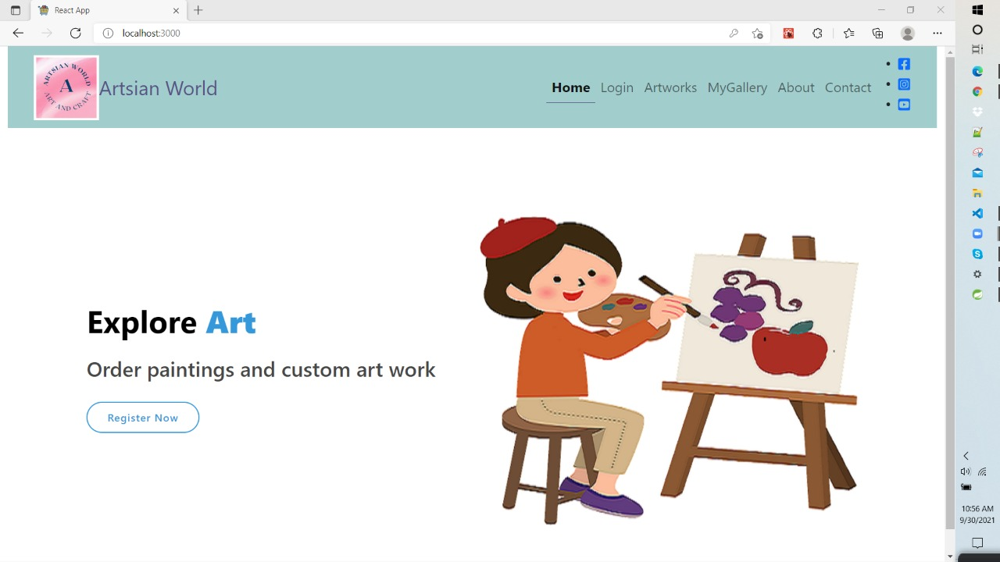
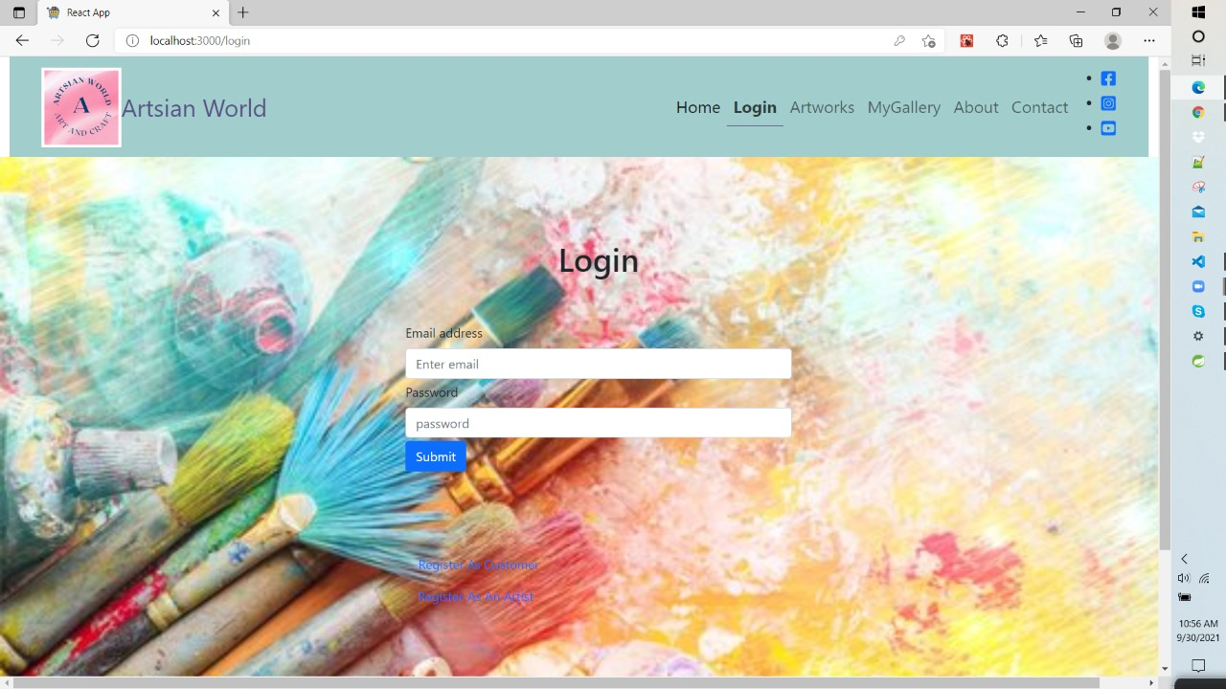

Slide 9
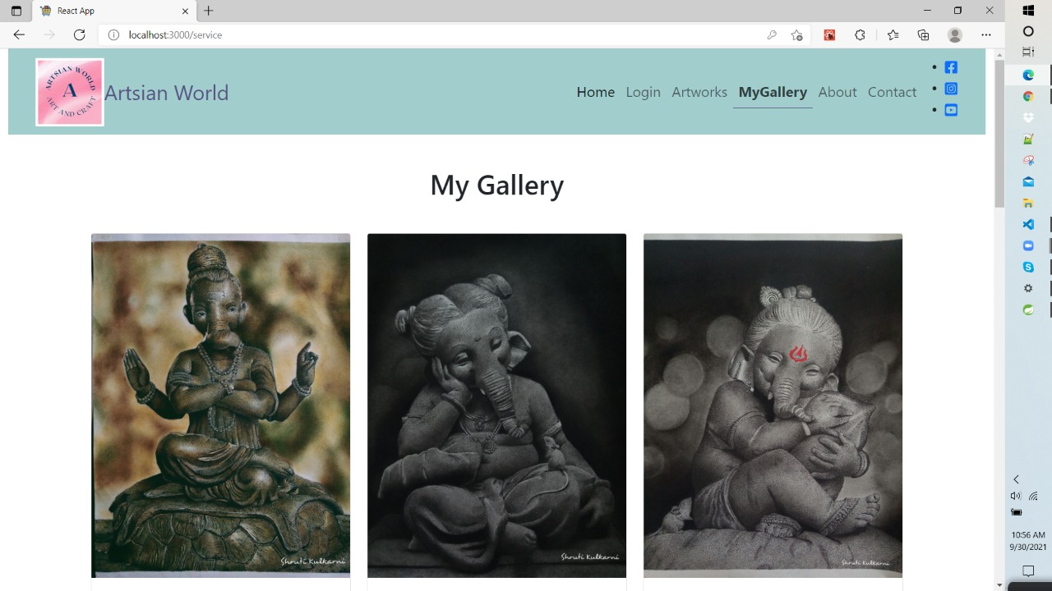

Slide 10
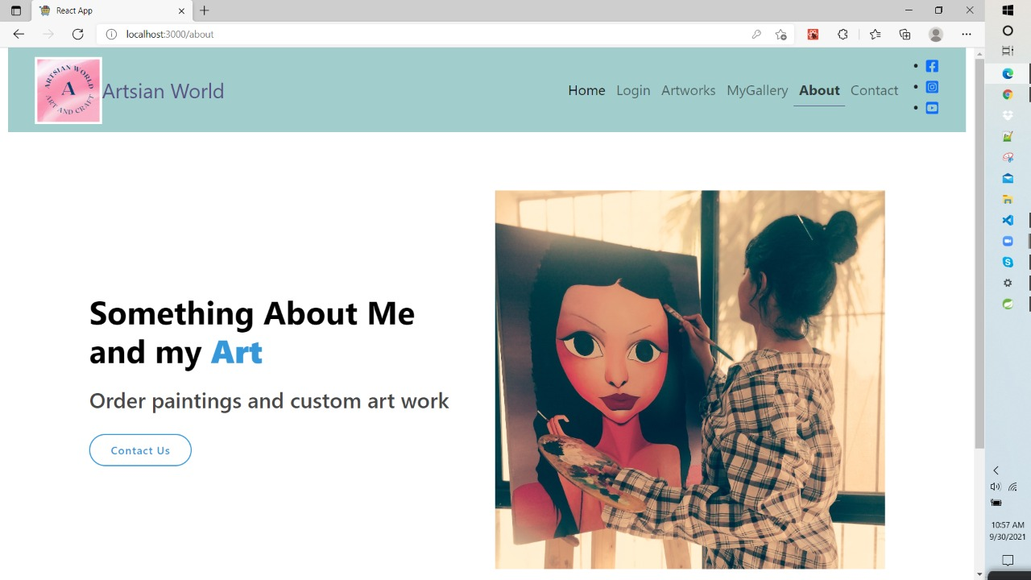

Slide 11
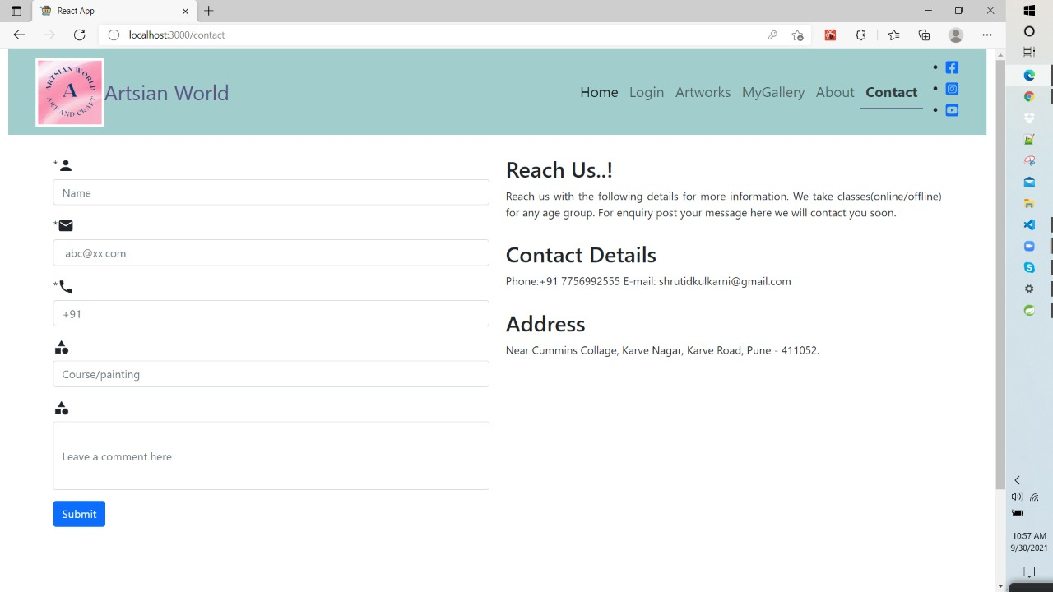

Slide 12
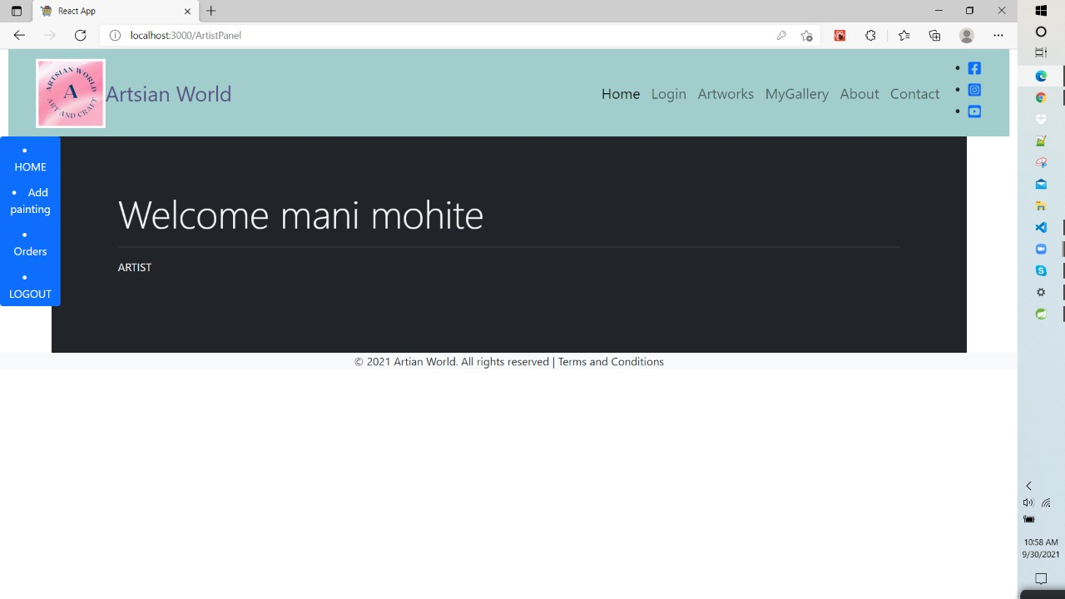

Slide 13
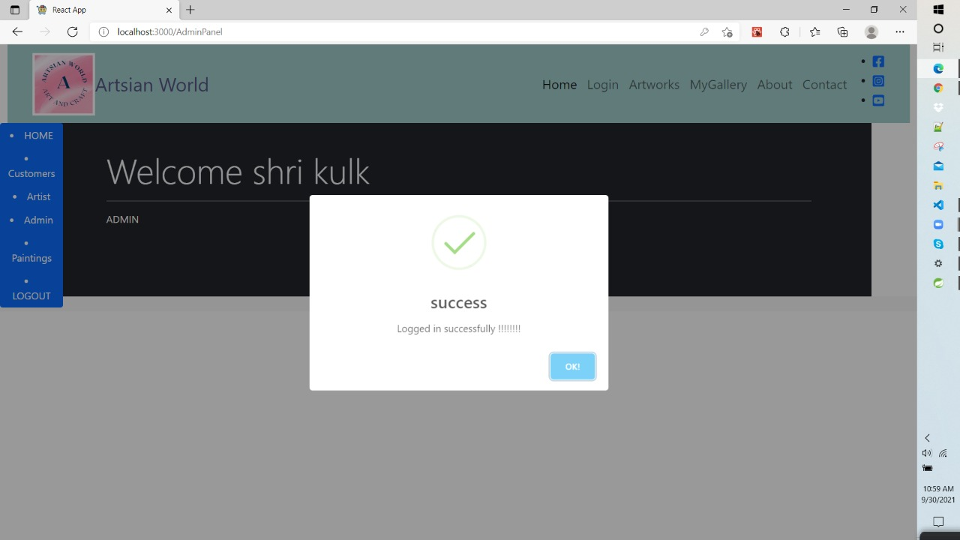

Slide 14
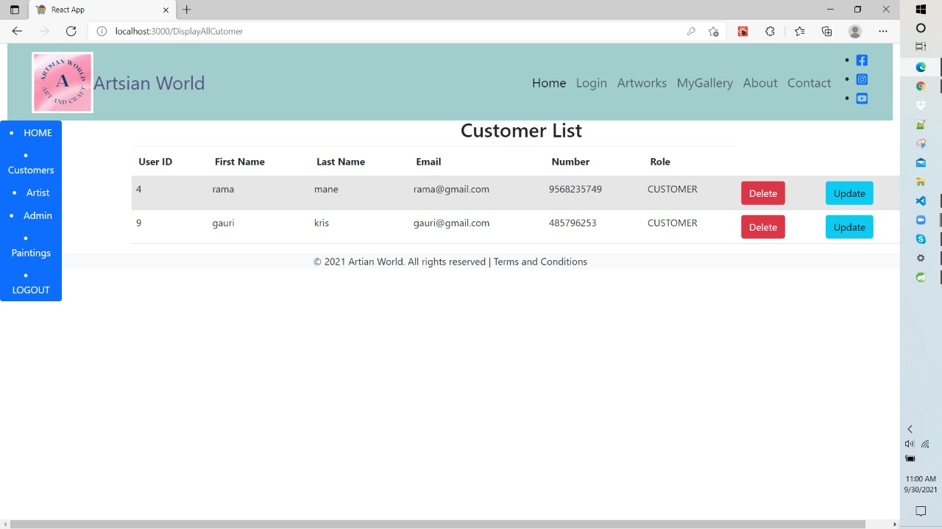

Slide 15
