Slide 1
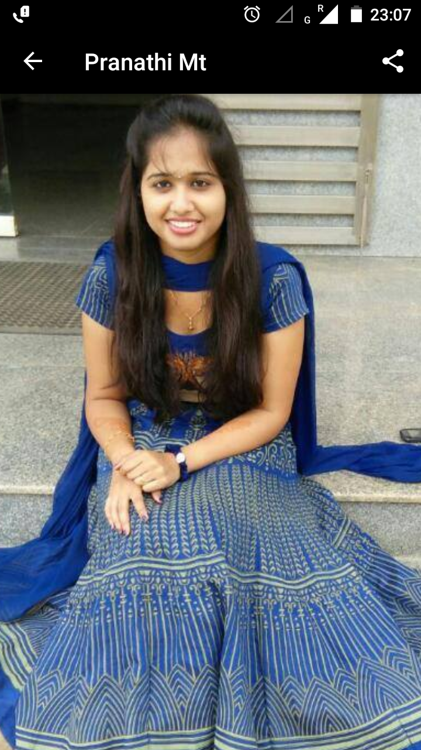
HELLO
Akkala Pranathi
.Net Full Stack Engineer
Mid : M1043108
Work Email : Akkala.Pranathi@Mindtree.com
Phone : 7760136008
Email : saipranathireddy96@gmail.com

Slide 2
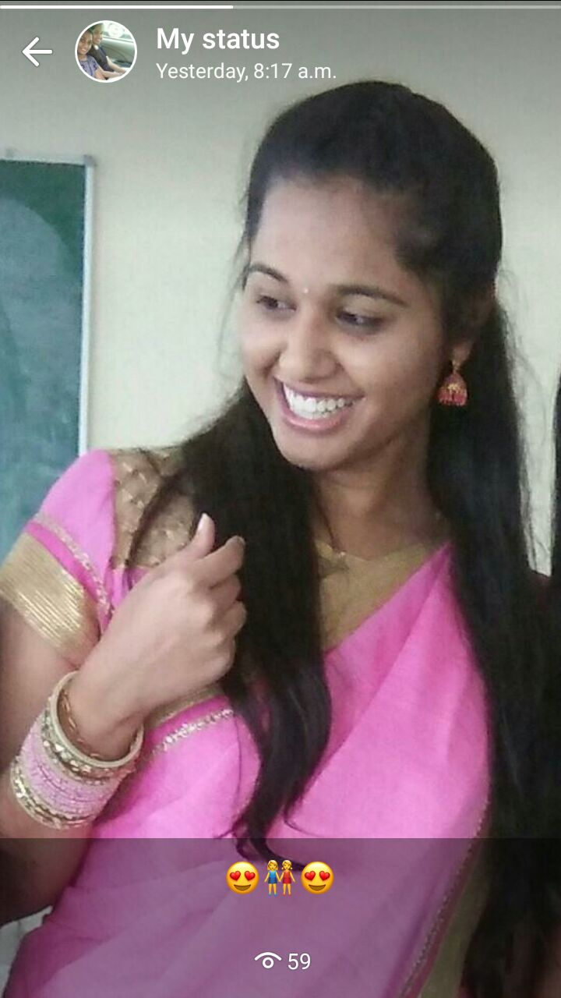
ABOUT ME
.Net Full Stack Engineer
I am Pranathi, I was born and brought up in Andhra Pradesh.
I Cut the cake on every July, 22 @ every Year.
I am a Simple living and high thinking Girl.
I am friendly, helpful and polite, have a good sense of humor.

Slide 3
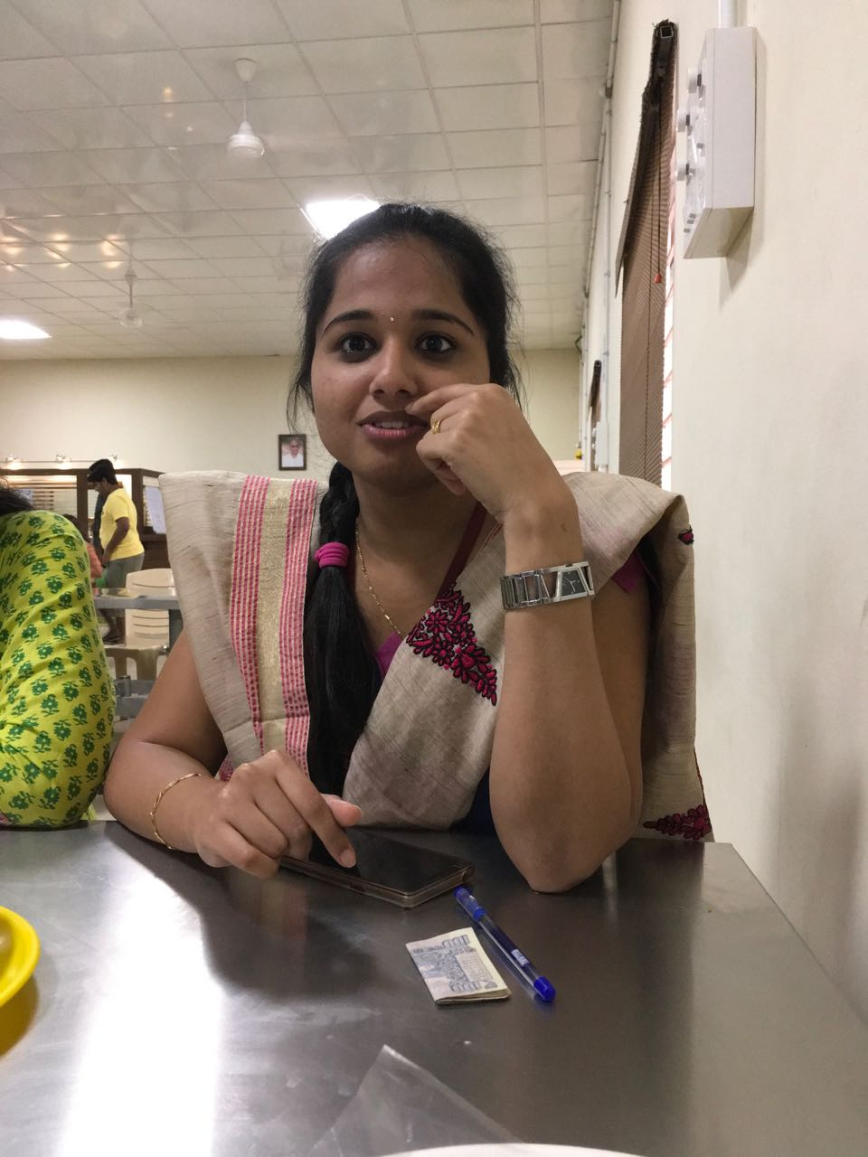
ABOUT ME
.Net Full Stack Engineer
I am kind of an extrovert, a person who loves being myself.
I stayed in boarding schools and colleges since school days which helped me in adapting to new people, places and situations easily.
I am Optimistic, Focused, Dedicated to work. A person who enjoys work with an enthusiasm to learn something new.

Slide 4
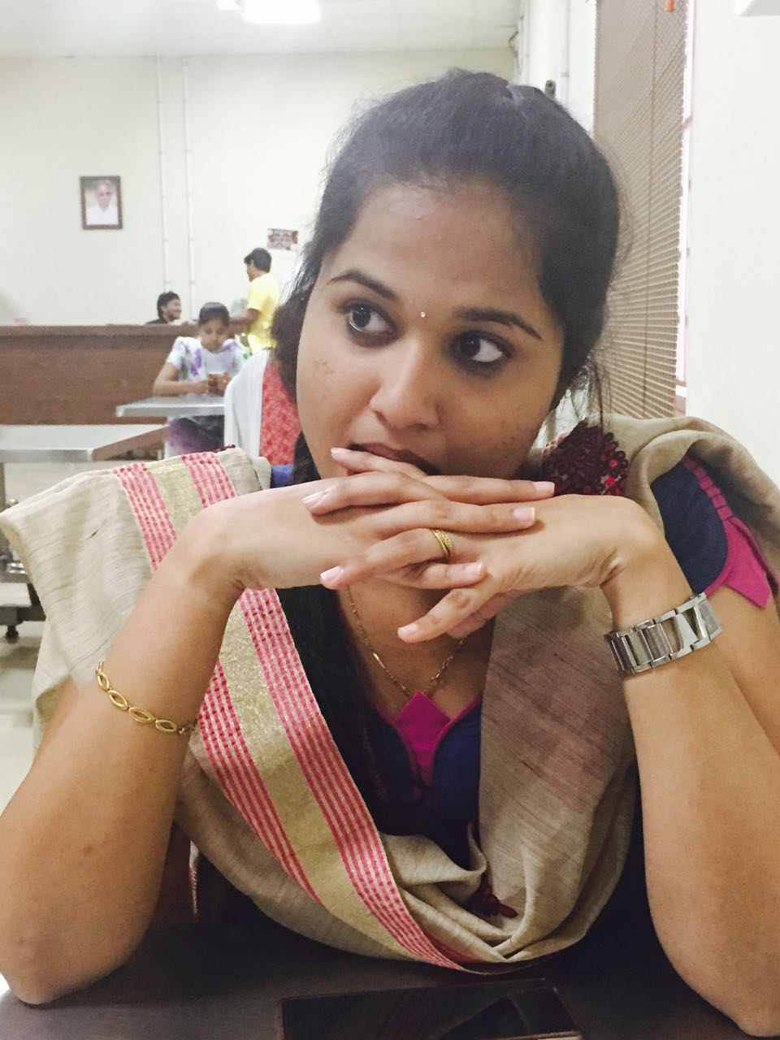
ABOUT ME
.Net Full Stack Engineer
I am a Team Player and always wants to learn new things from people in the team, as everyone has different views and approach towards a particular condition or work, so there is always something you can learn from others.
I am a good listener and learner and able to communicate well with people from all walks of life.

Slide 5
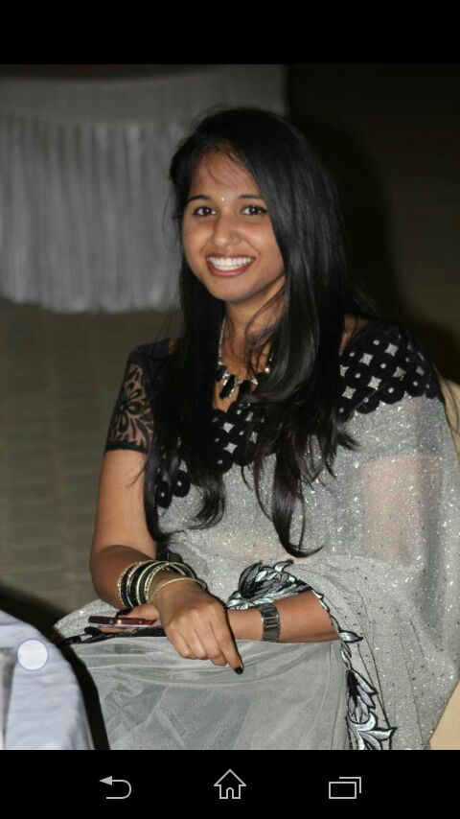
ABOUT ME
.Net Full Stack Engineer
I am determined and enthusiastic.
I also possess good planning and organized skills.
I am a punctual and self-motivated individual who is able to work in any environment and produce high standards of work.
Trying to be a better person everyday.

Slide 6
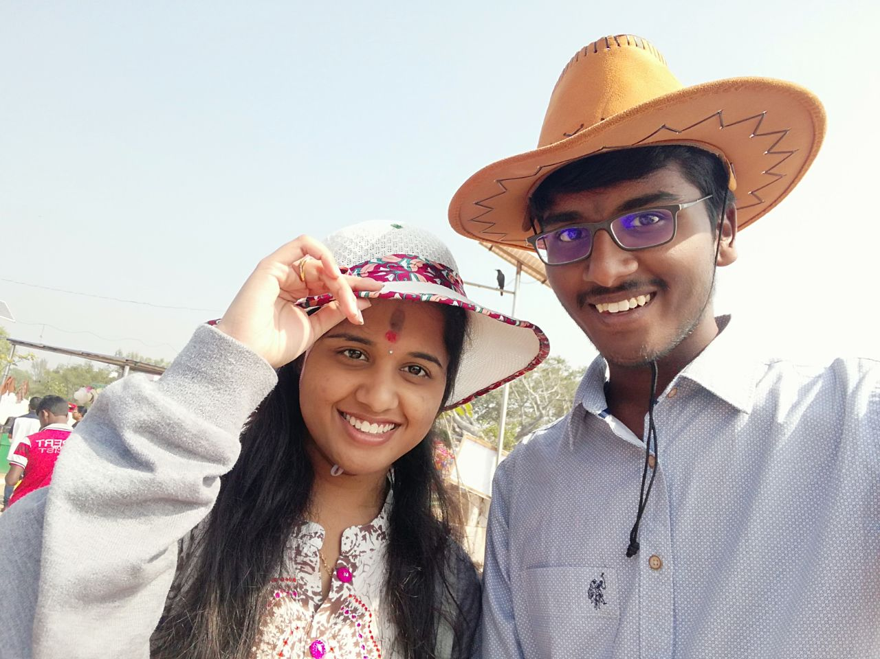
FAMILY
.Net Full Stack Engineer
Our Family have Four members in it.
My Father is a Business Man.
My Mother is a Home-maker.
My Younger Brother is doing his medicine.

Slide 7
Education :
Secondary Education:
Narayana Techno School,
Board:
Andhra Pradesh Board,
Year: 2010-2011
Place:
Tirupati, Andhra Pradesh
Percentage: 90.8%

Slide 8
Education :
Intermediate Education:
NRI Junior College,
Board:
Andhra Pradesh Board,
Year: 2011-2013
Place:
Hyderabad
Percentage: 96.3%

Slide 9
Education :
Engineering:
GITAM School of Technology,
University:
GITAM University,
Year: 2013-2017
Place:
Bangalore, Karnataka
CGPA: 8.66

Slide 10






Professional Skills :
C#
.NET
JS
Java

Slide 11


Professional Skills :
Angular
BootStrap

Slide 12
Life At Kalinga :
As a person I became more organized.
Became more punctual.
Got new friends.
Build up my Knowledge.
Got a start to shape my career.
Learnt how to explore and learn new things by myself.
Experienced working in a team.

Slide 13
Challenges Faced @ Kalinga
Being a student from different background it was not that easy to cope up with complete new technology and languages but finally it has become fun learning new things.
As a matter of fact that being too much dedicated, I get frustrated when things doesn’t get done. However I learnt how to handle such situations and my self at such situations.

Slide 14
My Project Work :
Name : TICKETS HERE
Description :
A Website as a Home to book tickets for the movie shows and Plays happening in the city which
gives personalized experience for a user and has a privilege of adding new movies, plays, Cast and
admin as an admin
TeamSize : 14
Technology used: Dotnet FrameWork,C# programming,Angular 5,HTML5,CSS3,MySQL.
Tools Used : Visual Studio Code,Visual Studio 2015,SQL Server Management Studio
My work :
Designed a page to display Movie Details and Theatres Playing that particular movie on clicking on a particular movie thumbnail.
Designed Dashboard for admin.
Designed form to add an admin as an admin.

