Slide 1
C4M Project
Computational Analysis for Potential Biomarkers associated with Mesothelioma
Group 20:
Pallawi
Prasanna
Deepanshu

Slide 2
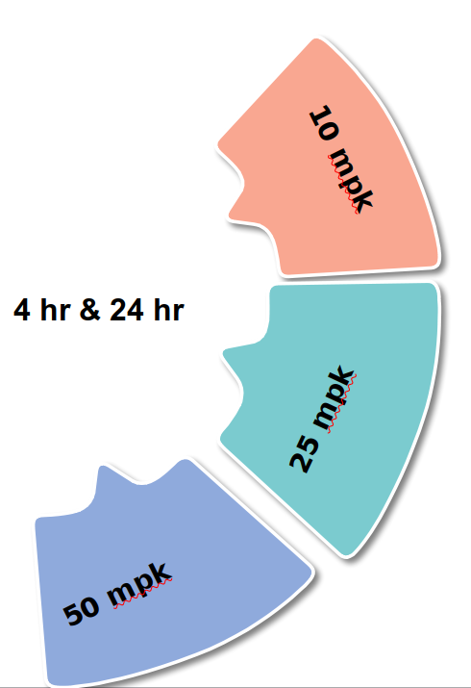
INTRODUCTION
Mesothelioma
Deadly disease
Currently no effective treatment
Aim
Predict Biomarkers
Accession : PRJNA924289; GEO: GSE222962
Data type : Transcriptome Data

Slide 3
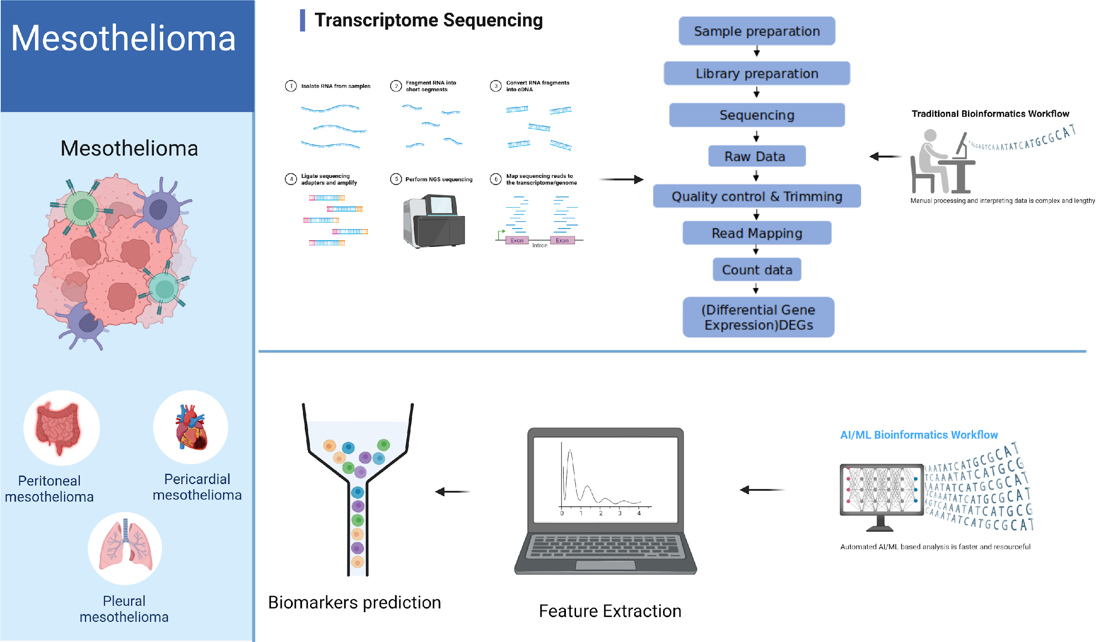
Workflow & its Feasibility
Traditional vs advanced analysis
Deseq2 analysis
AI/ML based workflow

Slide 4
Problem Statement
Mesothelioma, a rare and aggressive form of cancer, primarily caused by exposure to asbestos, poses significant challenges in early detection and effective treatment. Despite advancements in medical research, developing accurate predictive models for Mesothelioma prognosis remains a critical area of interest.
Our project aims to leverage data analysis to build a predictive model for Mesothelioma survival and treatment outcomes. The dataset used comprises clinical records, patient demographics, genetic markers, and treatment histories of Mesothelioma patients.

Slide 5
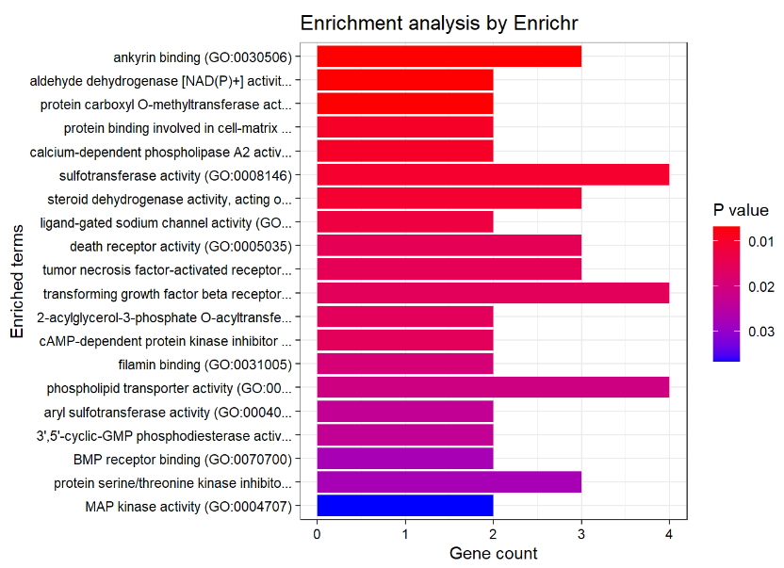
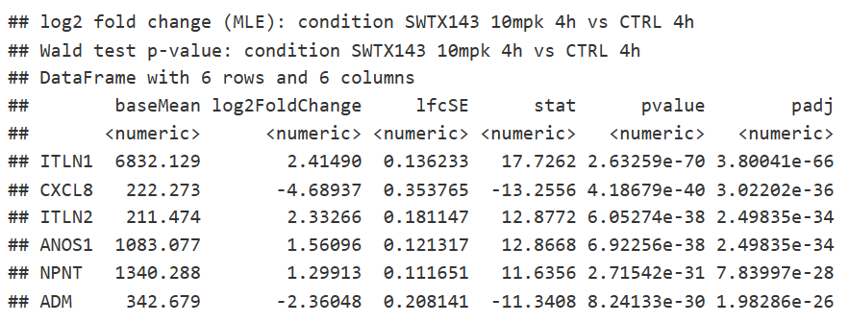
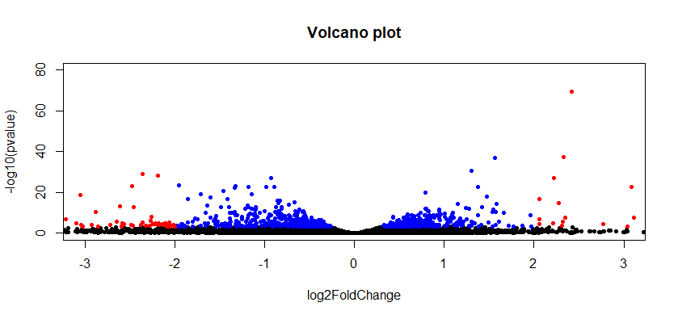
Differential Gene Expression Analysis
How was it done?
8 different experimental conditions (3 replicates)
CTRL_4h
SWTX143_10mpk_4h
SWTX143_25mpk_4h
SWTX143_50mpk_4h
Create pairs of experimental conditions
CTRL_4h & SWTX143_10mpk_4h
CTRL_4h & SWTX143_25mpk_4h
CTRL_4h & SWTX143_50mpk_4h
Perform DE analysis for each pair of experimental condition
What results were obtained?
CTRL_24h
SWTX143_10mpk_24h
SWTX143_25mpk_24h
SWTX143_50mpk_24h
CTRL_24h & SWTX143_10mpk_24h
CTRL_24h & SWTX143_25mpk_24h
CTRL_24h & SWTX143_50mpk_24h

Slide 6
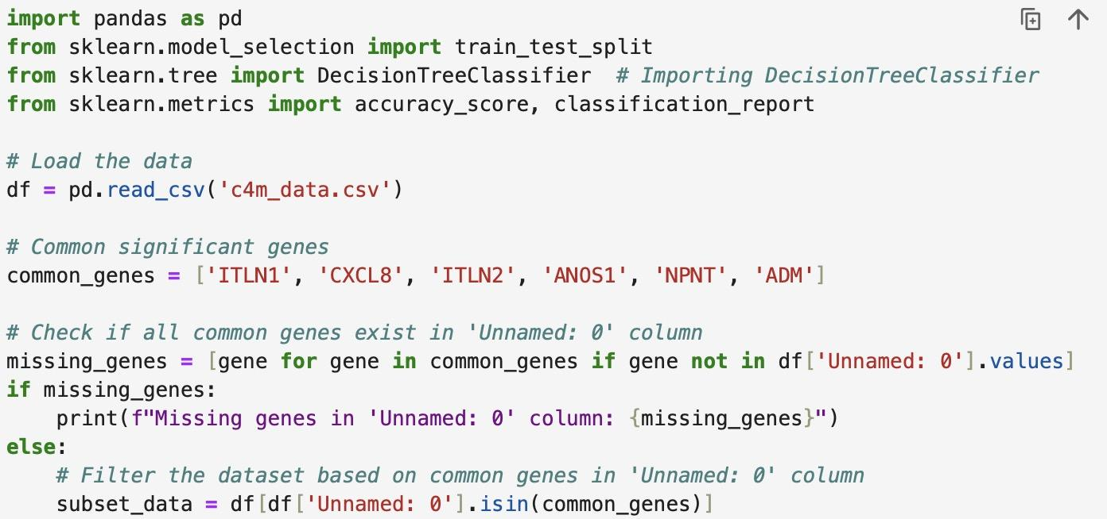
Predictions
Steps:
1. Load Data: Read our dataset
2. Identify Common Genes: Defined a list of significant genes for comparison.
3. Check Gene Presence: Checked if these genes exist within the 'Genes' column.
4. Filter Dataset: Extract rows corresponding to these significant genes.
5. Prepare Data: Split the dataset into features (genes) and the target variable ('Swtx_143_10mpk_4h').
6. Train Model: Utilize a machine learning classifier (e.g., RandomForestClassifier) to train on the feature and target data.
7. Evaluate Model: Assess the model's accuracy and performance using metrics like accuracy, precision, recall, and F1-score.
8. Prediction: Apply the trained model to predict the 'Swtx_143_10mpk_4h' class for new/unseen samples based on their gene expression profiles.

Slide 7
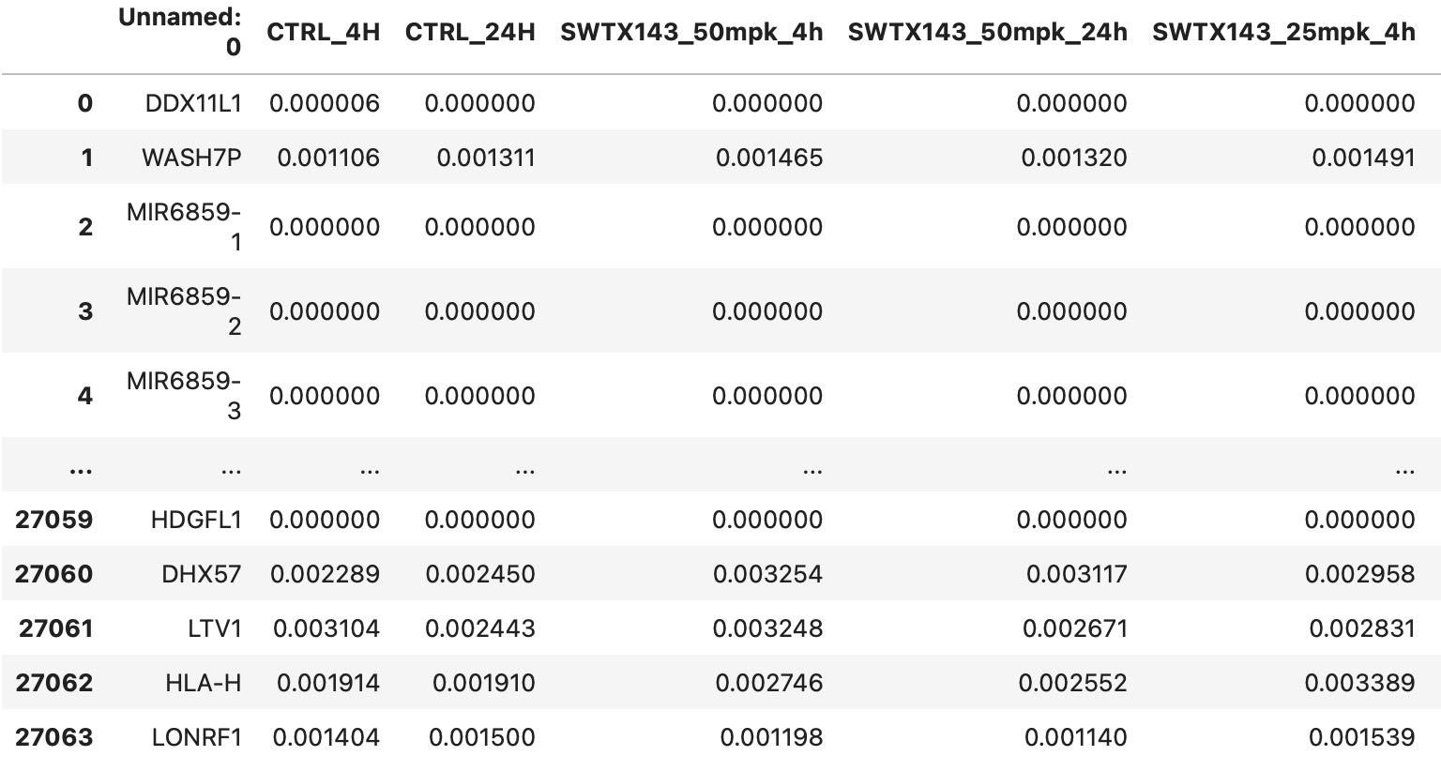
Inferences from the Prediction
Some potential biomarkers predicted are:
CXCL8 , KRT14 , ITLN2, ITLN1
SAA2, PI3, CHRDL1, ITLN1, SPRR2F
SPRR2F, PI3, TNNT3, MYH2

Slide 8
Contribution:
Pallawi Kumari:
Literature review
Data mining, data collection
Prasanna:
Differential gene expression analysis using DESeq2
Pathway enrichment analysis using EnrichR
Deepanshu:
Predicting biomarkers using the data after differential expression analysis.

