Slide 1
BlastRadius
Graph-Based Change Impact Prediction and Dependency Analysis for Software Repositories
Deepanshu (23BIT0264) · Sanskriti Singh (23BIT0256) · Prisha Vadhavkar (23BIT0010)
Guide: Dr. Yoga Raja C A
BITE497J Project I · Final Review · 21 October 2026 · SCORE, VIT Vellore
Notes:
Introduce the team and the guide. One-line pitch: BlastRadius asks which tests a code change actually broke in CI, and builds a public dataset (BR-Bench) that answers it from real GitHub Actions runs. The rings motif: the change sits at the centre; the dots are tests; the highlighted ones are the tests it broke.

Slide 2



Which tests will this change actually break?
Running every test on every change is slow and costly
Teams want to run only the tests a change can break.
Research is scored against the wrong labels
code change
Impact-analysis methods are evaluated on labels that never record a real test failure.
The evidence disappears
GitHub Actions logs expire after 90 days. Data not captured now is lost for good.
test failed in CI because of the change
test unaffected
Notes:
Every developer asks this before merging. The 'blast radius' of a change is the set of tests it actually breaks. Three motivations: cost of running full suites; the field's labels don't record failures; and GitHub Actions logs expire after 90 days, which made the harvester the most time-critical part of the project.

Slide 3



Three research camps, three different labels
Change impact analysis
Regression test selection
Predictive test selection
Co-change mining
Ekstazi, STARTS
Meta, Google
Label
Files edited together in Git history
Data
Public
Label
Tests that can reach the changed code
Data
Public tools
Label
Tests that actually failed in CI
Data
Proprietary
Wrong label: records developer habits, not failures
Safe over-approximation, not an observation
Right label, but no one else can use the data
BlastRadius: the right label (tests that actually failed in CI) on public, open-source data.
Notes:
CIA has public data with the wrong label. RTS tools give principled but over-approximate labels. PTS at Meta and Google uses the right label, but on private monorepos. BlastRadius closes the triangle.

Slide 4

Objectives and contribution
1
Build BR-Bench
An execution-grounded dataset linking code changes to the individual tests that failed in GitHub Actions.
What we claim
2
Measure the proxies
The contribution is the dataset and the measurement, not a new prediction model (decision D-02).
A predictor that loses to a simple baseline is still a publishable finding.
Target venue: MSR 2027 Data & Tool Showcase.
Quantify how far co-change predictions diverge from the tests that actually failed.
3
Commit-pinned code graph
Files, classes, methods and tests with their dependencies, as a substrate for dependency analysis.
4
Reproducible by construction
Deterministic pipeline: every number regenerates from raw logs with one command.
Notes:
Four objectives. Emphasise the claim discipline: we claim the dataset and the measurement, not state-of-the-art prediction. That keeps every claim fully supported by the data.

Slide 5

Literature survey: the seven approved papers
Paper | What it does | Gap BlastRadius addresses
Borg et al., IEEE TSE 2017 | Recommendation-based impact analysis in one industrial, safety-critical system | Proprietary single system; ground truth from change requests, not CI
Huang et al., IEEE TSE 2022 | Change-pattern mining (co-change labels) | Predicts what changes together, not which tests fail
Dai et al., Computer Comm. 2022 | Improved static impact analysis for C programs | Static only; no validation against execution
Zhao et al., JSME 2002 | Architectural slicing; component-level impact | Architecture-level and analytical
Angerer et al., ICSME 2016 | Modular impact analysis for configurable software | Configuration space; an orthogonal problem
Zhang et al., ICSM 2008 | Atomic-change impact analysis for AspectJ | Taxonomy only; not validated against execution
Gupta & Gupta, IJSSOE 2015 | Computes and ranks impacted functions | Small examples; ranks functions, not tests
None of the seven validates its impact set against the tests that actually failed in a real CI pipeline, because no public dataset made that possible.
Notes:
These are the seven references approved at the Zeroth Review. The common gap: none is validated against observed CI test failures. Huang et al.'s co-change label is exactly the kind of proxy our RQ1 measures.

Slide 6

Closest work, and what BR-Bench adds
Work | Label = observed CI failure | Public data | Per-test verdicts | Linked to the PR diff
Co-change impact analysis | ✗ | ✓ | ✗ | ✓
RTS tools (Ekstazi, STARTS) | reachability | ✓ | ✓ | ✓
Predictive test selection (Meta 2019, Google 2017) | ✓ | ✗ | ✓ | ✓
RTPTorrent (MSR 2020) | ✓ | ✓ | ✓ | Travis build jobs, no PR diff
GHALogs (MSR 2025) | raw logs only | ✓ | ✗ | ✗
BR-Bench (ours) | ✓ | ✓ | ✓ | ✓
What only BR-Bench does: it resolves a base run for every change and removes pre-existing and flaky failures, so a label means "this change broke this test".
Notes:
This is the 'advantage over others' slide. RTPTorrent has test outcomes but on Travis CI, organised by build job rather than PR with a diff. GHALogs is a large raw-log corpus but stops at the log: no per-test verdicts, no diff link, no de-flaking. Meta and Google have the right label on private data.

Slide 7
Research questions and scope
RQ1
Answered
RQ4
Answered
How far do co-change predictions diverge from the tests that actually failed?
What does the dataset contain, and how reliably was it labelled?
RQ2
Future work
RQ3
Future work
Which change characteristics predict that divergence?
Can a model trained on execution outcomes beat the proxies?
Java + Python only (D-03)
No LLM anywhere in the pipeline (D-17)
Graph layer is a course deliverable, outside the paper (D-48)
Notes:
RQ1 and RQ4 are answered in this project and in the paper. RQ2 and RQ3 are future work: the learned predictor was deliberately cut. In the paper RQ1 compares co-change with fault-revelation; static reachability depends on the graph layer, which stays outside the paper (D-48).

Slide 8
System architecture
1
SEART frame
2
Harvester
3
Raw store
4
Parsers
300 candidate repositories
rate-limited, resumable
immutable CI logs
Gradle · Maven · pytest
8
make tables + release
7
Binding
6
Labelling engine
5
test_id normaliser
BR-Bench on Zenodo
test → file at pinned commit
base run · T_reveal · flakiness
one canonical join key
Graph layer commit-pinned code graphs · test nodes bound to test_id · 5-primitive query API
Python 3.11 · uv · DuckDB + Parquet · tree-sitter · NetworkX · pytest · Streamlit · Next.js
Notes:
Follow the numbers: frame, harvest, raw store, parse, normalise test IDs, label, bind, then regenerate tables and build the release. The graph layer branches off binding and runs on the three-repository mini-corpus. Storage is DuckDB + Parquet with no server (D-06).

Slide 9

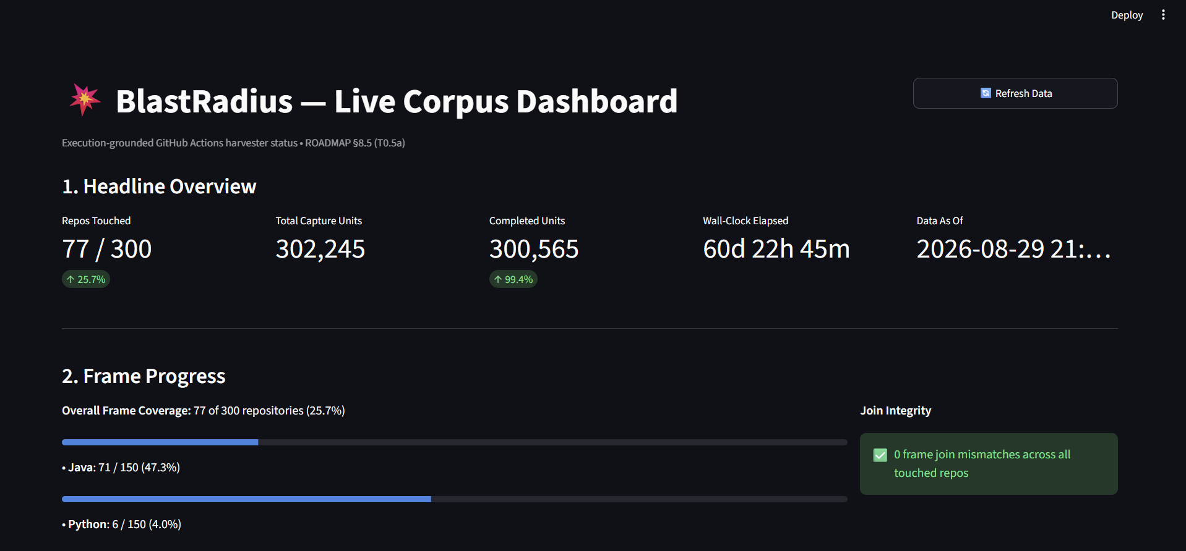


Harvester: racing the 90-day log expiry
Sampling frame from SEART: 300 repositories, 150 Java and 150 Python.
3 tokens × 5,000 requests/hour. Every request goes through one function, get_with_backoff(): quota, Retry-After, backoff, resumable cursors.
Logs expire after 90 days, so capture ran continuously for about 61 days, until 29 Aug 2026.
Live corpus dashboard (Streamlit): 300,565 of 302,245 capture units complete (99.4%), 0 join mismatches.
77 repositories captured (71 Java, 6 Python) into an immutable raw store.
Notes:
The only immovable deadline in the project was log expiry. The harvester stores raw API responses immutably so everything downstream can be rebuilt. The dashboard shows frame coverage: 77 of 300 repositories, 71 Java and 6 Python, which is why the corpus is Java-heavy (a stated limitation).

Slide 10




From raw CI logs to per-test outcomes
Raw job log
Parsed outcome
Canonical test_id
Strip ANSI codes and timestamps, handle ::group:: blocks and interleaved parallel output.
One record per test: name, verdict, failure message. Parsers for Gradle, Maven and pytest.
One normaliser (NFKC + casefold, Class#method). The project-wide join key, contract-tested on every merge.
Parser precision (development sets)
Both sets were used during development. The blind holdout (v5, 40 logs) is not yet scored, so independent precision is not claimed (D-53).
46/46
30/30
fixture corpus
holdout v1
Notes:
Parsing turns messy CI text into per-test verdicts. The normaliser is the single source of test identity: if two parsers spelled the same test differently, every join downstream would silently break. Be precise about precision: 46/46 and 30/30 are on development data; we do not claim independent precision until the blind holdout is scored.

Slide 11
Fault-revealing labels: base-run resolution
T_{reveal} = T_{head_fail} − T_{base_fail} − T_{flaky}
failed at head, not at base, and never flipped on the same commit
1
2
3
4
Find the tests failing at the head commit
Base run = latest run of the same workflow at the base commit; else walk back up to 10 ancestors
No base found → status no_base, emit no labels
Subtract base failures, then remove same-commit flips
Critical invariant: an empty base failure set is never read as "the base was green". Otherwise every failure at head would become a fault-revealing label, manufacturing false positives at scale.
Notes:
This is the hardest correctness problem in the project. A failure at head only counts if the same test did not already fail at base. If we cannot find a base run, we emit nothing: 5,520 of 12,581 failed runs (43.88%) are no_base and contribute no labels. Edge cases if asked: a cancelled or timed-out head run is excluded; a test that exists at head but not at base is a new test, never fault-revealing; a test at base but not at head is excluded; matrix builds take the union of failures across legs (D-12); a base found by walking back ancestors is kept with base_run_distance recorded. Splits: all 897, relaxed 770, strict 762 instances.

Slide 12
Binding each test to its file
94.29%
MET
combined (5,643 / 5,985) · Gate 1.5 needs ≥ 70%
63.83%
NOT MET
full confidence (3,820 / 5,985) · Gate 1.5 needs ≥ 70%
Clones are pinned to a fixed commit per repository (D-50), so figures no longer drift as upstream code changes.
Both numbers are always reported together (D-47).
Notes:
Binding connects a test ID from a log to a test file in the repository. Full confidence means the fully qualified class name matched; basename-only matches carry 0.5 confidence. Gate 1.5 is met on the combined figure and not met at full confidence; we report both, never just the flattering one.

Slide 13


Graph layer design
Fork & strip
Commit-pinned builder
Test nodes & edges
Query API
Graphify vendored at a fixed commit; 12 modules removed (−20,158 / +253 lines), including its LLM pass. 0 test regressions.
Git worktree at a given commit → tree-sitter on .java and .py → compressed node-link JSON keyed by (repo, sha).
Tests bound to test_id. Edges: direct calls, naming convention, mirrored layout. MultiDiGraph keyed by edge type.
5 primitives: shortest path, distance to any changed node, k-hop neighbourhood, same community, PageRank delta.
Incremental builds reuse a SHA-256 content cache; a blocking test checks the incremental graph equals a cold build exactly.
Notes:
The graph layer is Prisha's module. We forked an open-source extractor and removed everything non-deterministic, including its LLM pass, so graphs are exactly reproducible. A MultiDiGraph keyed by edge type stops a derived 'tests' edge from overwriting the 'calls' edge it was derived from — a defect the tests caught.

Slide 14

Graph layer results (3-repository mini-corpus)
427 / 427
Repository | Build | Graphs | Query (ms)
fla-org/flash-linear-attention | pytest | 107 | 47.7
Stirling-Tools/Stirling-PDF | Gradle | 140 | 99.7
spiculedata/saiku | Maven | 180 | 43.5
commit-pinned graphs built, 0 failures
Query latency ≤ 100 ms
Incremental build ≤ 10 s
Cold build ≤ 10 min
47.7 / 99.7 / 43.5 ms
25–29 s
mini-corpus only
MET
NOT MET
PARTIAL
Caught by the equivalence test: splicing a re-extracted subgraph diverged on 4/4 commit transitions (Java import resolution saw only the re-extracted files). Fix: pass the full file list; take incrementality from the cache.
Notes:
Results are on the three-repository mini-corpus and are a course deliverable, not part of the paper (D-48). Be honest about the budgets: query latency is met (99.7 ms is right at the limit), incremental build is not met, cold build is only shown on the mini-corpus.

Slide 15






Reproducible by construction
make tables
No LLM in the pipeline
Offline guard
Regenerates every reported number offline from raw logs in about 8 minutes. Each output file is stamped with the script and git commit that produced it.
Harvest, parse, label and every number come from deterministic code (D-17).
BR_OFFLINE=1: any network call during make tables raises an error.
Freshness guard
Complete-clone guard
821
tests passing (3 skipped), against real checked-in fixtures, no mocks
make tables refuses to run if a derived file is older than its inputs.
Rejects partial clones before binding runs.
Pinned commits
Release-key check
Binding runs against a fixed commit per repository.
The release build refuses to run without the pseudonymisation key.
Development method: an architect → operator → agent loop; every change was scoped, tested and verified by the team before it was committed.
Notes:
If a number cannot be regenerated by a script, it does not go in the report or the paper. The guards exist because each one corresponds to a real silent failure we hit (next slides). Be open about the development method if asked: an AI coding assistant was used for implementation, with no AI anywhere in the data pipeline, and every change was verified by us.

Slide 16
From 165,349 CI runs to 762 benchmark instances
Each stage is the intersection with the previous one. Log scale. Source: paper/generated/attrition_funnel.md
Notes:
Read top to bottom. The biggest losses: only 12,581 runs failed; logs for many failed jobs were not on disk; parsing a head test failure; and base resolution. 762 instances survive with at least one strict label. Every number here comes from attrition_funnel.md.

Slide 17
The dataset, and the gates we set ourselves
762
4,168
2,466
instances (strict split)
fault-revealing labels (strict split)
distinct tests (strict split)
Gate 1 · strict labels ≥ 5,000
4,168 / 5,000 (83.36%)
NOT MET
Gate 1 · strict instances ≥ 5,000
762 / 5,000 (15.24%)
NOT MET
Gate 1.5 · combined binding ≥ 70%
5,643 / 5,985 (94.29%)
MET
Gate 1.5 · full-confidence binding ≥ 70%
3,820 / 5,985 (63.83%)
NOT MET
Gate 3 · model beats best baseline
model not built (RQ3 is future work)
N/A
Notes:
Gates were set in the roadmap before results existed. We missed Gate 1 and say so; the dataset is still the first of its kind. Gate 2 (a solid RQ1 result) is the next slide.

Slide 18
RQ1: predictors versus the tests that actually failed
Of 1,316 tests that actually failed:
co-change predicted 61 (4.64%)
historical frequency predicted 519 (39.44%)
Method | P | R | J
Co-change, all | .011 | .051 | .010
Co-change, test files | .054 | .087 | .038
Changeset | .039 | .245 | .037
Historical frequency | .185 | .517 | .178
Co-change is trailing and symmetric; the leakage audit went from 640/713 leaking instances to 0/713.
Notes:
This is the headline finding. The co-change proxy the field uses recovered under 5% of the tests that actually failed; simply ranking tests by how often they failed before recovered about 39%. P, R, J are mean precision, recall and Jaccard at k = 10 on the same 576 instances. We fixed a leakage bug before trusting these numbers: the old co-change table used future commits for 640 of 713 instances.

Slide 19
What the labels look like
43.88%
of failed runs had no resolvable base (5,520 / 12,581) and emit no labels
0.54%
same-commit test flips (62 / 11,557), removed from labels as flaky
77.69%
of labels are unclassified: the regex classifier is a lower bound, and nothing is removed
Notes:
Class counts are from a regex on the failure message, so environment and timeout are lower bounds; 729 labels are clearly code-level. Environment and timeout labels stay in the strict set and are reported, not silently dropped. Base distance is usually zero: most bases are the exact base commit.

Slide 20

Silent failures we caught, and the guard each one left
Stale labels
Parameter types read as classes
Co-change leakage
Labels were never regenerated after a re-parse. Everything was rebuilt from raw logs (D-49); a freshness guard now blocks it.
JUnit 5 parameterised tests mis-parsed: 21 test IDs (60 rows) corrected one-to-one.
Future commits leaked into 640/713 instances. Now trailing and per-instance: 0/713.
Live logins in a bundle
Partial clone
Network inside make tables
A first local release kept real usernames. It was never published; the build now requires the key.
An interrupted clone resolved to our own repository. A complete-clone guard rejects it.
A table script called the API. Offline mode now raises on any request.
Notes:
None of these raised an exception. Each was found by an explicit check, and each now has a permanent guard. This is the project's core engineering lesson: no crash is not proof that a run worked.

Slide 21



Agentic workflow: from user story to deployment
Impact Analysis
Coding
PR Reviewer
Build & Deploy
Regression Suite
in: user story + codebase
out: impact analysis document
in: impact analysis + codebase
out: changed files + pull request
in: PR + impact analysis
out: review, merge, commit id
in: commit id + branch
out: build, deploy, or notify on failure
in: impact analysis + suite
out: test report
Demo story: "As a shopper, I want to apply the discount code FESTIVE20 at checkout to get 20% off my cart total, capped at Rs 500" on a 15-test sample library
Clean change
DEPLOYED
Out-of-scope change
BLOCKED
Reviewer in warn mode
NOTIFIED
7 of 15 tests at risk; reviewer approves and merges; build passes and deploys; regression 18/18 pass
The change also rewrites receipts; the scope check fails, so the reviewer requests changes
It merges; the build fails on 2 receipt tests; notification sent; impact recall 0/2
Impact analysis runs on the BlastRadius code graph, on the sample repo or any public GitHub repo (Analyze-a-repo tab). Separate demo path (D-55).
Notes:
New since the pre-final review: five agents take a user story to a deployed, regression-tested change. The Impact Analysis Agent builds the BlastRadius code graph of the target repository, matches the story to source files, and finds the tests that depend on them by reverse reachability; failure history from earlier regression runs raises a test's risk, because in BR-Bench failure history was the strongest predictor. The Coding Agent writes the change and opens a PR; the Reviewer checks scope, compile and the tests at risk, then merges and returns the commit id; the Build and Deploy Agent builds at that commit and deploys, or sends a notification on failure; the Regression Suite Agent runs the selected scope and the full suite and reports impact recall. Live demo: make agents-demo, then the Agents tab. Offline it uses keyword matching and recorded change sets; with an API key the model writes the code.

Slide 22
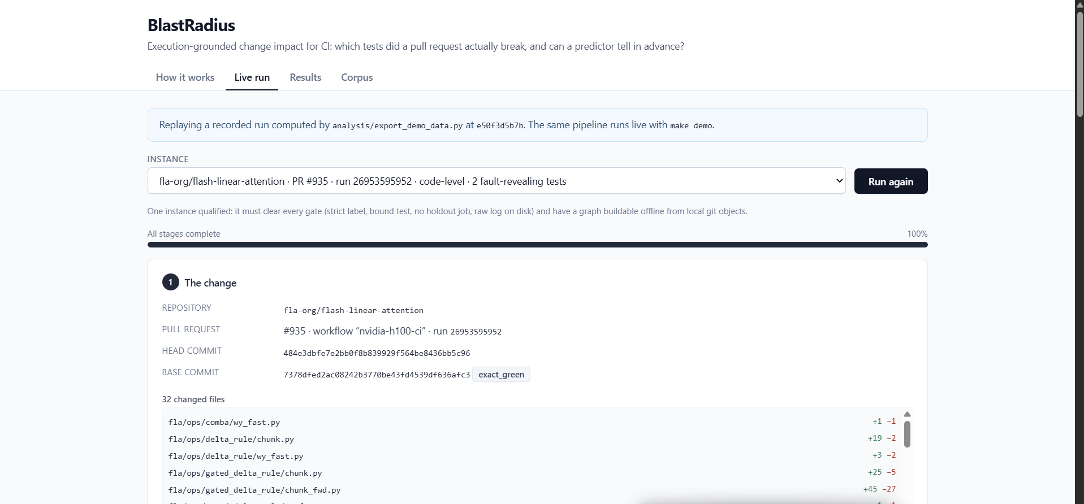
Demonstration
1
make demo-web
Next.js site on localhost:3000: Live run · Results · Agents · Corpus
2
make agents-demo
the five agents on a sample repo, three scenarios
3
make demo
the data pipeline as a terminal walkthrough
Demo site, Live run tab: fla-org/flash-linear-attention PR #935, a code-level failure with 2 fault-revealing tests, replayed stage by stage.
4
make tables
regenerate every number, offline
What the Live run tab walks through, stage by stage
5
make analyze
1 The change
2 Harvest
3 CI log
4 Parse
5 test_id
Analyze-a-repo tab: run the impact agent on any public GitHub repo
6 Base run
7 Labels
8 Binding
9 Code graph
10 Prediction
Notes:
Live demo order: (1) How it works tab, the 10-step pipeline; (2) Live run: walk the instance from the change, through the log line, parsed outcome, test_id, base run, label, binding and graph; (3) Results tab charts; (4) optionally the Streamlit dashboard. The site replays a recorded run, so it works without network; make demo runs the same pipeline live in the terminal.

Slide 23


Release: open, archived and citable
BR-Bench dataset
Source code
doi.org/10.5281/zenodo.23250262 · CC BY 4.0
doi.org/10.5281/zenodo.23250690 · MIT
instances
165,349 rows
github.com/DeepanshuOP/blastradius
release v1.0.0 · CITATION.cff · datasheet
v0.2 built and validated (base runs, changeset columns, schema validator); Zenodo deposit pending
outcomes
12,766 rows
cochange
175,204 rows
failure_messages
3,490 rows
Logins pseudonymised (keyed HMAC-SHA256)
Secret scan and canary string
SHA-256 checksum manifest
Next: MSR 2027 Data & Tool Showcase. Abstract due 5 Nov 2026, paper due 10 Nov 2026.
Notes:
Both the dataset and the code are archived on Zenodo with DOIs, which the MSR track requires. The release holds the four tables, not the raw log store. Author logins are pseudonymised with a keyed hash; the key is never committed.

Slide 24

Limitations and future work
Limitations
Future work
Gate 1 not met: 4,168 strict labels against a 5,000 target
Full-confidence binding 63.83%, below the 70% gate
Parser precision measured on development sets only
Labels are observational; no re-executed gold subset
Corpus skewed to Java (71 of 77 repositories)
Graph reachability not yet scored against real failures (base commits missing locally)
Score the blind holdout (v5) before camera-ready
Learned predictor and GNN to answer RQ3
Fetch base commits and score graph reachability vs real failures
Docker re-execution subset for causal labels
More Python repositories; base runs for non-failing runs
Notes:
State limitations before the panel asks. Every one of these is also written in the report and the paper. The next concrete step is scoring the blind holdout, which turns parser precision into an independent number.

Slide 25
Thank you
Questions?
1
BR-Bench is the first public, execution-grounded dataset of which tests a change broke: 762 instances and 4,168 labels on the strict split.
2
The proxy the field uses misses most real failures: co-change found 4.64% of failing tests; failure history found 39.44%.
3
Every number regenerates offline from raw logs with one command, and data and code are archived with DOIs.
github.com/DeepanshuOP/blastradius · doi.org/10.5281/zenodo.23250262
Notes:
Close on the three takeaways: a new public dataset, a clear measurement, and full reproducibility. Then take questions.

