Slide 1
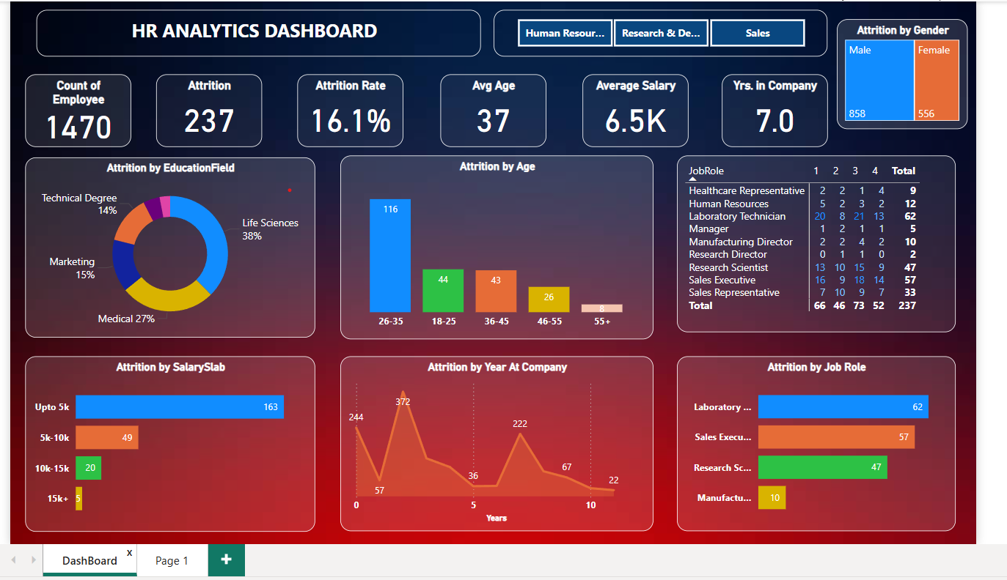

Slide 2
Problem Statements:
Q1. What is the total number of employees in the company?
Q2. What is the total number of employees who have left the company (attrition)?
Q3. What is the company’s overall attrition rate?
Attrition by Demographic Factors:
Q4. What is the count of attrition among male and female employees?
Q5. What is the number of attritions in each of the following age groups: 18-25, 26-35, 36-45, 46-55, and 55+?
Attrition by Job Role:
Q6. What is the average age of the employees in the company?
Q7. What is the average salary of the employees in the company?
Q8. What is the average number of years employees have been in the company?
Q9. What is the average age of the employees in the company?
Q10. What is the average salary of the employees in the company?
Q11. What is the average number of years employees have been in the company?
Q12. Are there any noticeable patterns or trends in attrition based on Education Field, Age, Salary Slab, Years at Company, or Job Role?

