Slide 1
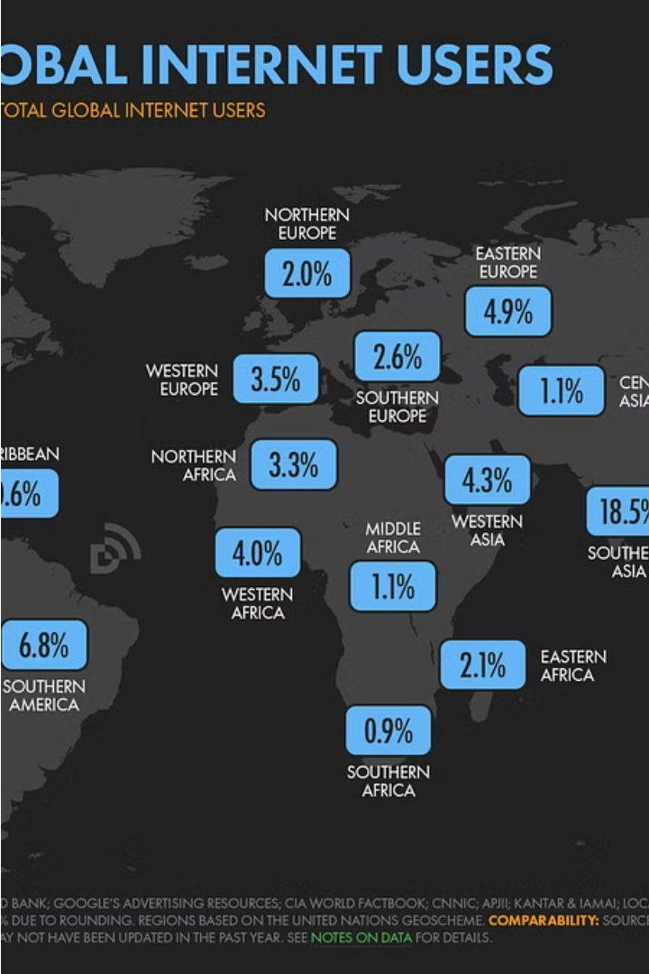


Data Visualization: Unlocking the Power of Technology Adoption
Explore the transformative impact of internet penetration, smartphone usage, and social media growth - the digital landscape shaping our connected world.
by Bindu K

Slide 2
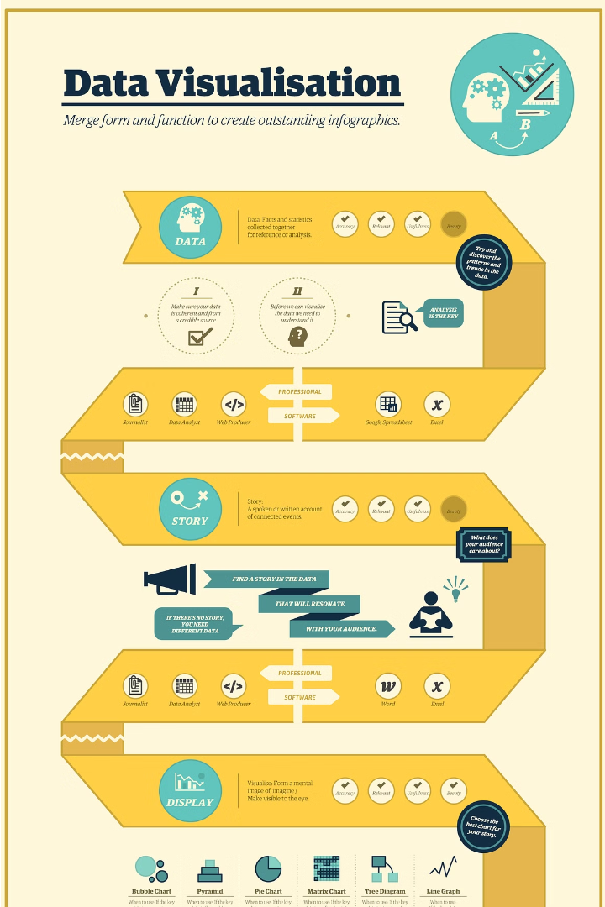
Introduction to Data Visualization
Data visualization is the art of transforming complex data into intuitive, visually appealing graphics that convey insights and tell compelling stories. It empowers organizations to make data-driven decisions and uncover hidden trends.

Slide 3
Global Internet Penetration Rates
50.9%
96%
88.1%
Global
North America
Europe
The percentage of the global population that uses the internet as of 2022.
The internet penetration rate in North America, the highest of any region.
The internet penetration rate in Europe, the second highest globally.
Internet access and usage has grown exponentially in the past two decades, transforming how people communicate, work, and access information worldwide. While North America and Europe lead in adoption, developing regions like Africa and Asia are rapidly increasing their internet penetration rates as well.

Slide 4

Smartphone Usage and Market Share
Android
iOS
The global smartphone market is dominated by Android and iOS operating systems, with Android holding a commanding 72.2% market share and iOS accounting for 27.8%. This reflects the widespread popularity and versatility of Android devices as well as the strong brand loyalty of Apple's iPhone lineup.

Slide 5




Factors Influencing Internet Penetration
Income Levels
Infrastructure
Education
Regulations
Household income is a key factor in determining internet access and adoption. Higher incomes enable more people to afford internet-connected devices and service plans.
Robust telecommunications infrastructure, including reliable broadband networks, is essential for widespread internet penetration. Lack of infrastructure is a barrier in many developing regions.
Higher levels of education are correlated with greater internet usage. Digital literacy skills are important for effectively navigating and utilizing online resources.
Government policies and regulations around internet access, pricing, and service availability can have a significant impact on internet adoption rates.

Slide 6
Growth of Social Media Platforms
The meteoric rise of social media platforms has transformed how people communicate, share information, and consume content worldwide. Platforms like Facebook, Twitter, and Instagram have grown exponentially, connecting billions of users globally and becoming integral to daily life.
Facebook
2.9 billion monthly active users as of 2022
Twitter
330 million monthly active users as of 2021
Instagram
1.4 billion monthly active users as of 2022
These platforms have disrupted traditional media, enabled real-time information sharing, and given a voice to individuals and communities globally. The growth of social media has had a profound impact on how people stay connected, consume news, and shape public discourse.

Slide 7
Impact of Smartphones on Daily Life
Omnipresent Connectivity
Productivity and Efficiency
Mobile Commerce
Lifestyle Integration
The rise of smartphones has transformed the way we shop, bank, and conduct financial transactions. From online purchases to mobile payments, smartphones have brought convenience and accessibility to our daily financial activities.
Smartphones have become an integral part of our daily routines, enabling constant connectivity to the digital world. They facilitate instant communication, information access, and entertainment at our fingertips.
Smartphones have revolutionized how we manage our schedules, tasks, and workflows. With a vast array of productivity apps, we can streamline our work, stay organized, and maximize our time throughout the day.
Smartphones have become deeply integrated into our daily lives, serving as personal assistants, entertainment hubs, and gateways to a wealth of information. They have reshaped how we navigate, socialize, and manage our personal well-being.

Slide 8

Importance of Data Visualization in Technology Adoption
Data visualization plays a crucial role in driving technology adoption by making complex information accessible and engaging. Visually representing data helps users quickly grasp trends, patterns, and insights that can inform their decision-making and drive technology adoption.
Effective data visualizations enable users to intuitively understand technology capabilities, benefits, and usage, reducing barriers to adoption. This visual communication is especially important for new or emerging technologies where users may be unfamiliar with the underlying concepts.

Slide 9
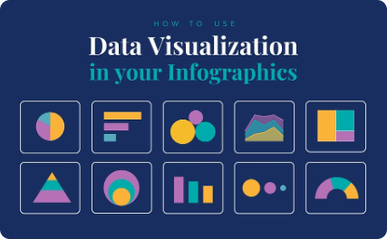
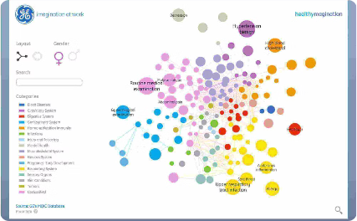
Key Principles of Effective Data Visualization
Clarity
Impact
Interactivity
Effective data visualizations present information in a clear, unambiguous way. Avoid clutter, use intuitive design, and ensure the key message is immediately apparent.
Data visualizations should have a strong visual impact, capturing the viewer's attention and communicating the insights effectively. Use bold colors, typography, and layout to drive the key points home.
Incorporating interactivity allows users to explore the data, uncover insights, and tailor the visualization to their needs. Well-designed interactions empower the audience and foster deeper engagement.

Slide 10



Case Studies of Successful Data Visualization Strategies
Intuitive Design
1
Visualizations that are easy to understand and interpret at a glance
Targeted Insights
2
Visualizations that highlight the most important data points and trends
Storytelling
3
Visualizations that weave a compelling narrative around the data
Effective data visualization is not just about presenting information; it's about communicating insights in a way that resonates with the audience. Successful case studies demonstrate how intuitive design, targeted insights, and strategic storytelling can transform complex data into impactful visuals that drive decision-making.

