Slide 1



CYBERSECURIT INTERNSHIP
WEEK 10 ASSIGNMENT
SOC - WAZUH SETUP & ALERT MONITORING
Submitted by
Name: Deepashree.C
Role: Cybersecurity Intern
Week: Week 10
SIN: DG/SEPTEMBER/CYBER/254
Submitted to: DG INTERNS HUB
TOPIC COVERED:
  Introduction to Security Operations Center (SOC) and SIEM
  Wazuh SIEM Architecture and Setup
  Wazuh Agent Installation and Configuration
  Security Event and Alert Monitoring
  Authentication Monitoring and File Integrity Monitoring
  Security Alert Analysis and Investigation
  Snort IDS and Wazuh Integration
  SOC Analyst Workflow and Incident Response

Slide 2
INTRODUCTION AND OBJECTIVES
Introduction
  A Security Operations Center (SOC) plays a vital role in an organization's cybersecurity infrastructure by providing centralized security monitoring, threat detection, incident response, and investigation.
  Security Information and Event Management (SIEM) solutions collect, correlate, and analyze security logs from multiple sources to identify suspicious activities and potential cyber threats.
  Wazuh is an open-source security monitoring platform that provides capabilities such as endpoint security monitoring, log analysis, file integrity monitoring, vulnerability detection, and security event analysis.
  By integrating Wazuh with intrusion detection systems such as Snort, organizations can enhance threat visibility, improve security event correlation, and strengthen their overall incident detection capabilities.

Slide 3
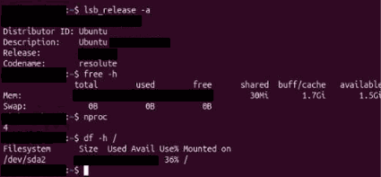
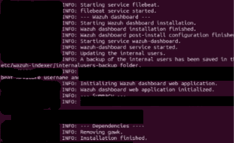
Objectives
  To understand the fundamental concepts of Security Operations Center (SOC) operations and SIEM technologies.
  To study the architecture, components, and deployment requirements of the Wazuh security monitoring platform.
  To explore endpoint monitoring, agent installation, configuration, and connectivity with the Wazuh server.
  To understand the process of security event collection, log analysis, alert generation, and threat investigation.
  To examine File Integrity Monitoring (FIM) and vulnerability detection features provided by Wazuh.
  To explore the integration of Snort Intrusion Detection System (IDS) alerts with Wazuh for centralized security monitoring and improved threat detection.

Slide 4
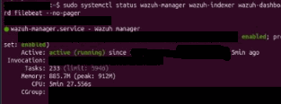
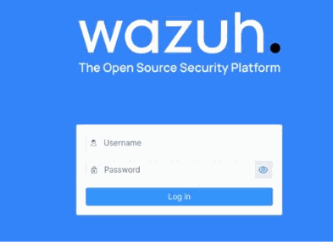
TOOLS AND TECHNOLOGIES
Technologies Used
  Wazuh SIEM: Used for centralized security monitoring, log analysis, and threat detection.
  Linux Operating System: Provides the platform for installing, configuring, and testing security tools.
  Wazuh Manager and Agent: Enable endpoint monitoring, event collection, and security analysis.
  Wazuh Indexer and Dashboard: Provide security data storage, visualization, and alert investigation.
  Snort IDS: Monitors network traffic and detects suspicious activities using predefined rules.
  Virtual Machine Environment: Provides an isolated setup for deploying and testing security tools.

Slide 5
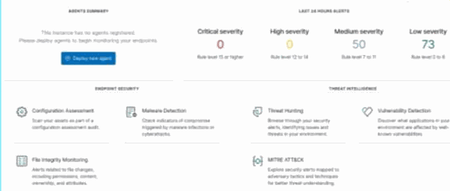
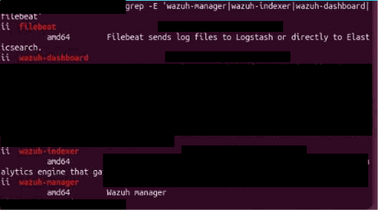
WAZUH SIEM ARCHITECTURE
Core Components
  Wazuh Agent: Collects security events, system logs, and monitoring data from endpoints.
  Wazuh Manager: Processes incoming events and identifies threats using decoders and detection rules.
  Wazuh Indexer: Stores and organizes security data for efficient searching and analysis.
  Wazuh Dashboard: Provides a user-friendly interface for security monitoring, alert visualization, and investigation.
  Monitoring Workflow
  Endpoint System → Wazuh Agent → Wazuh Manager → Wazuh Indexer → Wazuh Dashboard
  Operational Purpose
  This architecture provides centralized security monitoring, improves threat visibility, and helps security analysts detect and investigate suspicious activities across monitored endpoints.

Slide 6
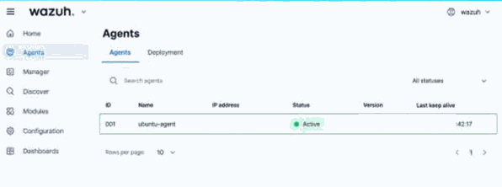
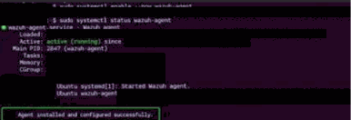
ENDPOINT MONITORING AND AGENT CONFIGURATION
Configuration Process
  Prepare and configure the endpoint system.
  Download and install the Wazuh agent.
  Set the Wazuh manager IP address and enrollment details.
  Start and enable the agent service.
  Check connectivity between the agent and manager.
  Verify agent registration and successful event collection.
Monitoring Benefits
  Provides centralized monitoring of endpoint systems.
  Collects system logs and authentication events.
  Detects suspicious activities and unauthorized changes.
  Helps security analysts investigate potential threats.
  Improves overall endpoint security and visibility.

Slide 7
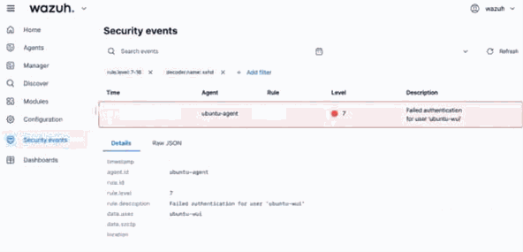
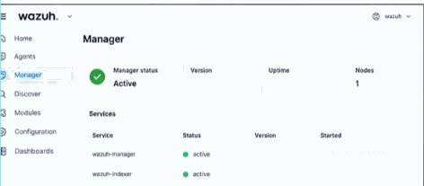
SECURITY EVENT AND ALERT MONITORING
Key Event Categories
Authentication Monitoring
  Monitors successful and failed login attempts.
  Identifies suspicious login patterns and unauthorized access.
File Integrity Monitoring (FIM)
  Detects file creation, modification, and deletion.
  Helps identify unauthorized changes.
Alert Investigation
  Reviews security alerts and affected endpoints.
  Analyzes events to identify potential threats

Slide 8

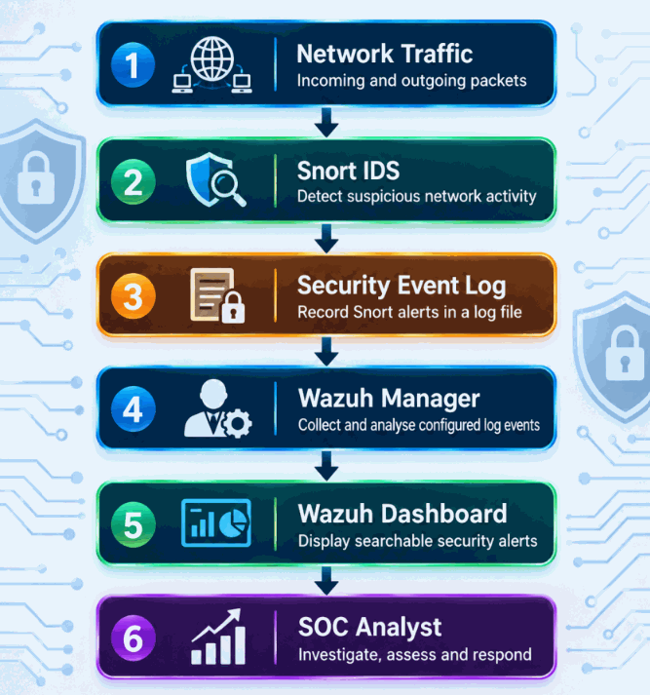
SNORT IDS AND WAZUH INTEGRATION
Integration Concept
Snort IDS monitors network traffic and detects suspicious activities using predefined rules.
Snort alerts can be forwarded to Wazuh for centralized monitoring and analysis.
Workflow
  Snort monitors incoming and outgoing network traffic.
  Suspicious activity generates alerts.
  Alerts are stored in log files.
  Wazuh collects and analyzes the Snort logs.
  SOC analysts review the generated alerts.
Security Benefits
  Centralized monitoring of network and endpoint events.
  Improved threat detection and visibility.
  Faster investigation of suspicious activities.
  Better incident analysis and reporting.

Slide 9
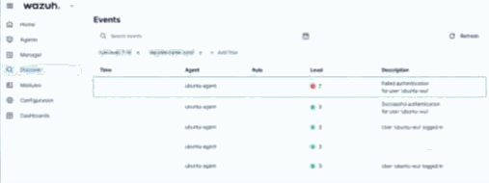
CHALLENGES, LEARNING OUTCOMES AND CONCLUSION
Challenges Encountered
  Faced difficulties during Wazuh installation and dashboard configuration.
  Experienced issues with agent connectivity and service verification.
  Could not fully confirm test alert generation and collection.
Learning Outcomes
  Understood SOC operations and SIEM architecture.
  Learned Wazuh components and endpoint monitoring.
  Gained knowledge of authentication monitoring and file integrity monitoring.
  Studied alert analysis and Snort integration with Wazuh.
Conclusion
The Week 10 activities provided a basic understanding of SOC operations, SIEM concepts, and Wazuh security monitoring. Despite some configuration challenges, the study helped build knowledge of endpoint monitoring, event collection, threat detection, and alert investigation.

