Slide 1
Battle of Neighborhoods
Locating the Best Location to run Cantonese Restaurant in NY
Deepkumar M. Bhagat

Slide 2
Introduction-
NYC is famous for its business-friendly environment and provides lots of business opportunities.
The market could be highly competitive in any field, including restaurants. Thus, any new business venture or expansion needs to be analyzed carefully
Cantonese restaurants have become so popular in the United States not just in China town but also elsewhere in the major and small cities, and even could be found on every corner.

Slide 3
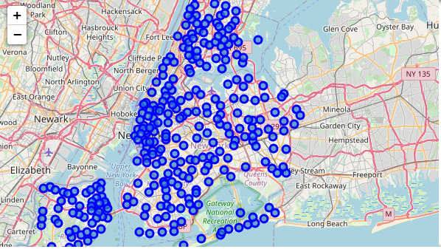
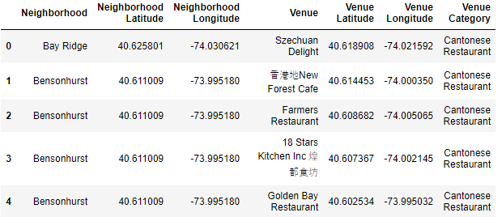
Data-
Dataset: https : //geo.nyu.edu/catalog/nyu245134572.
map
Foursquare venues

Slide 4
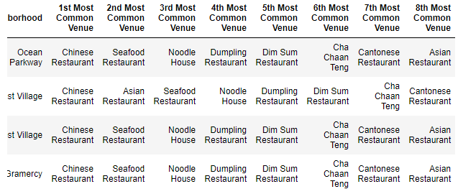
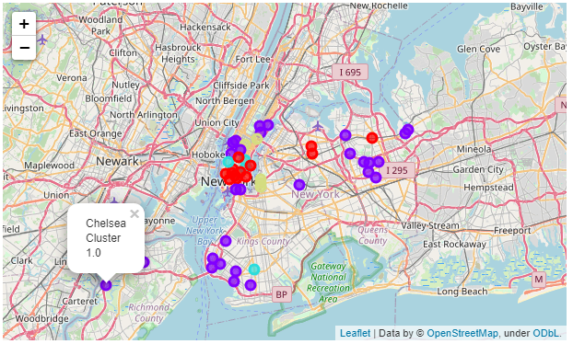
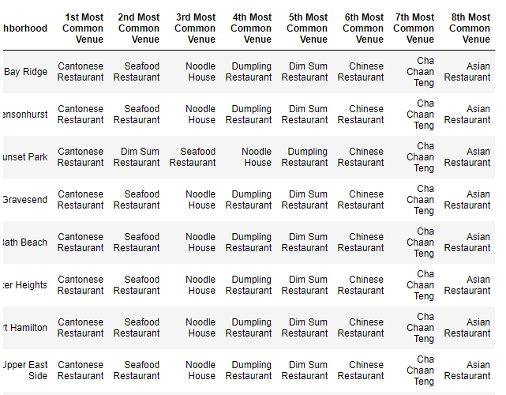
Following are the results-
K-means method

Slide 5
Conclusion -
Region labeled color purple can be good option such as in Chelsea, running Cantonese restaurant is easier.
Competition is in New York city, that’s why it’s risky to run business there.
More factors such as populations, transportation and inhabitants should be taken into consideration for further study.

