Slide 1
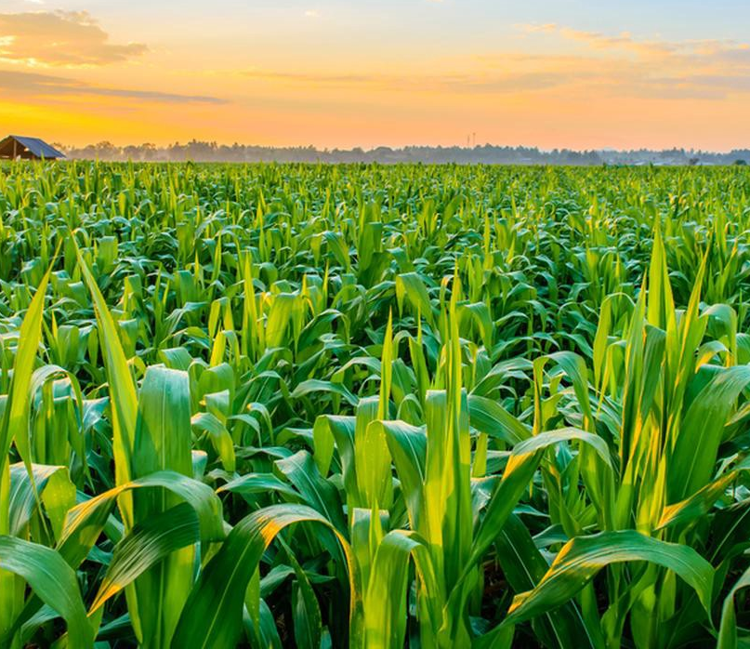
Predicting Plant Disease: A Solution for Increasing Yield
Date: 21 May 2021
Desh Deepak

Slide 2
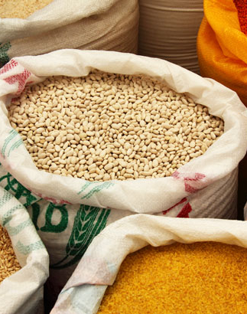
Welcome!
Contents:
Introduction to crops and factors
Human Impacts
Crops and Yield factors
Commonalities in pathogen diseases
Diagnosis using Deep Learning Model
Implementation in real world
Limitations and Improvements
Notes:
Welcome,
talk briefly about crop production and yield, human impact of lower yield and propose a solution for solving this with a deep learning backed prediction model

Slide 3
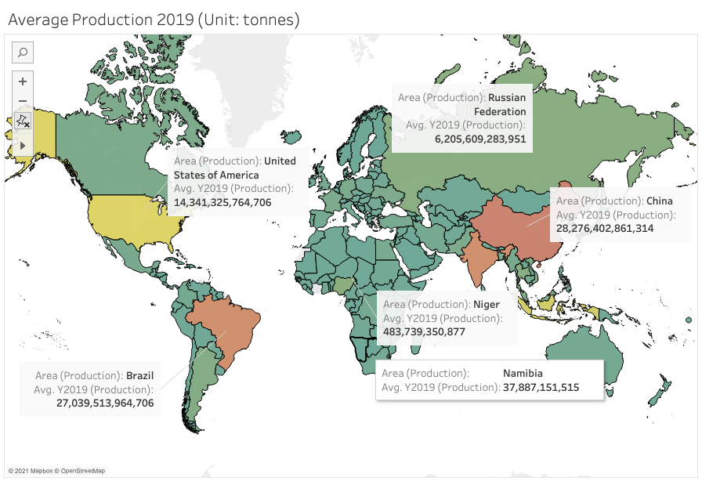

Where does our Food come from?
Production of crops in countries/regions in 2019

Slide 4
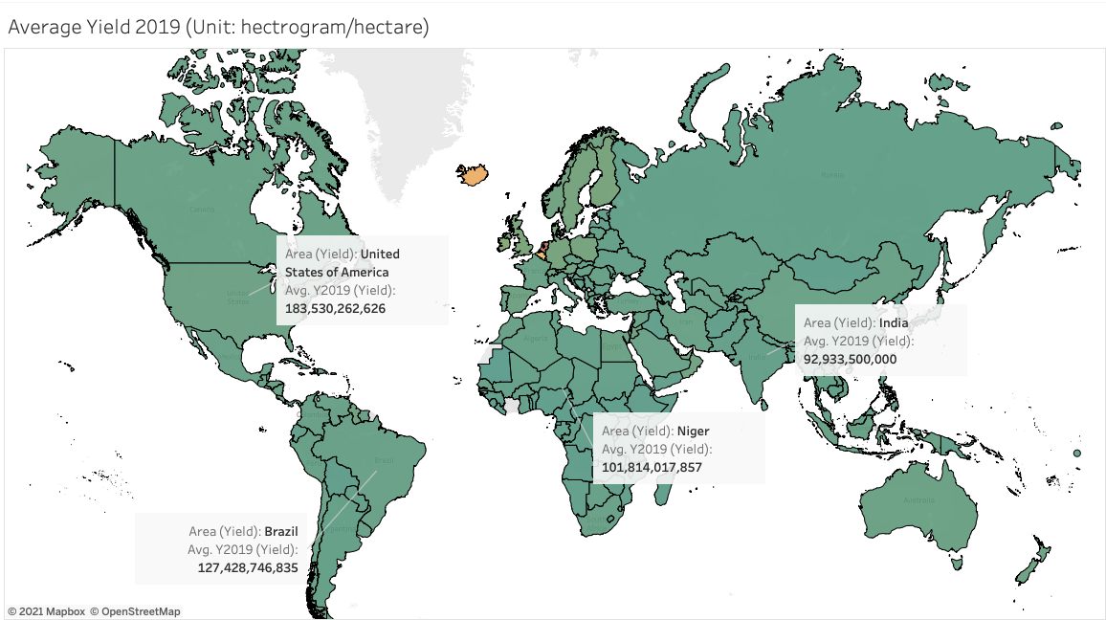

Where does our Food come from?
Yield of crops in countries world wide

Slide 5
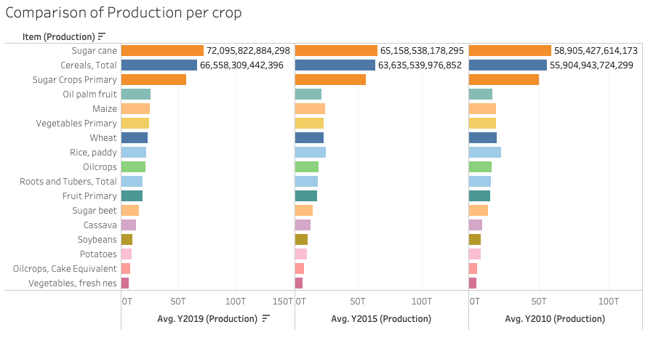
Where does our Food come from?
Comparison of Production per crop

Slide 6
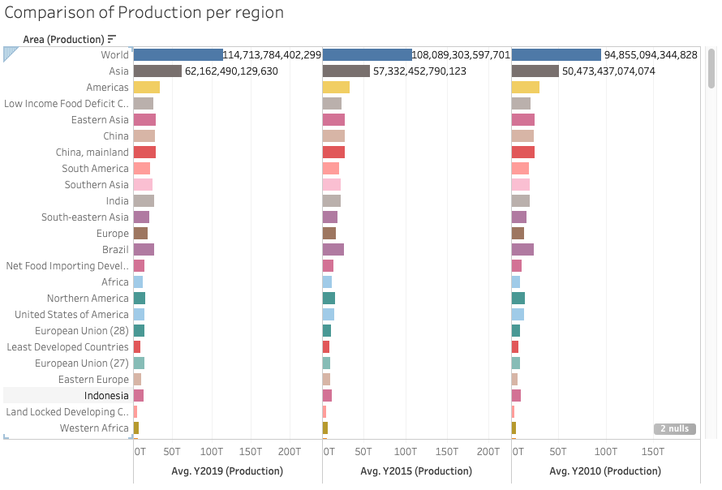
Where does our Food come from?
Comparison of Production per region

Slide 7
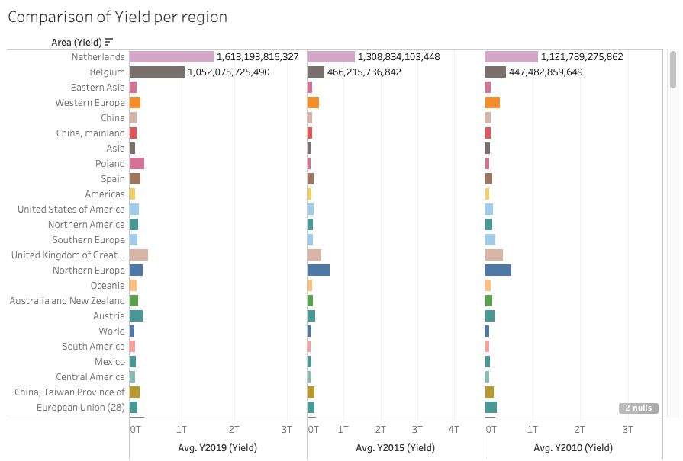
Where does our Food come from?
Yield for crops in regions/countries (Unit: hg/ha)

Slide 8
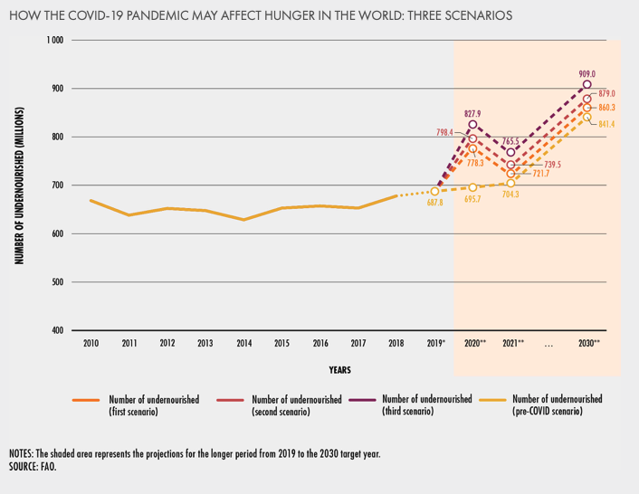
Human Impacts: How does this affect people and their nourishment?
Food insecurity trends:

Slide 9
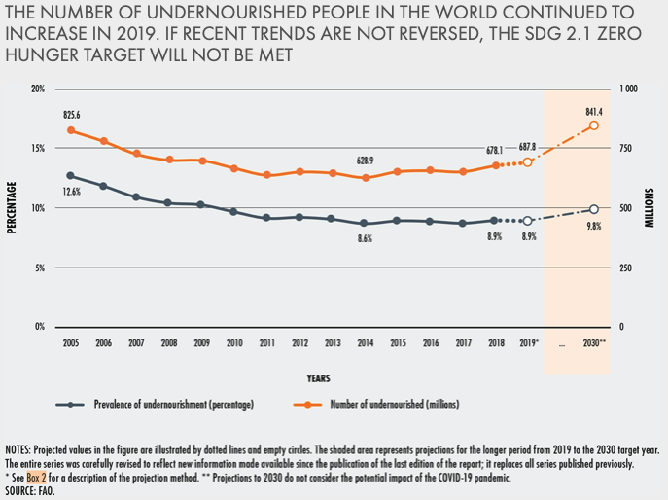
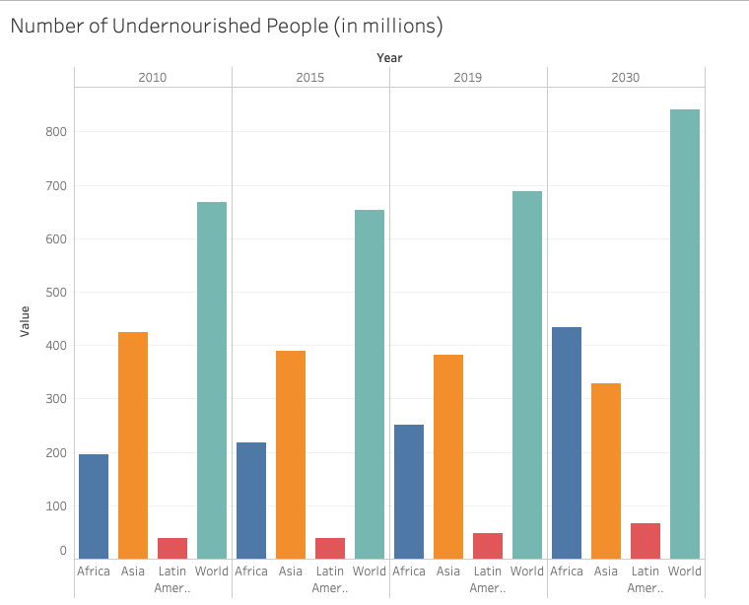
Human Impacts: How does this affect people and their nourishment?
Food insecurity trends:

Slide 10
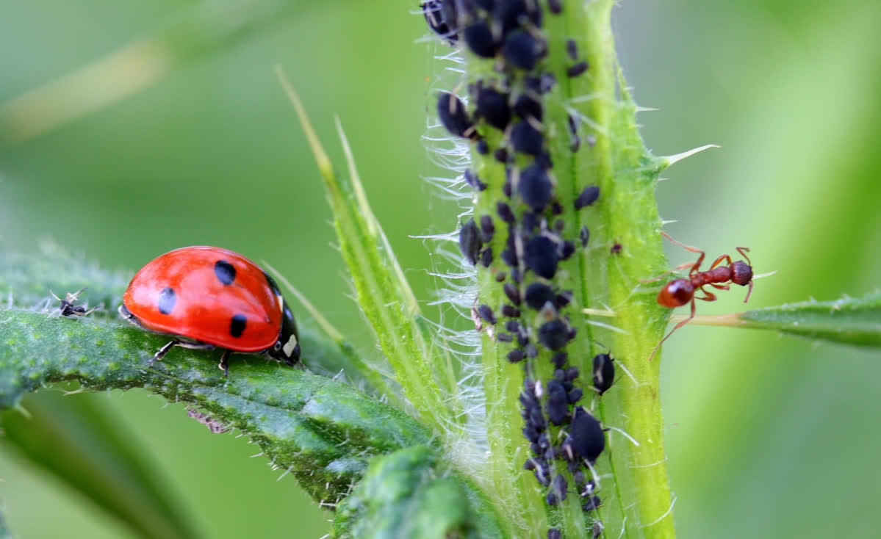
What are the causes of lower yield factors?
Abiotic Factors:
Examples:
Drought/Water
War and violence
Less government support
Climate Change/Temperature rise
Biotic Factors:
Pests
Viruses
Pathogens
Weeds

Slide 11
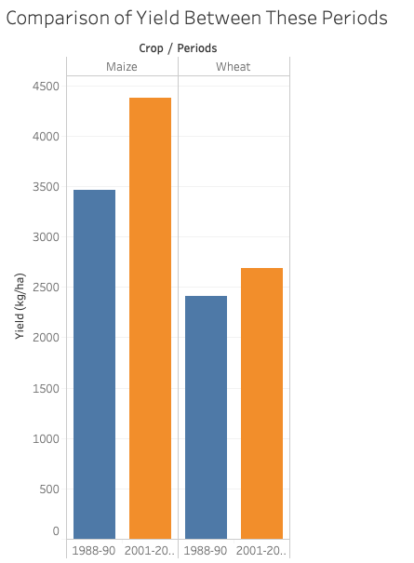
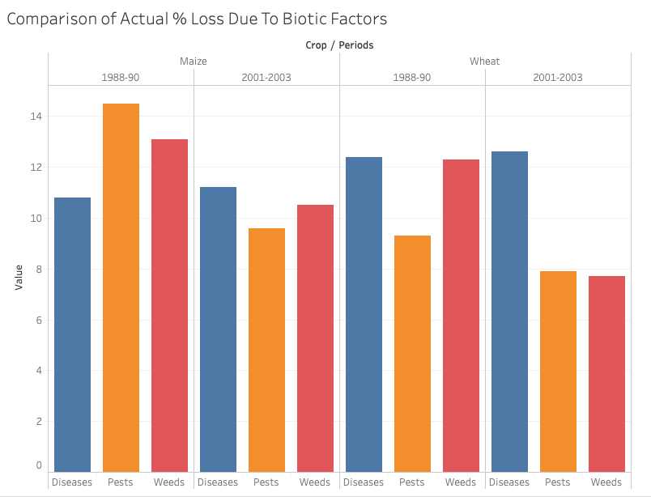
What are the causes of lower yield factors?

Slide 12
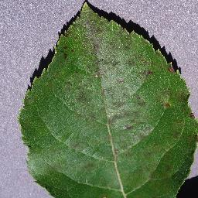
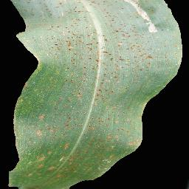
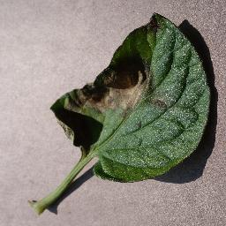
Commonalities in plant diseases due to pathogens
Identifying through patterns and spots on leaves:
Apple scab
Corn common rust
Tomato Late Blight

Slide 13
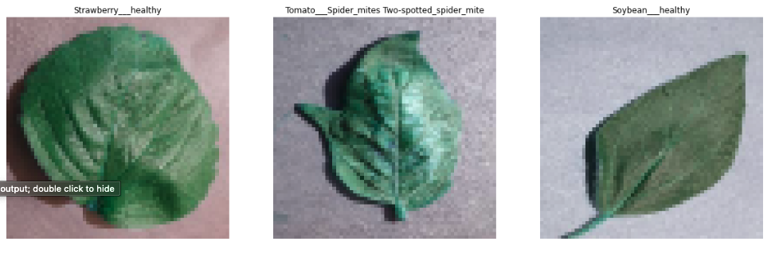
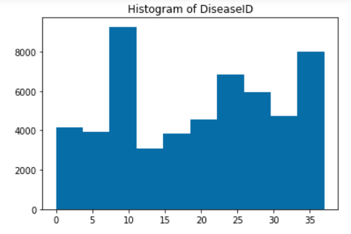
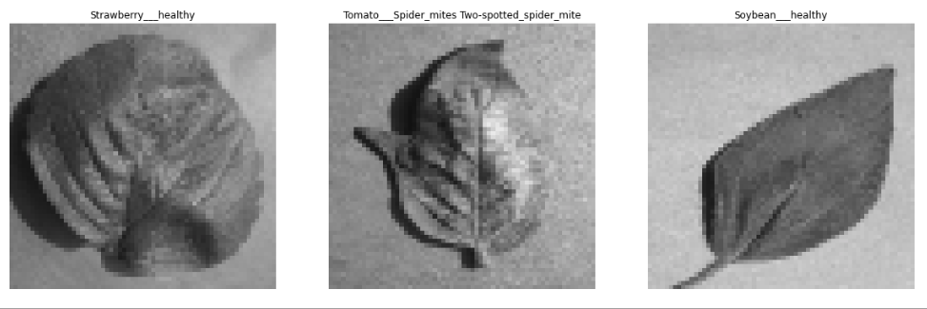
Diagnosis using Deep Learning model
Identifying through patterns and spots on leaves:

Slide 14
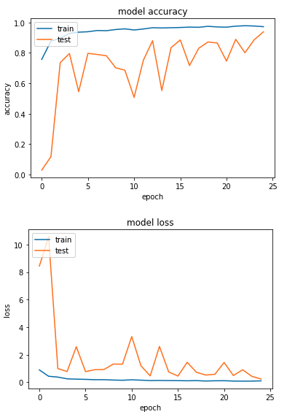
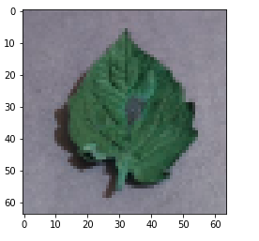

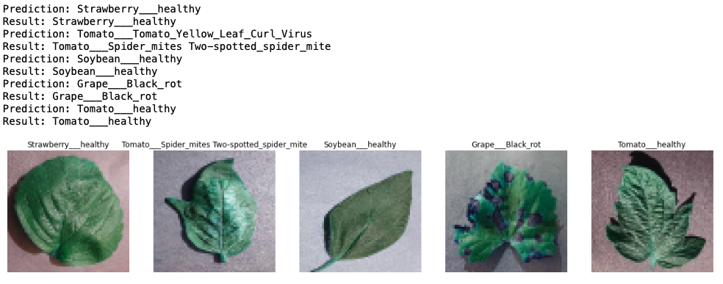
Diagnosis using Deep Learning model
Model Performance:
Wrong predictions:
Correct Predictions:

Slide 15
Diagnosis using Deep Learning model
Summary of Model Improvement Iterations:
Grayscale
Images
Color
Images
First three iterations using Sequential(), last one using ResNet50().

Slide 16
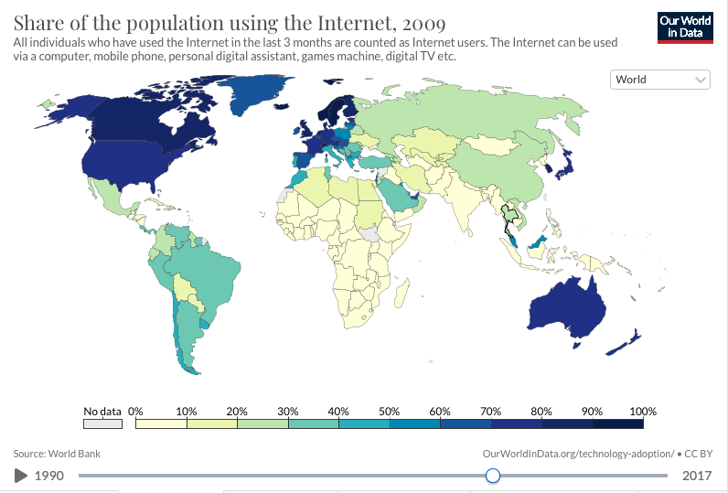
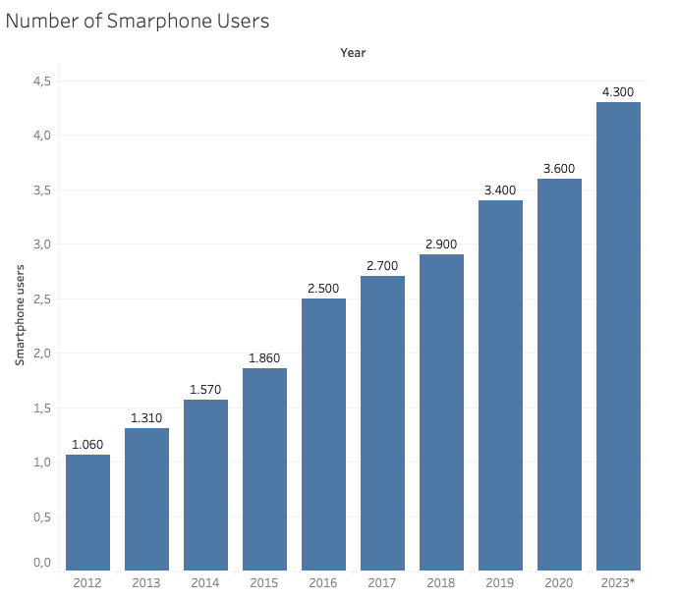
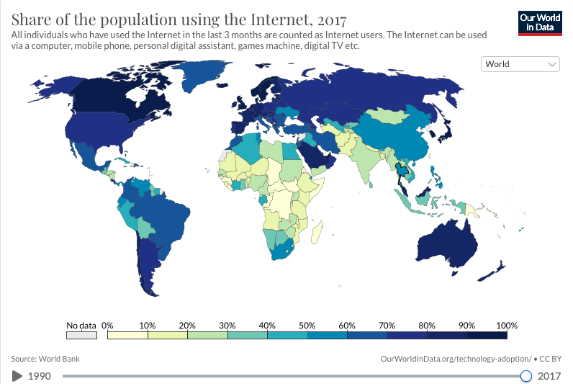
Diagnosis using Deep Learning model
Implementation in the real world:

Slide 17
Diagnosis using Deep Learning model
Limitations:
1. Images taken under other conditions.
2. Constrained to the classification of single leaves,
Facing up on a homogenous background.
3. 38 classes- practical perspective: farmers would
know what crops they are growing.
4. Diagnosis through lab analysis more effective,
this solution would not replace it.
Future Improvements:
More experiments with different train-test
Splits.
2. Adding noise to the model.
3. Splitting the experiments into individual
Disease types and running targeted models.
4. Other iterations with DL algorithms like
FastAI, GoogleNet, AlexNet.

Slide 18
Thank you!
Special thanks to Jan, David and Miguel for guidance and support.
And, thanks to everyone in my incredible cohort: Elena, Marta B, Neema, Imanol, Alberto, Anzi, Natalia, Enne, Thom, Marta C, Jorge, Joan and Nicoló.

Slide 19
References:
1. Plant Village Dataset: @spMohanty
https://github.com/spMohanty/PlantVillage-Dataset
2. Kaggle:
https://www.kaggle.com/emmarex/plant-disease-detection-using-keras
https://www.kaggle.com/abegaillagar/farmtechsoln-py
3. E.C.Oerke: https://citeseerx.ist.psu.edu/viewdoc/download?doi=10.1.1.657.5813&rep=rep1&type=pdf
4. World Bank Data:
https://data.worldbank.org/indicator/IT.NET.USER.ZS
5. FAO/FAOSTAT:
http://www.fao.org/faostat/en/
http://www.fao.org/3/y9422e/y9422e0f.htm
Smallholders produce data:
https://data.mendeley.com/datasets/tp63z6dz5g/1
7. Tensorflow/Keras documentation:
https://www.tensorflow.org/datasets/keras_example

