Slide 1


5th Semester DBMS Mini Project
INVENTORY MANAGEMENT SYSTEM
GUIDED BY:
Mrs.Chaithra G V and Dr.Gowramma G S
Asst. Professors
Department of ISE
DBIT
PRESENTED BY:
DEEPAK R
[1DB20IS042]
DEEPIKA M L
[1DB20IS043]
Department of Information Science and Engineering
Don Bosco Institute of Technology, Mysore road, Kumbalagodu,Bangalore

Slide 2
AGENDA
INTRODUCTION
ABSTRACT
ER DIAGRAM
SCHEMA DIAGRAM
CONCLUSION

Slide 3
INTRODUCTION
A Database Management System (DBMS) refers to the technology for creating and managing databases. Basically, DBMS is a software tool to organize (create, retrieve, update and manage) data in a database. The main aim of a DBMS is to supply a way to store up and retrieve database information that is both convenient and efficient. By data, we mean known facts that can be recorded and that have embedded meaning. Normally people use software such as DBASE IV or V, Microsoft ACCESS, or EXCEL to store data in the form of database. Database system is meant to handle large collection of information. Management of data involves both defining structures for information and providing mechanisms that can do the manipulation of those stored information. Moreover, the database system must ensure the safety of the information stored, despite system crashes or attempts at unauthorized access.

Slide 4
ABSTRACT
Inventory Management System using PHP and MYSQL is a web based application. It is a dynamic system.
It can be maintained and changed easily because it is based on database. It contains web pages that are
generated in real-time. These pages include Web scripting code, such as PHP. It is fully secured from
unauthorized access.
The main purpose of Inventory Management is to automate the existing manual system by the help of
computerized equipments and full-fledge computer software so that variable information can be stored
for longer period of time and access the information within the second. It keeps track of all the customers,
the purchases made during a given period and the inventory of the items.

Slide 5
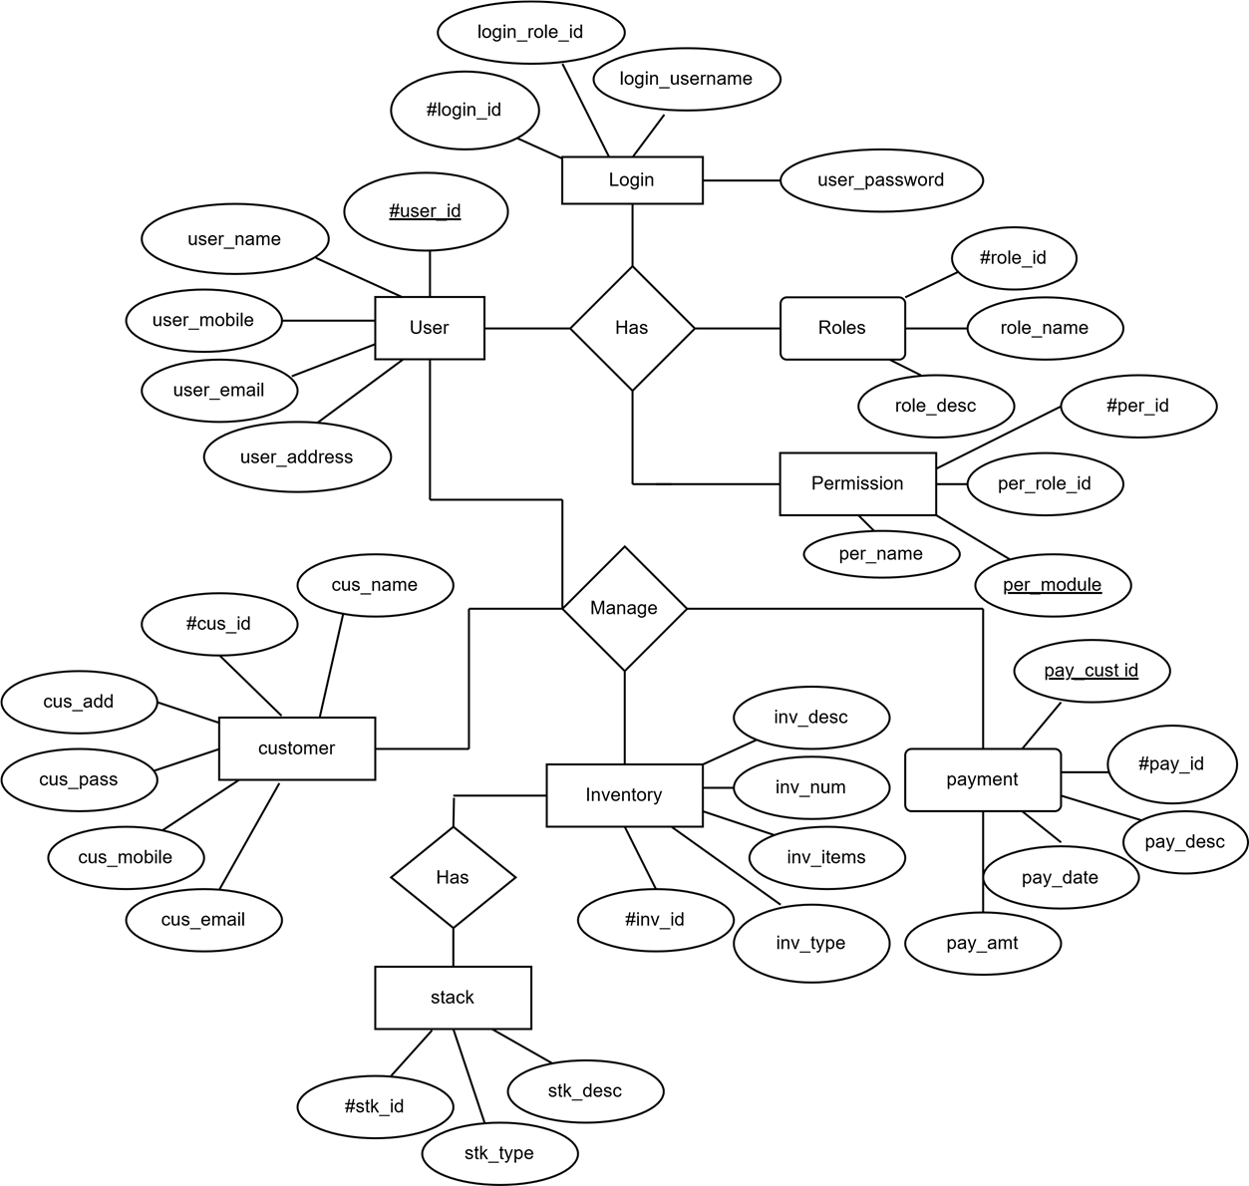
ER DIAGRAM

Slide 6
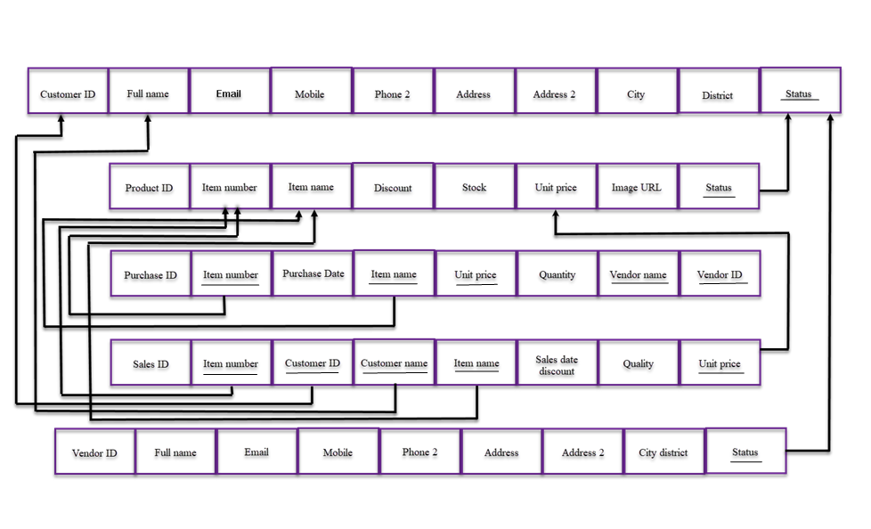
SCHEMA DIAGRAM

Slide 7
CONCLUSION
The project titled as Inventory Management System was deeply studied and analyzed to design the code
and implement. It was done under the guidance of the experienced project guide. All the current
requirements and possibilities have been taken care during the project time.
In addition to the features aforementioned, the proposed PHP project on Inventory Management System
is very flexible and can incorporate many new features and modules. Based on the user requirements,
modifications to various parts of the system can be done for all the module in the system.

Slide 8
REFERENCE
1. Ramez Elmasri and Shamkant B . Navathe , Fundamentals of Database Systems , 7th Edition ,
2017 , Pearson.
2. Ramakrishnan , and Gehrke , Database Management Systems , 3rd Edition , 2014 Mc Graw Hill
3. https://youtu.be/KLWA2vCERSQ
4. https://erdplus.com/
5. https://resources.fabric.inc/blog/answers/ecommerce-database-design-example

Slide 9
Thank You

