Slide 1
Natural Language to SQL Query Translator
Group: P3
Team Members:
Shyam JVS (120050052)
Prateek Chandan (120050042)
Anurag Shirolkar (120050003)
Deependra Patel (120050032)

Slide 2
Project Goal
Conversion of queries asked in natural language (English) to structured queries in SQL (Structured Query Language) on an underlying database.

Slide 3
Motivation Behind
Databases required to collect, organize & retrieve large amount of data.
SQL is a query language helpful in retrieving data from a Relational Database Management System. Other query languages include .QL, COQL, CQLF while SQL being among the most popular one used.
But using SQL requires the user to have sufficient knowledge of SQL syntax & structure. And with increasing importance to database systems and querying on them using a QL, access to non-expert users is desirable.
What about an NLS → SQL translator !!

Slide 4
Adopting a light-weight approach
Avoid a detailed semantic and syntactic analysis of sentence as it is computatinally expensive.
Rather use a light weight approach on parsing the sentence.
Shown to work quite well for most common queries. (Ref. 2)
Training with respect to POS tagging, parsing to obtain the noun clauses.

Slide 5
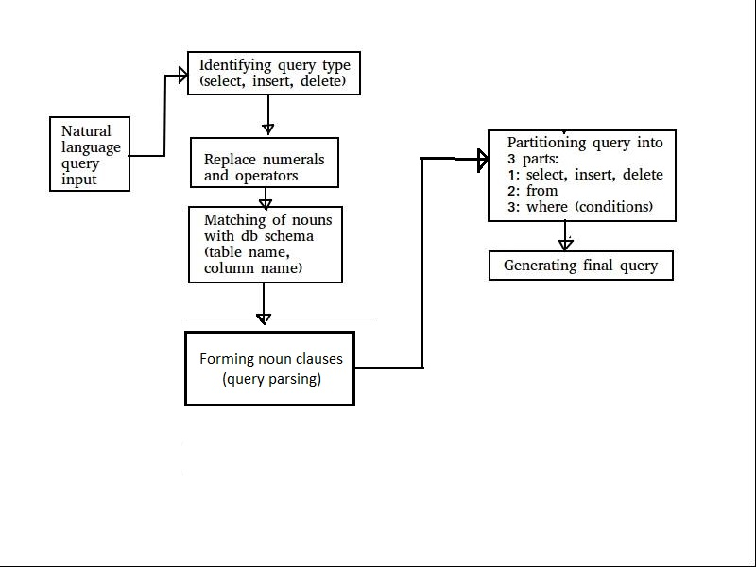
Rough Flowchart

Slide 6
Future Scope
Joins and grouping
Nested queries
Support for ambiguous aggregate functions
Support for abbreviation (using DB schema)
Missing table names
And many other interesting complications!

Slide 7
References
[Semantic mapping between NLQ → SQL queries]
http://disi.unitn.it/moschitti/articles/NLDB09.pdf
[A light weight approach to NLQ → SQL]
research.ijcaonline.org/volume82/number5/pxc3892152.pdf

