Slide 1
CROSS-MODEL STYLE TRANFER
DEEPESH TANK
18075017
CSE BTECH 4th SEMESTER

Slide 2
About Project
This project is code implementation of paper
Cross modal style transfer
By
Sahil Chelaramani(CVIT)
Abhishek Jha(KCIS)
Anoop M. Namboodiri(IIIT Hyderabad)

Slide 3
Method/Objective
This Project transfers the style from the text described in the content image
The group of k style image is matched from image database by the text retrieved from the content image and used for style transfer.
Original paper implemented using k = 5
The code implemented here is for k = 3 and can be modified for any value.
K >= 5 in code causes kernel to dies on our system. Therefore its is value is limited by computational power of CPU.

Slide 4
Database:
We didn’t use large sized YFCC100m dataset(>15).Therefore we manually created our dataset.
We have a dataset of 10 content images which are of size
576 x 512 pixels.
Image part of content image is an image of 512 x 512 pixels
Text part of content image is an image of 64 x 512 pixels
And have a dataset of 52 style-text caption images for style transfer of random sizes.

Slide 5
Architecture:
We use VGG16 architecture for implementing code
Layers which are used are:
block1_conv2 , block2_conv2 , block3_conv3 , block4_conv3 , block5_conv3
We have taken Weighted parameter of these layers as same as the parameter which were obtained by training the whole vgg16 on standard dataset “ImageNet”(15 million images).

Slide 6
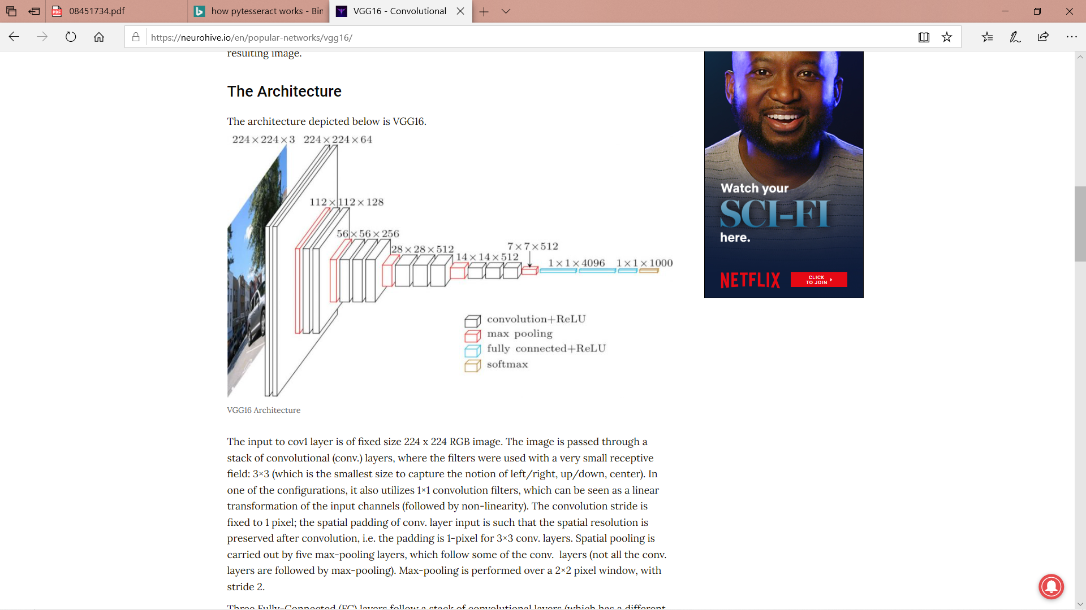

Slide 7
Brief Working of Code:
We take input image manually
We divide the image in two parts : content image and text image
Text image is then proceeded on pytesseract to retrieved the displayed data in text format.
The retrieved data is matched with style image caption pair in database to obtain all style image resembling the text.
The top k images taken into consideration. They are decided by visual similarity with content image . Only top k matched images are taken.

Slide 8
Brief Working of Code:
The visual similarity is decided by comparing each style image with content image on grey scale.
The top k images are tagged with their weighted probability of how similar are they are with content image.
The k images along with input images are then processed as modified input in form of array of RGB channels for input in vgg16 architecture.
Total loss = cw*(content loss) + sw*(style loss) + tvw(total variation loss)
cw = content weight, sw=style weight ,tvw = total variation weight

Slide 9
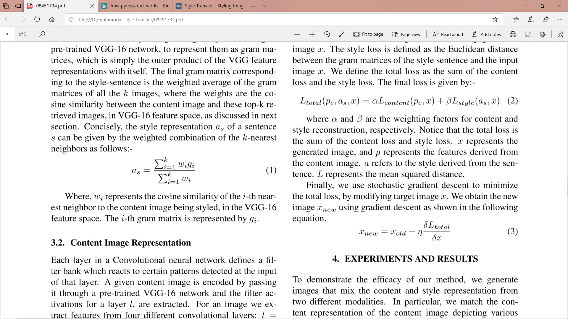
Brief Working of Code:
content and total variation loss are calculated same as calculated in standard style transfer paper of Leon Gatys’s neural style transfer.
In style loss we calculate gram matrix for each of k style image and finally take weighted mean of them.
Wi is the weighted probability associated with i^{th} image.

Slide 10
Brief Working of Code:
For optimizing the generated image at each iteration we use fmin_l_bfgs_b algorithm.
Finally we form an output image from generated image NumPy array obtained by vgg16 architecture.

Slide 11
Minor difference with paper:
We use better algorithm fmin_l_bfgs_b instead of gradient descent for optimization.
We use pytesseract pretrained optical character recognition (OCR) tool for text retrieval process instead of complicated word2vec model.

Slide 12
Parameter and Hyperparameters:
Style weight = 5.0
Content weight = 0.05
Total variation Weight = 1.0
Iterations = 10
K = 3

Slide 13
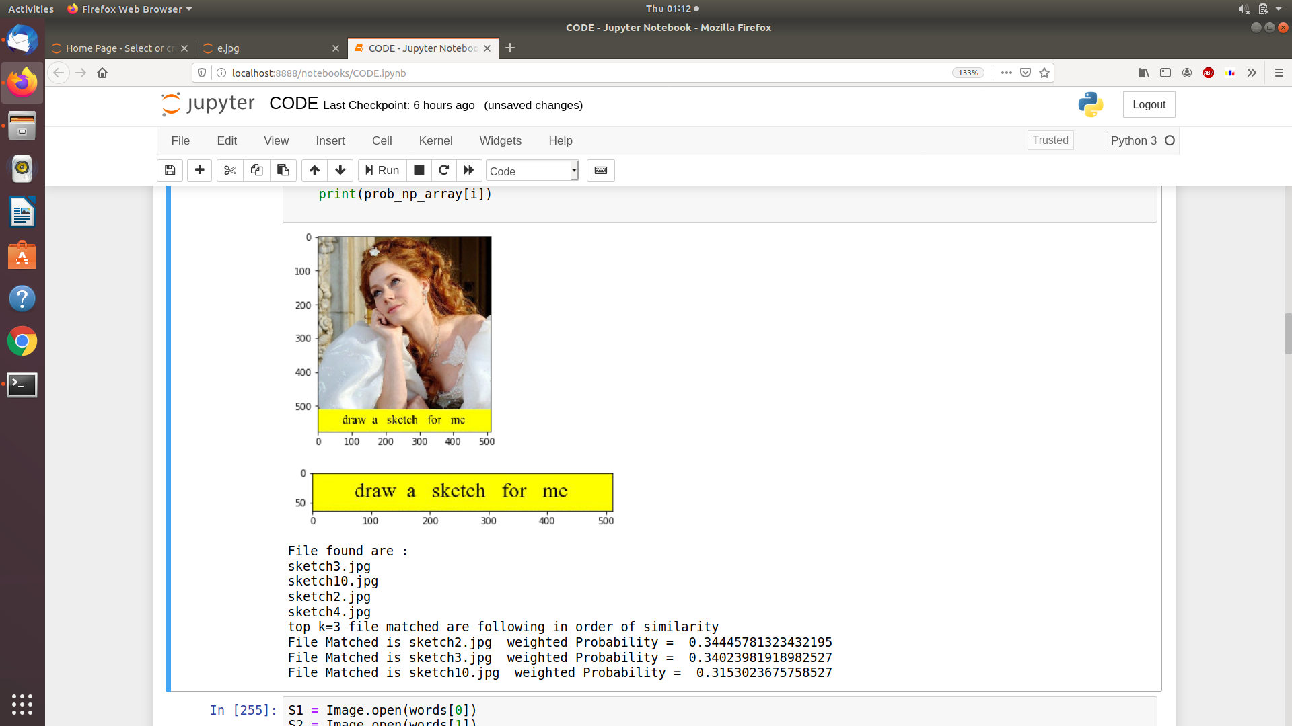
(input -> output):
Input image
Retrieved text image
Images found
Top k matched image

Slide 14
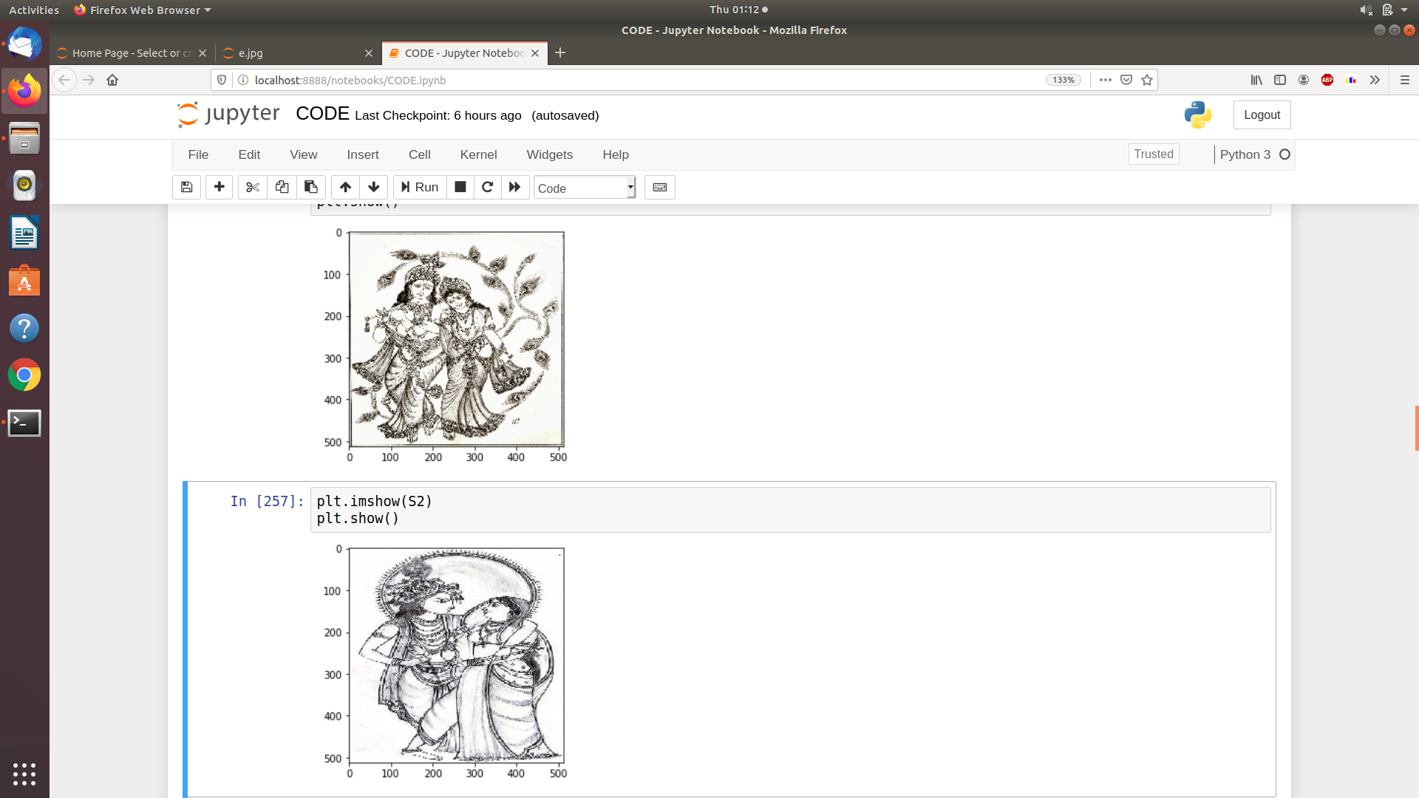
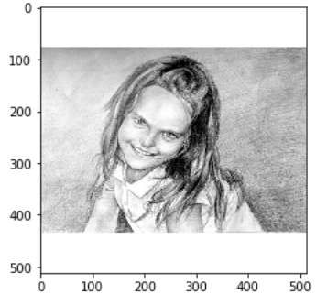
(input -> output):
TOP 1st matched image
TOP 2nd matched image
TOP 3rd matched image

Slide 15
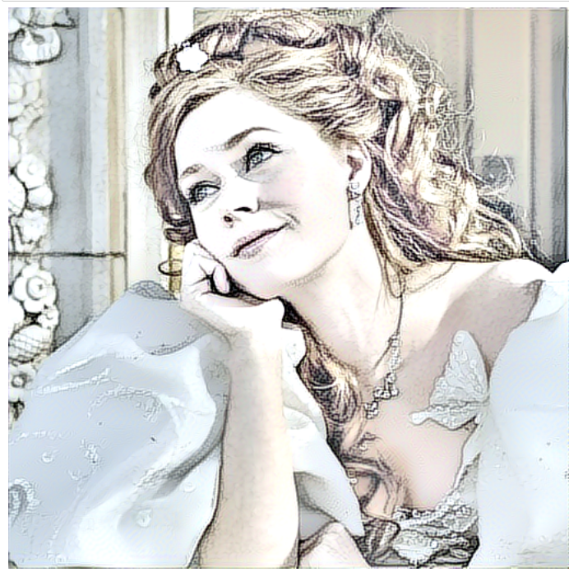
(input -> output):
Output image
input image

Slide 16
Analysis of code:
Strong Points:
Our method gives the best result as we used pretrained pytesseract model ensuring accuracy of 98 – 99 % which greater than purposed word2vec model of original paper.
Pytesseract based on retrieving letter from image than forming word therefore identifying out of vocabulary words while word2vec can’t identify such words.
We didn’t use YFCC100m dataset therefore ensuring code can be designed for a particular task and thus increasing computational speed of code.

Slide 17
Analysis of code:
Weak Points:
All style images should be almost similar as we have manually created they may not be therefore combination of the gram matrix may result to transfer style from chaotic noise image to content image . Solution to this problem is to keep k a small integer therefore we take k=3 for implementation and keeping style weight to be also a small number.

Slide 18
Reference:
CROSS-MODALSTYLETRANSFER Sahil Chelaramani*, Abhishek Jha*, Anoop M. Namboodiri (CVIT, KCIS, IIIT Hyderabad, India)
Leon A. Gatys, Alexander S. Ecker, and Matthias Bethge, “Image style transfer using convolutional neural networks,” in CVPR, June 2016
R. H. Byrd, P. Lu and J. Nocedal. A Limited Memory Algorithm for Bound Constrained Optimization, (1995), SIAM Journal on Scientific and Statistical Computing, 16, 5, pp. 1190-1208
C. Zhu, R. H. Byrd and J. Nocedal. L-BFGS-B: Algorithm 778: L-BFGS-B, FORTRAN routines for large scale bound constrained optimization (1997), ACM Transactions on Mathematical Software, 23, 4, pp. 550 – 560
J.L. Morales and J. Nocedal. L-BFGS-B: Remark on Algorithm 778: L-BFGS-B, FORTRAN routines for large scale bound constrained optimization (2011), ACM Transactions on Mathematical Software, 38, 1.

