Slide 1
DONATE BLOOD – SAVE LIFE (blood bank database management system)
GROUP MEMBERS :
DVIJ JOSHI – 18075026
DEEPESH TANK – 18075017
NAVNEET TAUNK - 18075041

Slide 2
FEATURES AVAILABLE IN THE WEB APPLICATION (WEBSITE)
DONOR LIST AND REQUEST LIST STORING DATA OF BLOOD REQUEST AND AVAILABLE DONOR DATA.
ELIGIBILITY CRITERIA FOR BLOOD DONATION
REGISTERED USERS CAN APPLY FOR “DONATE BLOOD” AS WELL AS “REQUEST BLOOD” ON BEHALF OF THEMSELVES AS WELL AS THEIR FRIENDS AND RELATIVES.
CHART FOR BLOOD DONORS, BLOOD BANKS ARE AVAILABLE.
LOCATION OF NEARBY BLOOD BANKS CAN BE VIEWED ON THE MAP.

Slide 3
FRONT END IN BRIEF
THE TEMPLATE FOR THE PAGES HAS BEEN FORMATTED ACCORDINGLY TO SERVE THE PURPOSE OF OUR WEBSITE.
USE OF HTML AND CSS HAS BEEN MADE IN ORDER TO GIVE IT A USER-FRIENDLY AND BRIGHT LOOK SO THAT THE WEBSITE LOOKS ATTRACTIVE TO THE USER.
MAP-VIEW HAS BEEN GENERATED WITH THE AID OF GOOGLE MAP LINKS WHICH HAS BEEN IMPLEMENTED IN THE BACKEND PART OF THE PROJECT.

Slide 4
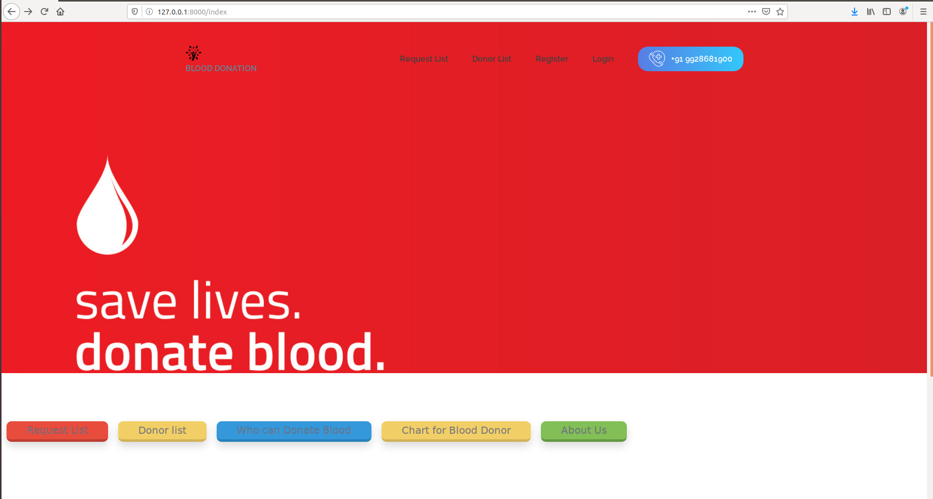
HOMEPAGE VIEW OF THE WEBSITE

Slide 5
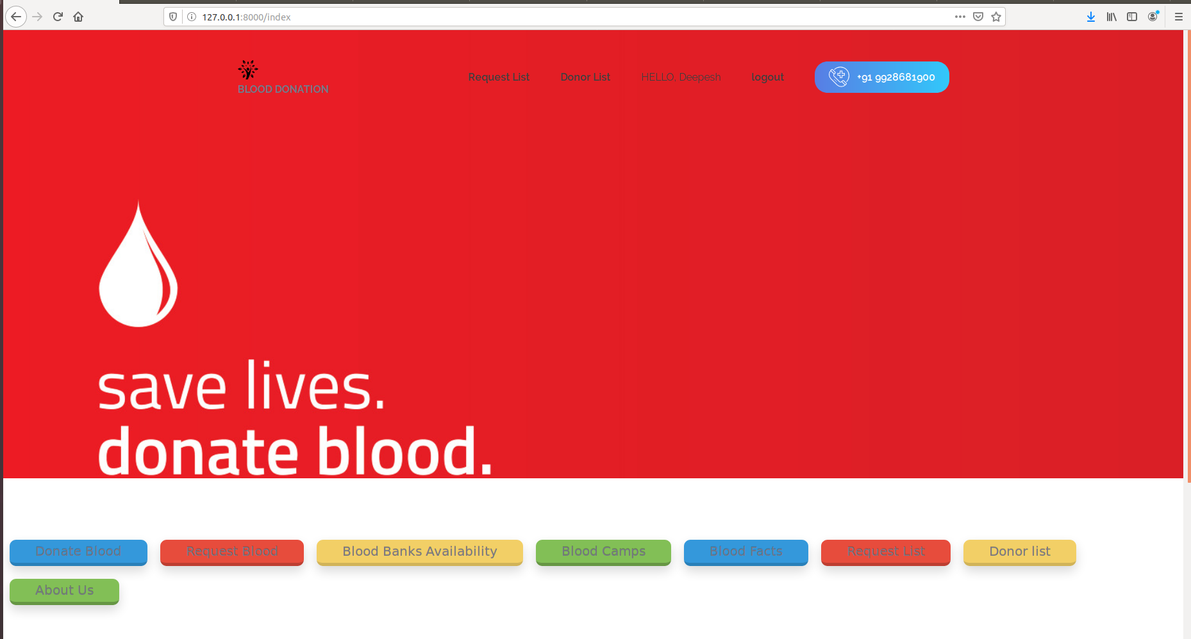
REGISTERED USER LOGGED IN PAGE VIEW

Slide 6
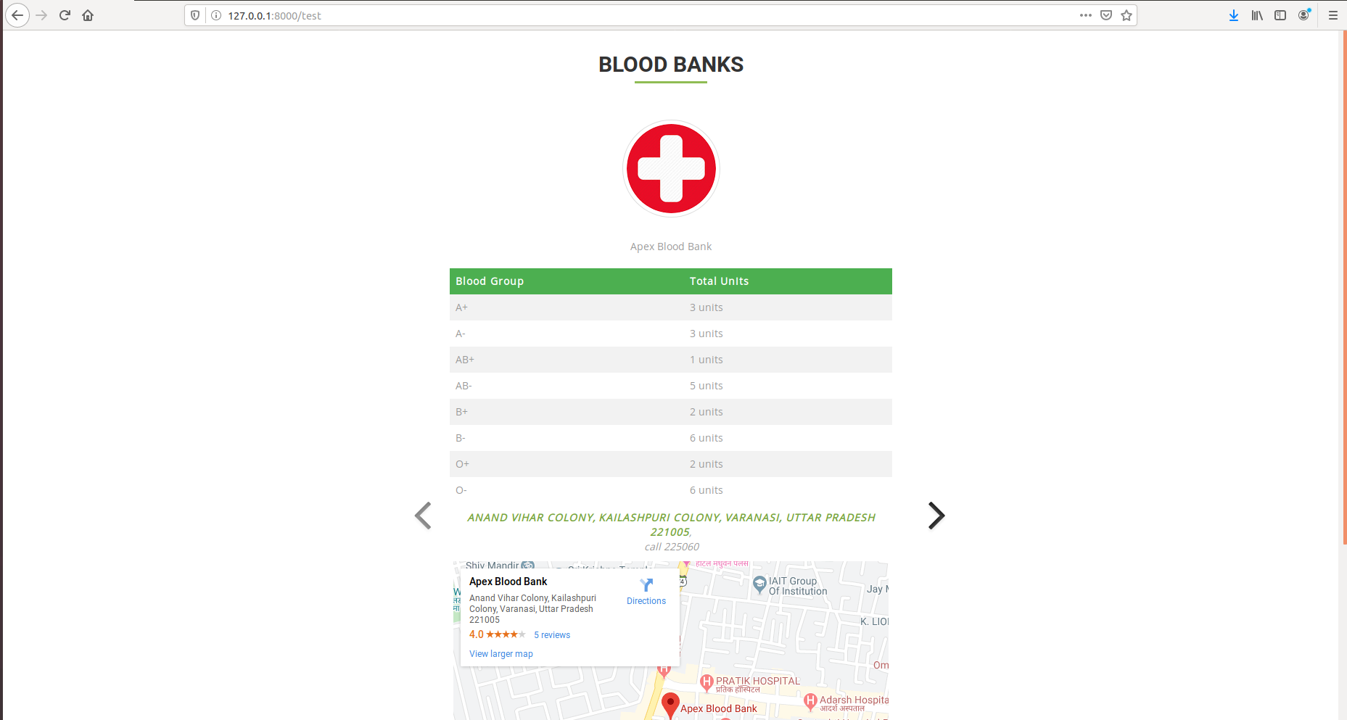
MAP VIEW FOR A LISTED BLOOD BANK

Slide 7
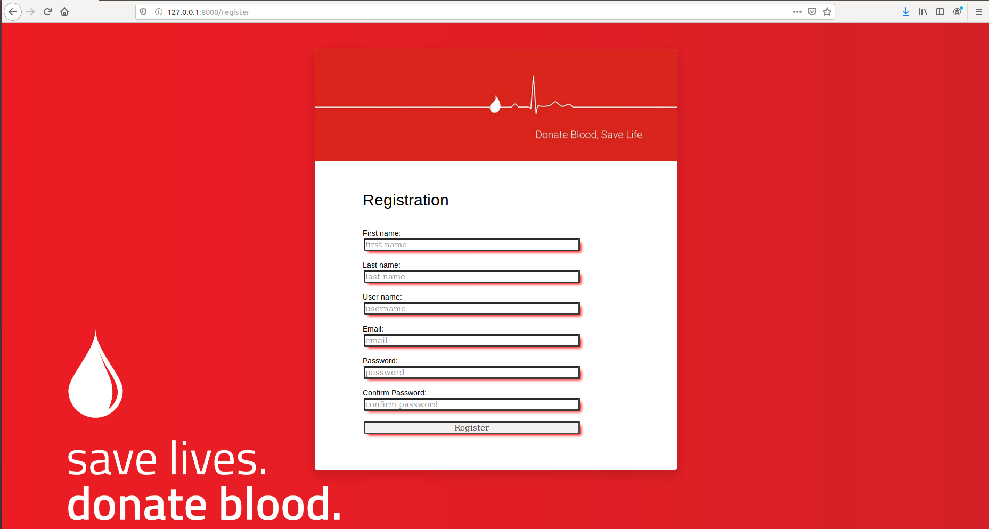
USER REGISTERATION PAGE

Slide 8
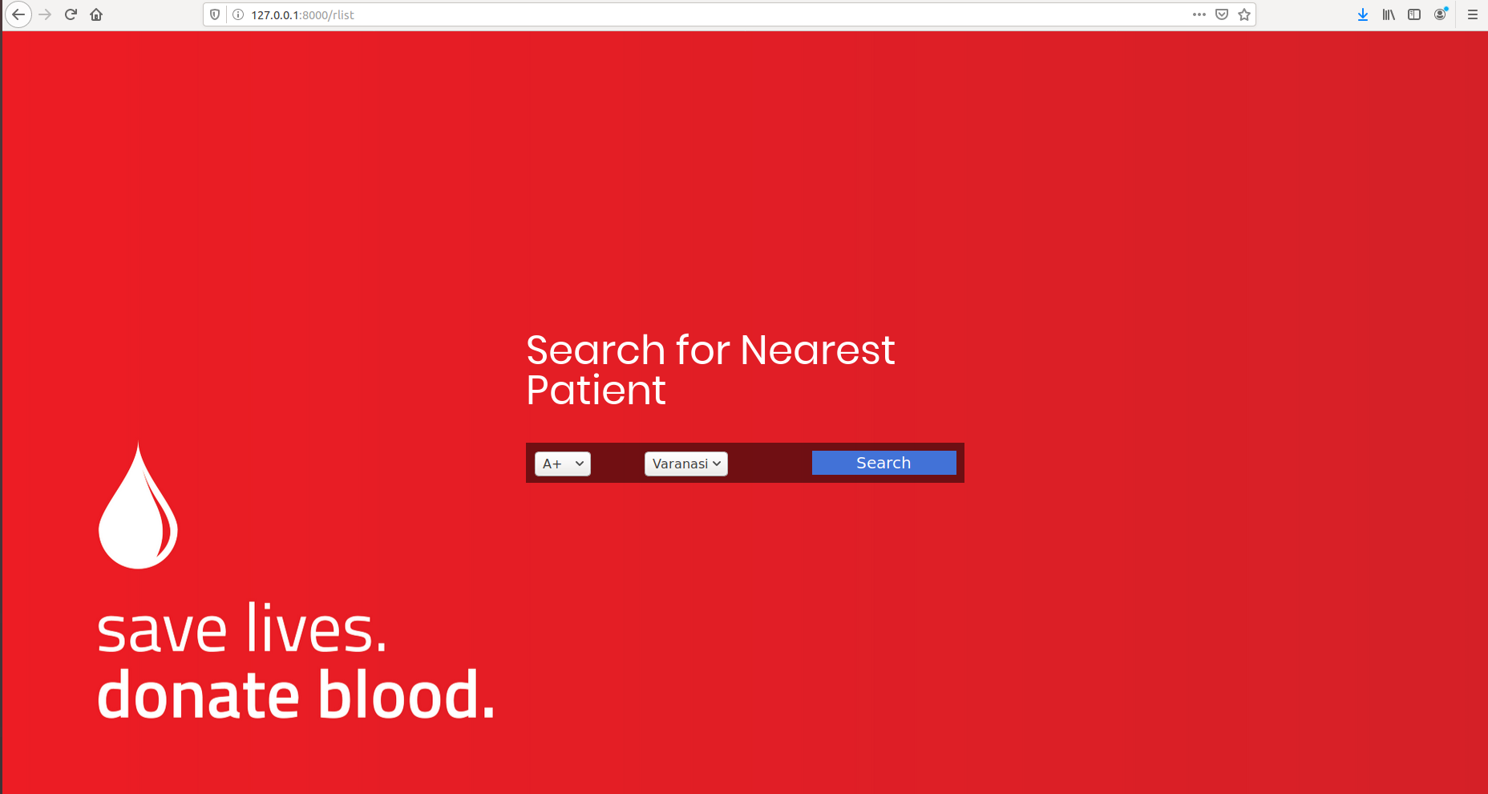
SEARCH FOR PATIENT PAGE
(WE HAVE A SIMILAR PAGE FOR DONOR)

Slide 9
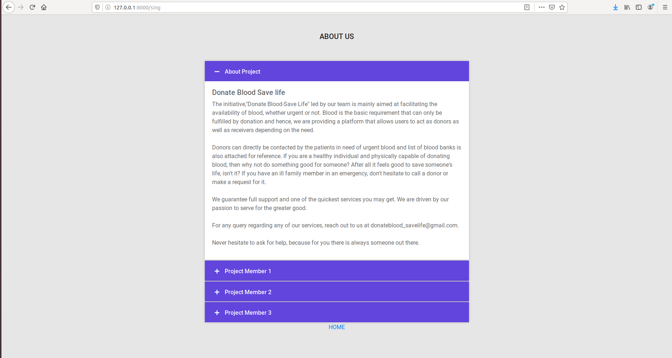
ABOUT US PAGE

Slide 10
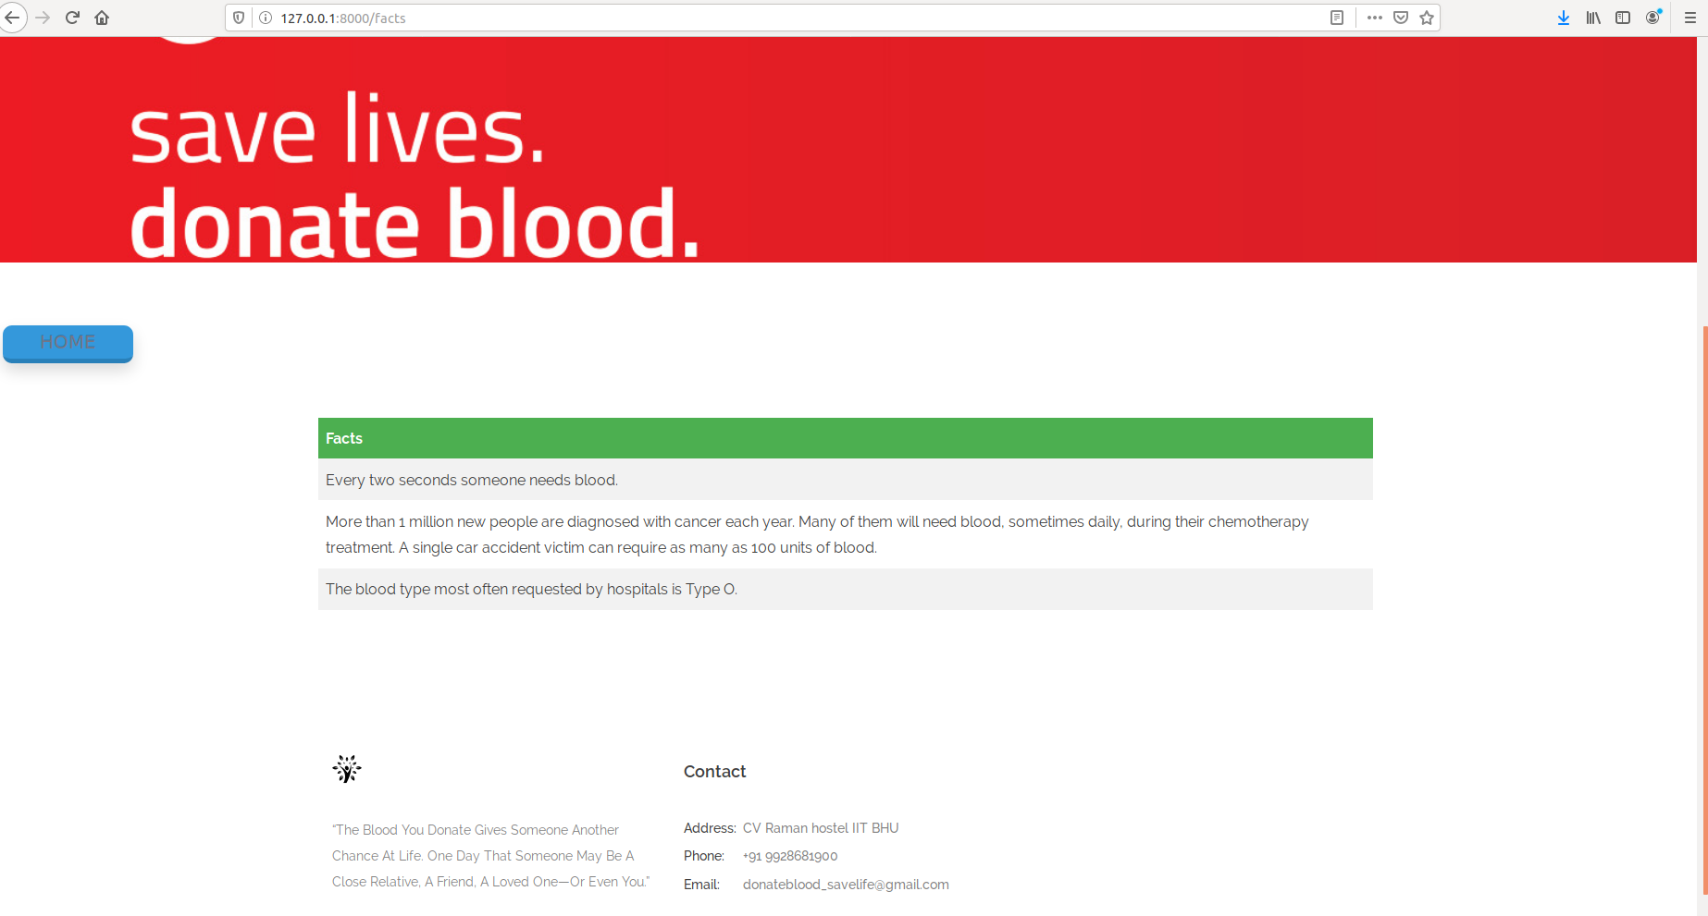
FACTS ABOUT BLOOD PAGE

Slide 11
BACKEND INFORMATION IN BRIEF
WE HAVE ADOPTED DJANGO FRAMEWORK FOR DEVELOPING THE WEBSITE.
IN VIEWS.PY FILE, WE HAVE CODED VIEW FUNCTION FOR HOME PAGE VIEW, REGISTERED USER LOGGED IN VIEW, BLOOD BANK MAP VIEW, FACTS ABOUT BLOOD VIEW, ABOUT US VIEW,ETC. FOR IMPLEMENTATION DETAILS VISIT UPCOMING SLIDES.
IN URLS.PY FILE, WE HAVE MAPPED VARIOUS URLS FOR CORRESPONDING VIEWS SO THAT USER CAN ACCESS ALL WEB PAGES SMOOTHLY. THERE IS A TAB TO SWITCH BACK TO HOMEPAGE IN EVERY WEB PAGE.
SOME HTML FILES HAVE BEEN CREATED FOR CREATING FORMS, BASIC FORMATTING AND CREATING THE DESIRED VIEW.
SIMILARLY, SETTINGS.PY HAS BEEN MODIFIED IN ACCORDANCE WITH THE DESIRED PURPOSE.
MODELS.PY STORES VARIOUS MODELS FOR FETCHING INFORMATION FROM THE PAGE AND STORING IN THE MYSQL DATABASE.

Slide 12
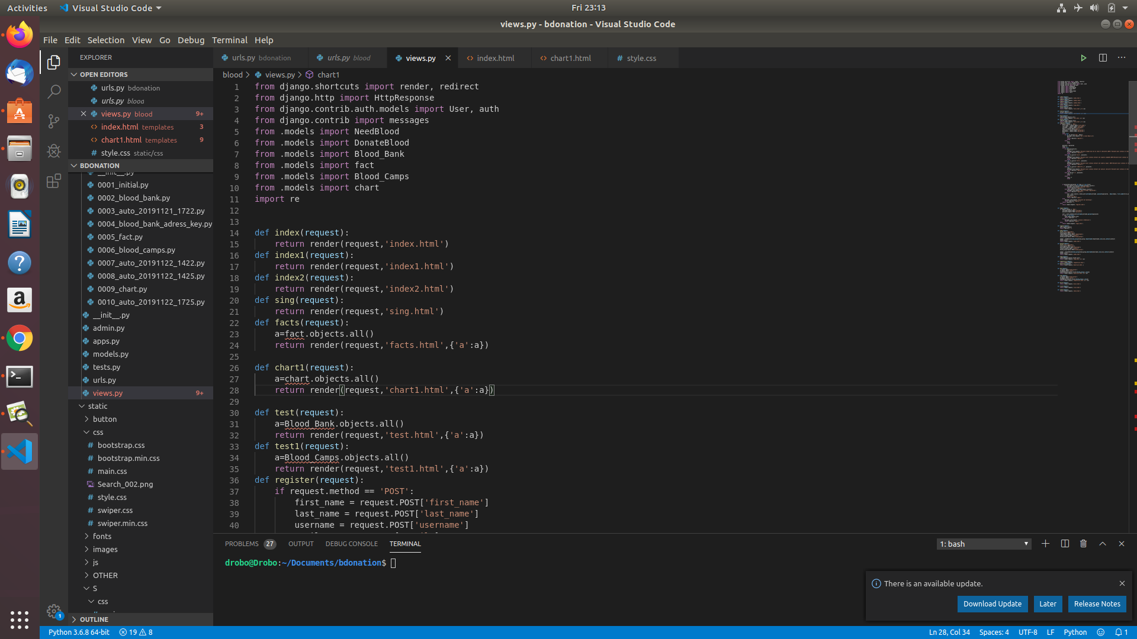
VIEWS.PY FILE

Slide 13
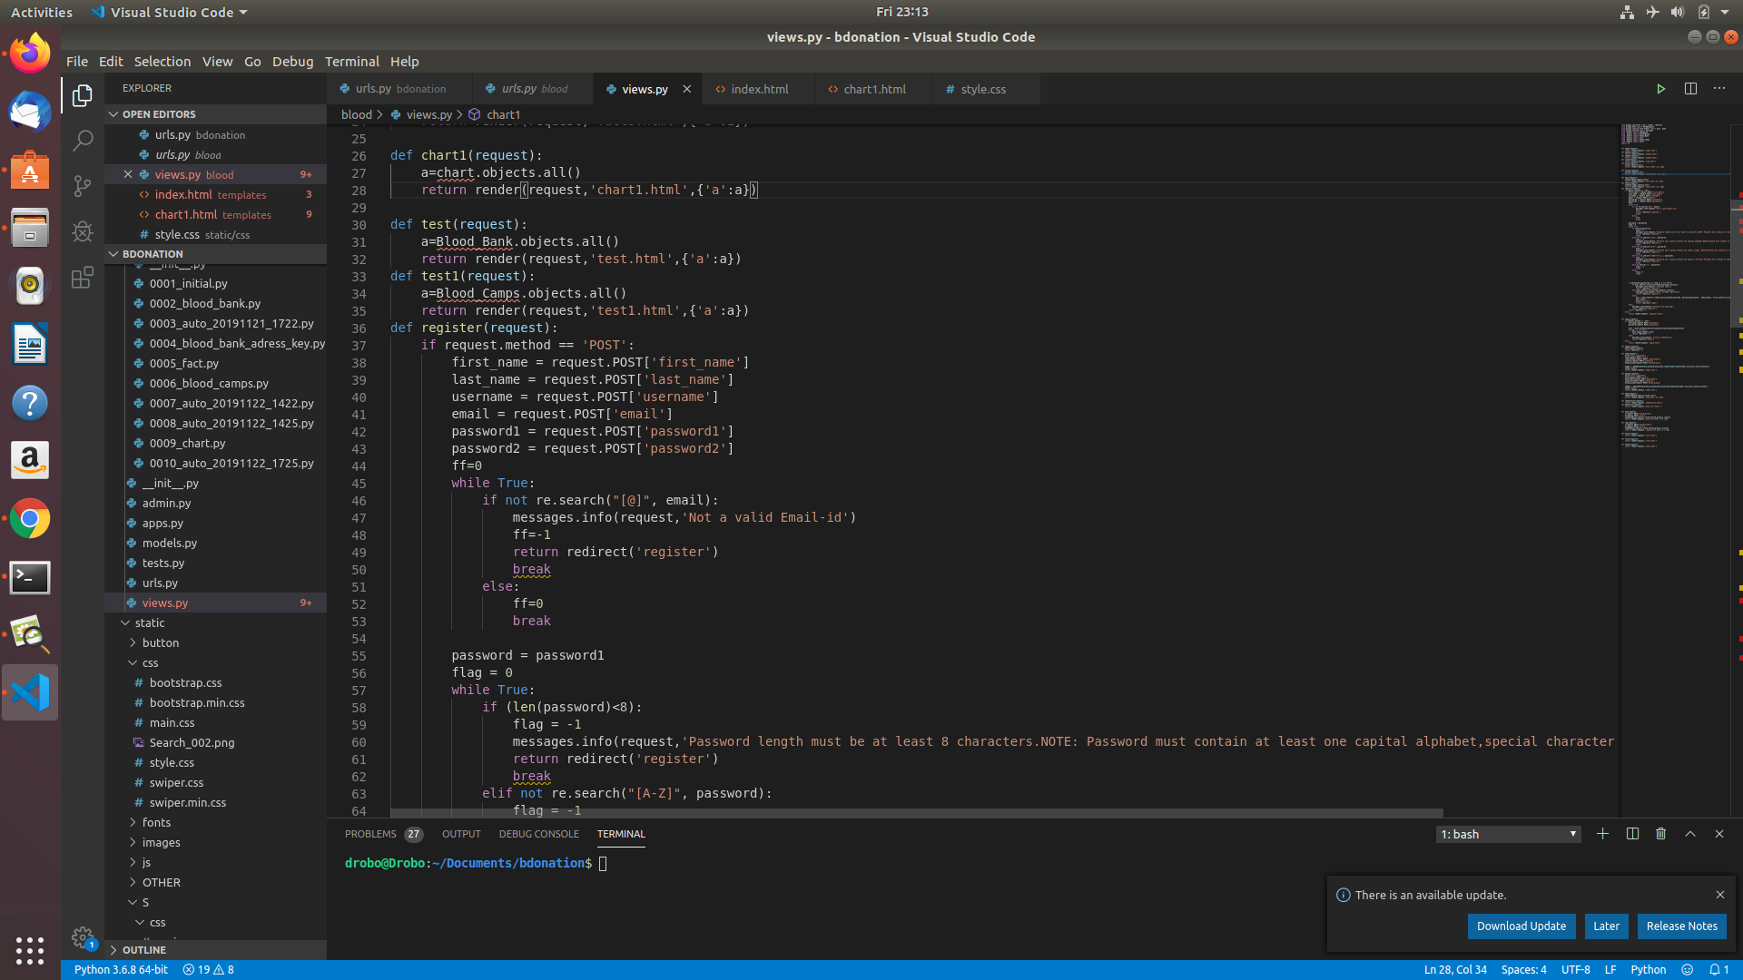
VIEWS.PY FILE (CONTINUED)

Slide 14
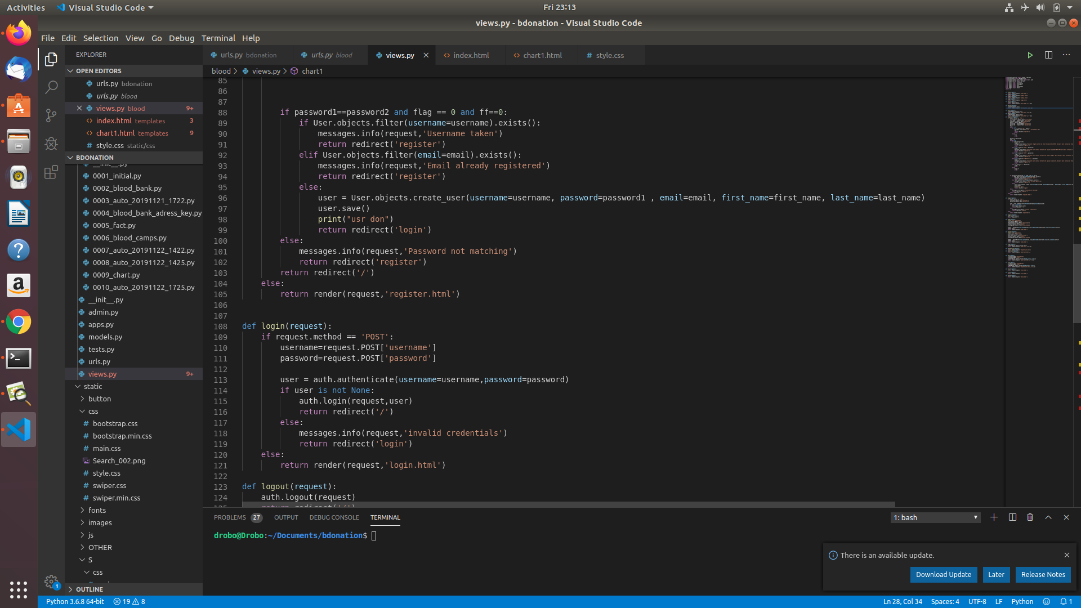
VIEWS.PY FILE (CONTINUED)
(THE FILE IS TOO LONG TO BE INCLUDED COMPLETELY IN THE SLIDES)

Slide 15
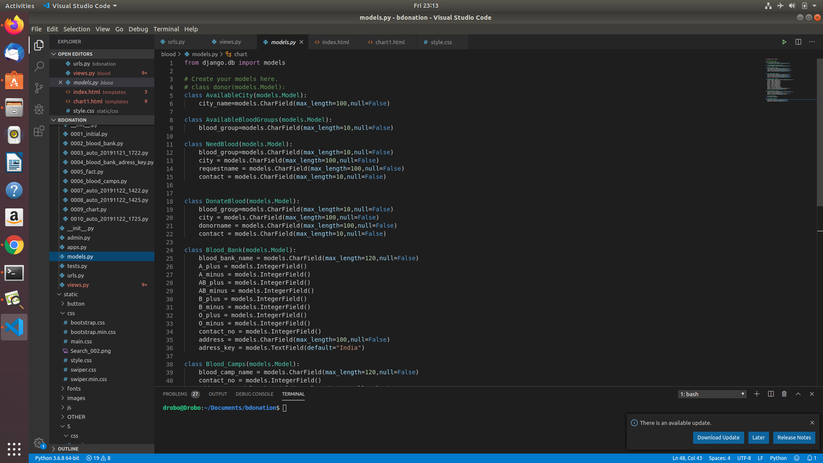
MODELS.PY FILE

Slide 16
THE END

