Slide 1
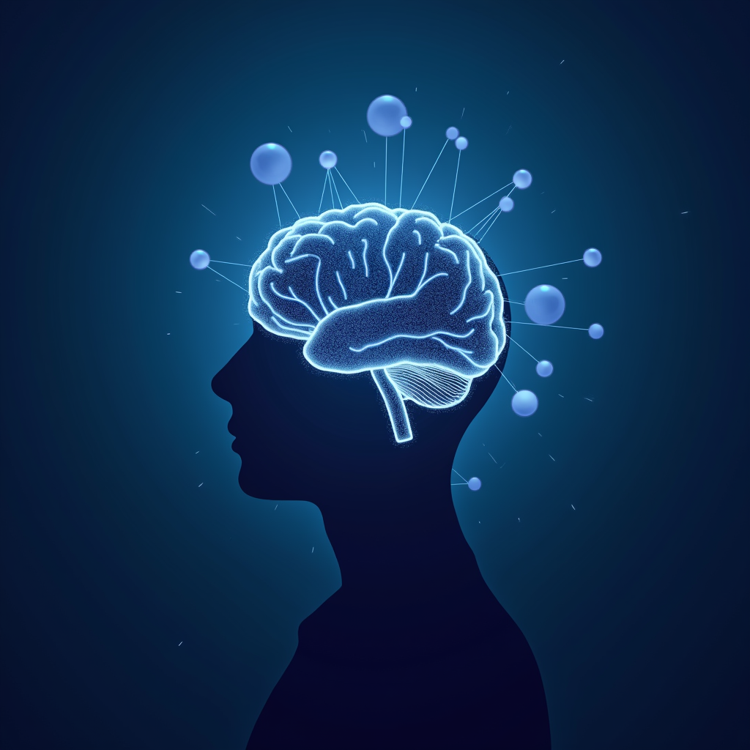
Introduction to Cognitive Imitation Learning
Picture a toddler who has never heard the word “physics” yet instantly adjusts her grip to match the...

Slide 2
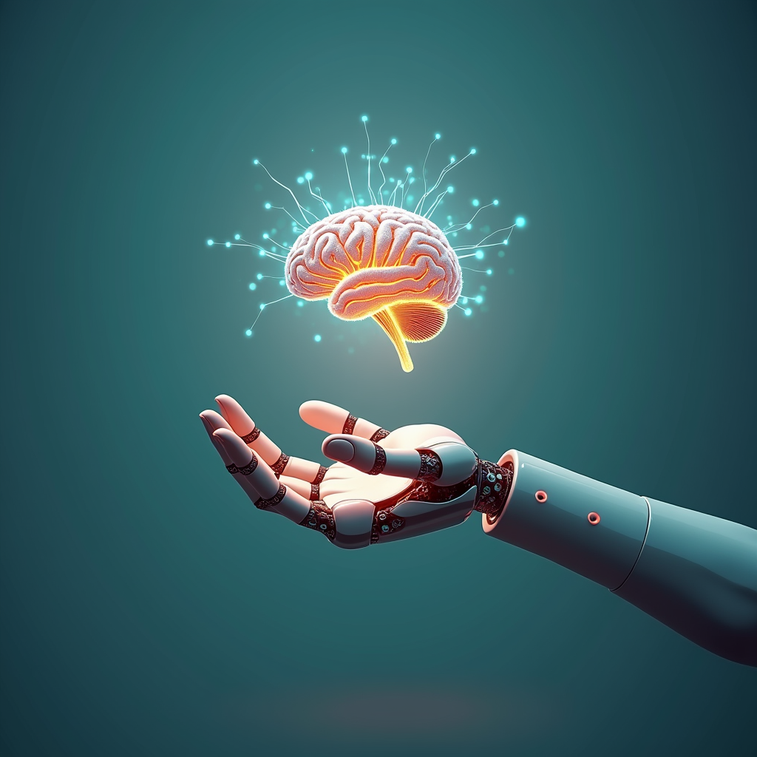
Cognitive Imitation Learning - Part 1
Picture a child who has never seen a bicycle before. After thirty silent seconds of watching her older brother wobble, coast, and triumphantly pedal away, she already “knows” what success feels like; her brain has compressed the entire sensory movie into a lightweight mental recipe that can be replayed, twisted, and re-run on her own body. Cognitive imitation learning works the same way for machines: instead of mindlessly copying joint angles, the algorithm reconstructs the hidden causal beliefs that make the expert tick—why she hesitates at the curb, how she reallocates attention the instant a dog darts out. The result is a portable “theory of the task” that transfers to new cities, new bikes, even new riders.
Inside the code, this “theory” is a generative world model that the agent trains like an over-eager film student: it predicts the next frame, compares it with the expert footage, and updates only the parameters that matter for narrative flow. When Boston Dynamics’ latest humanoid steps onto a slackline it has never seen, it does not balance by rote; it hallucinates plausible futures, checks which of them the expert would have approved, and tightropes forward with the poise of a Silicon Valley exec on a weekend retreat. The payoff spills far beyond viral robot videos: wind-turbine drones learn to mimic veteran inspectors and spot micro-cracks 30 % faster, while surgical-assist arms adopt the “gesture grammar” of top surgeons, cutting training time from months to days without a single extra incision.

Slide 3
Conclusion
Imagine a child who learns to tie shoelaces not by reading a manual but by watching an older sibling’s fingers dance—once the sequence clicks, the child tosses away the prototype and invents a faster double-knot. Cognitive imitation learning is AI’s version of that moment: a glance, a replication, a leap beyond the demo. We’ve seen how algorithms can now distill the invisible grammar of expert thought—whether a pilot’s snap decision or a chemist’s hunch—then re-assemble it in silicon that keeps improving long after the mentor has left the room. The takeaway is not that machines are becoming human; rather, they are becoming exquisite mirrors that reflect the best of what we know and then angle the reflection to reveal shortcuts we never noticed.
So what disappears tomorrow? The myth that every skill needs months of labeled data; the bottleneck of expert time; the fear that knowledge retires when people do. What appears? Factories where rookie robots shadow veteran technicians for a single shift, then run the line all night with fewer defects. Hospitals where junior doctors consult a living library of past diagnoses that updates itself after every surgery. Research labs where AI apprentices watch Nobel laureates brainstorm, then propose experiments their mentors hadn’t yet imagined. Your next step is to treat expertise as renewable currency: codify it, share it, and let it compound. Start by identifying the tacit wizardry hidden in your best performer’s workflow—capture it, curate it, and release it like open-source lightning into every corner of your organization.

