Slide 1
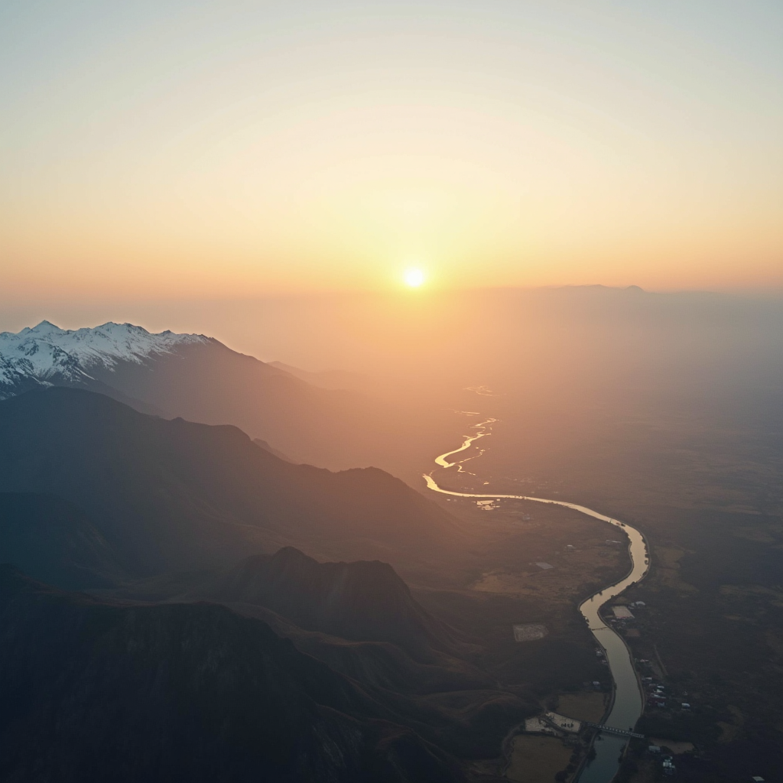
Introduction to India's Landsacape
Imagine unrolling a living atlas the size of Europe yet crammed inside one subcontinent: the page op...

Slide 2
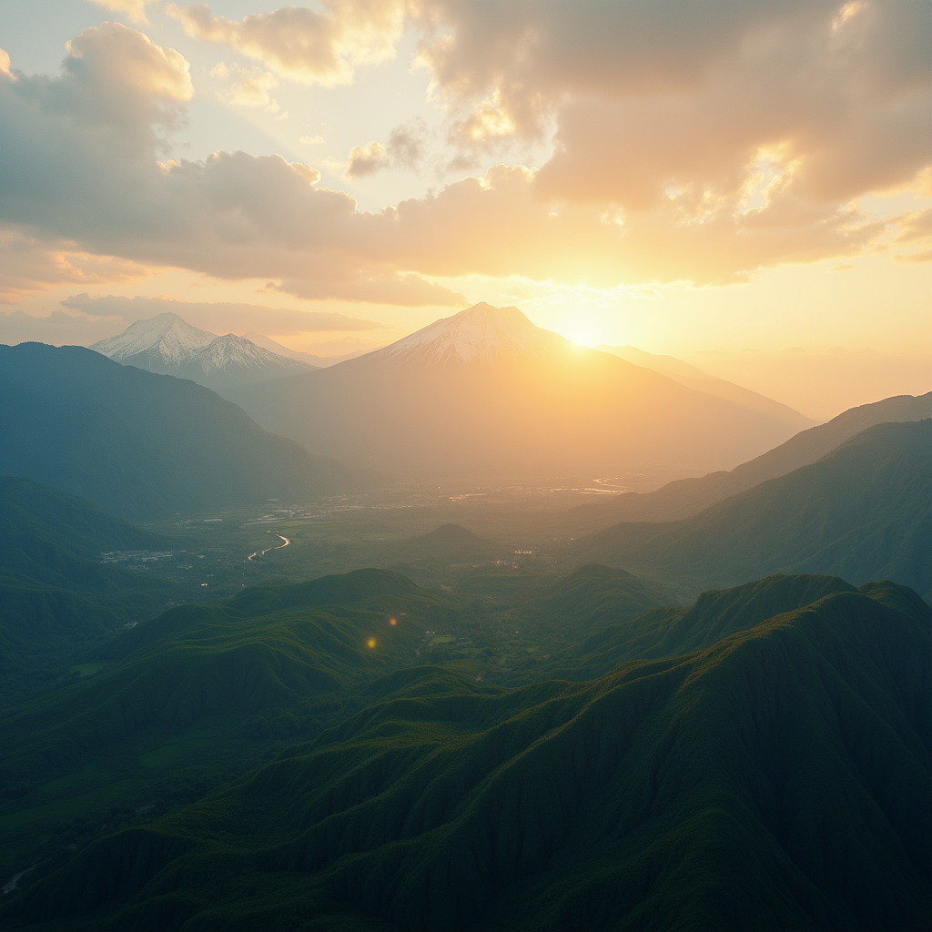
India's Landsacape - Part 1
Picture India as a living, breathing patchwork quilt stitched together by four master craftspeople: the Himalaya, the Deccan, the Coast, and the River. From the snow-sapphire ramparts that keep the cold silk winds of Tibet at bay, to the basalt-black plateaus that once bubbled like toffee 66 million years ago, the subcontinent is less a landmass than a storyboard of restless geology. The same tectonic crunch that hoists Kanchenjunga also powers the annual monsoon elevator: warm ocean air rides the plateau edge skyward, condenses into cloud-factories, and then dispatches liquid freight across a billion farms. Without this geochemical duet—mountain as barricade, plateau as heat engine—India’s rice bowls, cotton belts, and mango orchards would collapse like scenes deleted from a film.
Zoom in and the abstractions turn into livelihoods. In Sikkim, cardamom farmers now insure their crop against cloudbursts using satellite soil-moisture data, a micro-level adaptation of the same monsoon mechanics. In Kutch, saltpan workers follow Pleistocene-era marine terraces inland, chasing the ghost shoreline for the purest gypsum, while solar pumps keep the brine basins alive—an elegant marriage of ancient landscape memory and 21st-century energy. Even the urbanite glued to a Mumbai commuter app is unknowingly surfing the Western Ghats’ orographic lift; those hills force air upward, squeeze out rainfall, refill the lakes that keep the city’s taps from running dry. Thus every paneer cube in Delhi, every bolt of Bengaluru silk, every Chennai auto-rickshaw ride is a receipt for services rendered by India’s restless terrain.
Understanding these links flips the tired narrative of “geography as destiny” into “geography as venture capital.” Civil engineers designing avalanche-resistant tunnels along the new Trans-Himalayan highway borrow avalanche-flow models from Swiss data but tweak them for Indian snow density, saving ₹300 crore in maintenance. Fintech startups use high-resolution elevation maps to predict flood risk for farm loans, cutting non-performing assets by 18%. Even tourism boards now market “geological itineraries,” where travelers trace the Deccan basalt columns at dusk and end the day sampling wines grown on the same volcanic soils—turning rocks into revenue. In short, India’s landscape is not a scenic backdrop; it is the operating system on which its agriculture, finance, and culture continually debug, iterate, and upgrade.

Slide 3
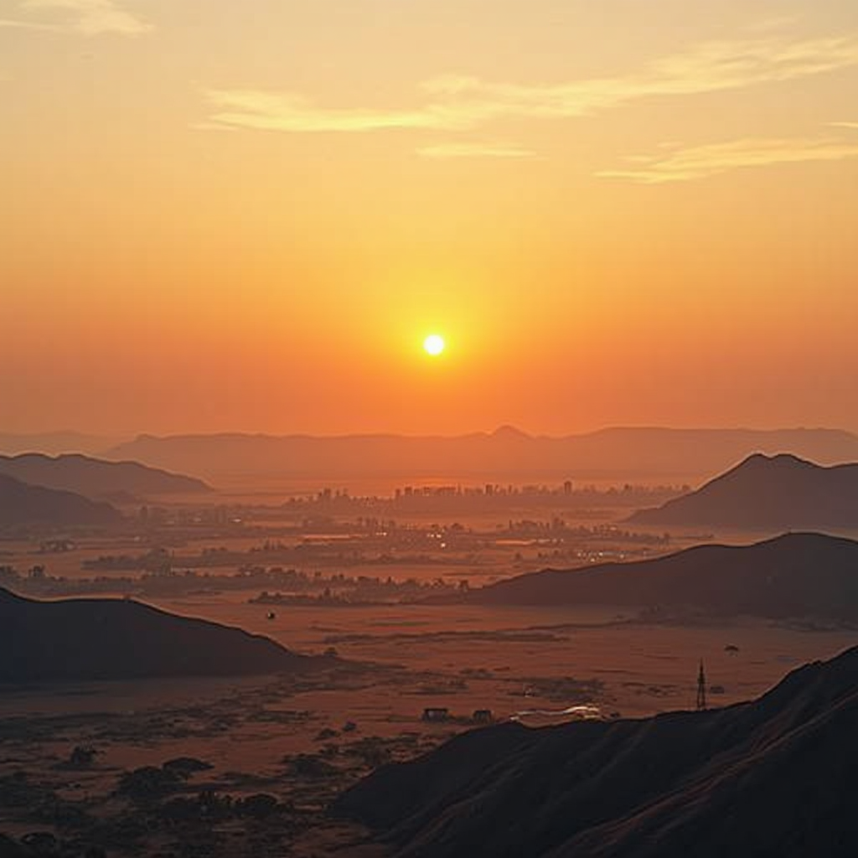
Conclusion
Picture India’s landscape as a living manuscript: every gulley and ridge is a sentence, every monsoon a comma, every desert silence a full stop. We have leafed through its pages—glaciers that sign their names in meltwater, basalt cliffs that still echo with lava lullabies, deltas where silt stacks up like first drafts of civilisation. The summary is not a list of biomes but a single truth: geography here is an author that never stops revising, and we are footnotes learning to write ourselves into the margin.
Take away three fingerprints of this authorship. First, diversity is not a tourist slogan; it is an economic gearbox—cardamom slopes and salt pans shift GDP as deftly as any ministry. Second, resilience is engineered into the terrain itself: the same Thar dunes that swallow trains also seed dust that fertilises distant fisheries, proving that loss can be a convertible currency. Third, every viewer leaves with a co-ownership clause—your city’s rooftop rainwater tank is now a tributary of the Ganga, your commute’s carbon a guest worker in the Sunderbans. Landscape is a contract renewed daily by how you choose to live.
So the next step is refreshingly small: pick one pixel of the map and zoom in until it becomes a mirror. Whether you green a 2-metre verge outside your office or audit a supply chain that starts in a Meghalaya limestone cave, you are continuing the manuscript. India’s landscape does not demand heroism; it asks for footnotes that refuse to end—sentences written in compost, solar panels, or simply a bus ticket left unpurchased. Close the presentation, open the map again, and author the sequel.

