Slide 1
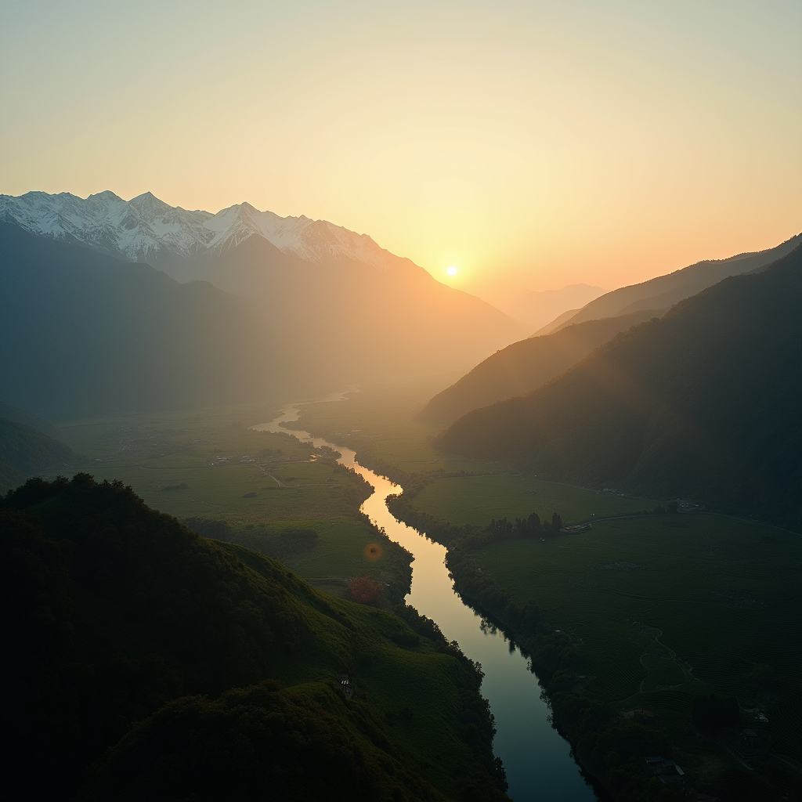
Introduction to Indian Landsacape
Imagine the subcontinent as a living, breathing atlas: its spine is the snow-lit Himalaya, its lungs...

Slide 2
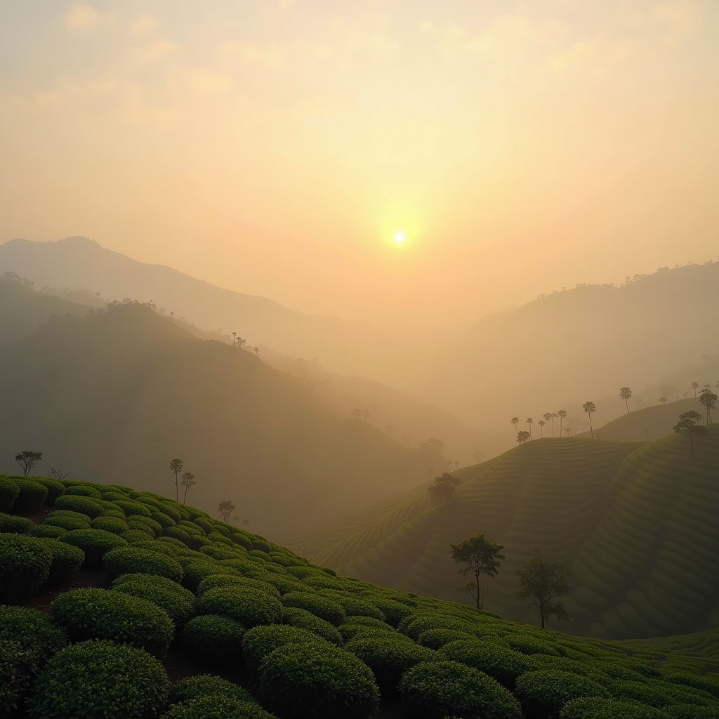
Indian Landsacape - Part 1
Picture India as a living, breathing palimpsest: every tectonic shrug, monsoon sigh, and empire stamp has left a translucent layer that still glows if you know where to look. The land isn’t a backdrop; it is an active co-author of the subcontinent’s story. From the salt-encrusted ribs of the Rann of Kutch—where the earth mirrors the sky so perfectly that the horizon line vanishes and camel caravans seem to walk on clouds—to the evergreen folds of the Western Ghats, whose escarpments trap oceanic mist and quietly seed the entire Deccan with rivers, each province behaves like a self-contained planet with its own thermal dialect and scent grammar. Understanding these micro-cosms is the first, non-negotiable concept: India’s landscapes are not scenery but negotiated interfaces between geology, climate and culture, updated every hour by the monsoon’s algorithmic pulse.
This negotiation is visible in the floating gardens of Srinagar’s Dal Lake, where farmers turn reeds into arable real estate, or in Odisha’s black-cotton ‘Cotton Kora’ fields that swell like a sponge overnight and shrink the next noon, cracking into jigsaw puzzles that local engineers read like barcodes to decide the depth of a foundation. Even the apparent emptiness of Ladakh’s high-altitude cold desert is a masterclass in applied micro-climate: villages sit on alluvial fans where glacial streams drop their load, creating pockets of apricot orchards at 11,000 ft—an edible firewall against winter scurvy. Investors now map these pockets with lidar drones, not for real estate but to site zero-carbon data centres whose cooling bills evaporate in the dry mountain air; meanwhile, Bengaluru start-ups lease parched stretches of Kutch for algaculture, turning brine and sunlight into pharmaceutical-grade beta-carotene. Thus the Indian landscape is a venture capital ledger written in topography, where a forgotten ravine or salt flat can flip into a billion-dollar niche if you decode its latent services.
The broader implication is that sustainability here is not a imported ethic but a long-standing, high-stakes design competition. Khasi living bridges in Meghalaya—tree roots trained over centuries to span rivers—outperform steel suspension bridges in cyclone resilience, teaching engineers how to grow infrastructure rather than build it. Similarly, the Banni grasslands of Kutch, once dismissed as wasteland, store more carbon per hectare than many temperate forests because of a cryptic symbiosis between salt-tolerant grasses and mycorrhizal fungi; carbon-credit aggregators are now paying Maldhari herders to keep grazing patterns intact, turning traditional migration routes into climate securities. Recognising these living patents embedded in the landscape reframes conservation from a moral plea into an arbitrage opportunity: the most original applications will belong to those who stop seeing land as a commodity and start reading it as open-source code, endlessly forking into new utilities—pharma, fintech, climate hedging—while still honouring the cultural checksums that keep the system from collapsing into ecological debt.

Slide 3
Conclusion
Picture the subcontinent as a living manuscript: the Himalayas form its hardbound spine, the Deccan Plateau its thick, hand-pressed pages, and the monsoon a restless reader who underlines entire paragraphs in silver ink. Tonight we closed that book, but the margins are still wet; every fold in the Western Ghats and every swirl of the Ganges has left a watermark on our thinking. If we leave here remembering only statistics—one-thirteenth of Earth’s humanity on one-thirty-third of its land—we miss the real plot twist: India is a geography that edits you back. The moment you map it, it redraws your own mental coastlines.
So pocket three imperatives before you stand up: first, treat scale like spice—use it to intensify, not to overwhelm; a single Rajasthani village can illuminate more policy than a continent of spreadsheets. Second, remember that resilience here is engineered from the ground up, not the top down; from the kuhl irrigation channels of Himachal to the stilted homes of Majuli, the landscape has already beta-tested climate solutions we still struggle to code into models. Finally, let reciprocity replace extraction: whether you design cities, supply chains, or stories, negotiate with the land as you would with a co-author who can withdraw permission at any monsoon. Step outside, and the air may smell of jacarandas or diesel, but it will certainly smell of possibility—because an Indian landscape never concludes; it simply invites the next draft.

