Slide 1
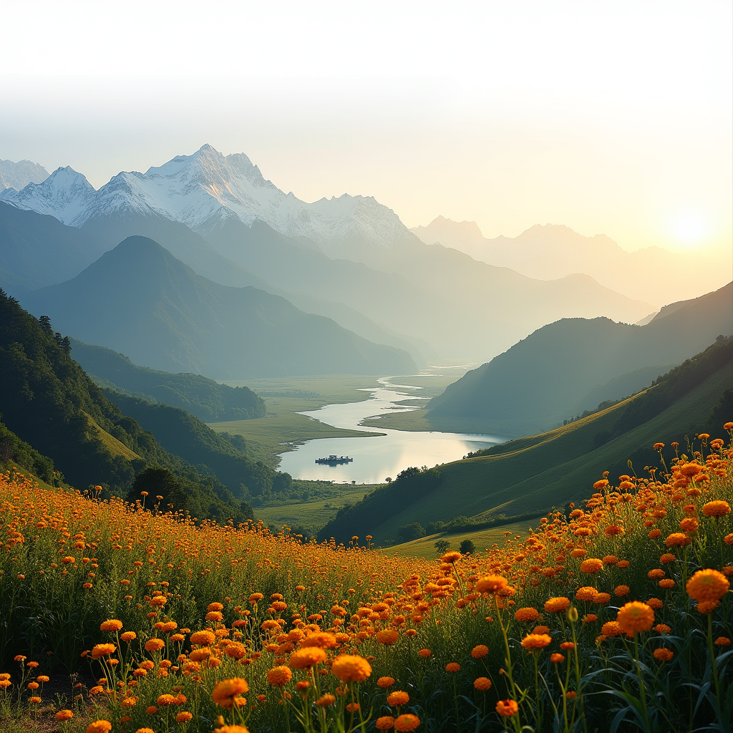
Introduction to Indian Landsacape
India’s landscape is less a backdrop and more a restless manuscript—every fold in the Western Ghats,...

Slide 2
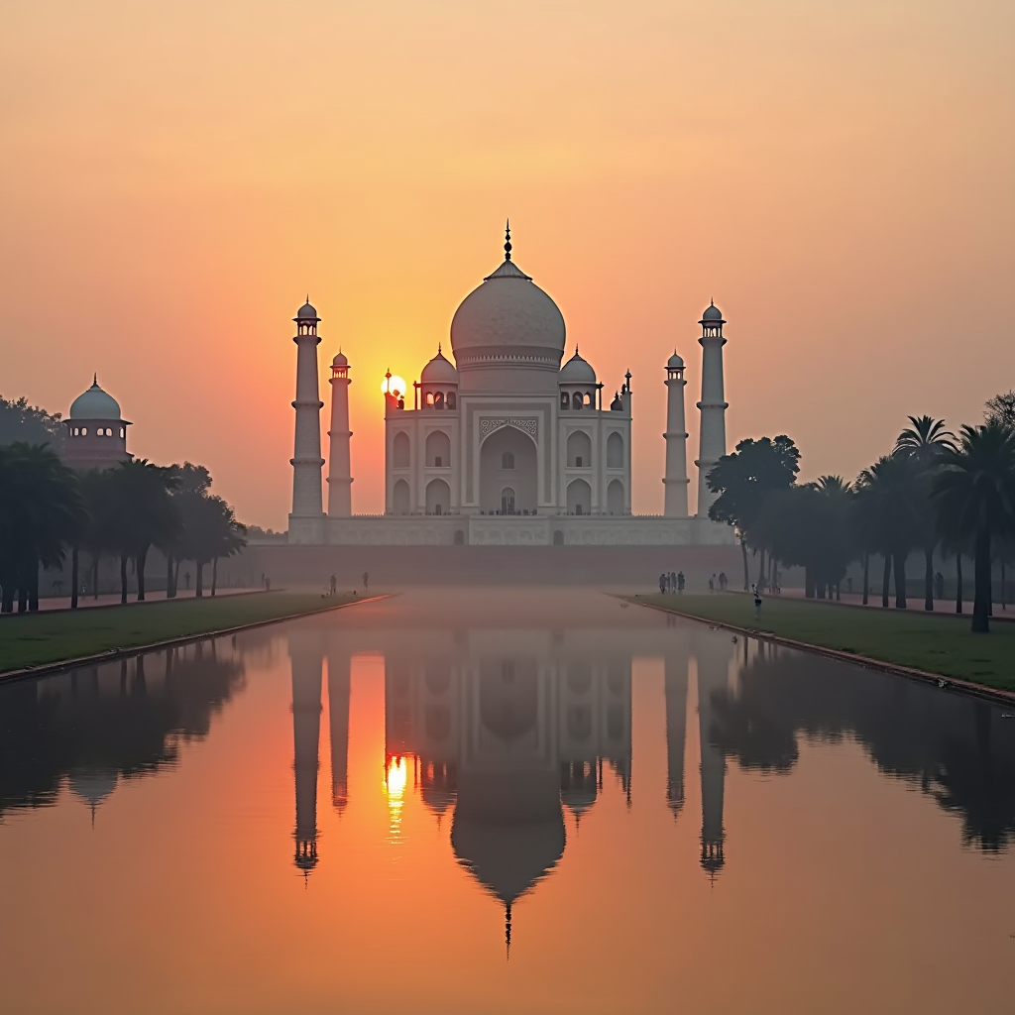
Indian Landsacape - Part 1
Picture the subcontinent as a living manuscript: every fold of the Western Ghats is a dog-eared page chronicling sixty million years of volcanic breathing, while the Thar’s dunes are marginalia scrawled by a capricious wind that refuses to stay still. These landforms are not static scenery; they are transactions—monsoon clouds haggle with the Ghats, trading moisture for life, and the salt crust of Rann doubles as a brittle ledger recording tectonic IOUs from the Himalayan push. To read India geographically is to watch a continent-sized experiment in negotiation, where topography, climate and culture edit one another in real time.
Consider the living applications hiding inside this experiment: Kerala’s laterite hills, once dreaded for their infertility, now host staggered-tier coffee that uses the same gradient physics as a Japanese bonsai garden, yielding beans that sell in Berlin for the price of single-malt. In the cold deserts of Ladakh, glacial ice stupas store winter water as vertical glaciers, releasing it in micro-doses so orchards can bloom at 3,500 m—an idea now copied in Alpine ski resorts. Even the Gangetic floodplain, long typecast as a breadbasket, is quietly moonlighting as a carbon market: farmers planting flood-tolerant mango and rice varieties earn tradable credits that offset emissions in Seoul’s tech corridor. Landscape here is less postcard, more operating system—open-source, endlessly forked.

Slide 3
Conclusion
India’s landscape is less a static backdrop and more a living ledger: every fold in the Western Ghats is an entry of tectonic persistence, every swirl in the Sundarbans a footnote on rising seas. Today we traced that ledger from the salt-crested Rann to the fog-sculpted Cardamom hills, realizing that “geography” here is a verb—something citizens negotiate each monsoon, each election, each festival. The takeaway is not that India is diverse, but that its diversity is an operating system: when a Kerala fisherman toggles between GPS and grandfather’s star map, or a Ladakhi engineer channels glacial melt through micro-hydro, they are debugging and upgrading that OS in real time.
So the story doesn’t end with scenic postcards; it pivots to stewardship. Think of the land as a startup where equity is still available, but the runway is shrinking. Rajasthan’s solar canals, Meghalaya’s living-root bridges, and Odisha’s millet revival are seed rounds showing outsized ROI in carbon saved and culture preserved. Your next step is to pick a lane—policy, capital, design, or storytelling—and inject what we learned tonight: that scale in India is best measured not in hectares but in habits. Fund a drone pilot who can map invasive lantana in the Nilgiris, commission a climate-risk atlas for your supply chain, or simply reroute your next vacation to homestays that pay villagers to keep the forest intact. The subcontinent has been rewriting itself for 50 million years; it is now looking for co-authors.

