Slide 1

Topic : Energy Forecast
GROUP 1
1.kavya
2.kanchan
3.Atharva
4.Deepesh
5.Abhivrudhi
6.Abhishek

Slide 2

To Predict :
Business Objective: A combined-cycle power plant comprises gas turbines, steam turbines, and heat recovery steam generators. In this type of plant, the electricity is generated by gas and steam turbines combined in one cycle. Then, it is transferred from one turbine to another. We have to model the energy generated as a function of exhaust vacuum and ambient variables and use that model to improve the plant's performance.
Data Set Details : This is a project where the variable to be predicted is energy production The data file contains 9568 observations with five variables collected from a combined cycle power plant over six years when the power plant was set to work with a full load.
Energy Production

Slide 3
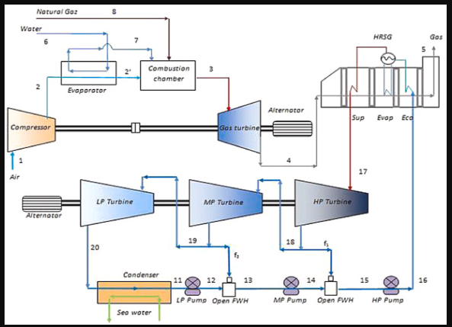

COMBINED CYCLE POWER PLANT
f
rch

Slide 4
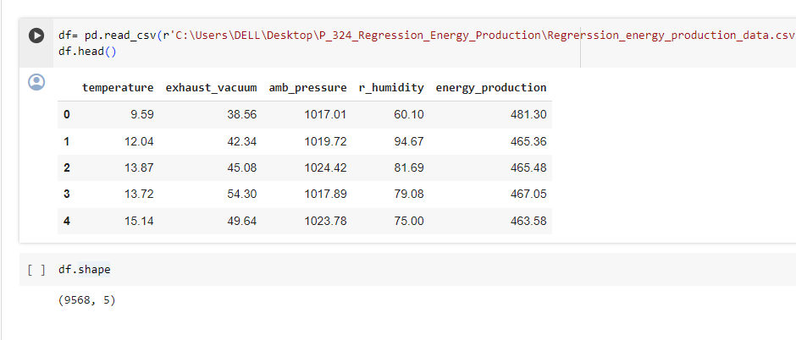
LOADING THE DATASET
The dataset consists of 9568 rows and 5 columns

Slide 5
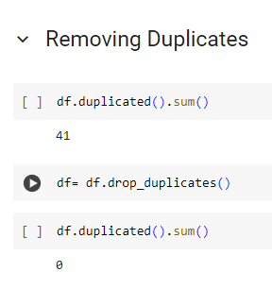

Slide 6
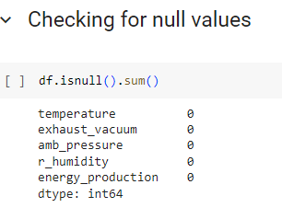
HOW TO CHECCK THE NULL VALUES:
AS WE CAN SEE
THERE ARE NO
NULL VALUES
PRESENT
WE CAN FURTHER PROCEED..........

Slide 7
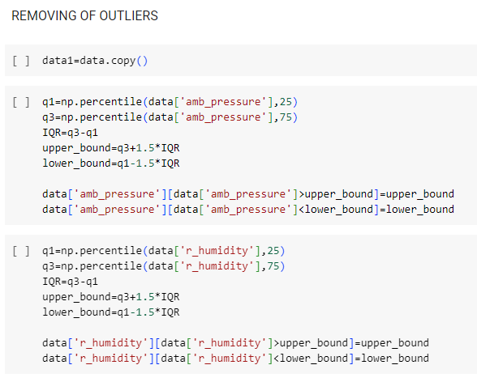

Slide 8
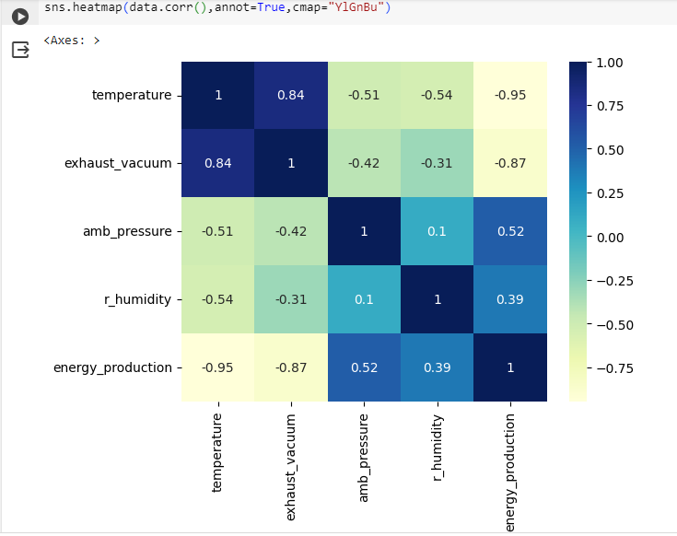
Figure shows the Pearson correlation matrix for CCPP input and output attributes after preprocessing. The Pearson correlation coefficient provides an indication of the level of gradual shift of independent parameters in order to accurately examine the influential aspects of the data. The negative value of coefficients shows the inverse correlation between the variables, whereas the positive value suggests a positive correlation. If the value of the coefficient is 0, it means both the variables are uncorrelated. It can be observed from Figure that input attributes AT and V are negatively correlated to the output PE. Whereas AP and RH have a positive correlation with PE. There is a strong positive correlation between AT and V, and both the input attributes have a negative correlation with AP and RH, respectively.

Slide 9
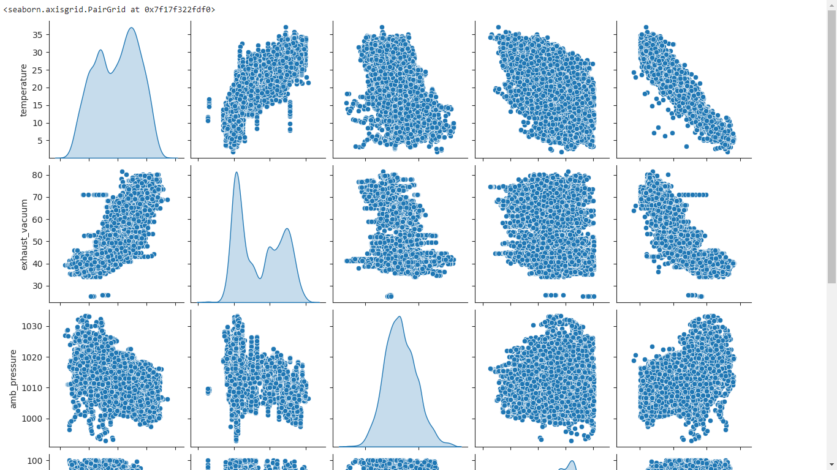
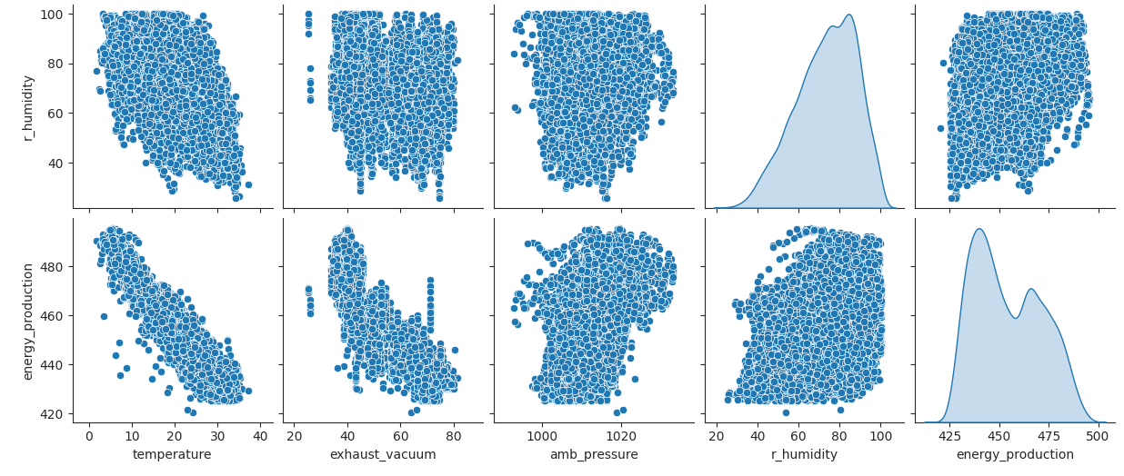
P
A
I
R
P
L
O
T
S

Slide 10
WHY SHOULD WE REMOVE OUTLIERS?
Although outliers are common in datasets,
not many know how to deal with the
presence of such observations. It is usually
practical to remove them since they can
skew the results of data analyses and
hamper model performance

Slide 11
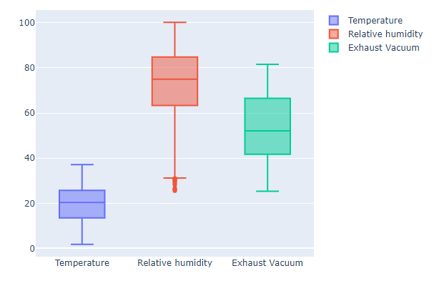
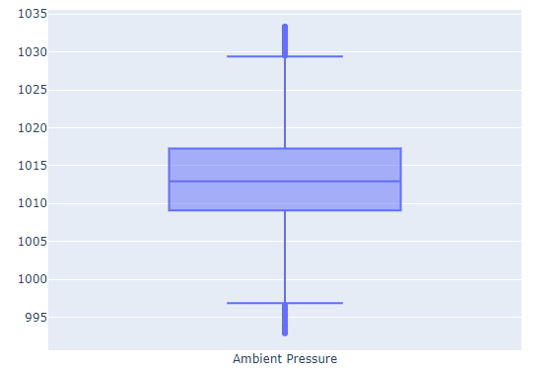
BOXPLOTS
We can see that
r_humidity and
Exhaust_vacuum
have the outliers
and we need to
remove them

Slide 12
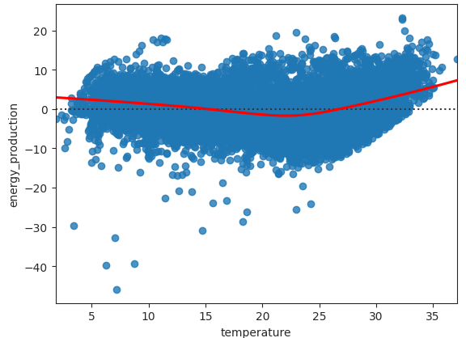
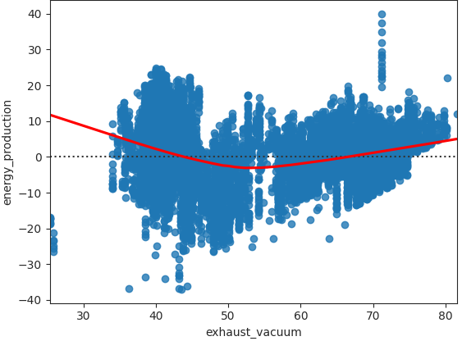
RESIDUAL PLOTS
Residual Plot: A residual plot is a scatterplot that displays the residuals on the vertical axis and the independent variable on the horizontal axis. Residual plots help us to determine whether a linear model is appropriate in modeling the given data.

Slide 13
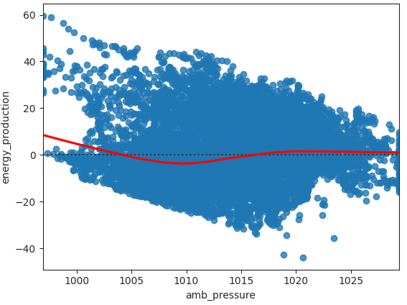
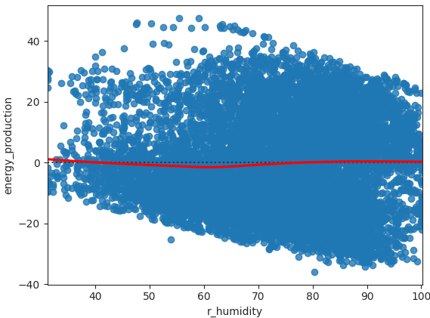

Slide 14
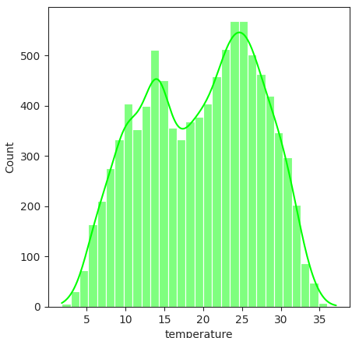
A Histogram represents data provided
in the form of some groups.
It is an accurate method for the
graphical representation of
numerical data distribution.
It is a type of bar plot where the
X-axis represents the bin ranges
while the Y-axis gives
information about frequency.
HISTOGRAMS
BI MODAL DISTRIBUTION

Slide 15
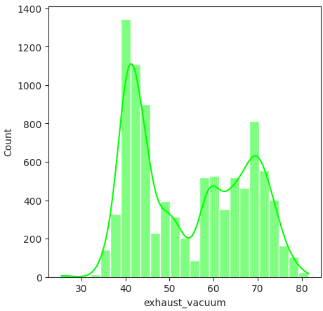
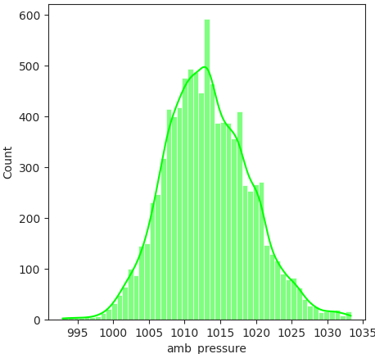
Normal distribution
Uneven distribution

Slide 16
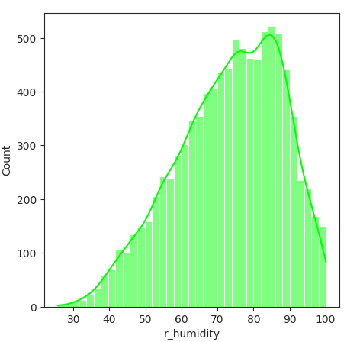
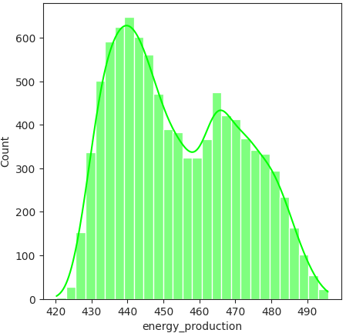
Bi modal distribution
Left skewed distribution

Slide 17
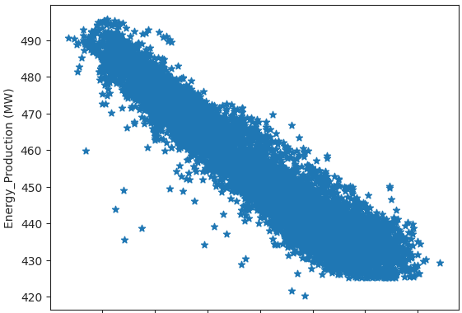
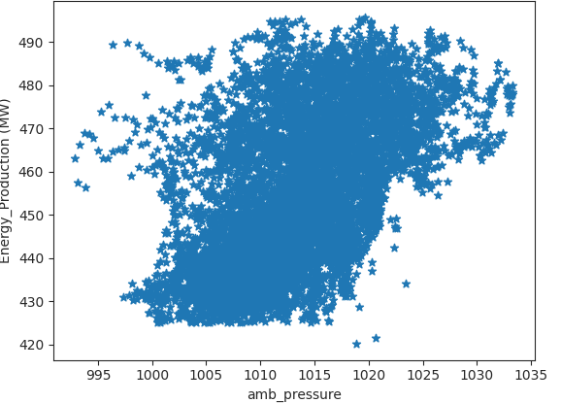
SCATTER PLOTS: Scatter plots are used to observe relationships between variables.
temperature

Slide 18
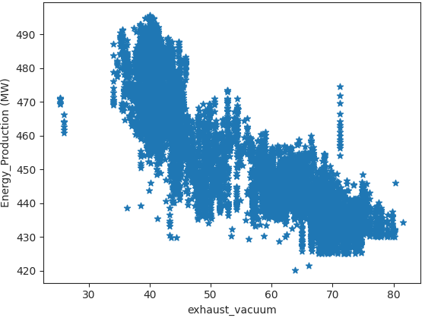
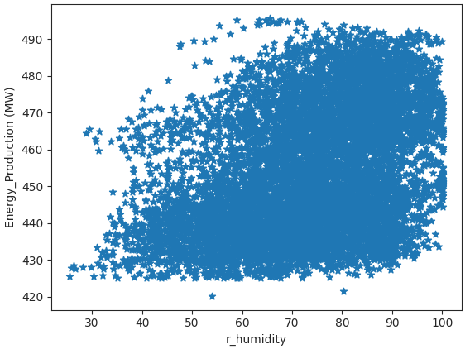

Slide 19

THANKYOU

