Slide 1
MODEL BUILDING
Deepesh Kumar Verma
Abhivrudhi Navaliger
Senugala Kavya Sree
Kanchan Kag
Kajale Atharva Tushar
Chinchawade Abhishek Madhav

Slide 2
Model Building Approaches
Random Forest
Linear Regression
Support Vector Regression
Gradient Boosting Regressor
LightGBM Regressor
K-Nearest Neighbor Regressor
Decision Tree Regressor

Slide 3
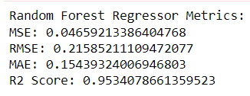
1.Random Forest

Slide 4
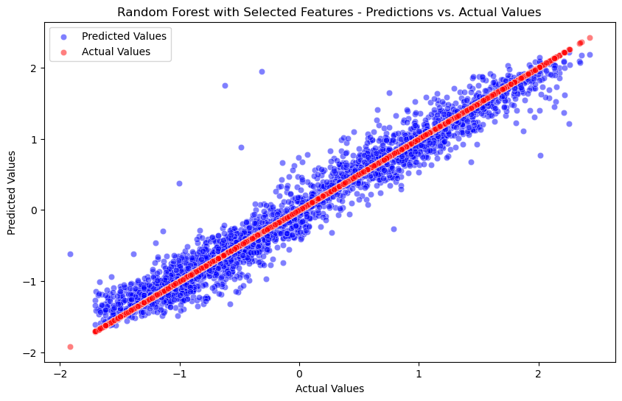
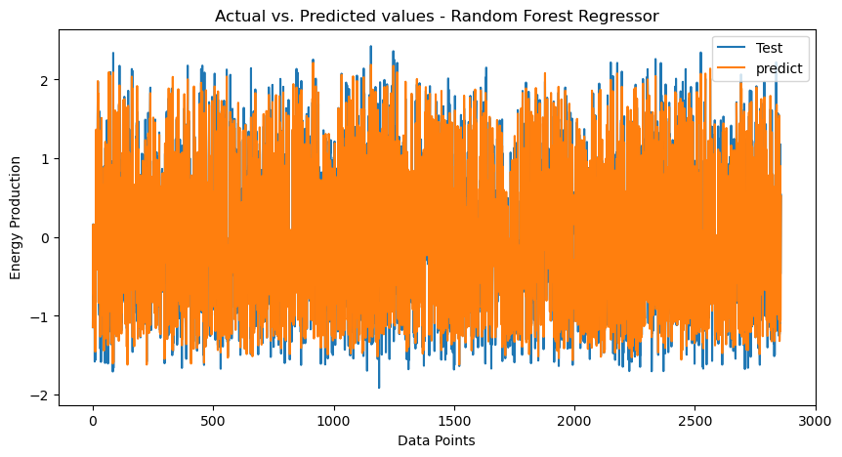

Slide 5
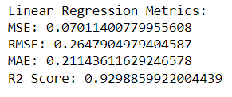
2. Linear Regressor

Slide 6
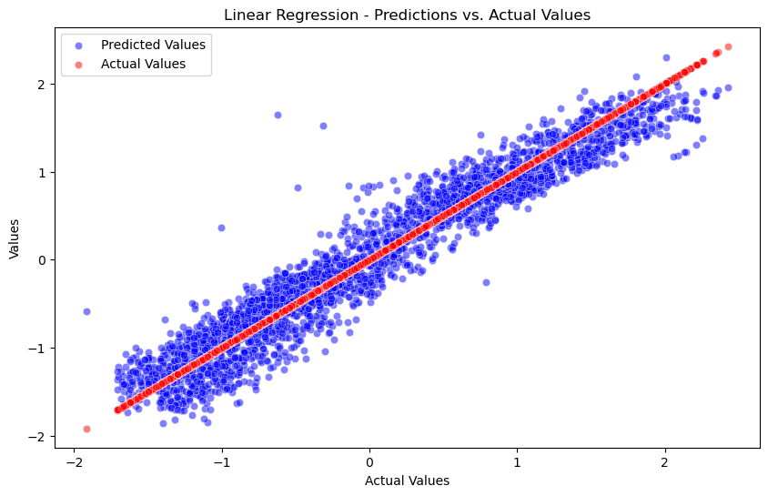
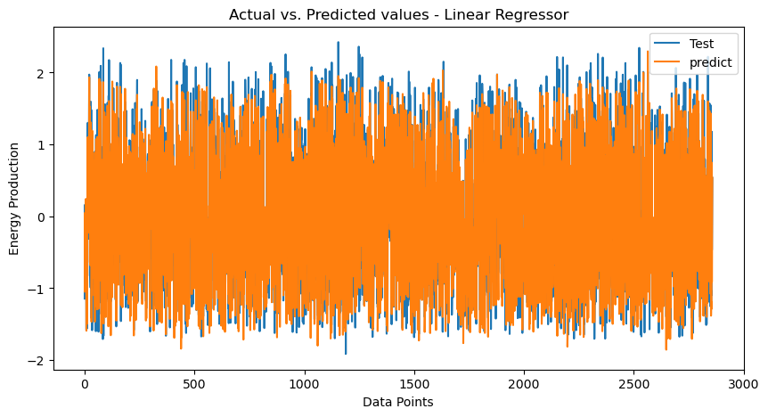

Slide 7
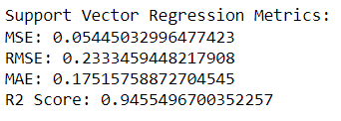
3. Support Vector Regressor

Slide 8
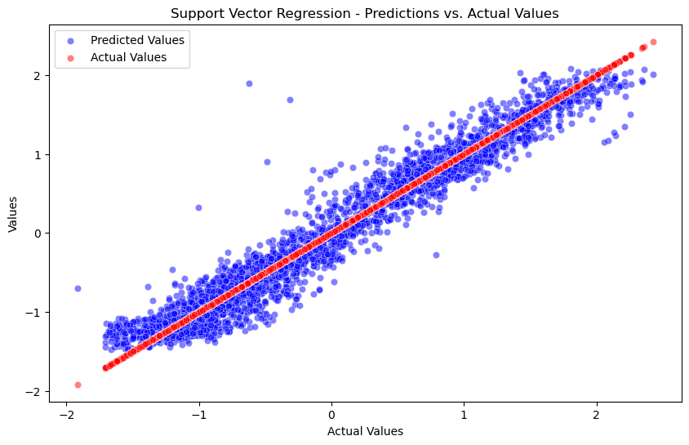
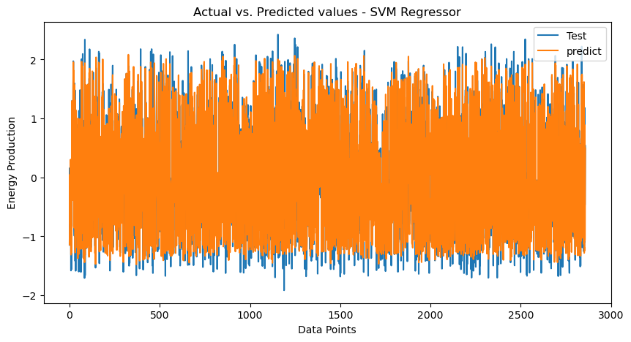

Slide 9
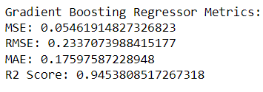
4. Gradient Boosting Regressor

Slide 10
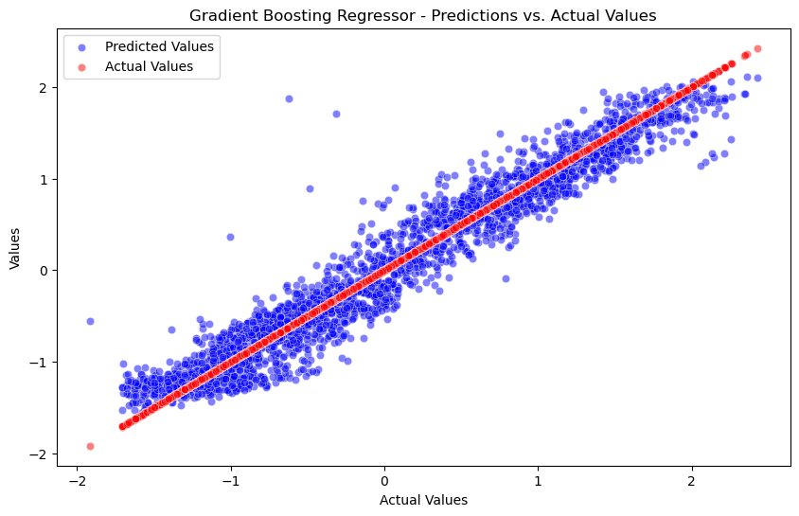
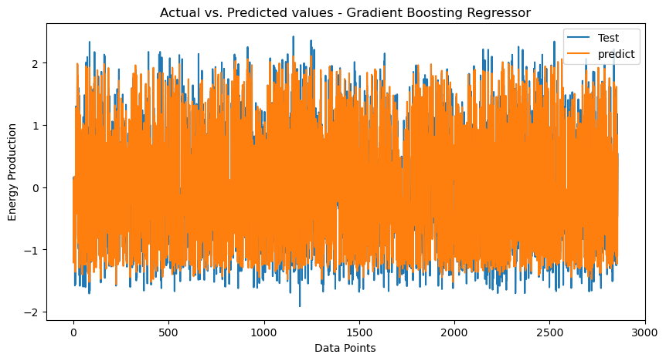

Slide 11
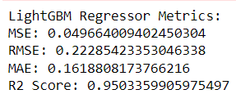
5. LightGBM Regressor

Slide 12
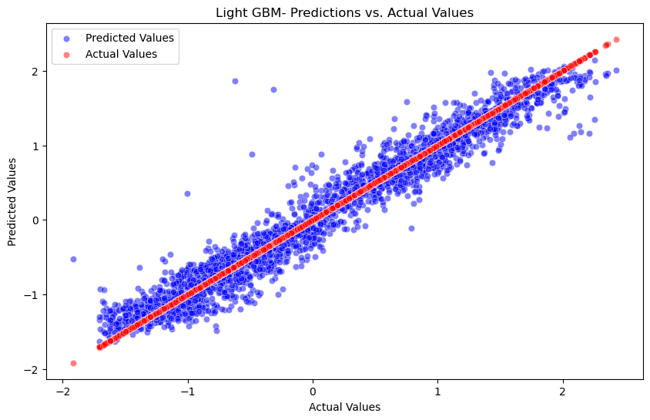
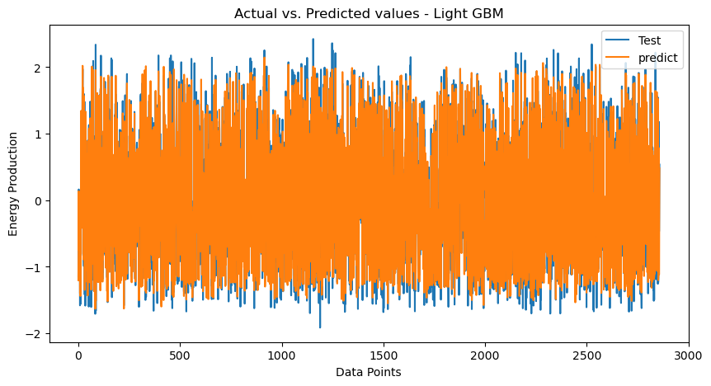

Slide 13
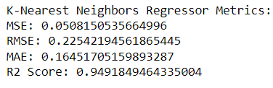
6. K-Nearest Neighbour Regressor

Slide 14
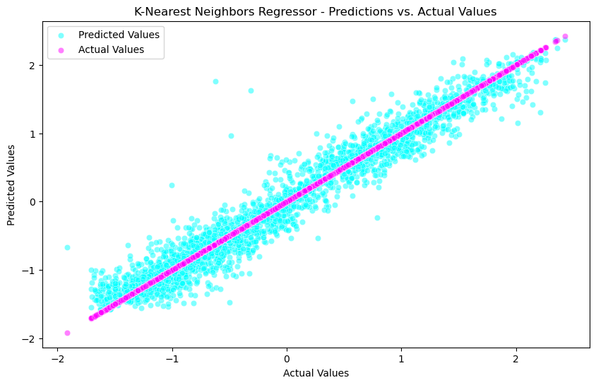
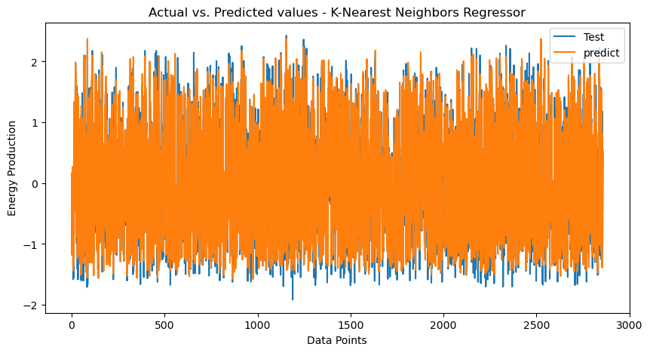

Slide 15
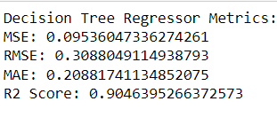
7. Decision Tree Regressor

Slide 16
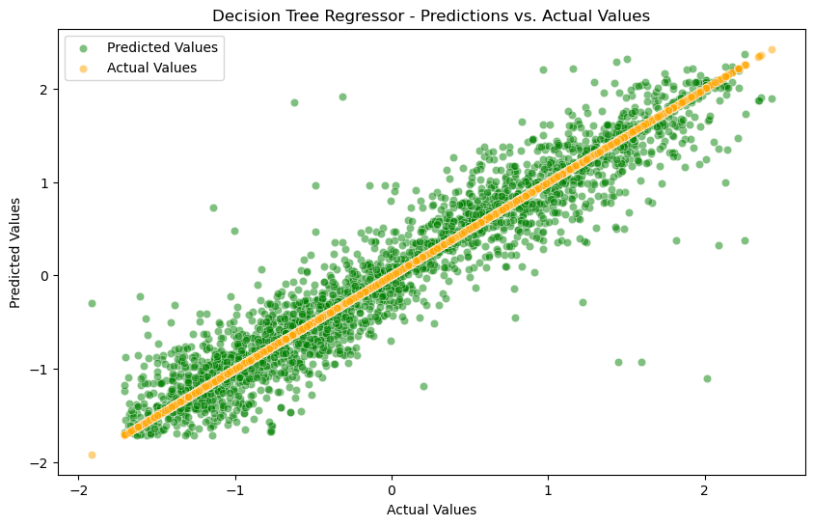
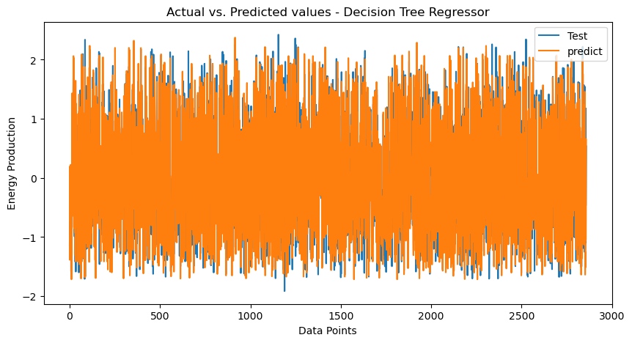

Slide 17
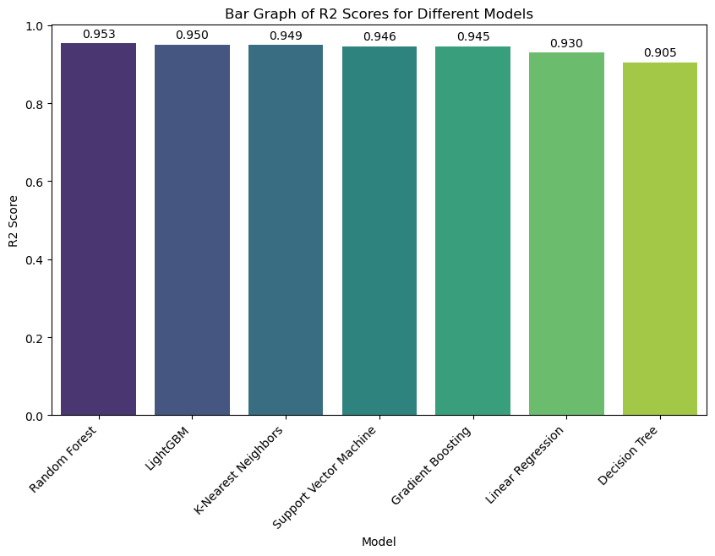
Comparison of all R2-Scores

Slide 18
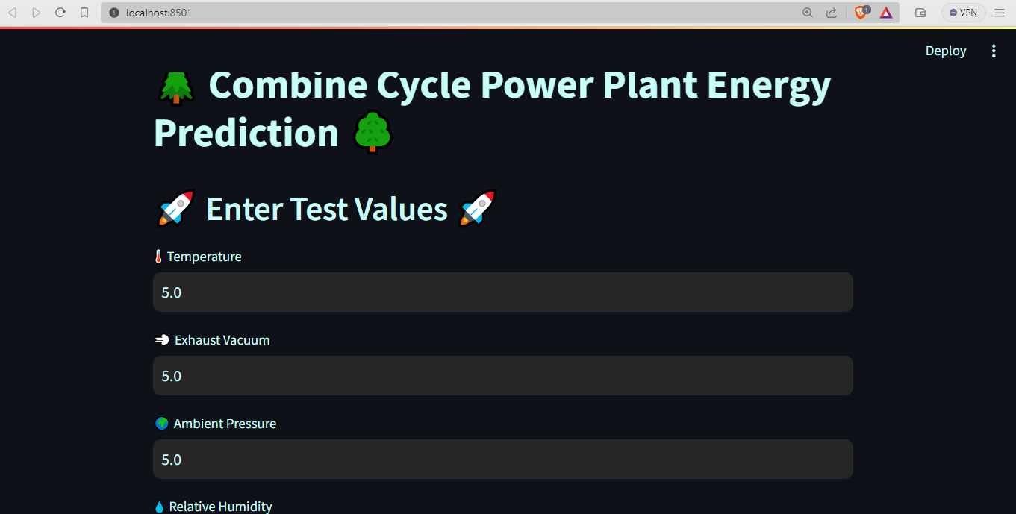
DEPLOYMENT

Slide 19
Challenges Faced:
Model Loading and Path Consistency:
- Ensuring seamless model loading across different environments and avoiding hardcoded absolute paths presented an initial challenge.
How We Overcame the Challenges:
Dynamic Model Loading:
- Adopting a dynamic approach by using relative paths and the `os` module, ensuring the model file is accessible regardless of deployment location.

