Slide 1
Customer personality ANALYSIS
Project 267 Group 4
Mentor :- Aishwarya Ajay
Deepesh Kumar Verma
Nikhitha K R
Maddukuri Sai Kiran
Ankit Gurudas Chunarkar
Sneha
Yogasree M

Slide 2
Problem Statement:. Need to perform clustering to summarize customer segments. It help to identify pattern and insights that can be used to optimize marketing campaigns, personalize product offerings and improve customer service. Ultimately goal is to build stronger, more meaningful relationships with customers , increase customer satisfaction, and drive sales or leads.

Slide 3
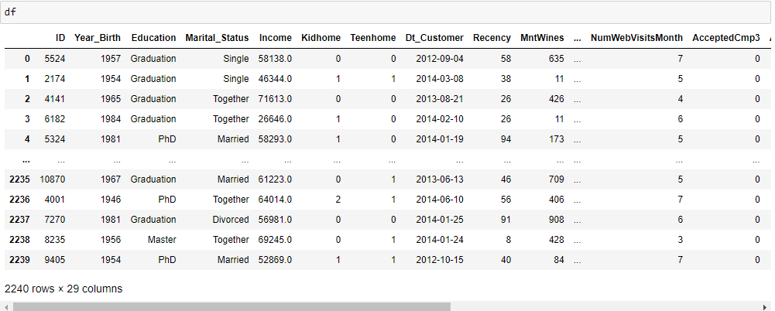
1. Details of the data
(A) Data set details:. In data set there are 2240 rows and 29 columns.

Slide 4
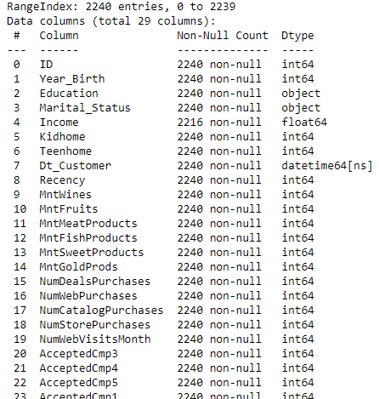
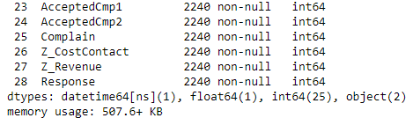
(b) Information about the data i.e. data type of each column , memory usage, count of the null value in each column, total column, total entries etc.

Slide 5
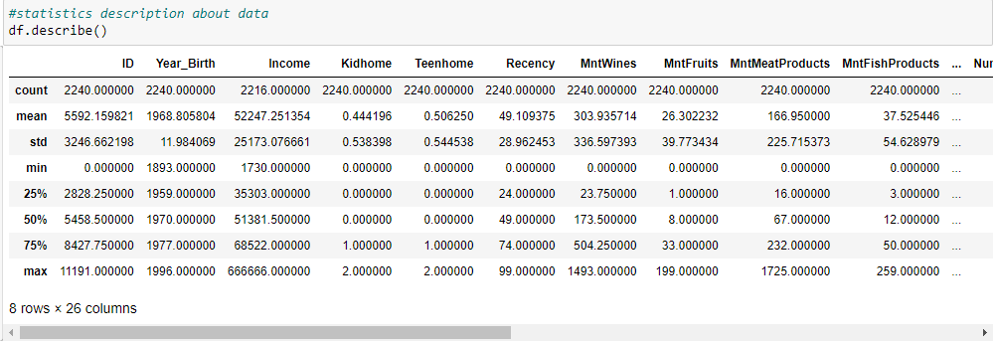
(C) statistics description of numerical data

Slide 6
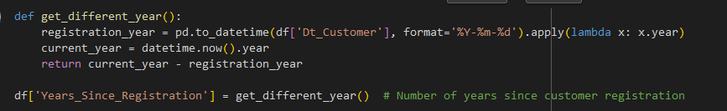
2. Feature engineering & Feature Selection
* Label encoding
On Year_birth
(B) On Dt_Customer

Slide 7
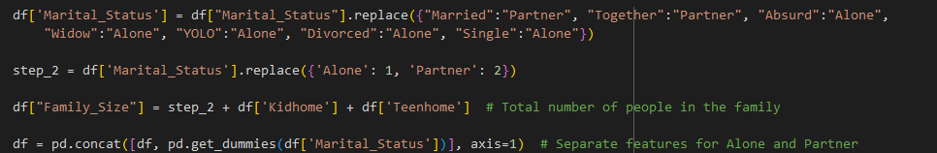
(C) On Education
(D) On Marital Status

Slide 8

(E) On Products
(F) On_Accepted_Campaigns
(G) On_Purchases

Slide 9
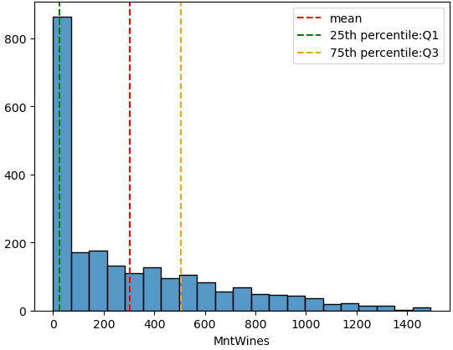
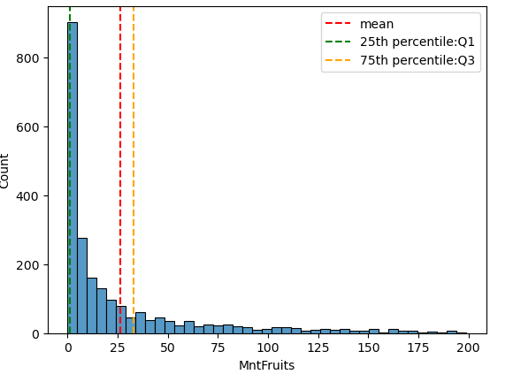
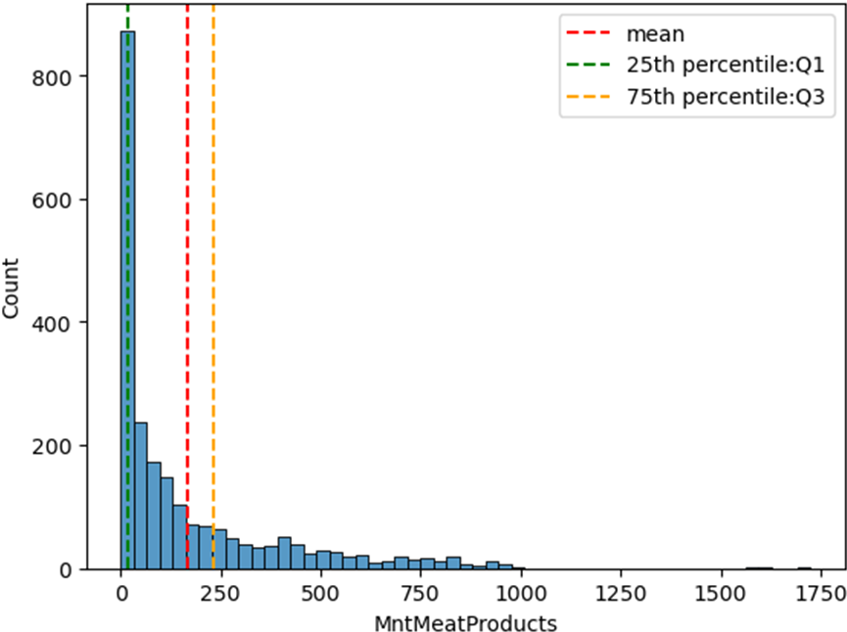
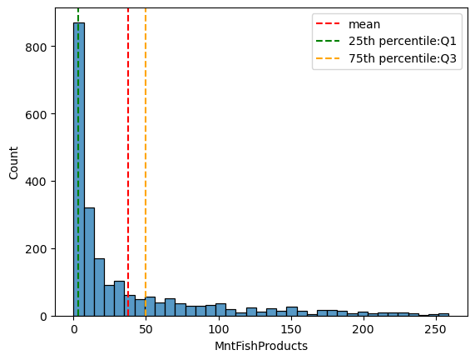
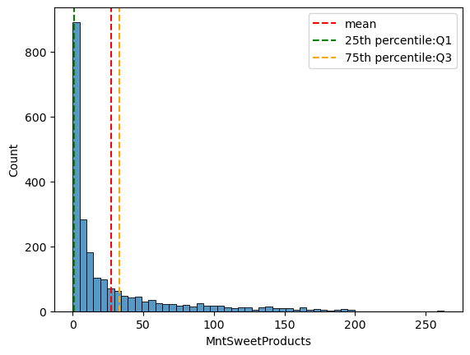
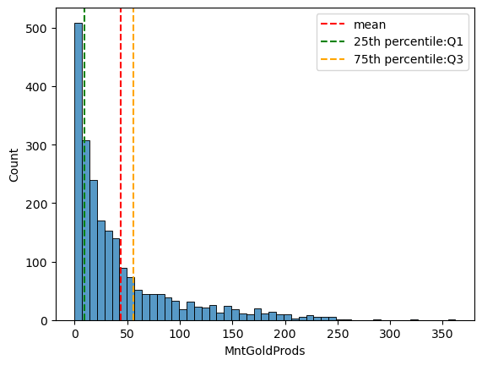
3. EDA: (A) Histogram of product

Slide 10
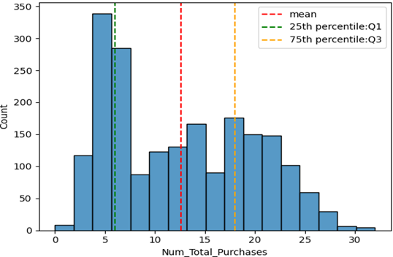
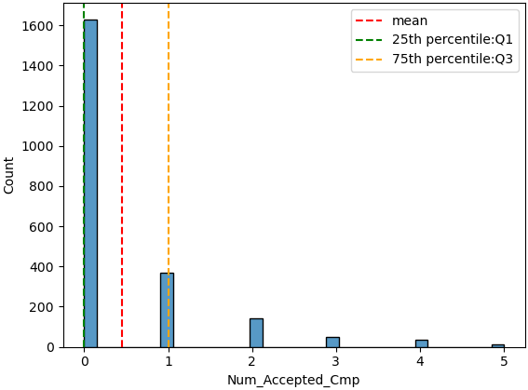
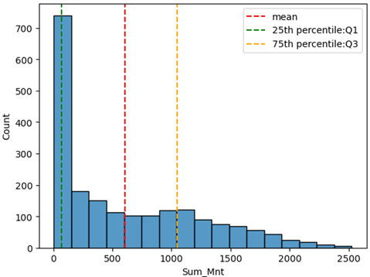

Slide 11
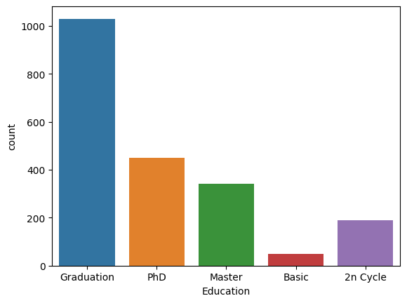
B. Univariant Analysis For Education

Slide 12
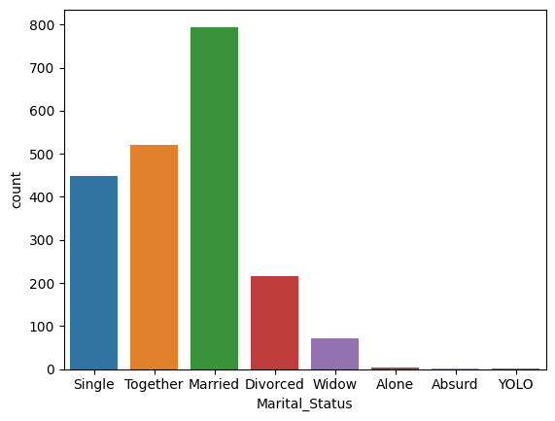
For Marital Status

Slide 13
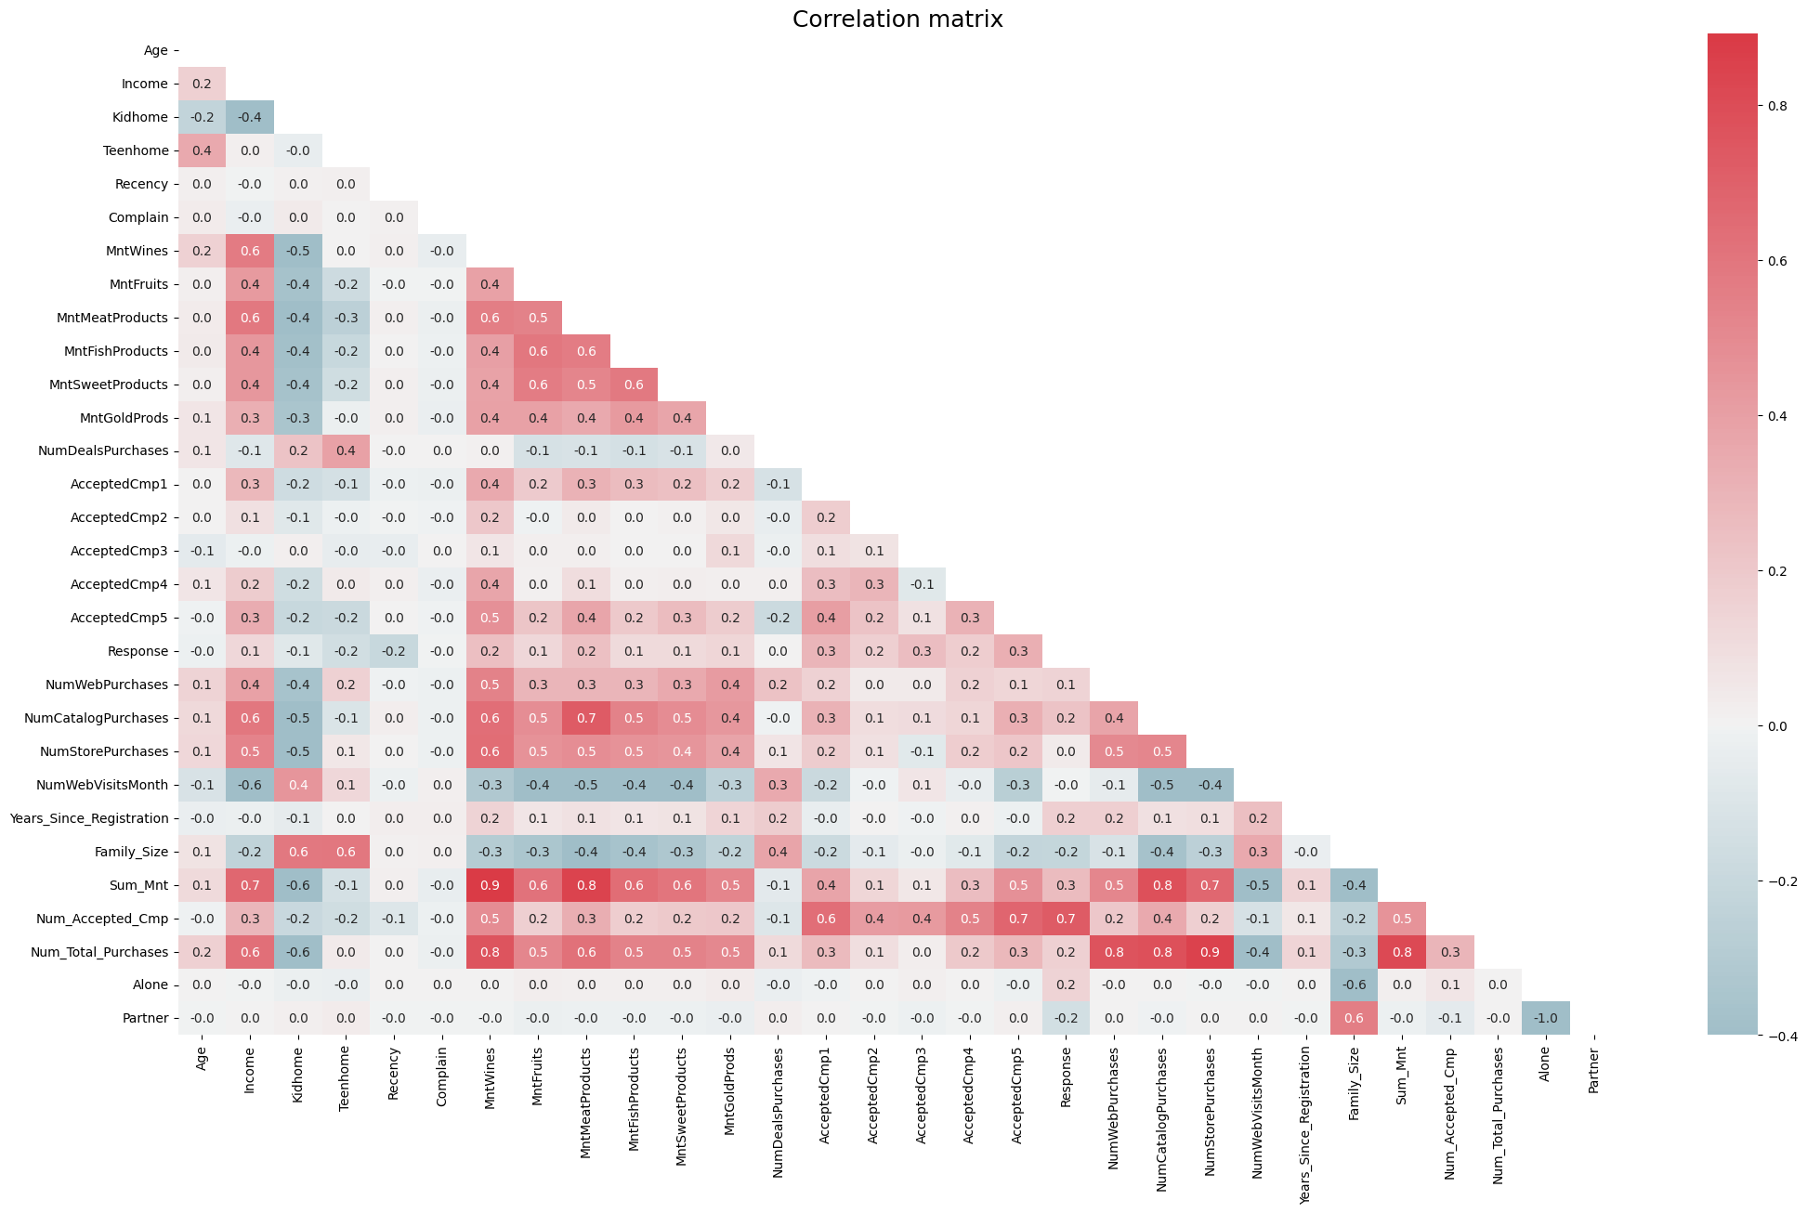
(C) Correlation matrix

Slide 14
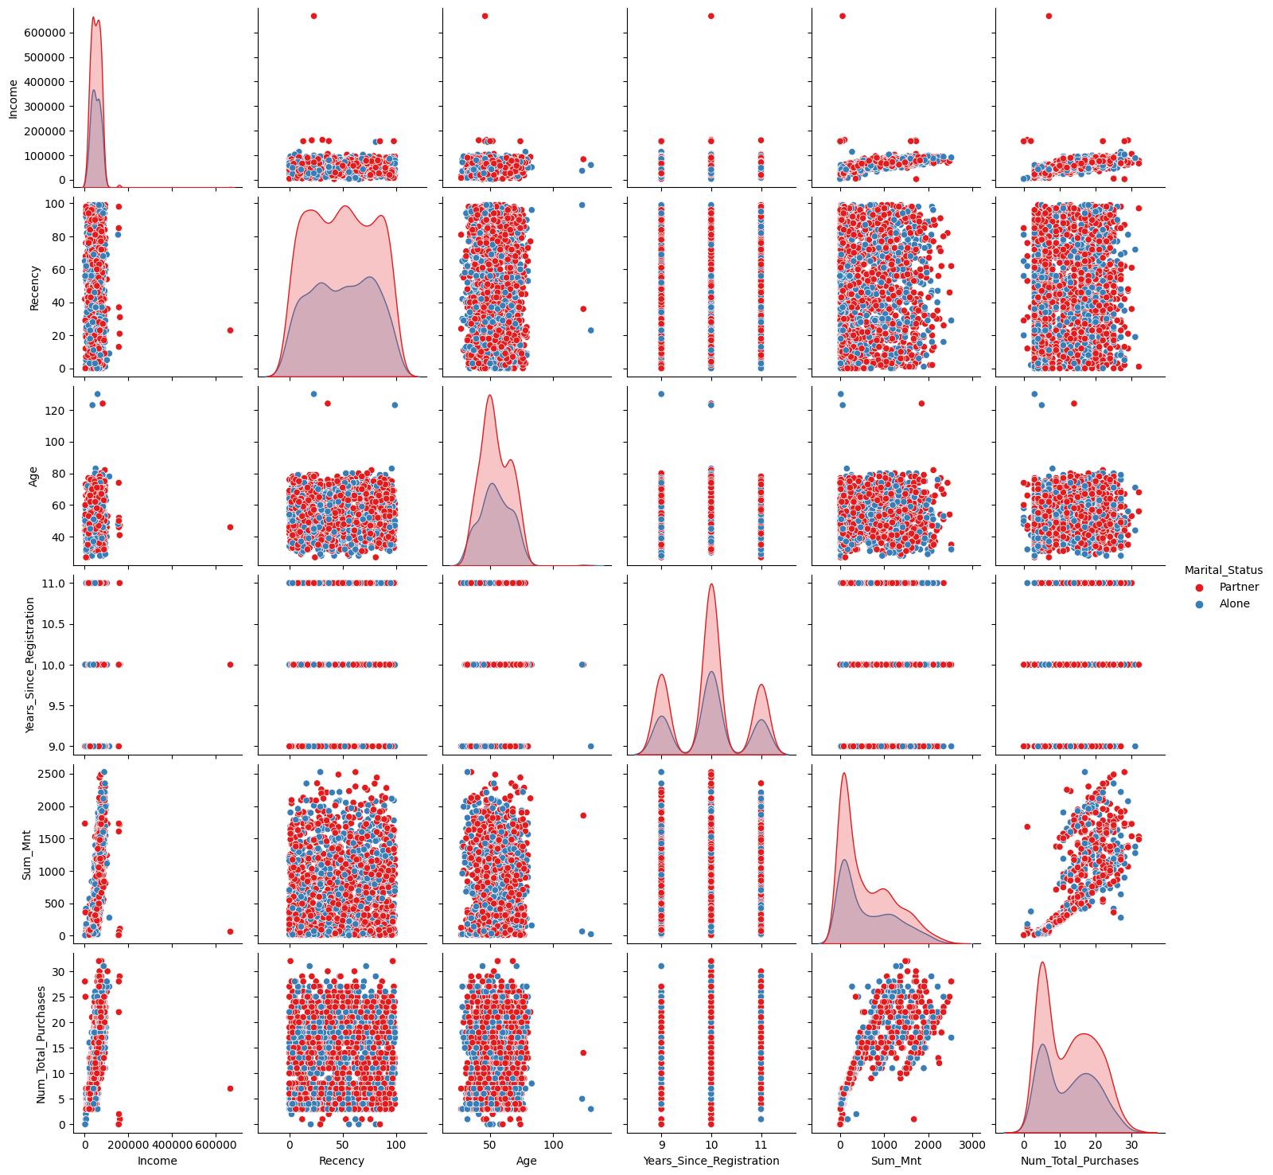
(D) Pair Plots
(C) Correlation matrix

Slide 15
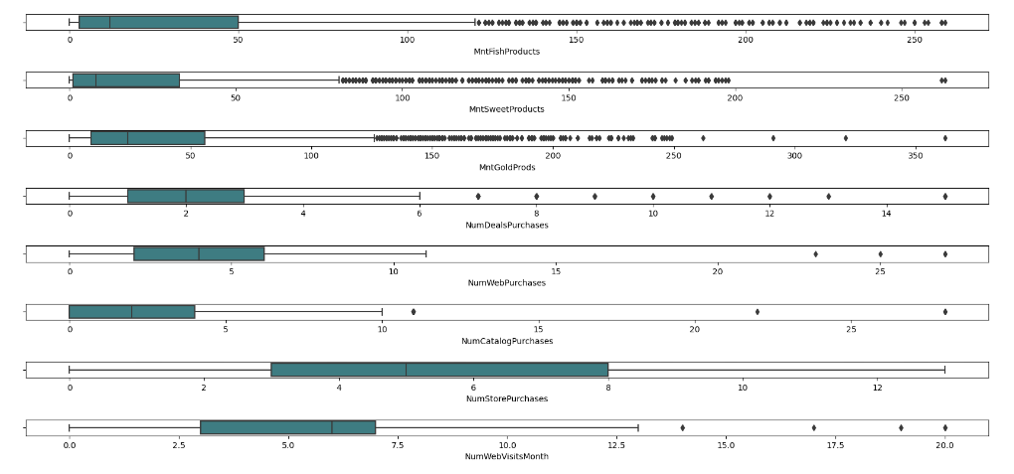
(E) Box Plot Visualization on Numerical Data

Slide 16
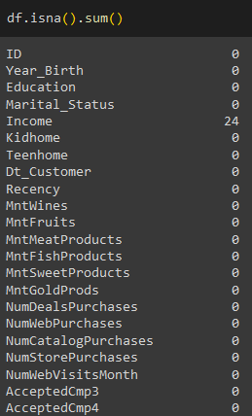
(F) Finding the null value and correct them .
(G) Remove unnecessary features

Slide 17
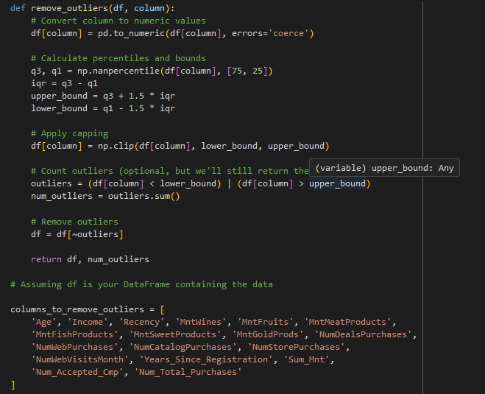

(H) Removing Outliers
(I) Removing Duplicated Values

Slide 18
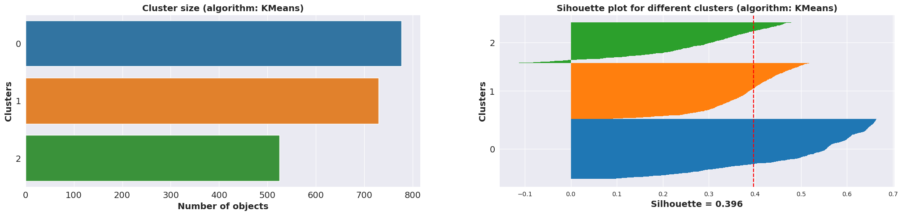
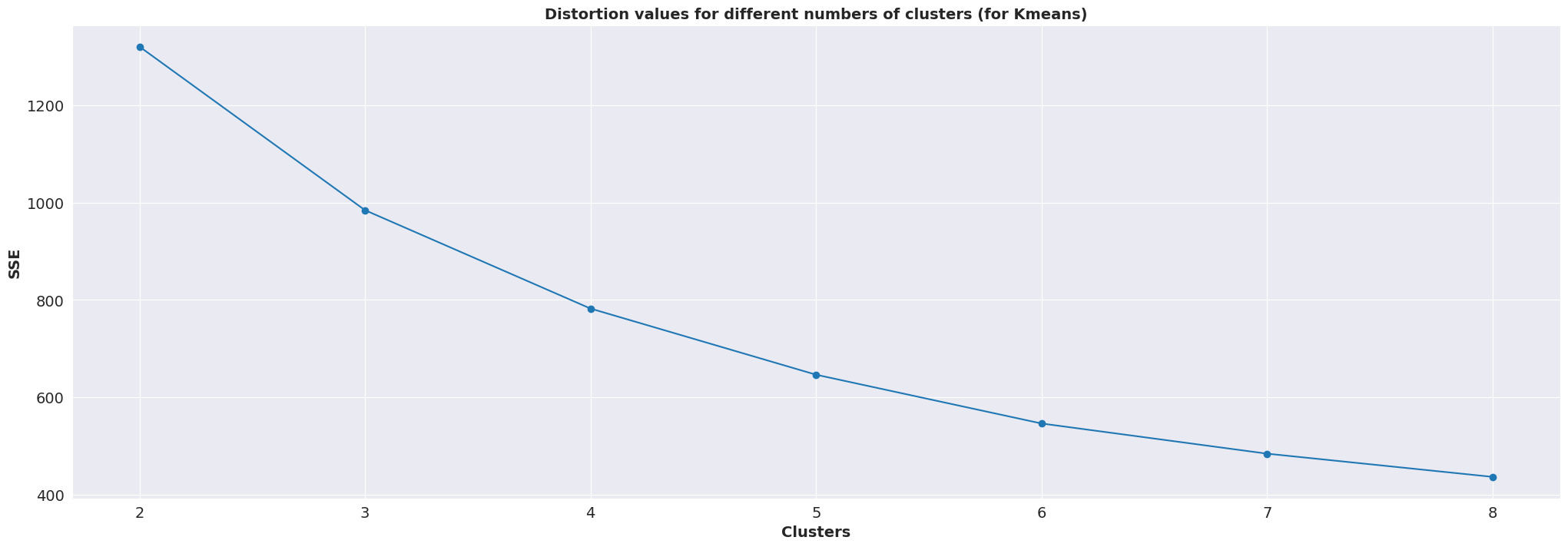
1. Clustering: (A) K-Means

Slide 19
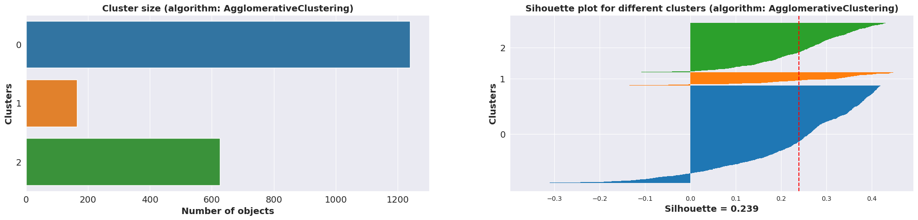
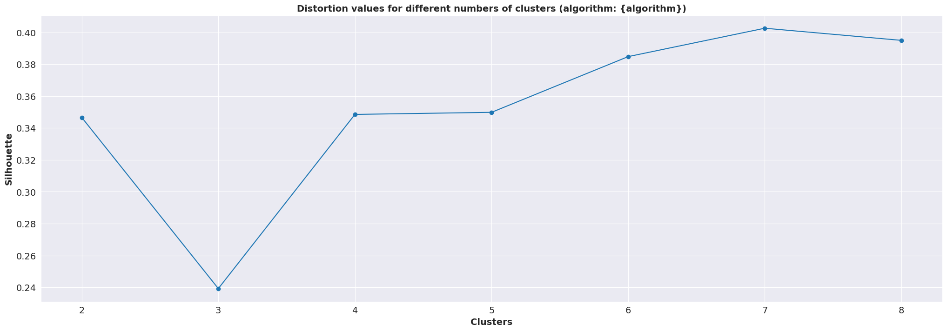
(B) Agglomerative

Slide 20
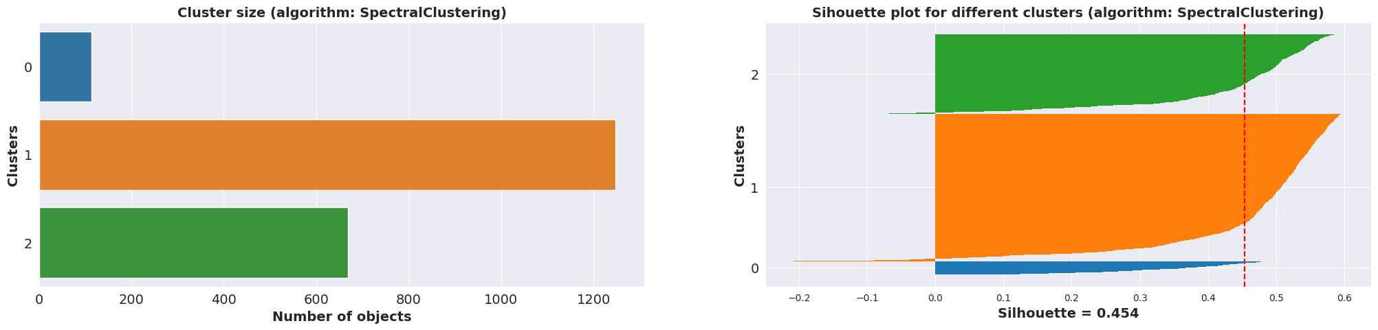
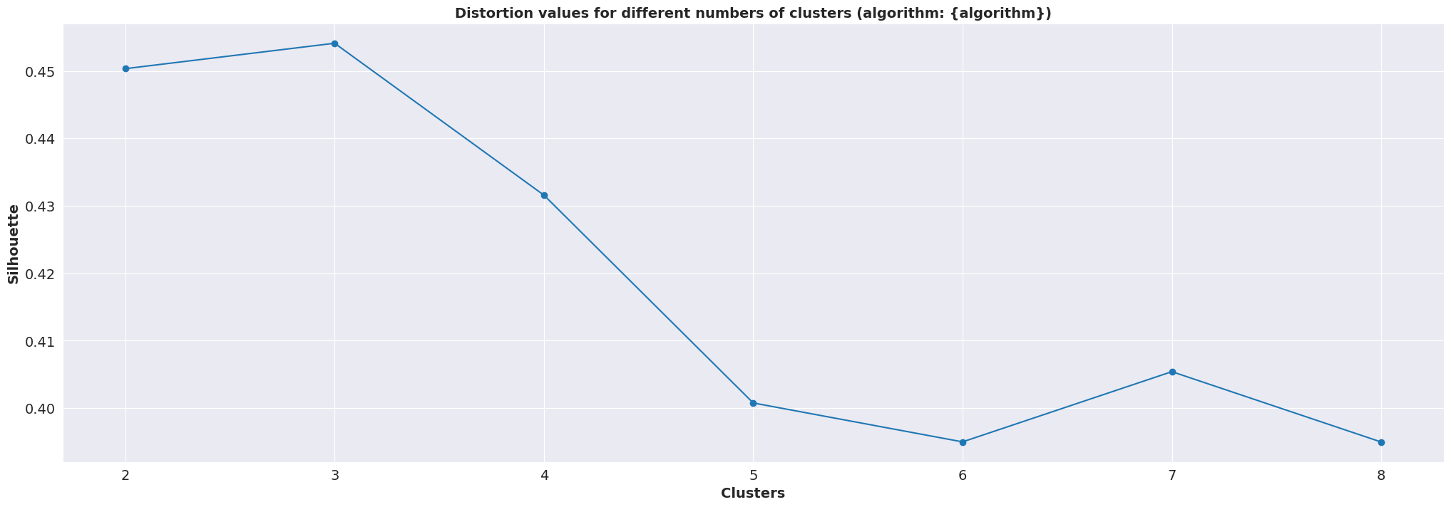
(C) Spectral

Slide 21
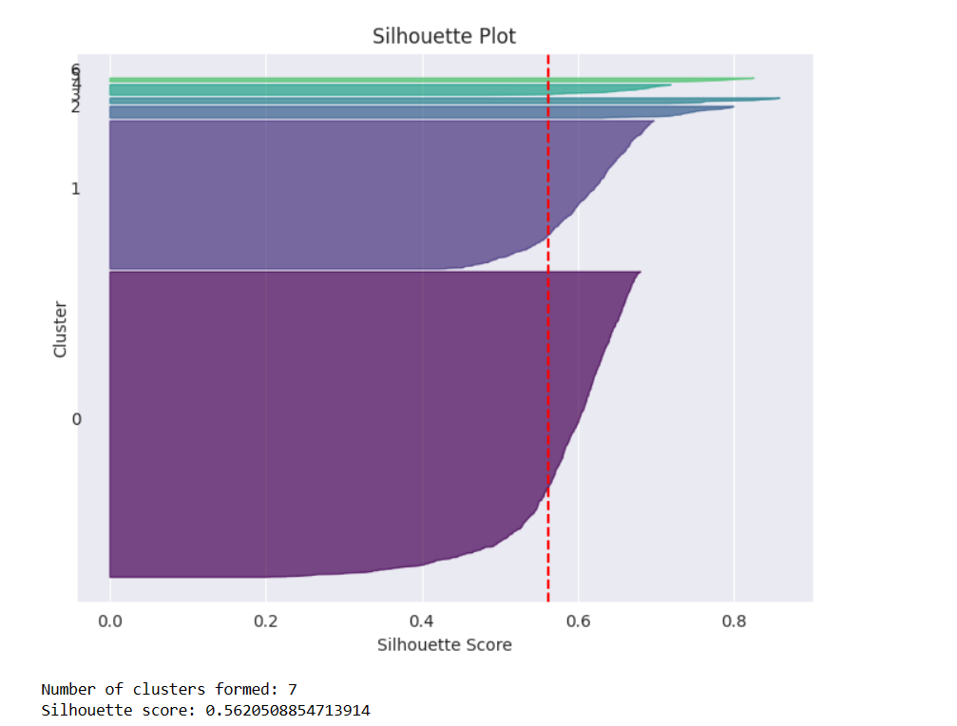
(D) DBSCAN

Slide 22
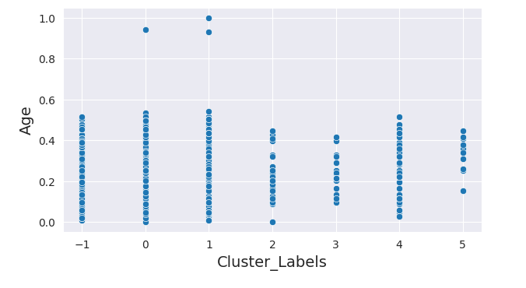
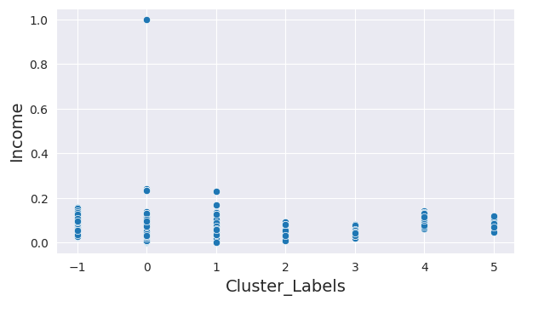
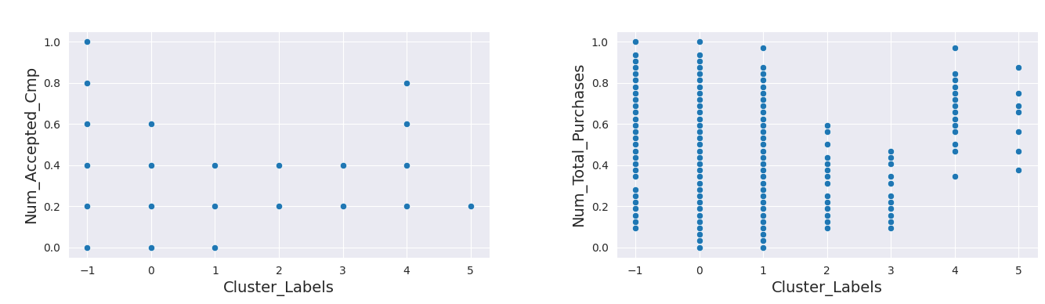

Slide 23
MODEL BUILDING
Decision Tree
Random Forest
XG Boost

Slide 24
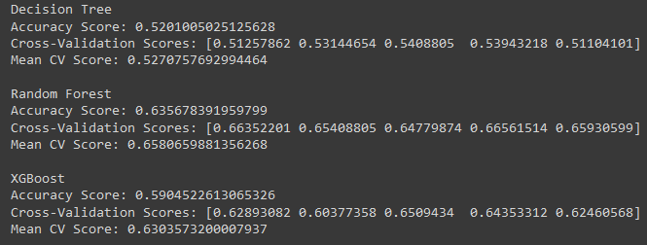
CONSIDERING the accuracy scores and mean cross-validation scores, it appears that Random Forest classifiers have the highest accuracy and mean CV scores among the models you've tested. If interpretability is a concern, Logistic Regression might be a better choice. If you're looking for more predictive power and are comfortable with potentially higher complexity, Random Forest might be preferred.
Cross-Validation of all the models:

Slide 25
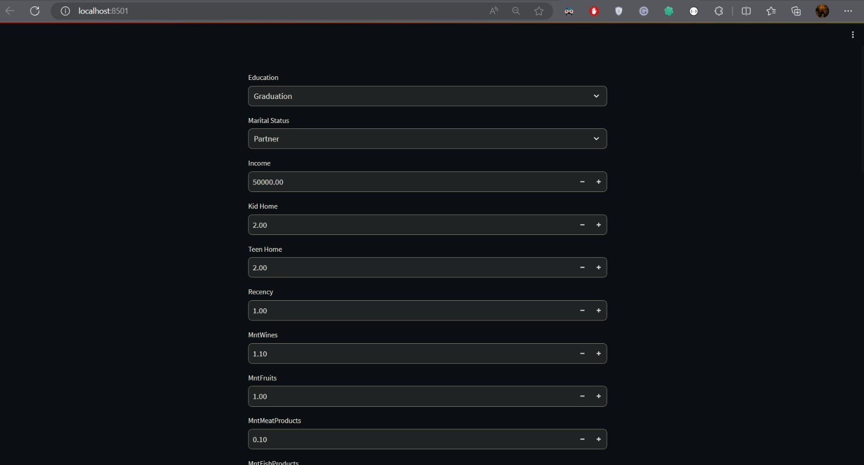
Deployment using streamlit

Slide 26
