Slide 1

Internet Traffic Prediction:
Project Mentor:-Karthik Muskula
Group 6:-
1. Deepesh Kumar Verma
2. Shubham Kumar Rai
3. Aparna P
4. Sankalp khare
5. Shilpa. R
6. Ruksaar Fatima
7. Anoop K S
Date: 30-Aug-2023

Slide 2

Business Problem:
The goal is to predict internet traffic using a time-series forecasting technique to optimize resource allocation. Many real-world organizations, such as e-commerce retailers like Amazon, Ebay, and others, use such applications to predict and monitor internet traffic. You can forecast the Internet traffic in this project using time-series models as ARIMA and Holt-Winters. This project involves comparing the performance of the time-series prediction models designed of different approaches.
Objective:
This dataset consists of about 173 rows day wise website visitor's consisting of Internet traffic prediction. Our aim is train our model so that it can correctly predict whether a given day wise website visitors data is given into one separate datasets. In this datasets consisting around 4031 daily visitors.

Slide 3
Exploratory Data Analysis (EDA) &
Feature Engineering

Slide 4
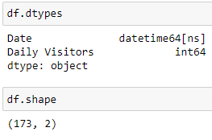
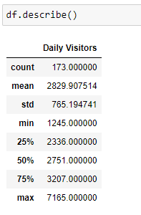
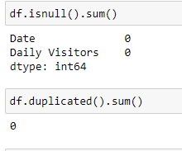
Dataset Details:

Slide 5
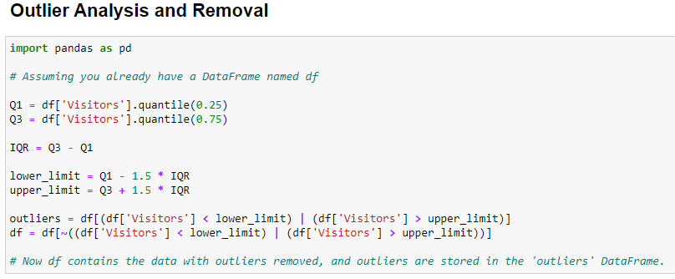
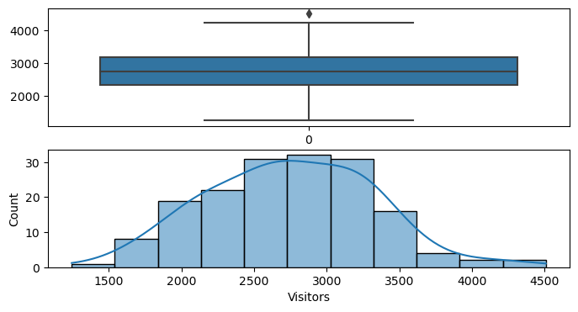

Slide 6
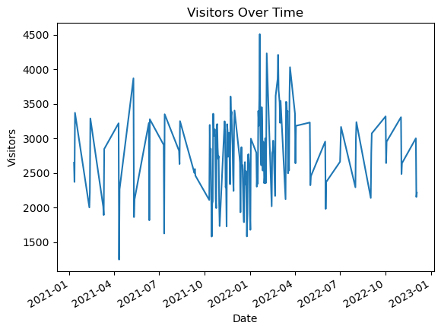
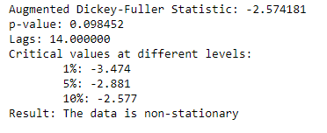

Checking for Stationarity

Slide 7
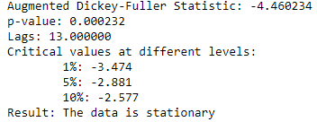
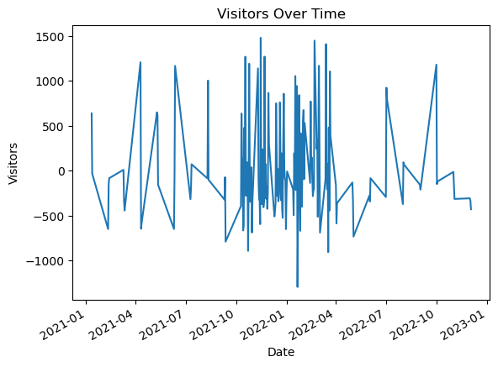
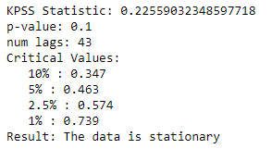
1. Augmented Dickey-Fuller
2. Kwiatkowski-Phillips-Schmidt-Shin(KPSS)

Slide 8
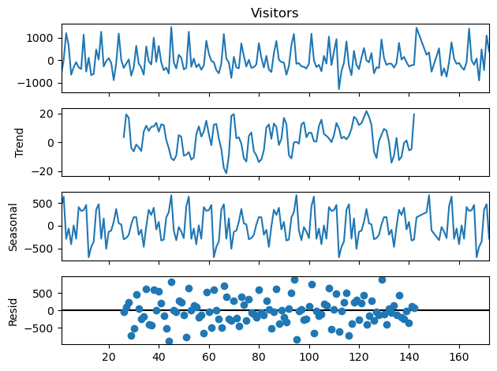
Checking for Seasonality

Slide 9
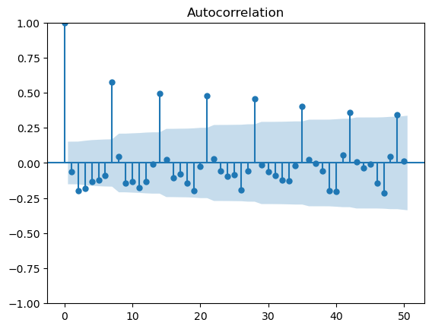
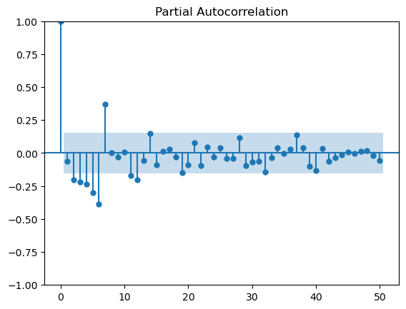
ACF Plot
PACF Plot

Slide 10
Model Building

Slide 11
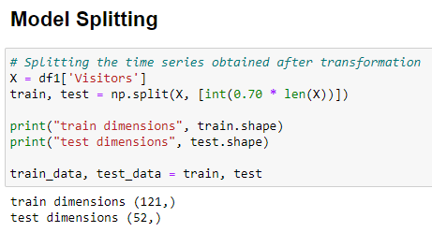

Slide 12
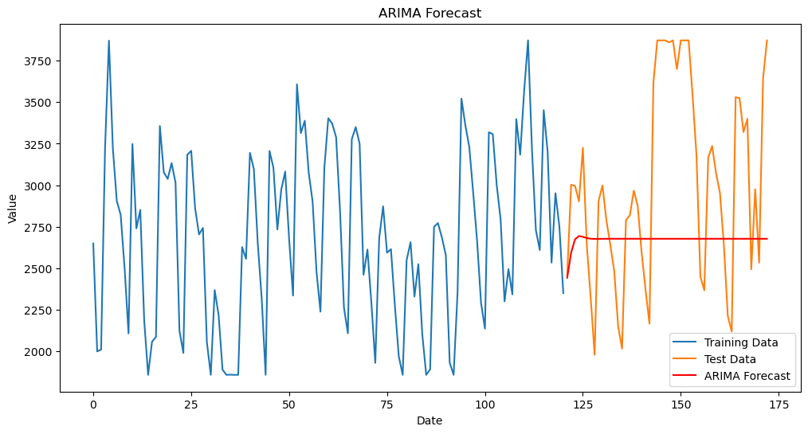

1. ARIMA Model

Slide 13
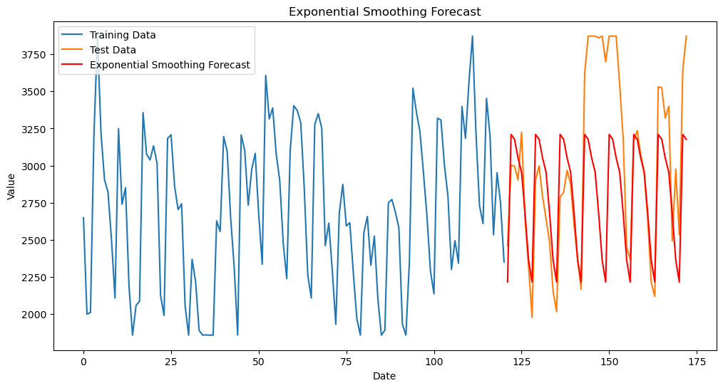

2. Exponential Smoothing

Slide 14
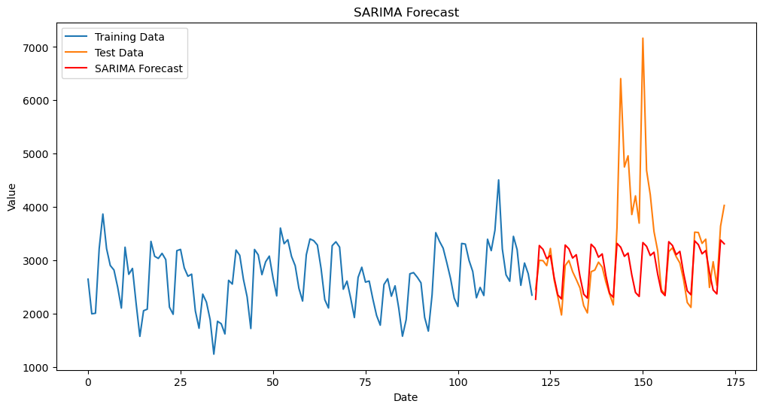

3. SARIMA Model

Slide 15
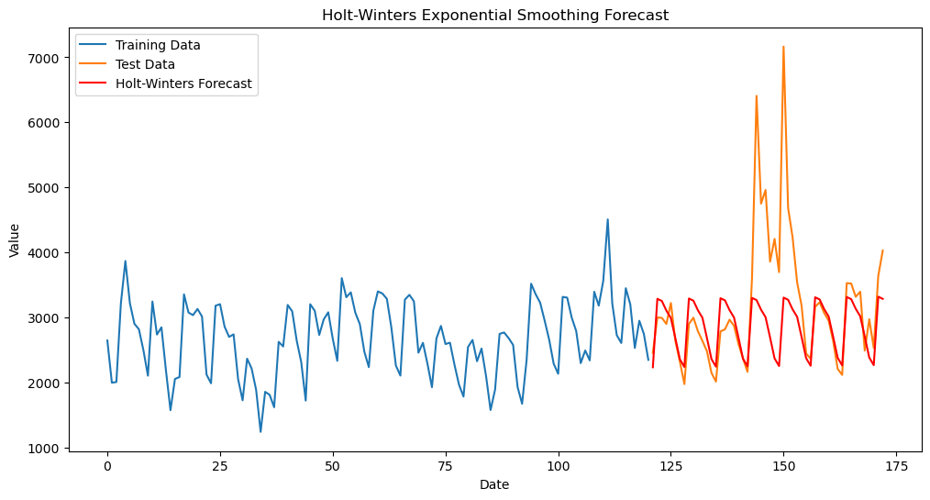

4. Holt-Winters Exponential Smoothing

Slide 16
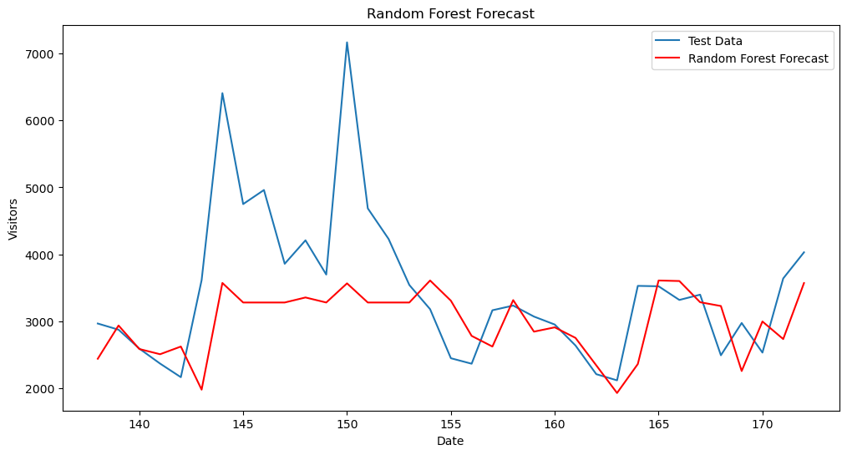

5. Random Forest

Slide 17
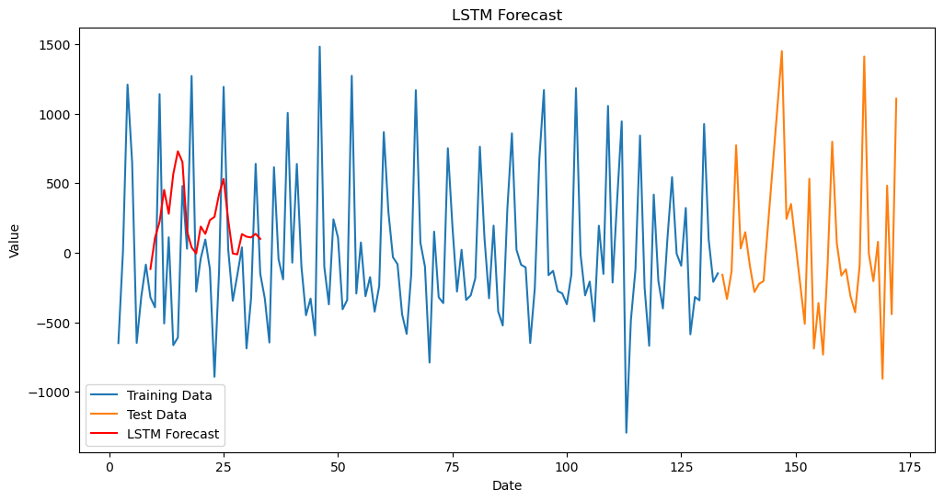

6. LSTM

Slide 18
Deployment

Slide 19
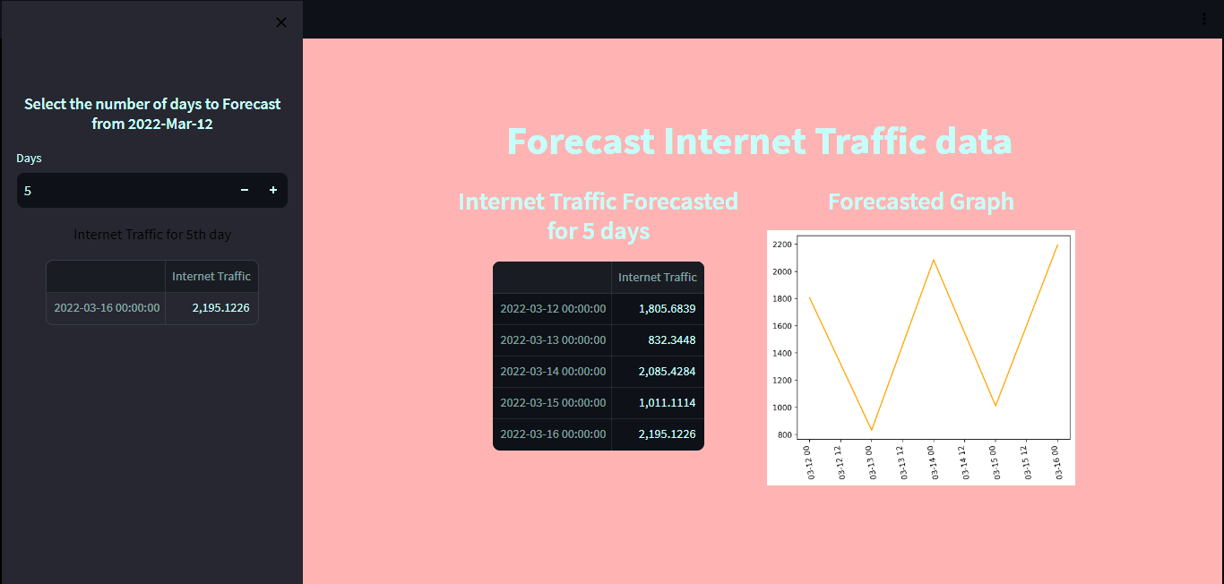

Slide 20
Challenges Faced
Non-Stationary Data: The initial challenge was dealing with non-stationary like ARIMA and SARIMA, which assume stationarity. time series data. Non-stationary data can make it difficult to build accurate time series models
Forecasting Horizon: The original model was designed to forecast for 7 days, but there was a need to extend the forecasting horizon to 30 days. This required a modification in the model's input data and possibly its configuration.
How We Overcame These Challenges:
Stationarity Check: To address the issue of non-stationary data, stationarity tests like the KPSS (Kwiatkowski-Phillips-Schmidt-Shin) and ADF (Augmented Dickey-Fuller) tests were performed.
Differencing: To make the data stationary, differencing was used. Differencing involves subtracting each value from its previous value. It helps remove trends and seasonality, making the data more amenable to modelling.
Forecasting Horizon Extension: When the model encountered an error while trying to forecast for 30 days, the input data was changed from 'daily_data_last_7' to 'daily_data_last_30'. This change allowed the model to forecast for a longer time horizon.

