Slide 1

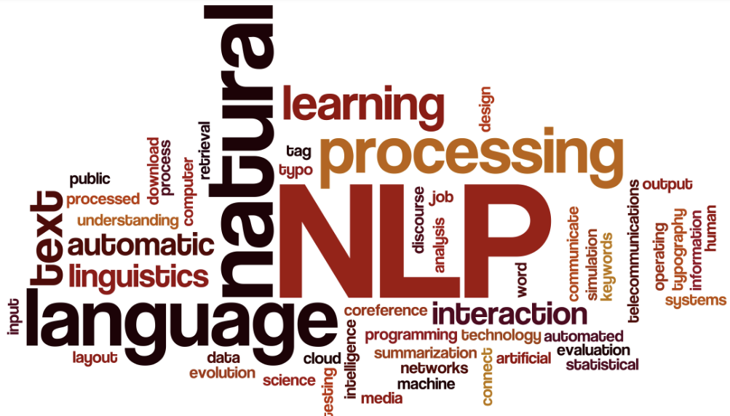
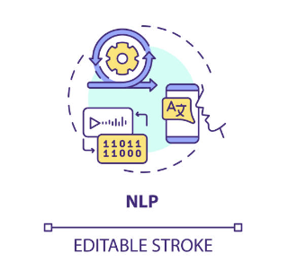
Resume classification
Group -1
MENTOR
Mr. Advaith
Group Members:
Mr. Harshal Khilari
Mr. Naresh Kulunge
Mr. Deepesh Kumar Verma
Mr. Pritam Paul
Mr. Rohit Vasant Gaikwad
Mr. Sai Kiran

Slide 2
OBJECTIVE:
Project Problem:
CREATE EFFICIENT MODEL TO CLASSIFY ANY GIVEN RESUME OF THE JOB APPLICANTS TO SIGNIFICANTLY REDUCE THE MANUAL EFFORT FOR HRM, TO ACHIEVE HIGHER LEVEL OF ACCURACY, AND TO AUTOMATE THE PROCESS FOR MINIMAL HUMAN INTERVENTION
Predict/create an accurate model for classification of resumes of the job applicants according to category based on its features like skills, education and job experience.
There are various prominent features in the resumes which gives details in skills, qualification , technical skills etc.

Slide 3
Project Architecture / Project Flow
IMPORT /LOAD DATA
EDA
MODEL BUILDING
DEPLOYMENT
MODEL EVALUATION
FINAL MODEL

Slide 4
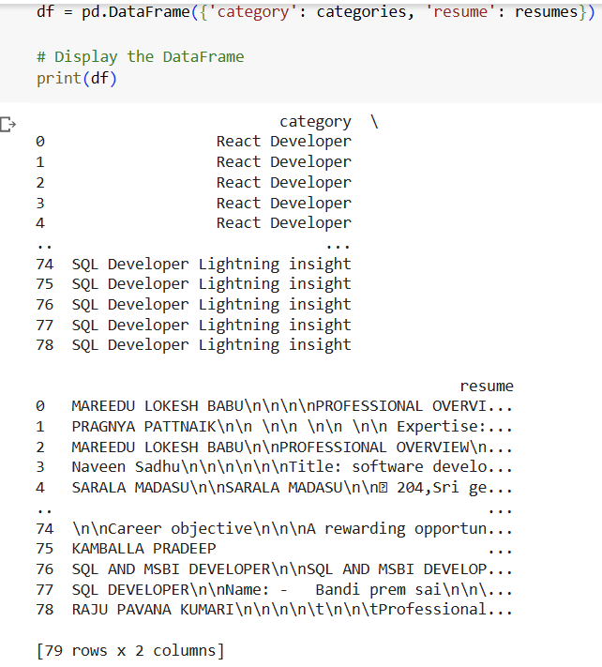
DATA IMPORT/ LOAD
There are 79 rows and 2 columns created for the dataset.

Slide 5
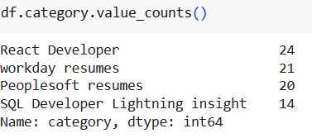
DATA SET DETAILS
Data has the aggregation of different resume on various categories.
- Resume categories of the job applicants includes React Developer(24), Workday resumes(21), Peoplesoft resumes(20) and SQL developer(14) respectively
_
Datatypes present: int64(24)

Slide 6
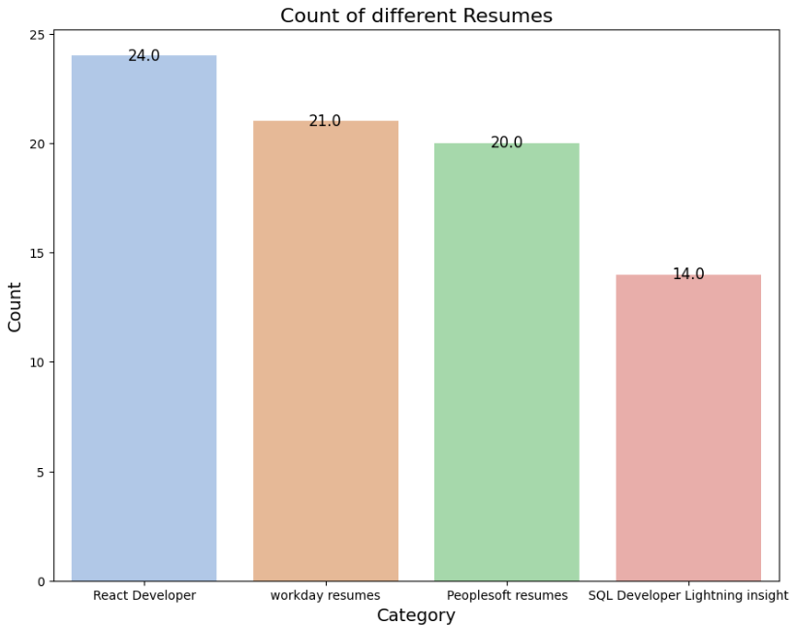
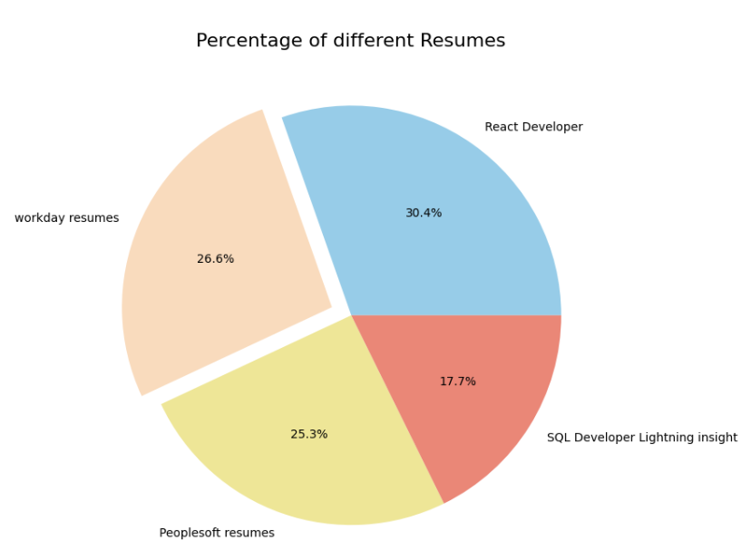
Plot Diagrams
Count barplot and pie chart portrays the distribution of the resume categories from the total

Slide 7
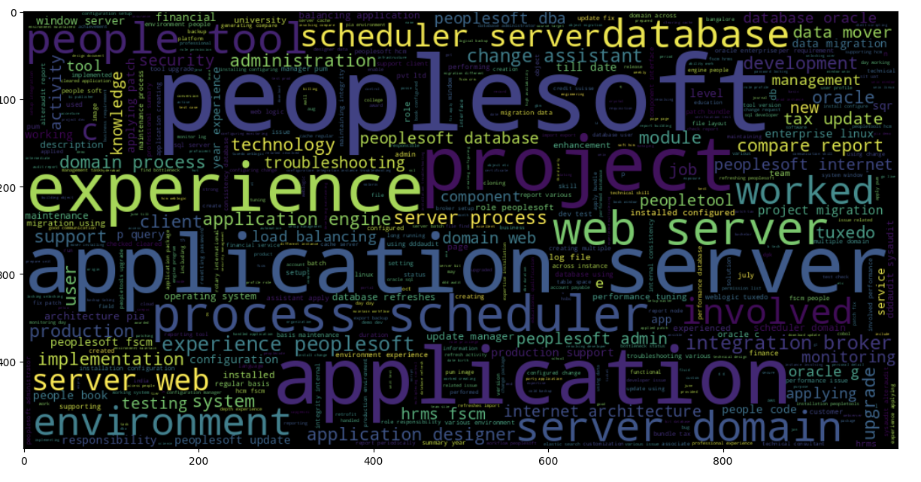
Plot Diagrams
WordCloud from Peoplesoft resumes

Slide 8
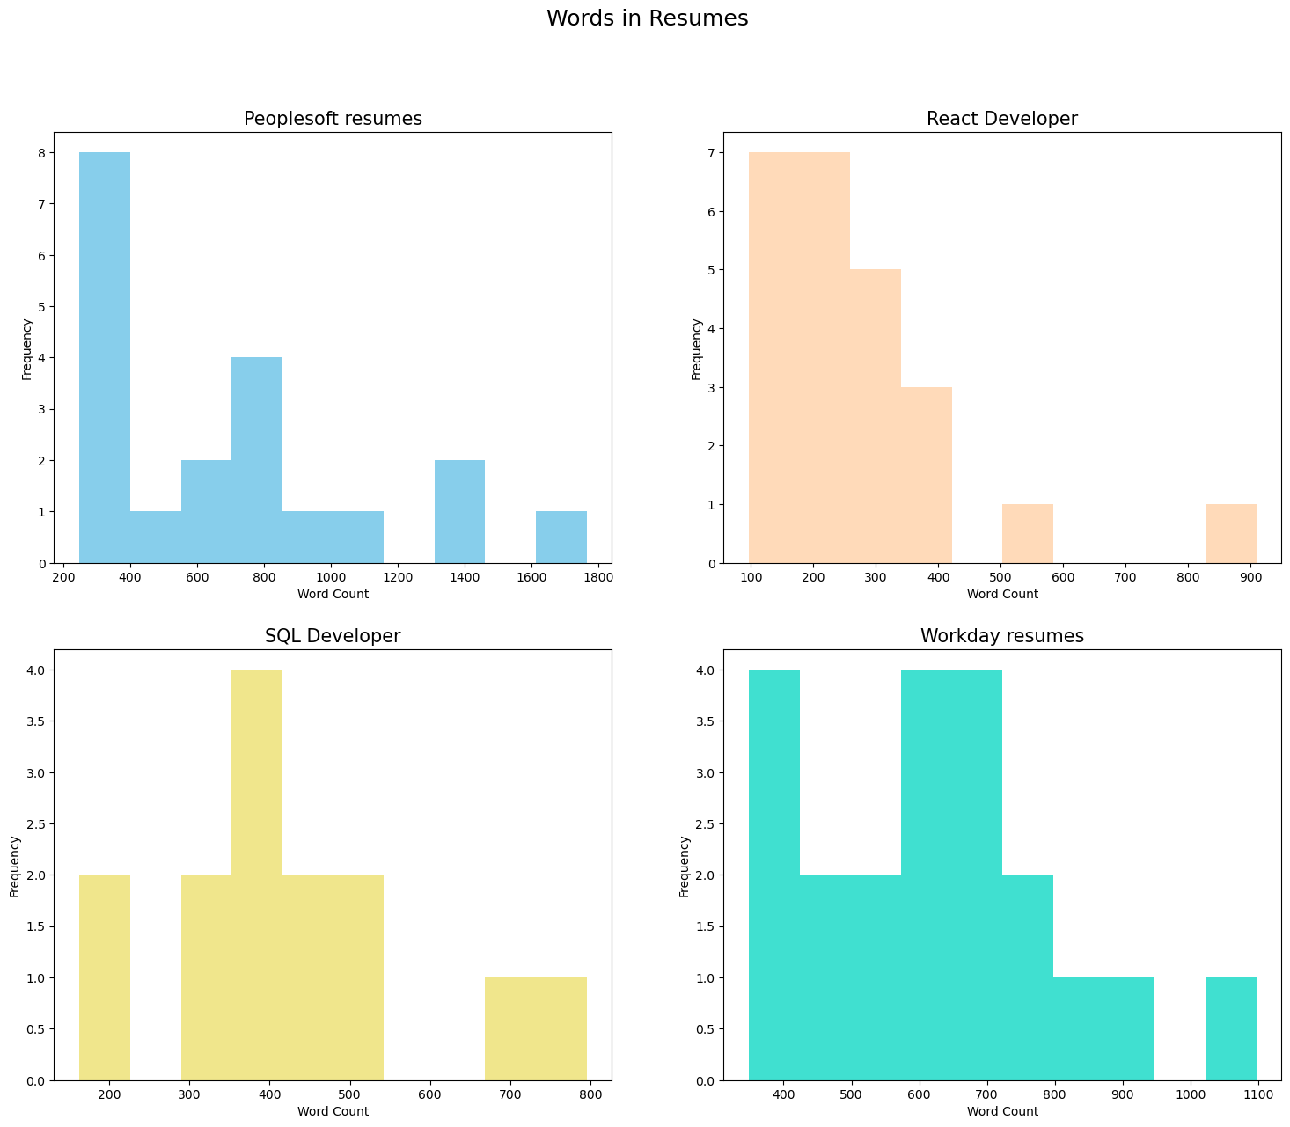

Slide 9
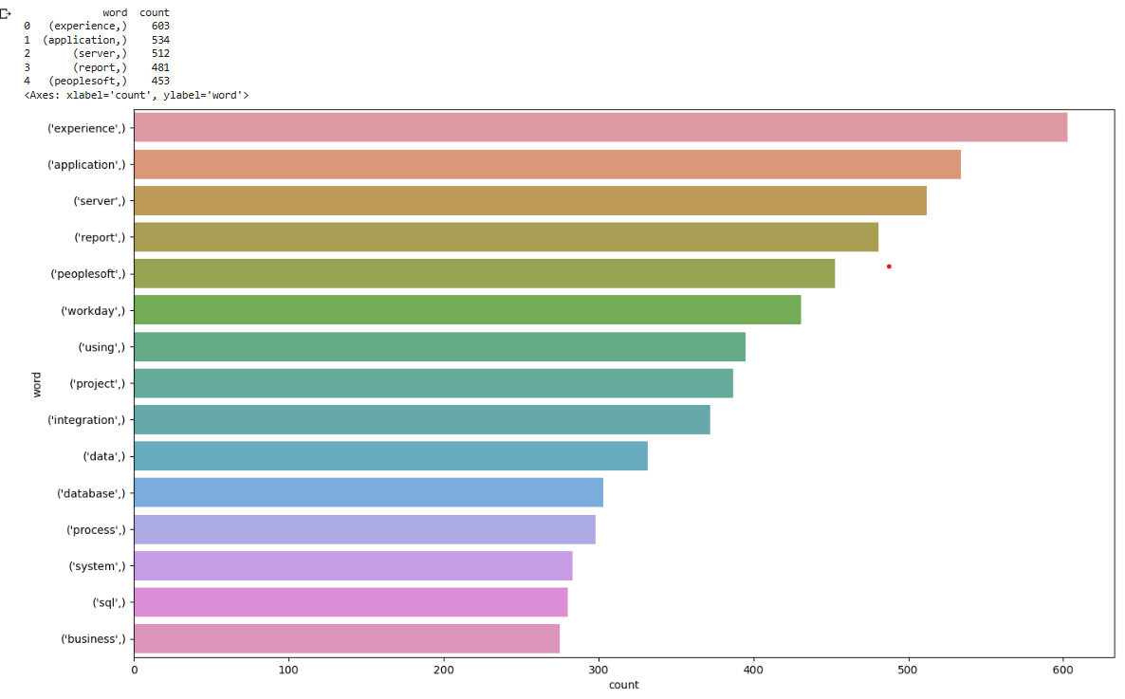
Plot Diagrams
Uni-gram Plot

Slide 10
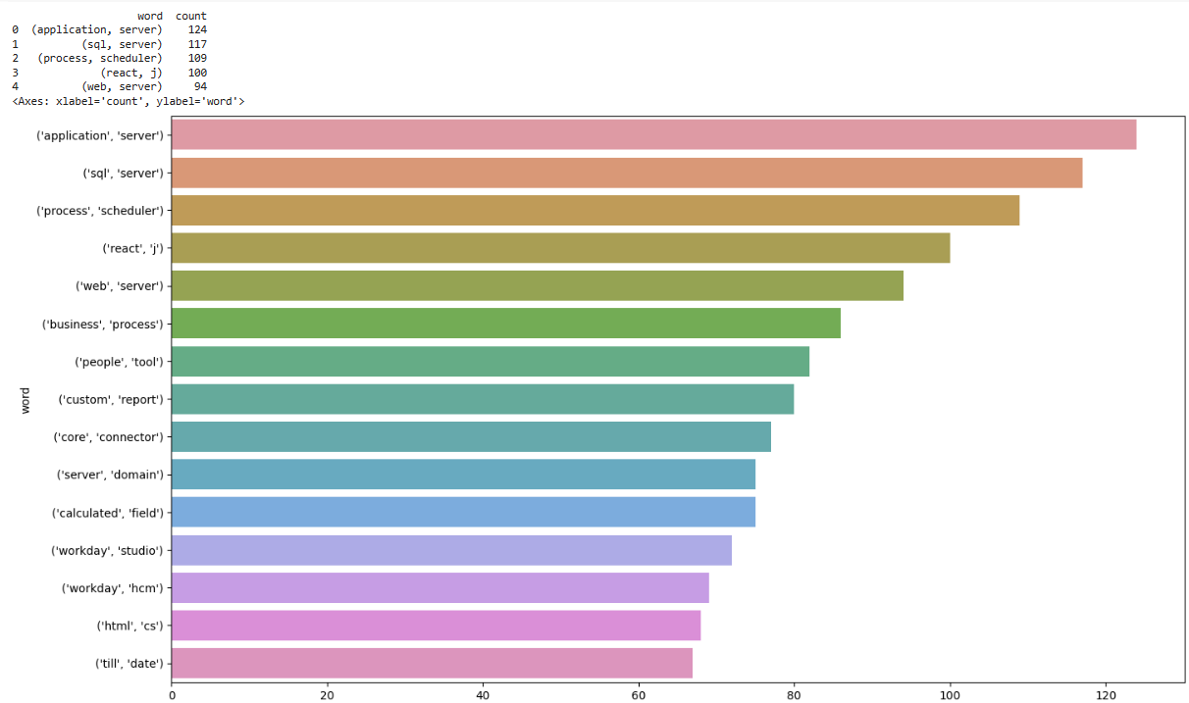
Plot Diagrams
Bi-gram Plot

Slide 11
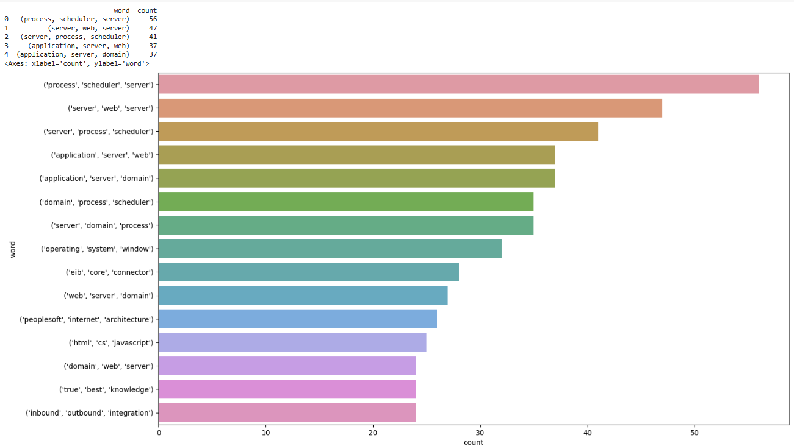
Plot Diagrams
Tri-gram Plot

Slide 12
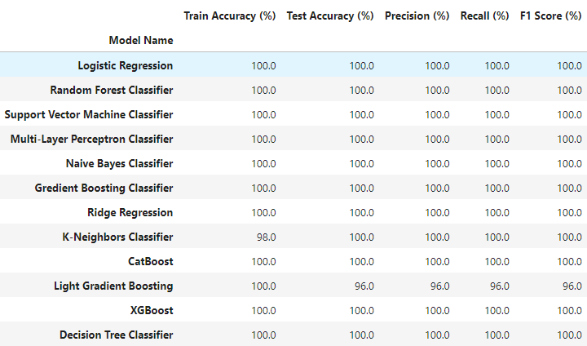
MODELING EVALUATION

Slide 13
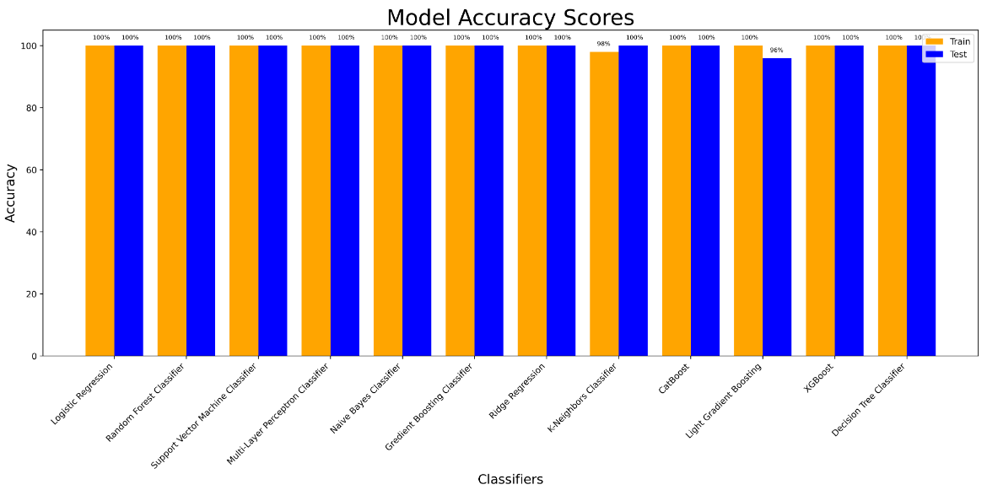
MODELING EVALUATION

Slide 14
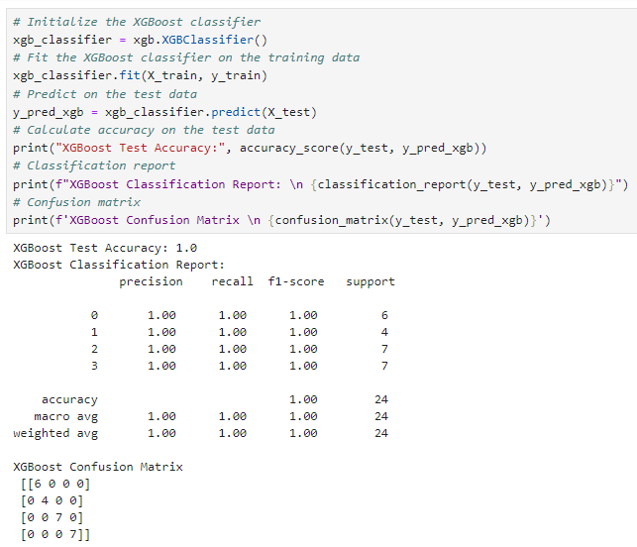
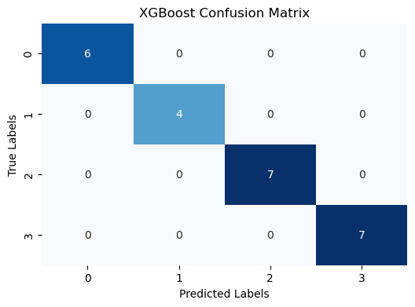
FINAL MODEL

Slide 15
CONCLUSIONS
1.The final XGboost model exhibits promising performance with an accuracy of 100% on both training and test data. This level of accuracy and recall strikes a suitable balance..
2. It's important to note that the dataset's simplicity might limit its representational power. Applicants’ skills, qualification and work experiences are diverse and the available features captures most of the underlying dynamics. Incorporating additional factors such as age,location etc.
In summary, the XGboost model's high accuracy demonstrate its efficacy. Incorporating more diverse and comprehensive data could further refine its predictions.

Slide 16
CHALLENGES FACED DURING THE PROJECT
Hard to unzip the zipped folder using the python code took days trying it. Also struggled in choosing specific visualisation in the EDA part.
Co-ordinating with the group members on resolving errors.
iii.Continous facing of errors like antiwords, stopwords, and other errors occured due to incompatible OS which slowed down the pace of project progress.

Slide 17
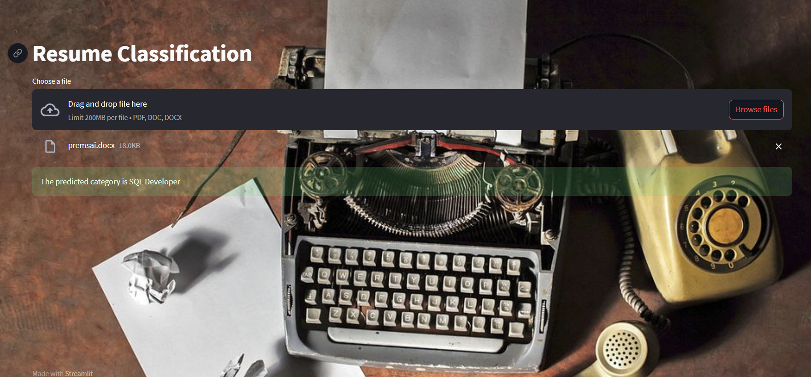
DEPLOYMENT OF NLP MODEL BY USING STREAMLIT

Slide 18
Thank You !

